Slide 1
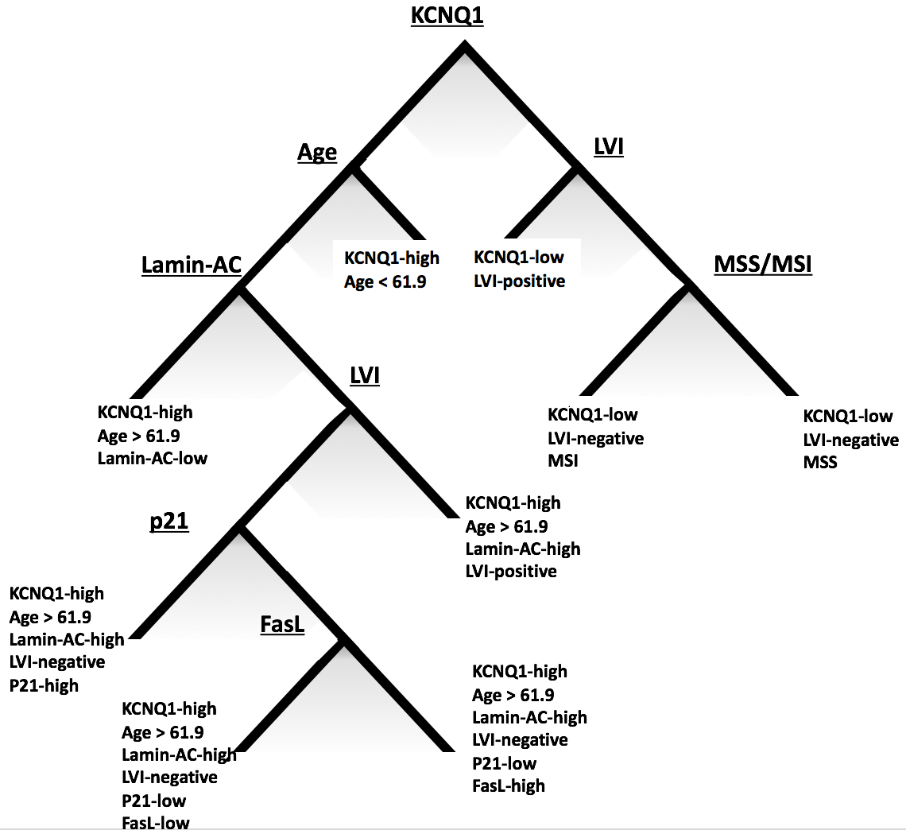
Supplementary Figure 1
No-ACT, unpruned
Supplementary figure 1:
Unpruned classification tree by CART analysis for ACT-untreated patients.

Slide 2
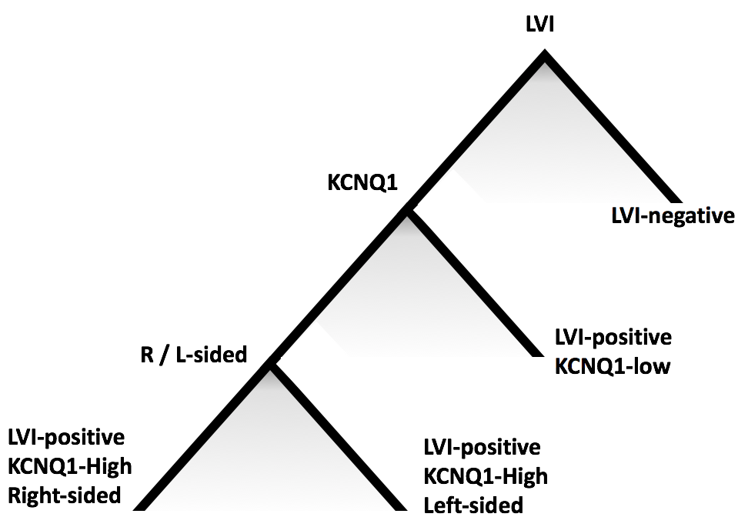
Supplementary Figure 2
ACT, unpruned
Supplementary figure 2:
Unpruned classification tree by CART analysis for ACT-treated patients.

Slide 3
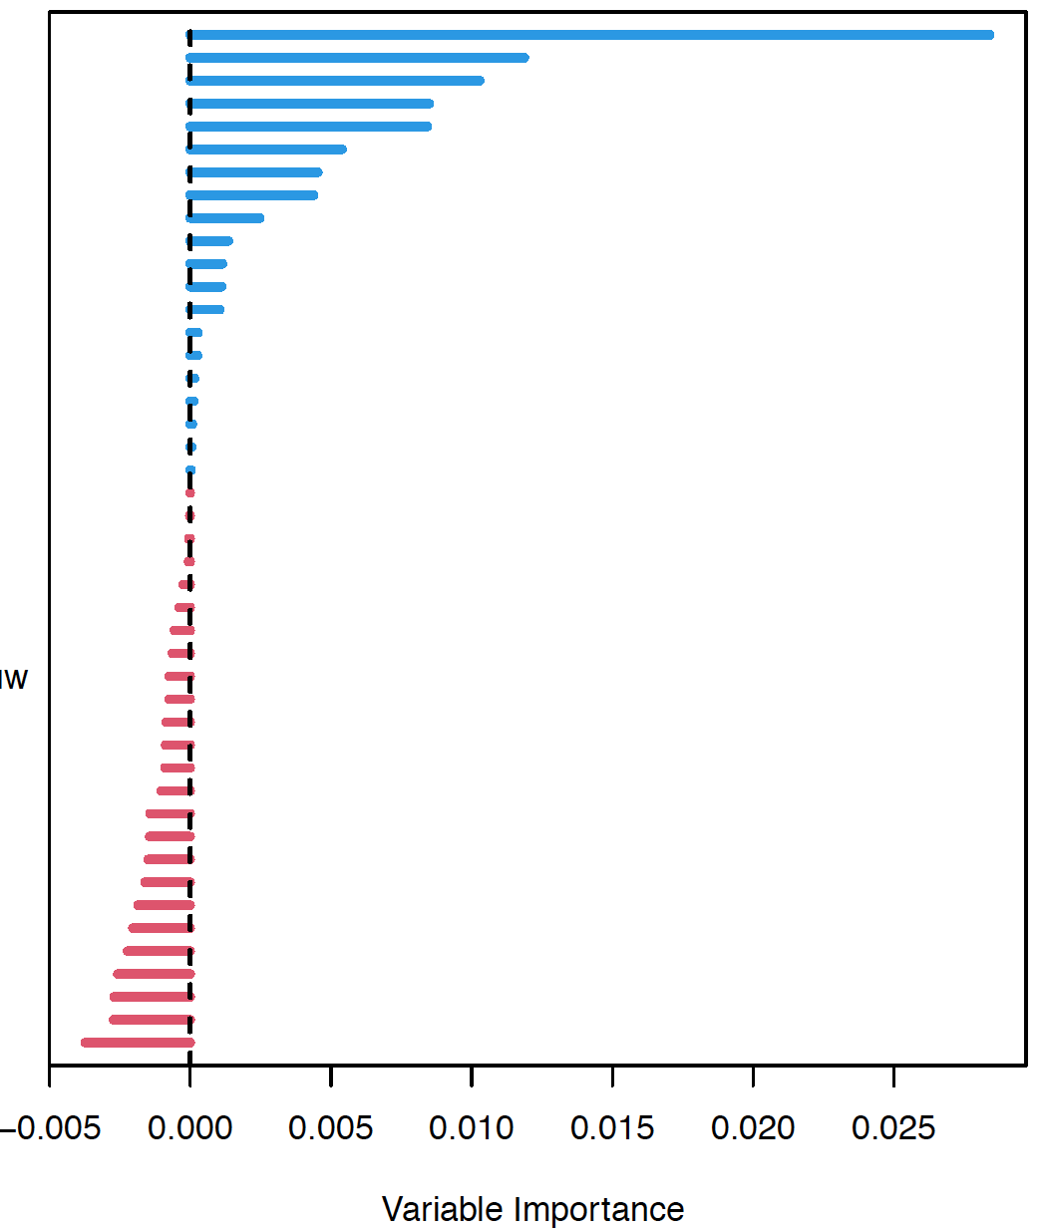
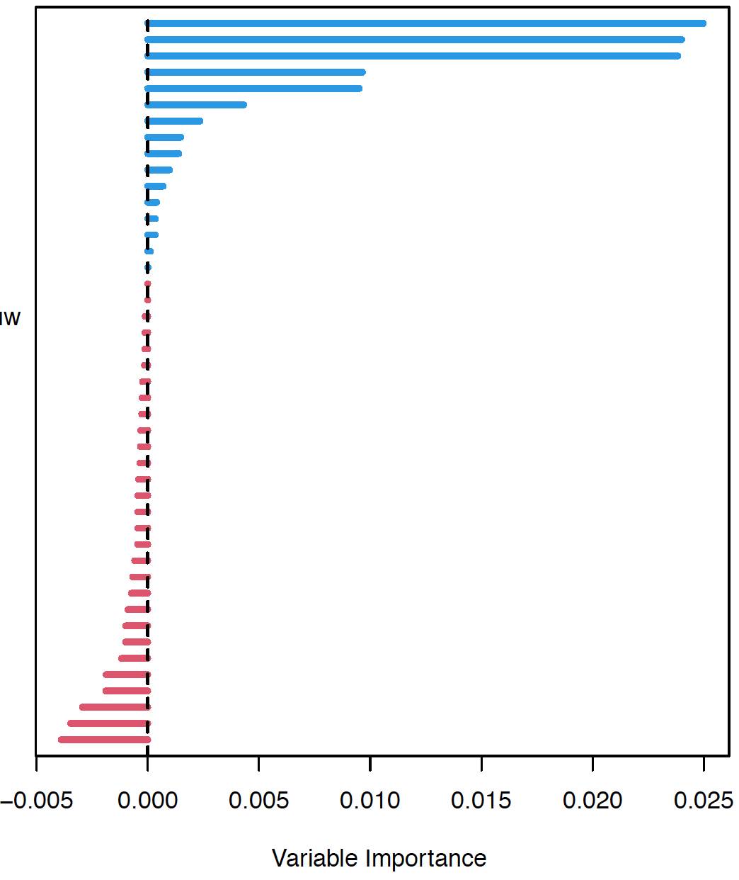
Supplementary Figure 3
No-ACT ACT
KCNQ1
P53
Lamin AC
N-stage
LVI
BCLX
P21
ITD
Emergency
FAS
EGFR (membr)
CD44
Perforation
Stage
Right-sided
T-stage
MIB1
FasL
MacroD2
Mucinous
ACT
CDX2
Aurka
CyclinD1
EGFR (cytopl)
HER2NEU
VEGFA
XIAP
MSI-status
cFLIP
betaCat
P27
HTR2B
Ulceration
BAX
Sex
TS
Age
Bcl2
LUM
Differentiation
VCAN
HIF1a
Tumourspill
Diameter
KCNQ1
LVI
MacroD2
P27
Emergency
Bcl2
Right-sided
BAX
HER2NEU
VEGFA
Perforation
MIB1
Stage
Aurka
EGFR (cytopl)
Mucinous
ACT
Tumourspill
MSI-status
Differentation
EGFR (membr)
ITD
P21
Sex
FasL
Ulceration
XIAP
P53
HTR2B
TS
CDX2
BCLX
T-stage
Hif1a
CyclinD1
CD44
BetaCat
LUM
Lamin AC
VCAN
cFLIP
FAS
Diameter
Age
Supplementary figure 3:
Variable importance graphs for both ACT-untreated and -treated patients. LVI = lymphovascular invasion / ITD = isolated tumour deposits / Emergency = emergency surgery / ACT = adjuvant chemotherapy.

