Slide 1
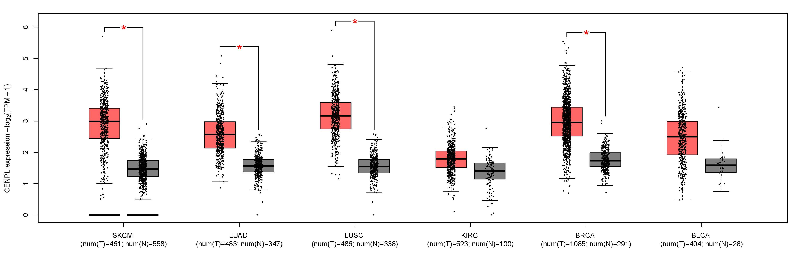
Supplement figure 1：The expression level of CENPL mRNA in skin cutaneous melanoma (SKCM), lung adenocarcinoma (LUAD), lung squamous cell carcinoma (LUSC), kidney renal clear cell carcinoma (KIRC), breast invasive carcinoma (BRCA), and bladder urothelial carcinoma (BLCA), *: p-value < 0.01. (GEPIA)

