Slide 1
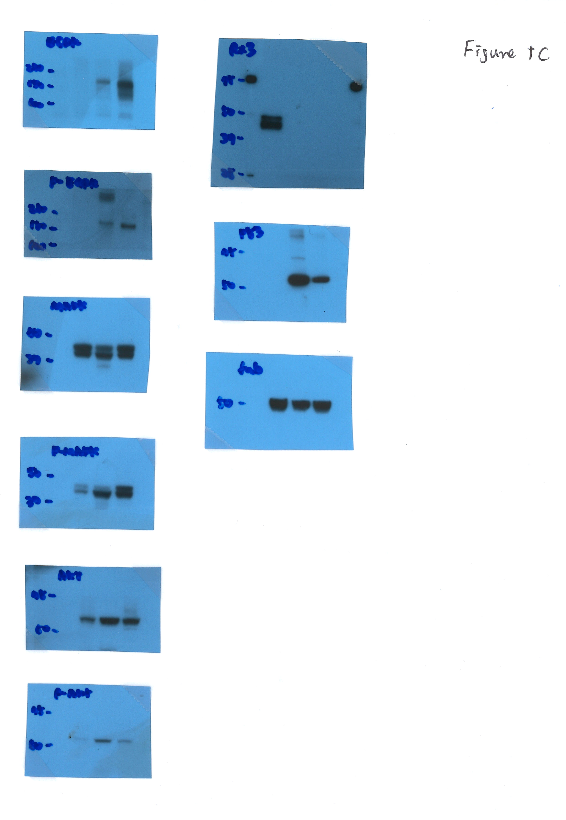
Supplementary Figure 1.
Figure 1C original data
EGFR
RUNX3
phospho-EGFR
p53
MAPK
Tubulin
phospho-MAPK
AKT
phospho-AKT

Slide 2
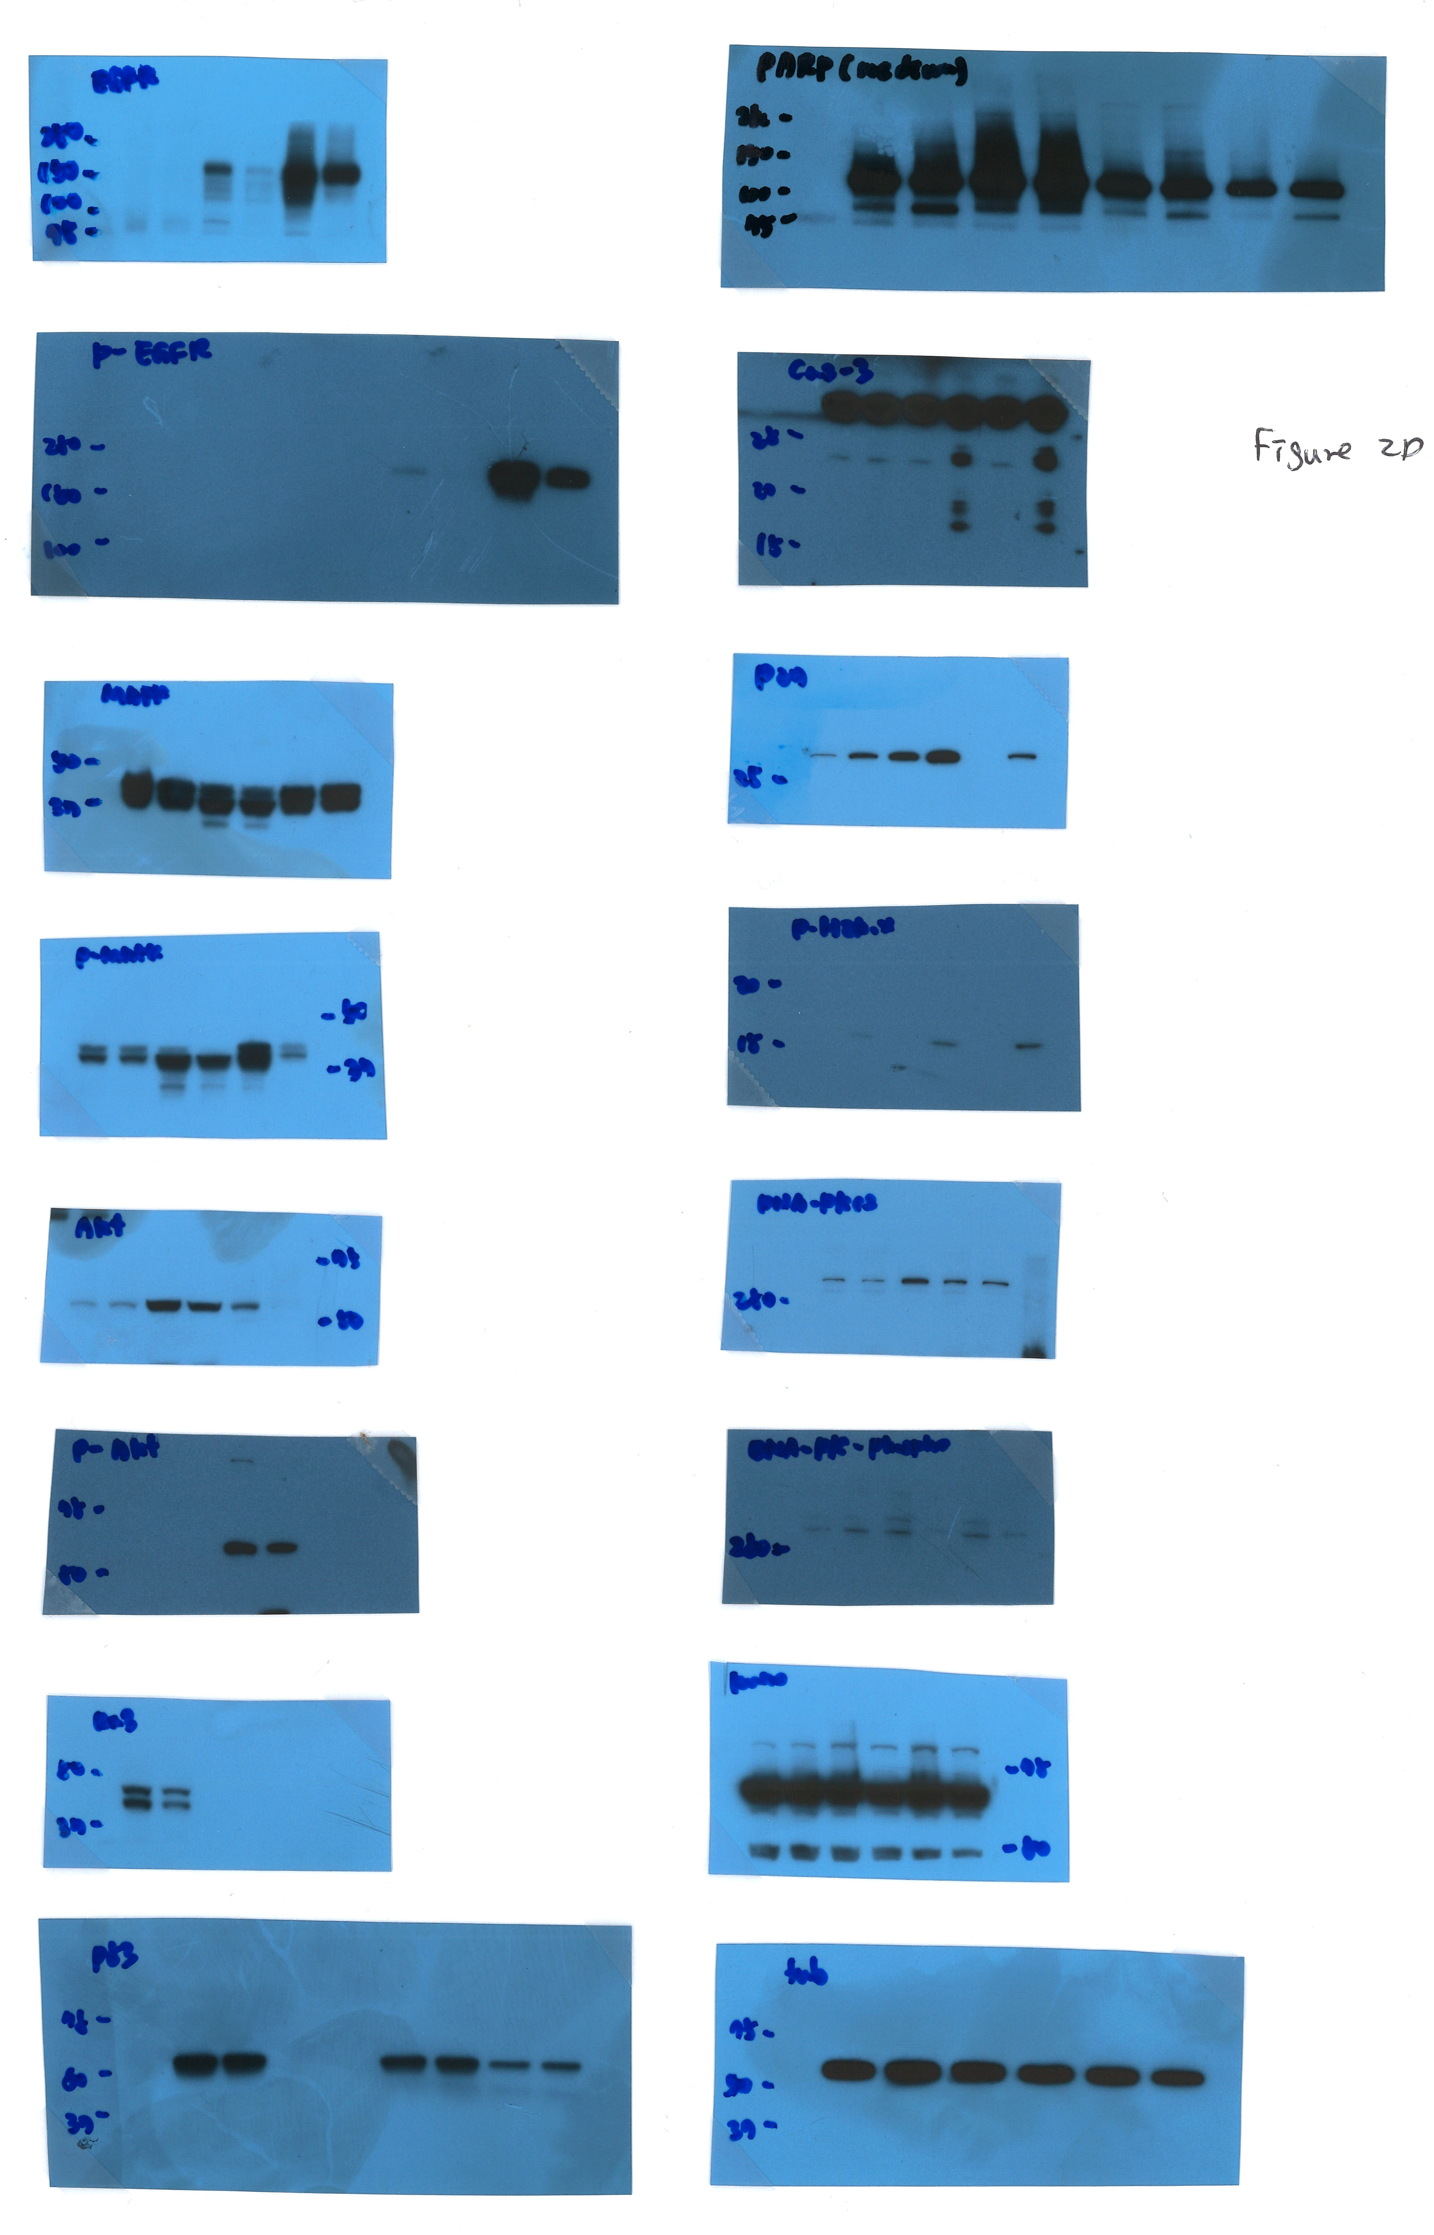
Figure 2D original data
EGFR
RARP
phospho-EGFR
Caspase3
MAPK
p27
phospho-MAPK
phospho-H2A.X
AKT
DNA-PKcs
phospho-AKT
phospho-DNA-PKcs
RUNX3
Ku70
p53
Tubulin

Slide 3
Figure 4D original data
EGFR
phospho-H2A.X
phospho-EGFR
DNA-PKcs
MAPK
phospho-DNA-PKcs
phospho-MAPK
Ku70
Cleaved RARP
p27
Cleaved Caspase3
Tubulin

Slide 4
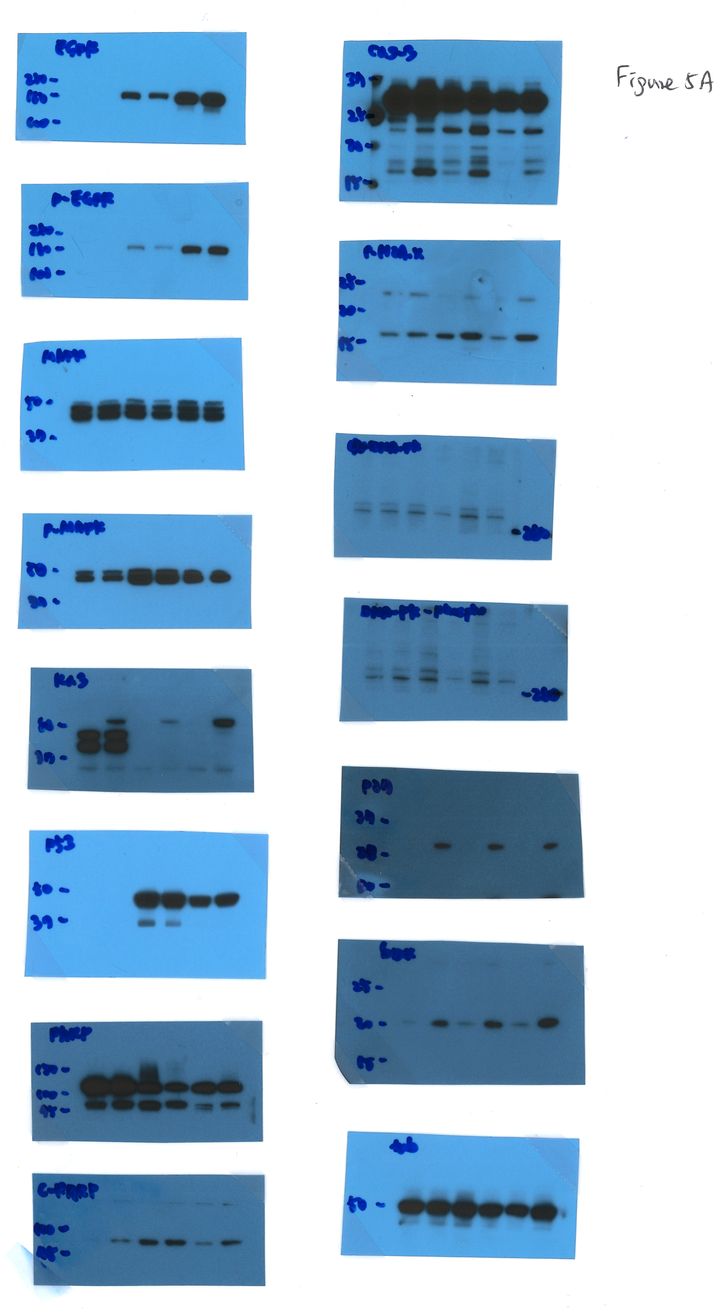
Figure 5A original data
EGFR
Caspase3
phospho-EGFR
phospho-H2A.X
MAPK
DNA-PKcs
phospho-MAPK
phospho-DNA-PKcs
RUNX3
p27
p53
Bax
RARP
Tubulin
Cleaved RARP

Slide 5
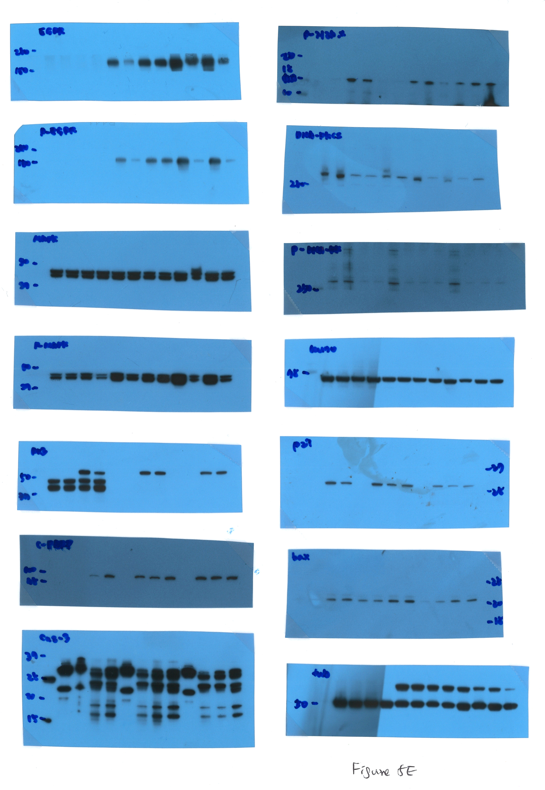
Figure 5E original data
EGFR
phospho-H2A.X
phospho-EGFR
DNA-PKcs
MAPK
phospho-DNA-PKcs
phospho-MAPK
Ku70
RUNX3
p27
Cleaved RARP
Bax
Cleaved Caspase3
Tubulin

Slide 6
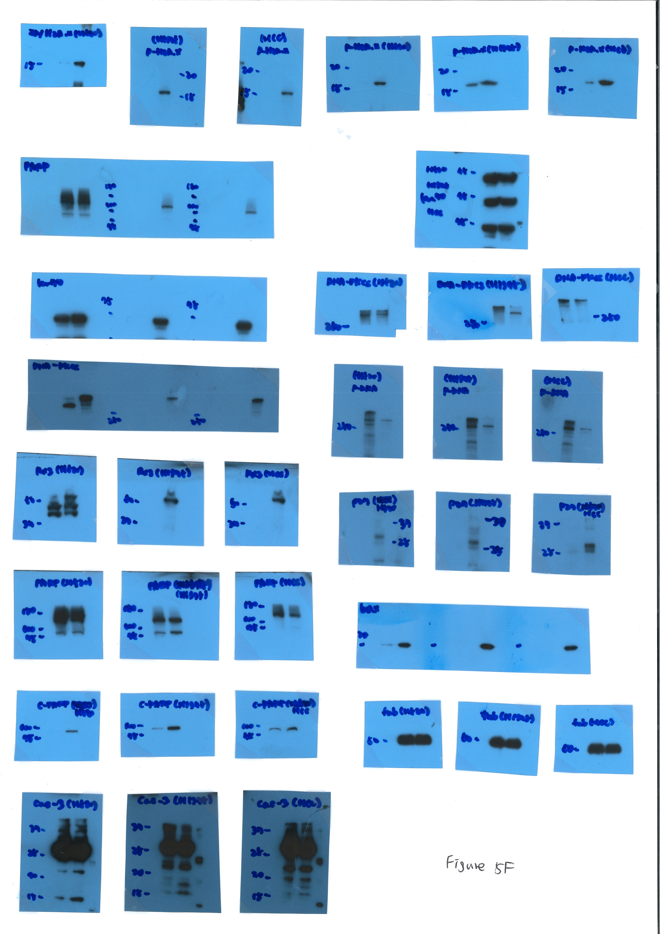
Figure 5F original data
RUNX3 IP/phosph-H2A.X IB
phospho-H2A.X
H520
H1975
HCC827
H520
H1975
HCC827
RUNX3 IP/PARP IB
Ku70
H520
H1975
H520
H1975
HCC827
HCC827
RUNX3 IP/Ku70 IB
DNA-PKcs
H520
H1975
HCC827
H520
H1975
HCC827
RUNX3 IP/DNA-PKcs IB
phospho-DNA-PKcs
H520
H1975
HCC827
RUNX3 IP/RUNX3 IB
H520
H1975
HCC827
p27
H520
H1975
HCC827
PARP
H520
H1975
HCC827
Bax
H520
H1975
HCC827
H520
Cleaved PARP
H1975
HCC827
Tubulin
H520
H1975
HCC827
H520
Cleaved Caspase 3
H1975
HCC827
H520
H1975
HCC827

Slide 7
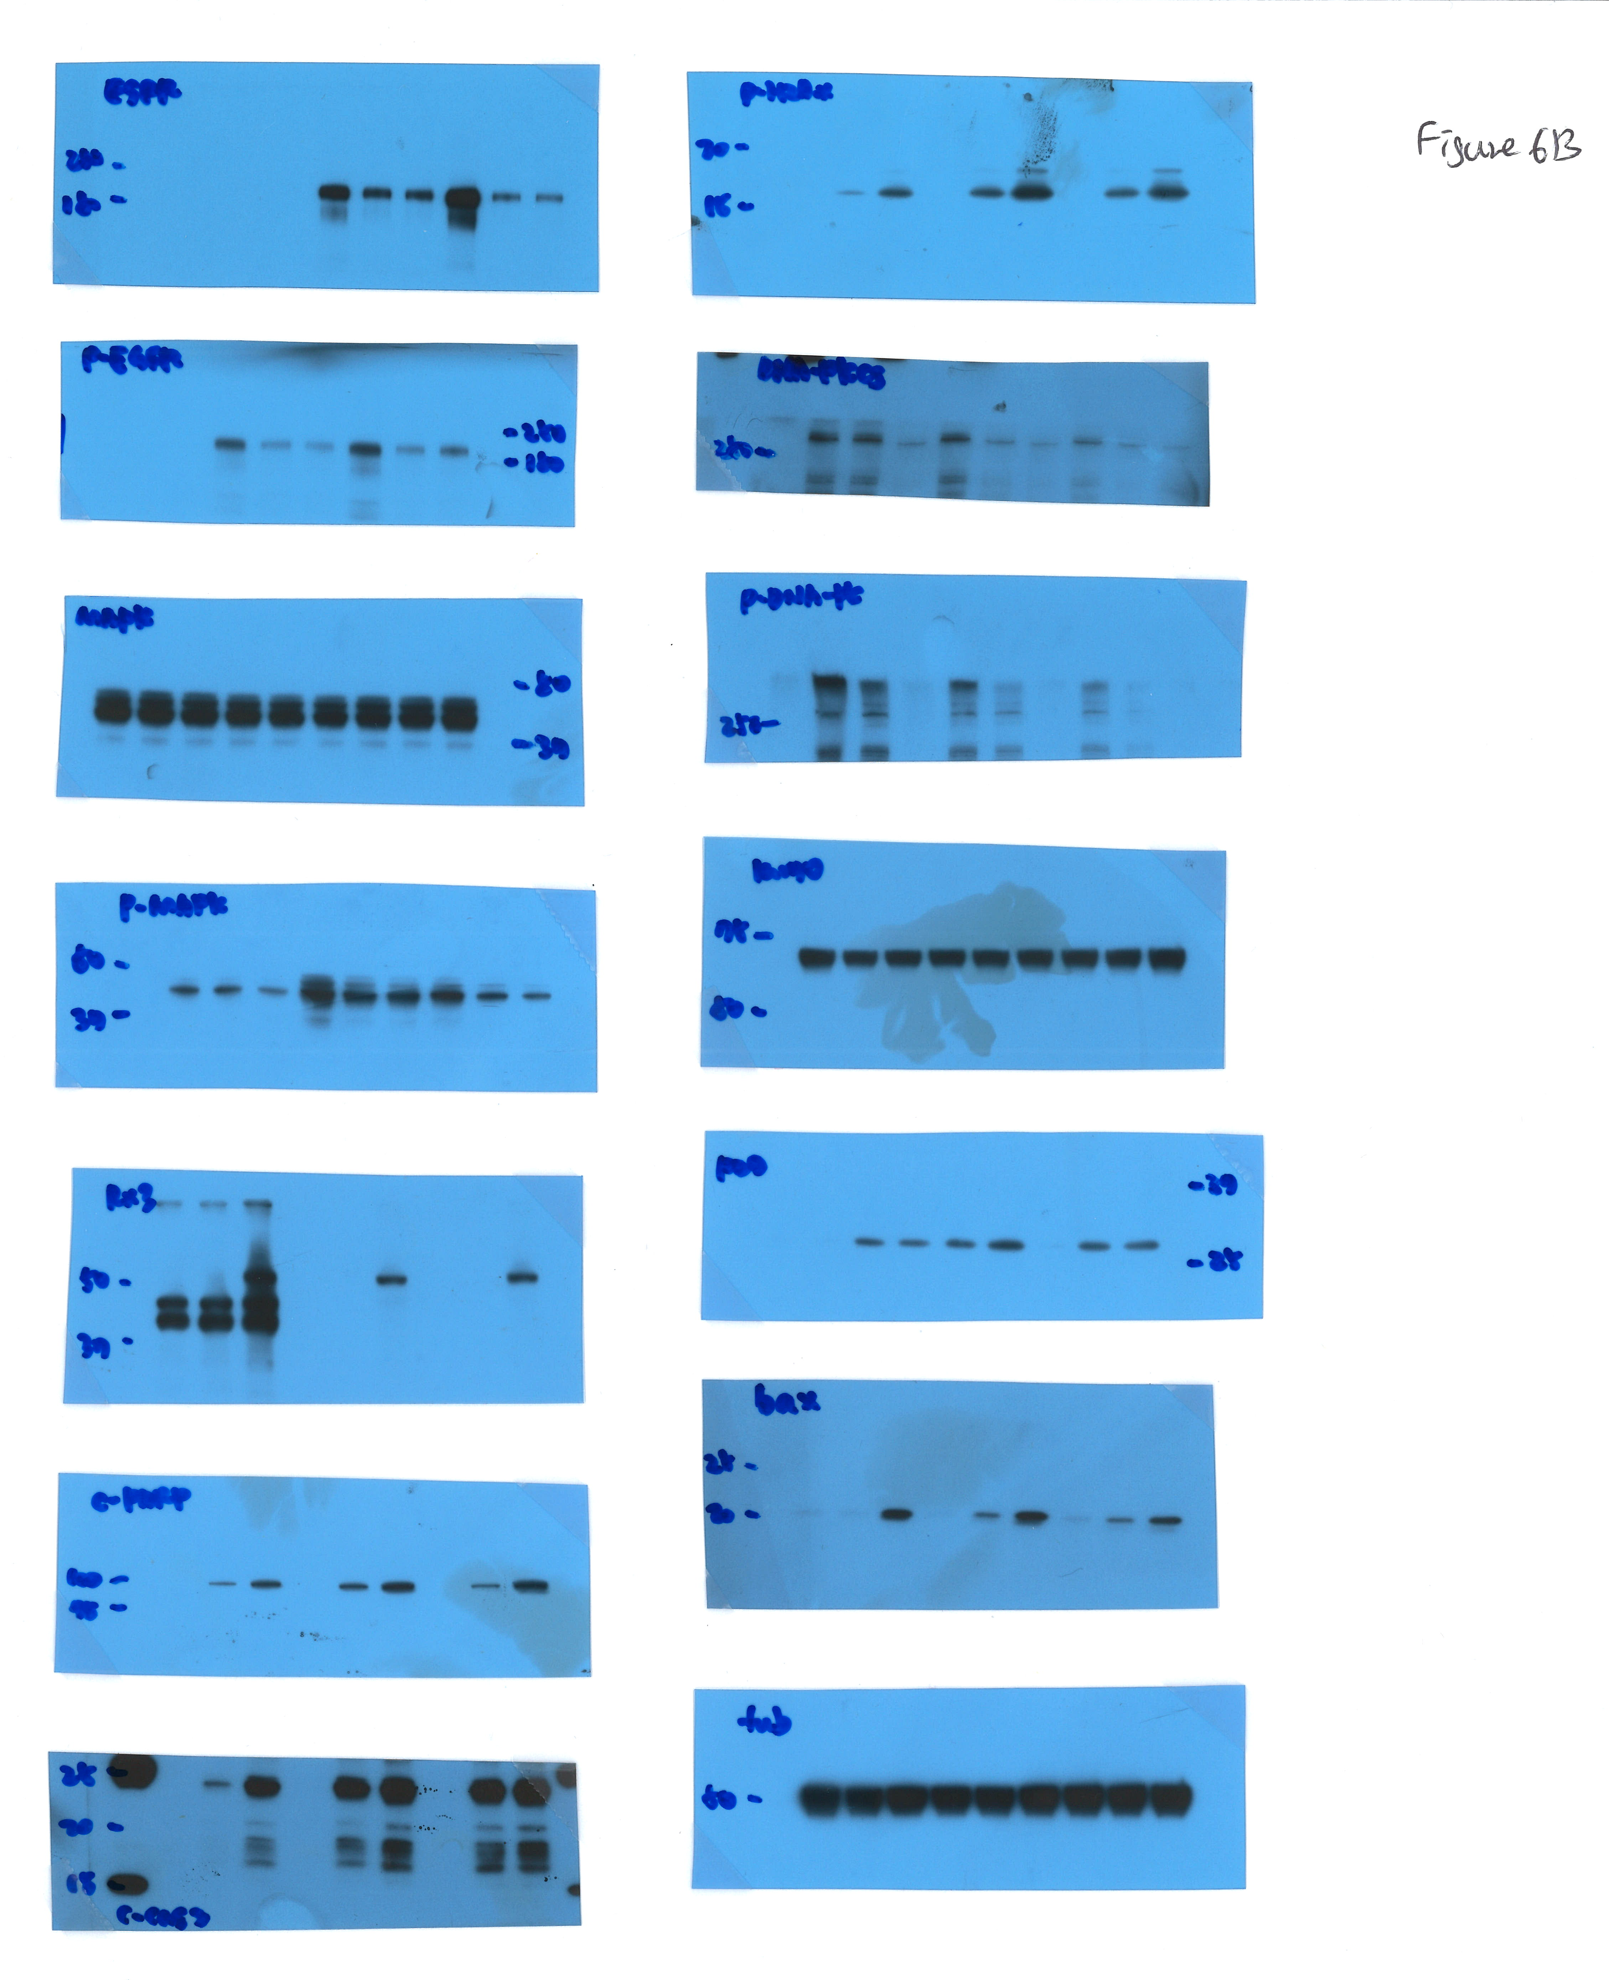
Figure 6B original data
EGFR
phospho-H2A.X
phospho-EGFR
DNA-PKcs
MAPK
phospho-DNA-PKcs
phospho-MAPK
Ku70
RUNX3
p27
Bax
Cleaved RARP
Tubulin
Cleaved Caspase3

