Slide 1
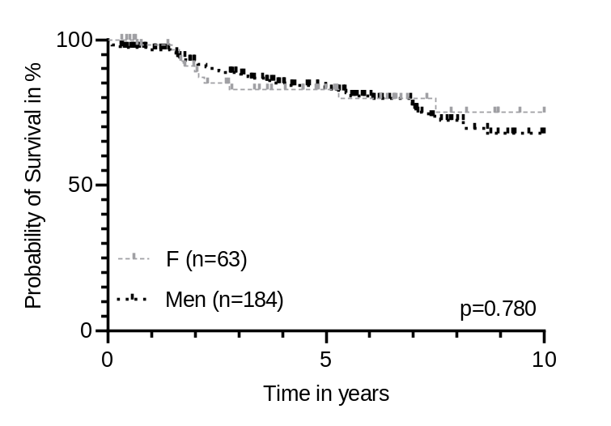
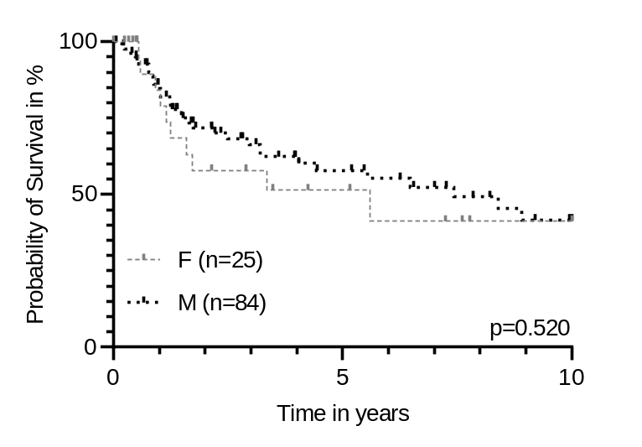
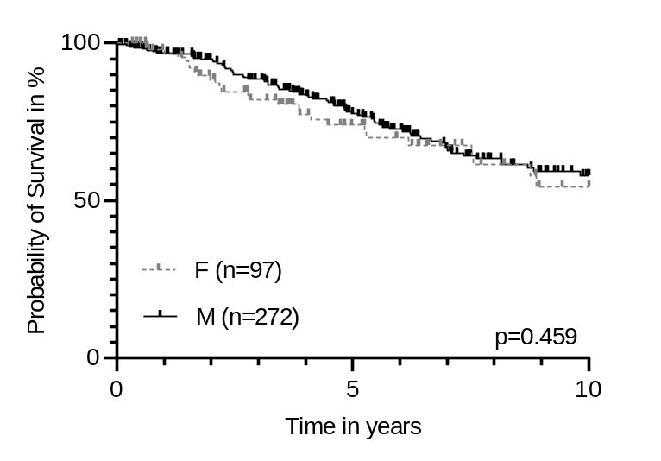
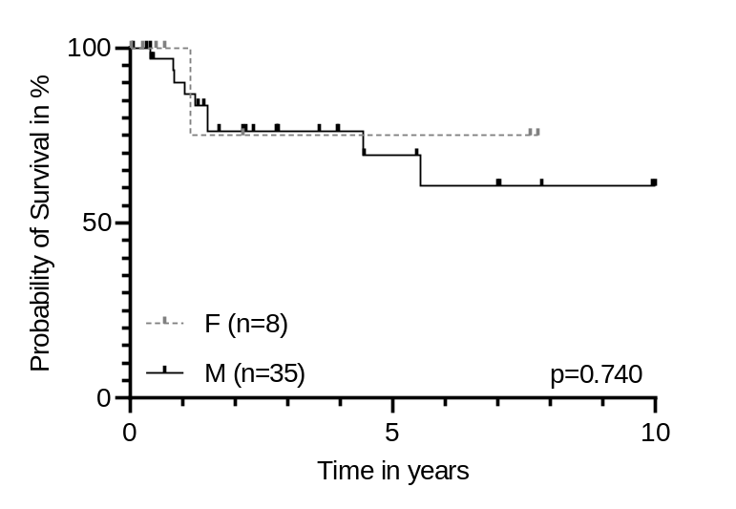
Surgery + adj. therapy
Def. radiochemotherapy
A
p16+
B
p16+
C
AJCC8 stage I + II
D
AJCC8 stage I + II
Additional figure 2: Gender specific overall survival according to therapy. Gender-specific overall survival of patients treated with surgery +/- adjuvant therapy (A, C) or definitive radiochemotherapy (RCT) (B, D). A In the subgroup p16-positive (p16+) patients (defined as either p16+/HPV+ or p16+/HPV-; n = 247); B In the subgroup p16+ patients (n = 109), C In the subgroup American Joint Committee of Cancer (AJCC)8th edition stage I+II (n = 369); D In the subgroup AJCC8th I+II (n = 43)

