Slide 1
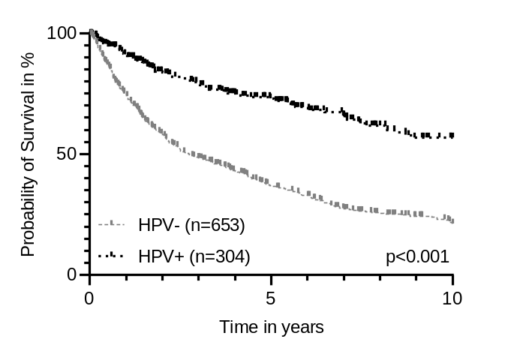
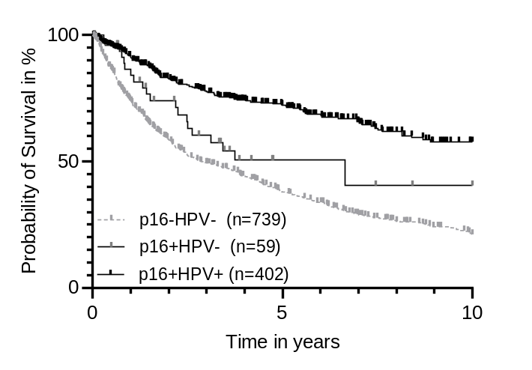
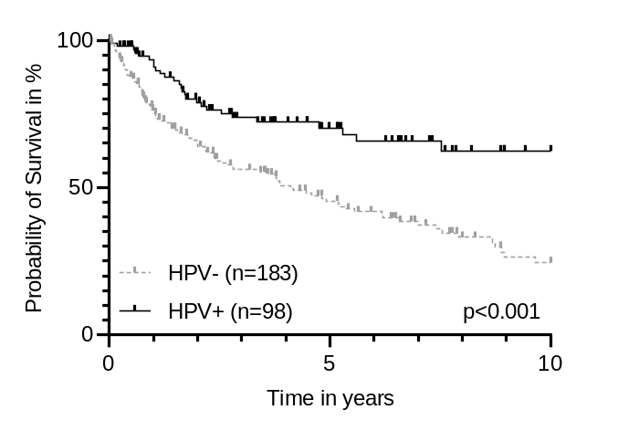
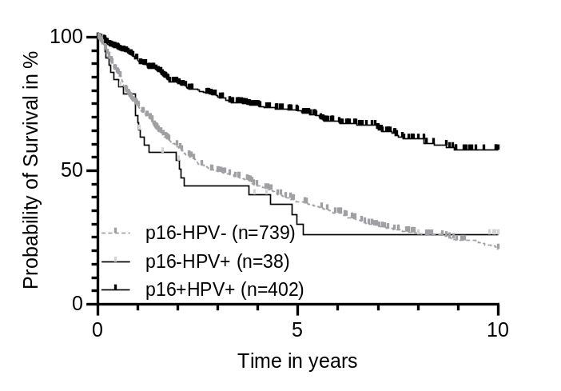
A
males
C
total cohort
**
**
p= 0.058
B
females
D
total cohort
**
**
p= 0.552
Additional figure 3: Overall Survival in Human papillomavirus positive vs. Human papillomavirus negative cohort. A In the male cohort (n = 957); B In the female cohort (n = 281); C + D In the total cohort (n=1238). HPV-negative defined as either p16-/HPV-, p16-/HPV+ and p16+/HPV-; HPV-positive defined as p16+/HPV+; ** = p<0.001

