Slide 1
Title: Macrophage Infiltration in 3D Cancer Spheroids to Recapitulate the TME and Unveil Interactions within Cancer Cells and Macrophages to Modulate Chemotherapeutic drug efficacy
Khushwant Singh¹, Pramod K. Gautam^{1*}
¹Department of Biochemistry, All India Institute of Medical Sciences, New Delhi-110 029, INDIA
^{1*}Department of Biochemistry, All India Institute of Medical Sciences, New Delhi-110 029, INDIA
^{1*}Corresponding Author:
Dr. Pramod K. Gautam
Associate Professor
Department of Biochemistry
All India Institute of Medical Sciences
New Delhi-110 029, INDIA
E-mail - gautam@aiims.edu

Slide 2
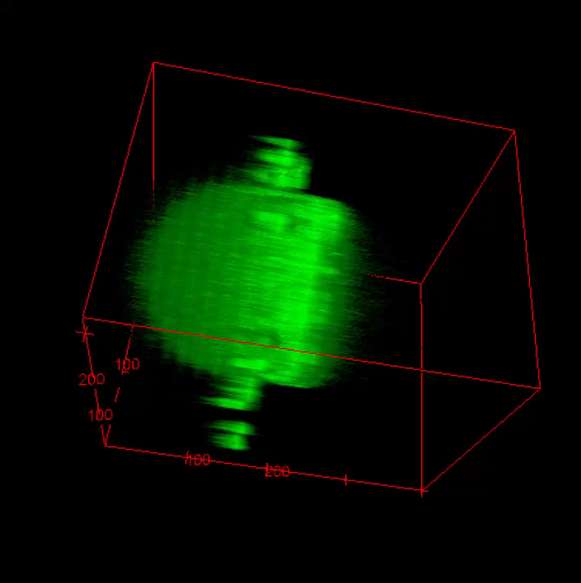
100μm
Supplementary Figure 1: A. Z- scan confocal microscopy (at 10X magnification) of Spheroids for CalcineAM penetration analysis.

Slide 3
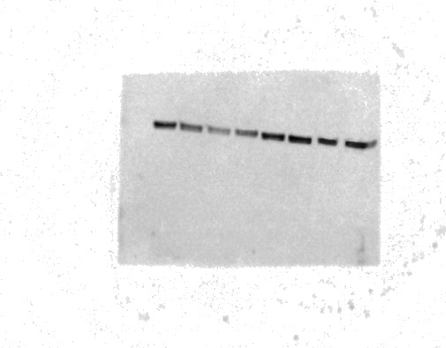
A.
Optimum exposure
B.
High exposure
CAL33 without macrophages
CAL33 with macrophages
Day 3
Day 5
Day 7
Day 9
Day 3
Day 5
Day 7
Day 9
68-70kDa
HSP70
CAL33 without macrophages
CAL33 with macrophages
Day 3
Day 5
Day 7
Day 9
Day 3
Day 5
Day 7
Day 9
68-70kDa
Supplementary Figure 2: A-B. Western blot analysis of HSP70.

Slide 4
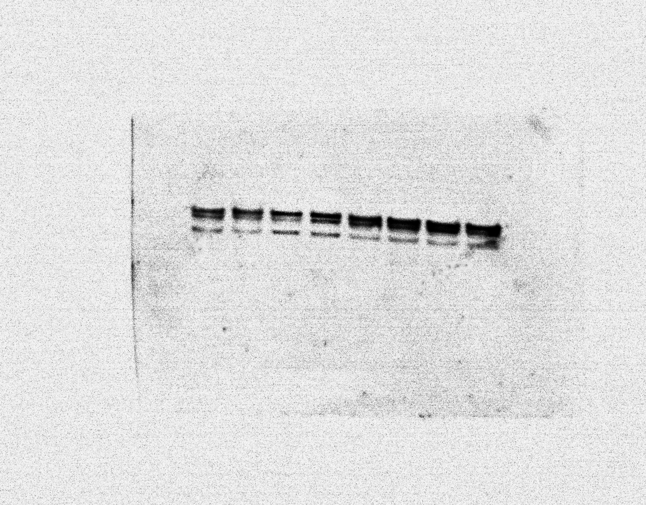
A.
Optimum exposure
B.
High exposure
CAL33 without macrophages
CAL33 with macrophages
Day 3
Day 5
Day 7
Day 9
Day 3
Day 5
Day 7
Day 9
42kDa
37kDa
Cathepsin B
CAL33 with macrophages
CAL33 without macrophages
Day 3
Day 5
Day 7
Day 9
Day 3
Day 5
Day 7
Day 9
42kDa
37kDa
Supplementary Figure 3: A-B. Western blot analysis of Cathepsin B

Slide 5
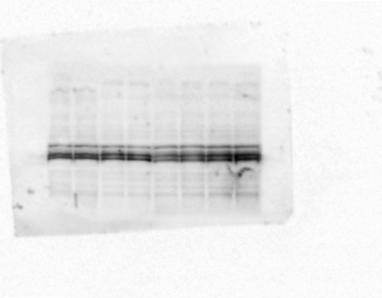
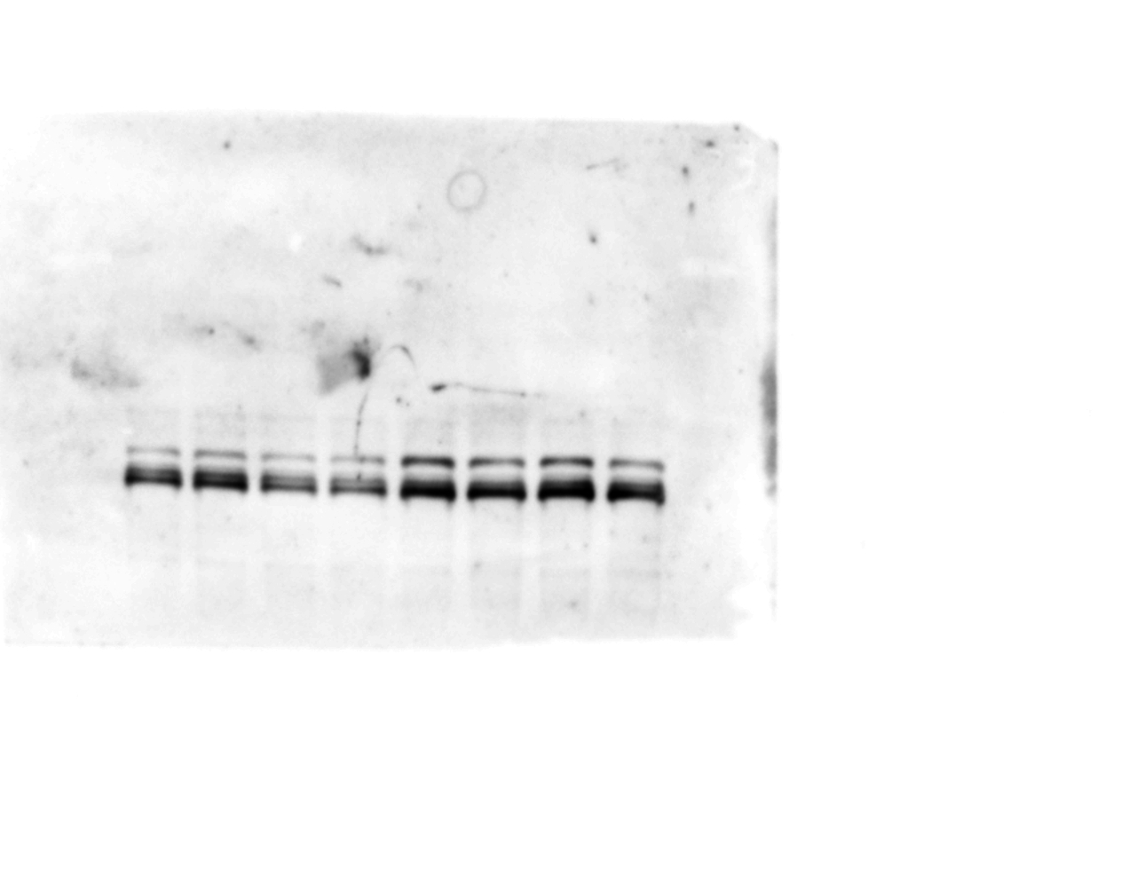
A.
Optimum exposure
B.
High exposure
CAL33 without macrophages
CAL33 with macrophages
Day 3
Day 5
Day 7
Day 9
Day 3
Day 5
Day 7
Day 9
42kDa
34kDa
26kDa
Cathepsin L
CAL33 without macrophages
CAL33 with macrophages
Day 3
Day 5
Day 7
Day 9
Day 3
Day 5
Day 7
Day 9
42kDa
34kDa
26kDa
Supplementary Figure 4: A-B. Western blot analysis of Cathepsin L.

Slide 6
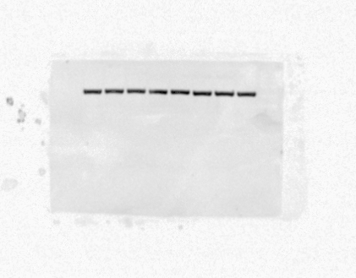
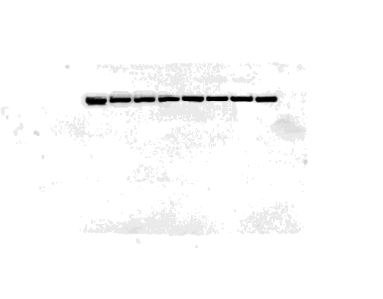
A.
Optimum exposure
B.
High exposure
CAL33 without macrophages
CAL33 with macrophages
Day 3
Day 5
Day 7
Day 9
Day 3
Day 5
Day 7
Day 9
42kDa
β-actin
CAL33 with macrophages
CAL33 without macrophages
Day 3
Day 5
Day 7
Day 9
Day 3
Day 5
Day 7
Day 9
42kDa
Supplementary Figure 5: A-B. Western blot analysis of β-actin

Slide 7
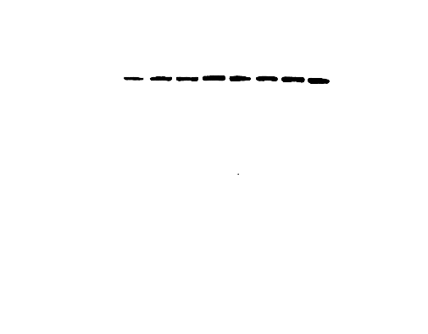
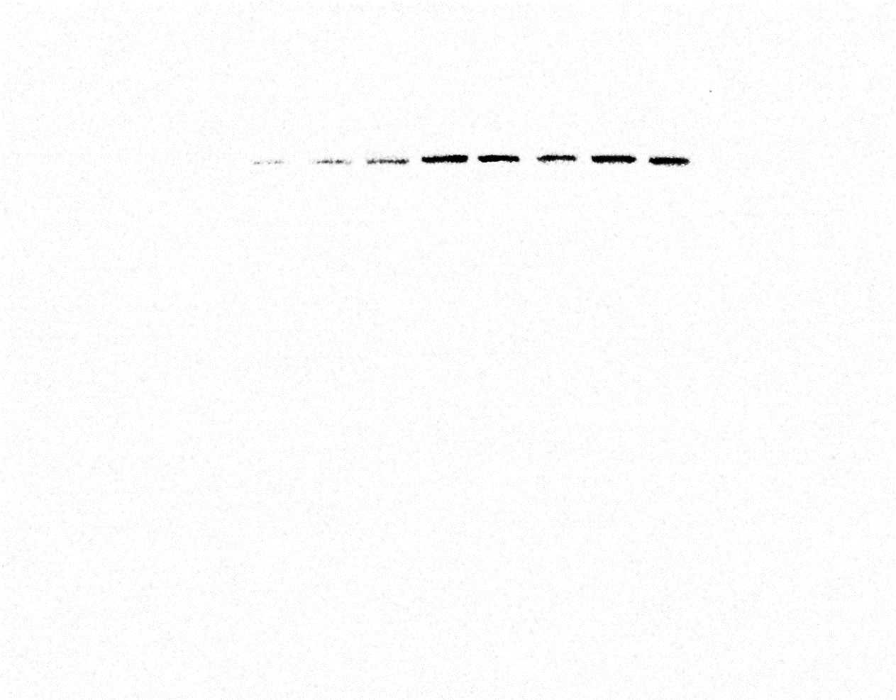
A.
Optimum exposure
B.
High exposure
CAL33 without macrophages
CAL33 with macrophages
Day 3
Day 5
Day 7
Day 9
Day 3
Day 5
Day 7
Day 9
110kDa
HIF-1α
CAL33 with macrophages
CAL33 without macrophages
Day 3
Day 5
Day 7
Day 9
Day 3
Day 5
Day 7
Day 9
110kDa
Supplementary Figure 6: A-B. Western blot analysis of HIF-1α

Slide 8
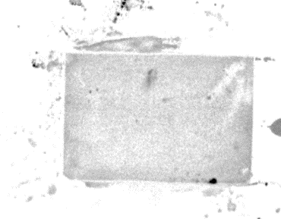
A.
Mo Macrophages treated with CoCl2
50 μM
Ladder
100 μM
50 μM
CoCl2
0 μM
150 μM
0 μM
100 μM
150 μM
HIF-1α
110kDa
HSP70
70kDa
B.
Mo Macrophages treated with CoCl2
50 μM
Ladder
100 μM
50 μM
CoCl2
0 μM
150 μM
0 μM
100 μM
150 μM
HIF-1α
110kDa
HSP70
70kDa
Supplementary Figure 7: A-B. Western blot analysis of HIF-1α and HSP70

Slide 9
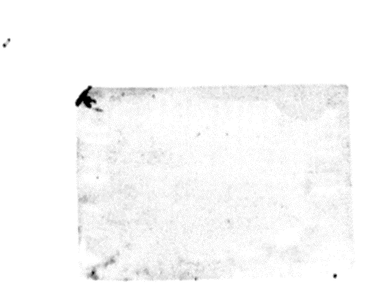
A.
Mo Macrophages treated with CoCl2
50 μM
Ladder
100 μM
50 μM
CoCl2
0 μM
150 μM
0 μM
100 μM
150 μM
Cathepsin L
Cathepsin B
42kDa
42kDa
34kDa
37kDa
26kDa
B.
Mo Macrophages treated with CoCl2
50 μM
Ladder
100 μM
50 μM
CoCl2
0 μM
150 μM
0 μM
100 μM
150 μM
Cathepsin L
Cathepsin B
42kDa
42kDa
34kDa
37kDa
26kDa
Supplementary Figure 8: A-B. Western blot analysis of Cathepsin B and Cathepsin L.

Slide 10
A.
Mo Macrophages treated with CoCl2
Ladder
50 μM
0 μM
100 μM
150 μM
CoCl2
β-actin
42kDa
B.
Mo Macrophages treated with CoCl2
Ladder
50 μM
0 μM
100 μM
150 μM
CoCl2
β-actin
42kDa
Supplementary Figure 8: A-B. Western blot analysis of β-actin

