Slide 1
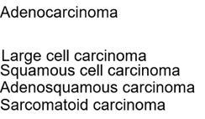
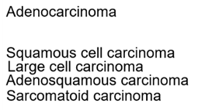
Supplementary Figure 1
Kaseda, et al.
(A)
(B)

Slide 2
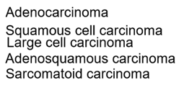
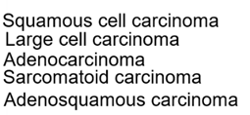
Supplementary Figure 2
Kaseda, et al.
(A)
(B)

Slide 3
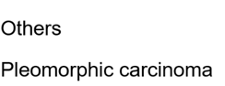
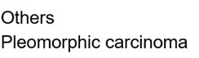
Supplementary Figure 3
Kaseda, et al.
(A)
(B)

