Slide 1
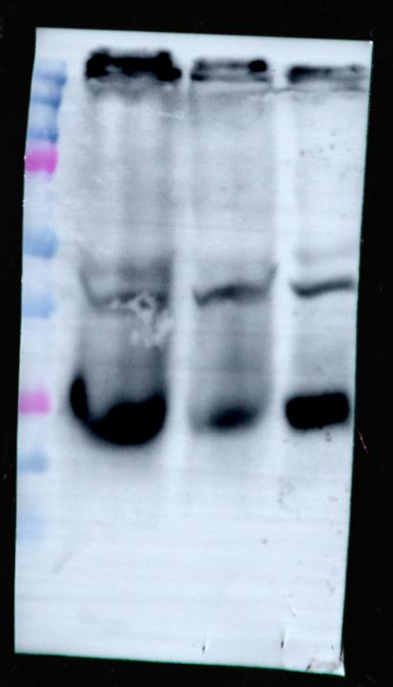
Figure1B
Upper panel
Ladder(KDa)
93UV147T
OCT1
UDSCC2
75
50
TSG101
43KDa
37
25
20

Slide 2
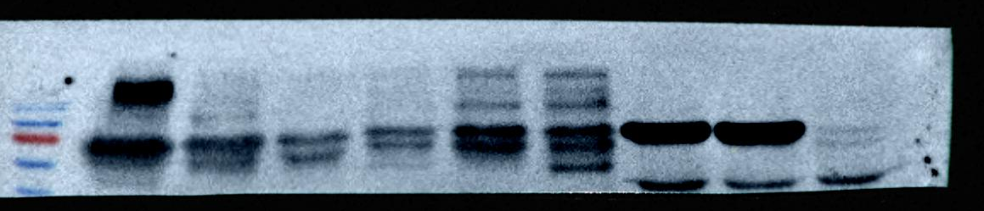
Figure1B
Lower panel
Ladder(KDa)
93UV147T
OCT1
UDSCC2
100
HSP70
70KDa
70
55

