Slide 1
 | Acidic
 | Basic
 | Neutral
 | Hydrophobic
anchor residue
V
L
K
L
Anchor
Mutation
DP5
W
F
 |  |  |  |  |  | I, L, V
Peptide | g15 ratio | -4 | -3 | -2 | -1 | 1 | 2 | 3 | 4 | 5 | 6 | 7 | 8 | 9 | 10 | 11 | 12 | 13 | 14
R
D
G
ES#5–7_wt | 4.5 |  |  |  |  |  |  |  |  |  |  | Y
ES#5_Y537S | 3.4 |  |  |  | C | K | N | V | V | P | L | S | D | L | L | L | E | M | L
ES#5–7_wt | 4.5 |  |  |  |  |  |  |  |  |  |  | Y
ES#6_Y537N | 3.7 |  |  |  | C | K | N | V | V | P | L | N | D | L | L | L | E | M | L
ES#5–7_wt | 4.5 |  |  |  |  |  |  |  |  |  |  |  | D
ES#7_D538G | 2.1 |  |  |  | C | K | N | V | V | P | L | Y | G | L | L | L | E | M | L
Fig. 8
g15 ratio > 2.0
Figure S1 Possible binding registers of ESR1-peptides
Binding registers of peptides inferred from known anchor residues for DP5. The peptides with a g15 ratio >2.0 are highlighted in light blue. Anchor residues (boxed in black) and mutation sites (boxed in red). Amino acids were color-coded: acidic (pink), basic (green), neutral (yellow), or hydrophobic (brown).

Slide 2
Strong
binding
DP5
Strong/weak
binders
10
DRB1*04:05
10
g15 ratio
<1
<1
DRB1*12:01
%Rank (NetMHCIIpan-4.1)
10
<1
<1
DRB1*15:01
10
Figure S2 Comparison of measured and predicted binding patterns
Comparison of measured and predicted binding patterns of DP5, DRB1*04:05, DRB1*12:01, and DRB1*15:01, for ES#5–7_Y537S/N, D538G. %Rank (NetMHCIIpan) (black) and g15 ratio (red). The data for g15 ratio <1.0 are not displayed. The horizontal dotted line (black) denotes the threshold (%Rank = 10) for a weak binder predicted by NetMHCIIpan-4.1. The horizontal dotted line (red) denotes the threshold for a strong binder (g15 ratio = 2.0) obtained by the MHC-density assay.

Slide 3
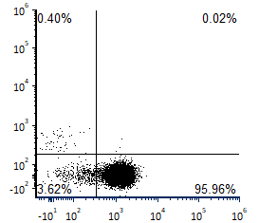
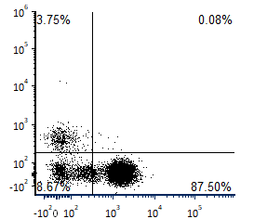
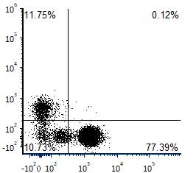
A
B
ES#5_Y537S (donor 2)
ES#6_Y537N (donor 3)
CD8 (FITC)
CD8 (FITC)
C
CD4 (PE)
CD4 (PE)
ES#7_D538G (donor 3)
CD8 (FITC)
CD4 (PE)
Figure S3 Compositions of antigen-specific T cells
(A–C) Flow cytometry analysis of T cells stimulated by ES#5_Y537S (donor 2) (A), ES#6_Y537N (donor 3) (B) and ES#7_D538G (donor 3) and (C) stained with anti-CD4 mAb (PE) and anti-CD8 mAb (FITC).

