Slide 1
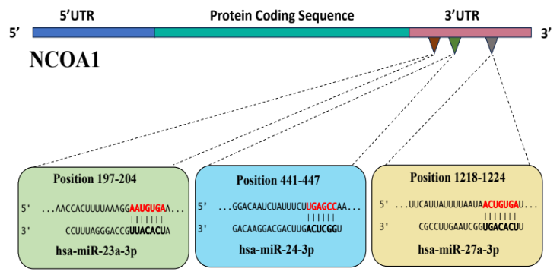
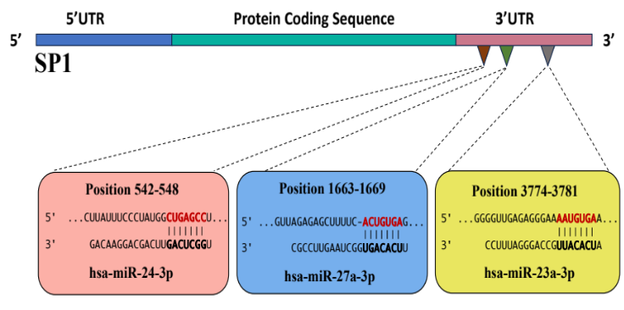
Supplementary Figure 1
A
B
Supplementary Figure 1: Predicted binding sites of miR-23a/miR-24-2/miR-27a at the 3’ UTR of (A) NCOA1 and
(B) SP1

