Slide 1
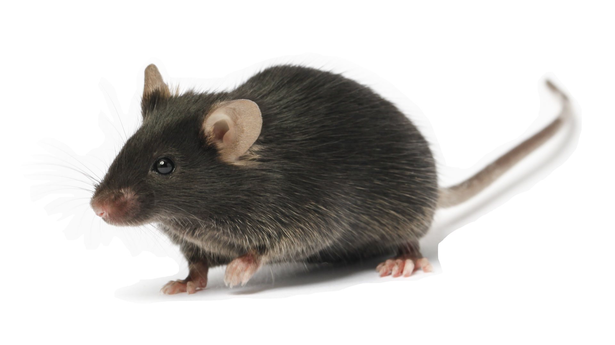
% of carriers
FVB/N-Tie2-GFP Mice
C57BL/6-Tie2-GFP Mice
Backcrossing generation

