Slide 1
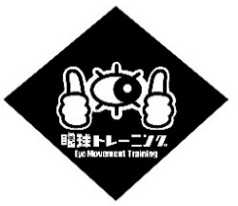

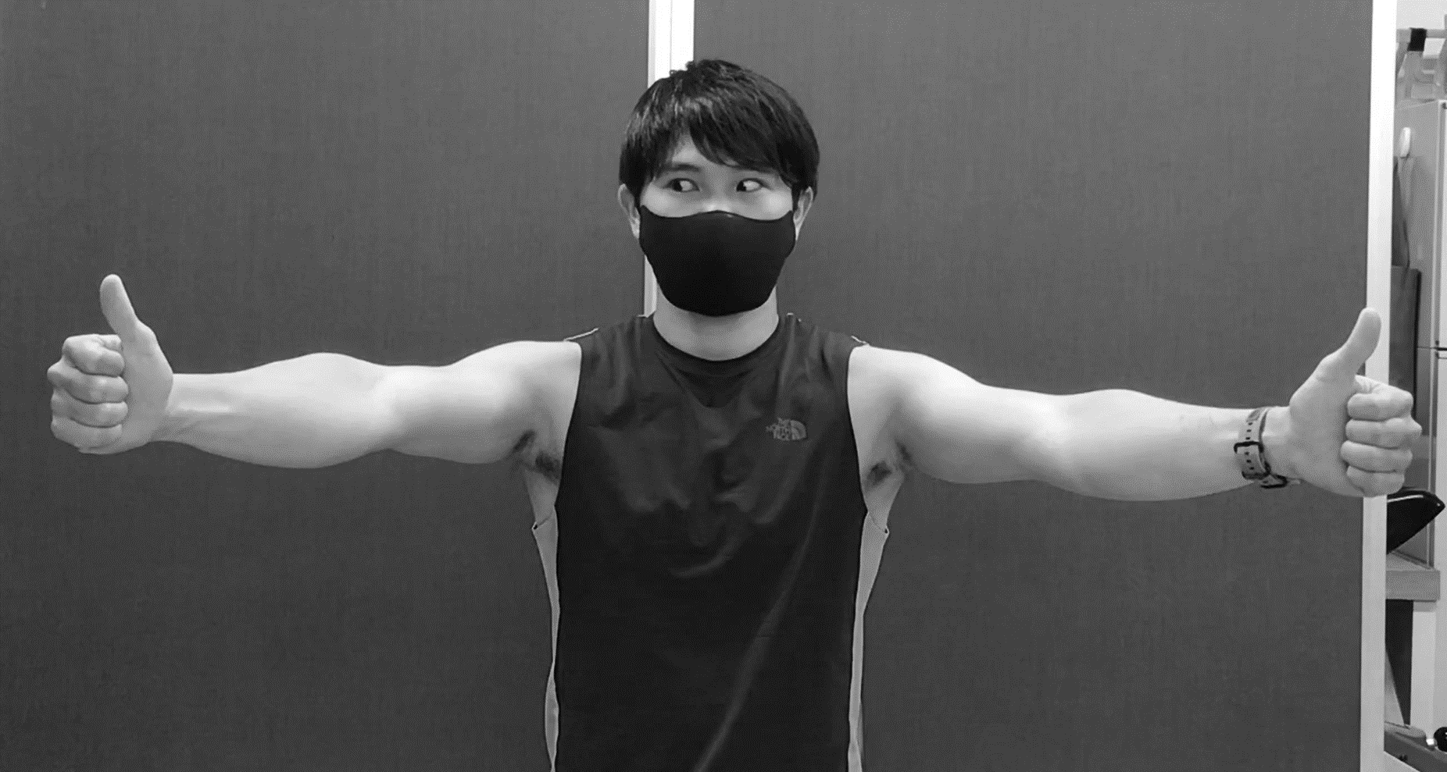
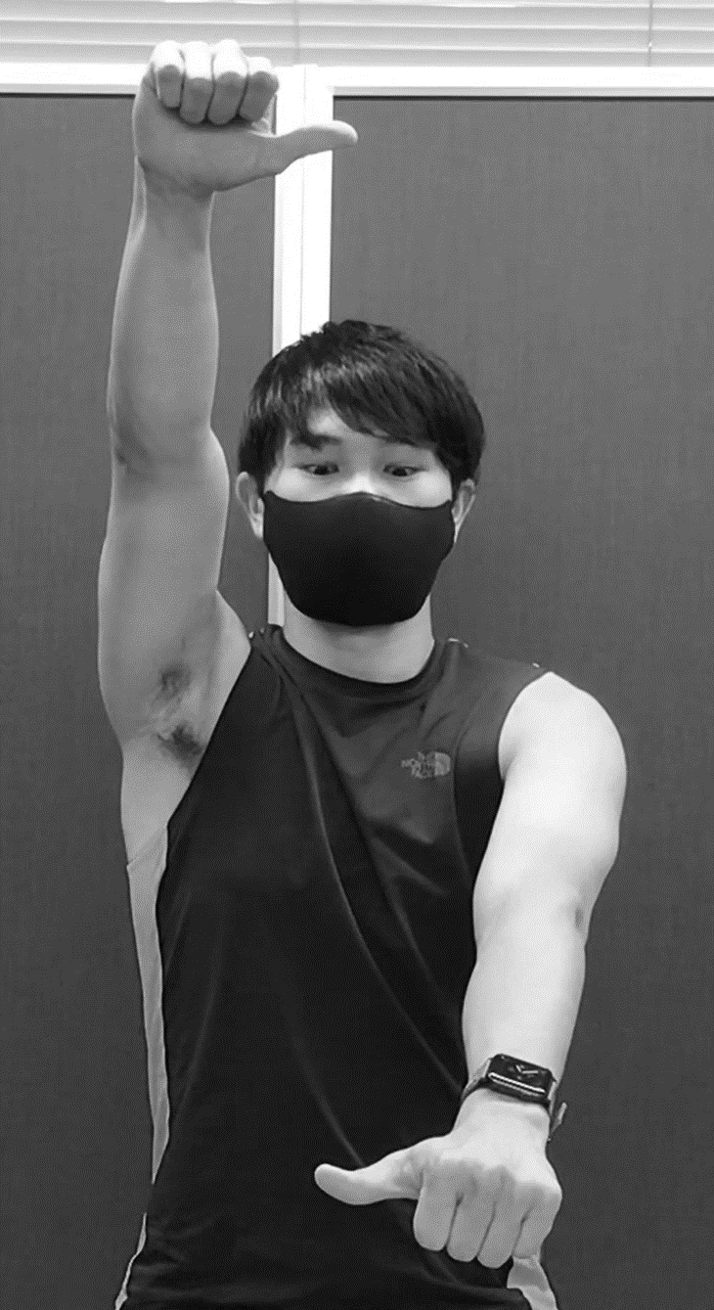
Revised: Jan 5, 2026
Eye Movement Training
＜Menu 1＞
① Fast Horizontal Saccades
② Fast Vertical Saccades
Move only your eyes.
Keep your head still.
Rapidly switch your gaze between your right and left thumbs.
Perform 20 repetitions for each direction.
Stand with your feet about as wide as your shoulders.
QR
code A
Practice Videos
Unauthorized reproduction is prohibited.
“SUKUBARA®” (Reg. No. 6476079), “Kids Balance” (Reg. No. 6516377), and the “Eye Movement Training” logo (Reg. No. 6521056) are registered trademarks.
Before use, please scan QR code B to read the safety precautions.
QR
code B
QR
code C
Practice Record Submission
ID：
Name：
Laboratory of Artificial Intelligence, University of Tsukuba

Slide 2
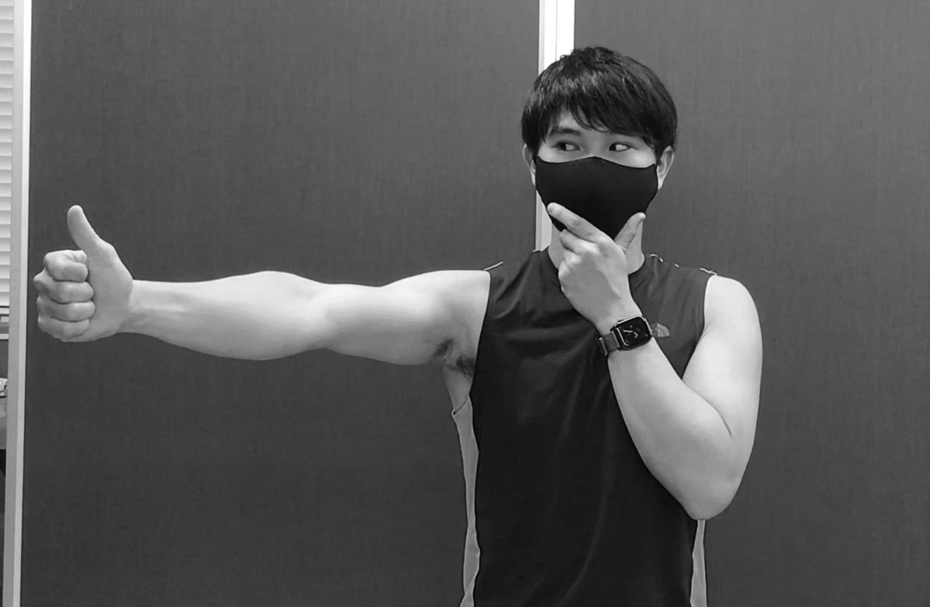
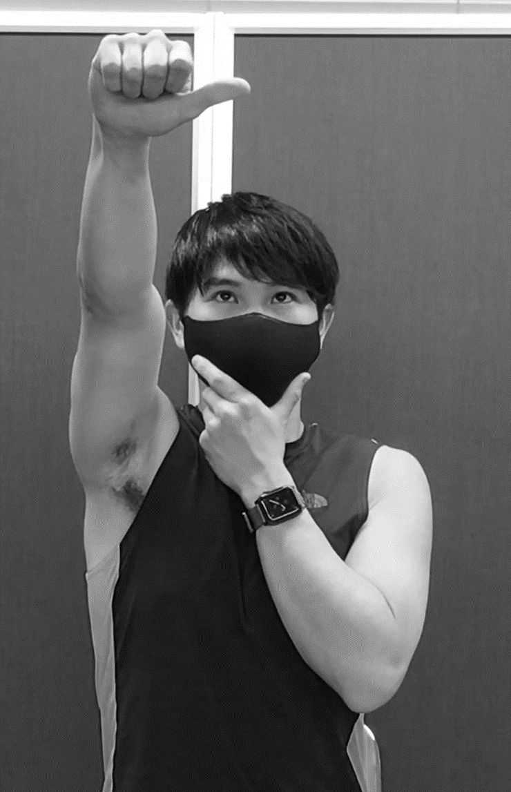
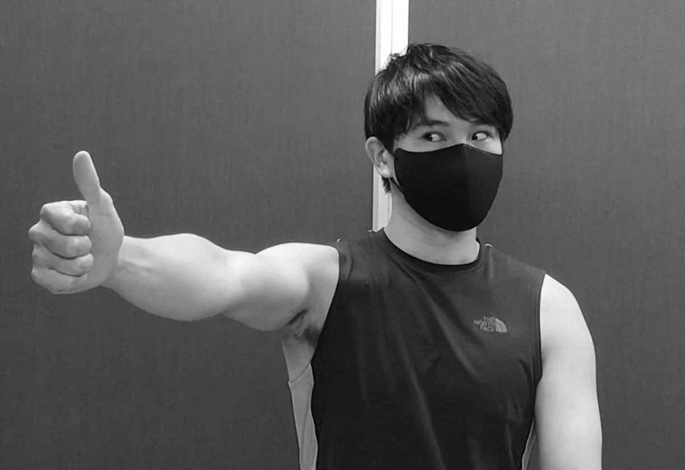
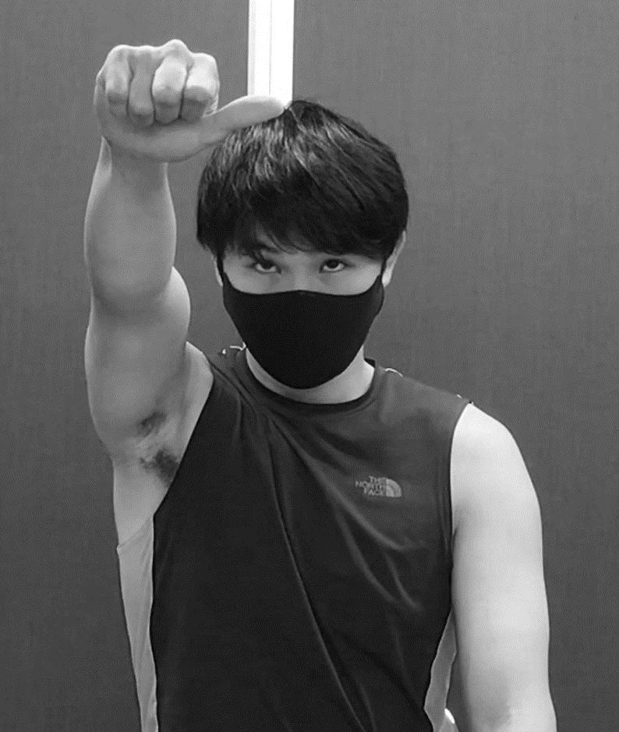
Eye Movement Training
＜Menu 2＞
③ Slow Horizontal 1
(smooth-motion)
④ Slow Vertical 1
(smooth-motion)
Use one hand to gently hold your head so it stays still.
Slowly move your thumb left and right while keeping your eyes on it.
Move within a range of approximately 30 degrees.
Perform 20 repetitions for each direction.
⑤ Slow Horizontal 2 (Vestibulo-Ocular Reflex x2)
⑥ Slow Vertical 2(Vestibulo-Ocular Reflex x2)
Move your head and hand in opposite directions.
Keep your eyes fixed on your thumb.
Perform 20 repetitions for each direction.
Move your head and hand slowly.
Perform ① ~ ⑥ for 20 repetitions each

