Slide 1
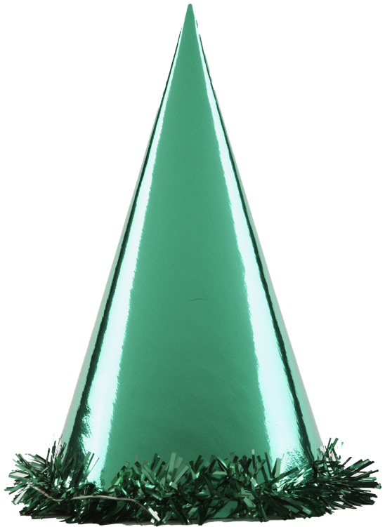
CAMSA Sequence of Skills
At the go signal, two foot jumps through the right column of hoops
Sliding sideways from cone A to B and back to A
Catches a ball thrown by examiner, moves to the throwing line and throws the ball at the target
Skipping around the cones C and D to behind the hoops
One foot hop in each hoop
Running from the hoops to the kicking line to kick the ball between the cones on the wall.
Throwing target
1.5m
Between the cones is the kicking area
2m
Wall
5m
Floor
B
Throwing / kicking line
3m
3
6
C
2
A
4
1m
5
1
5m
5
5
1
5
D
5
1
5
1m
Starts Here

