Slide 1

Adolescent Mental Health Workshop
PART 1
May 11, 2024

Slide 2
Welcome!
Icebreaker game
Case discussion #1 (large group)
Case discussion #2 (small groups)
Snack break
Case #3 (large group)

Slide 3
Introductions
Name
Dream SHS
Your hobbies
Your dreams!!!!

Slide 4
A few “rules:”
We want to learn from YOU! Please speak freely, honestly and openly. Nothing you say or do here will impact your grades or school performance in any way.
One speaker at a time, please!
“Las Vegas” rules: what happens here stays in this room.
Results may be shared in summary with your school administrators and guidance counselors but will never be shared in a way that would identify you individually.
Sometimes, talking about stressful or emotional problems may bring up some intense personal feelings. Please talk to us if you are feeling this way!

Slide 5

When we say “mental health” or “mental wellness,” what kinds of things come to mind?

Slide 6
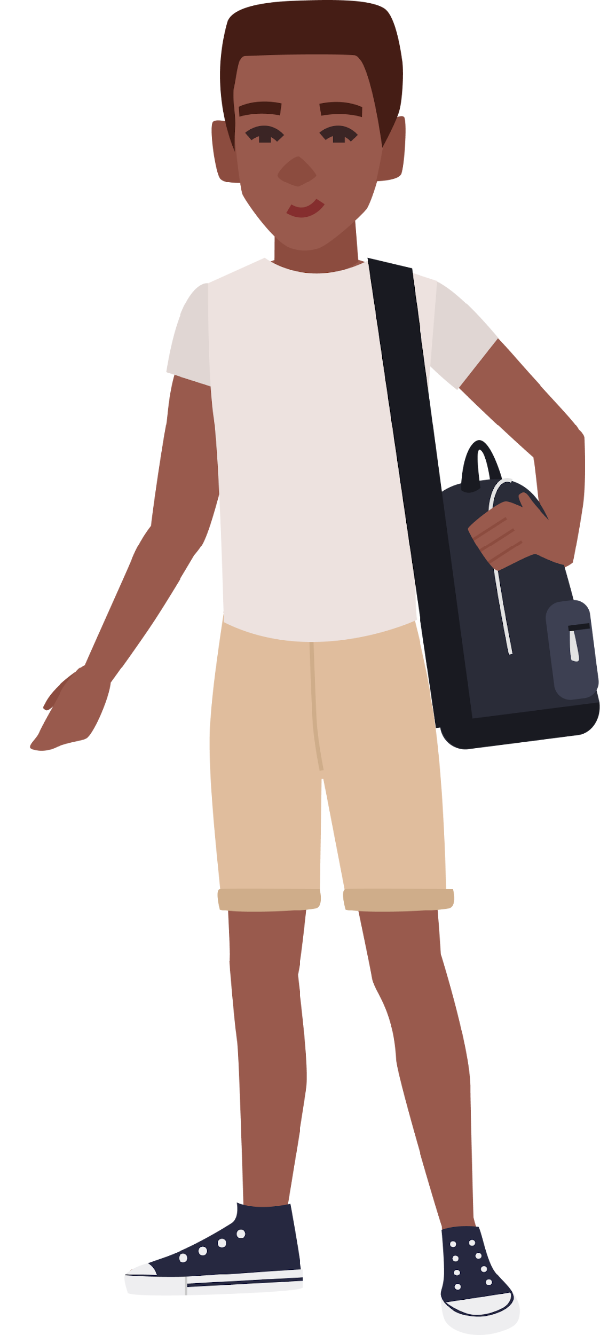
Case 1
Kojo
Notes:
Kojo is a SHS student. He typically enjoys playing football and hanging out with his friends,

Slide 7
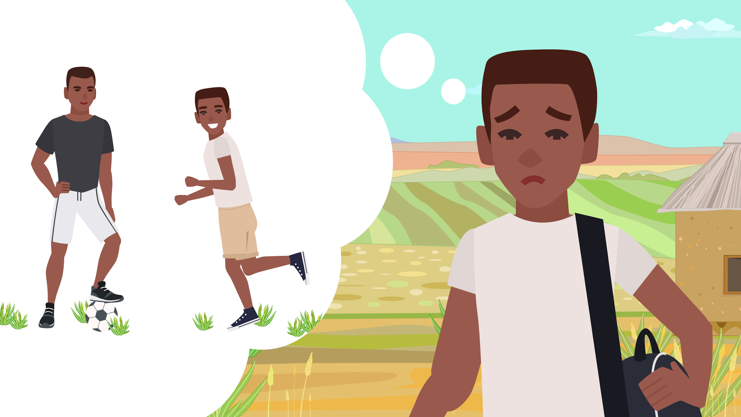
Notes:
but lately, he’s been finding that he’s just not enjoying football the way he used to. He’s not quite sure why, but he’s often feeling stressed, sad, and lonely. Many times, he doesn’t sleep well at night.

Slide 8
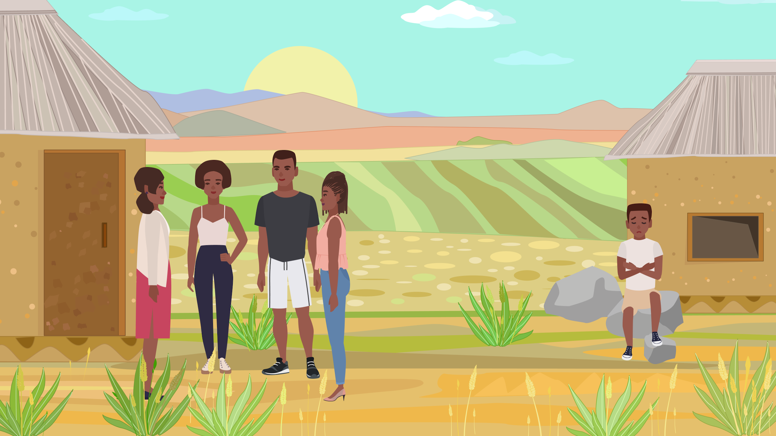
Notes:
He also feels isolated from his friends, feeling like none of them will understand how he’s feeling.

Slide 9
Recognizing mental health signs
What are some signs that someone might be struggling with their mental health, like feeling very sad or anxious?
Imagine in a few months or years, what might happen if Kojo doesn’t find help for these feelings? How could this affect his life, education, or future job?

Slide 10
What are some reasons someone might feel like they can’t get help when they are feeling very sad or anxious?
  Are there any cultural beliefs or attitudes within your schools or communities that might contribute?
Notes:
Barriers
- feel like problem is beyond getting a solution, scared of peopel making fun of him

Slide 11
Getting help
Think about a time when embarrassment or fear of judgement stopped you from sharing with friends, family, or teachers. How do you think stigma or lack of information about mental health impact young people in your community?

Slide 12

Getting help
Are you aware of any rules at school or in your community that affect how mental health issues are handled?
  How do these impact a young person’s willingness to ask for help?
Notes:
Rules can be formal or informal

Slide 13
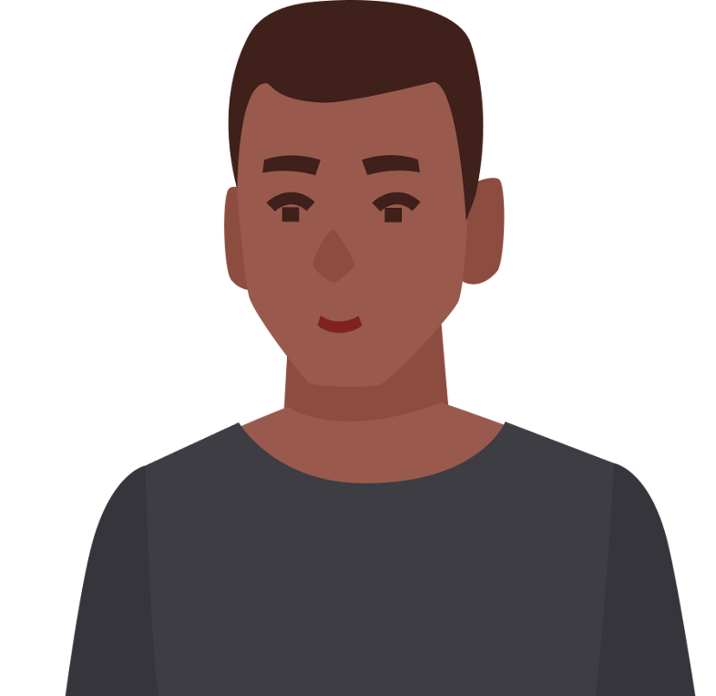
Case 2A
Abu

Slide 14
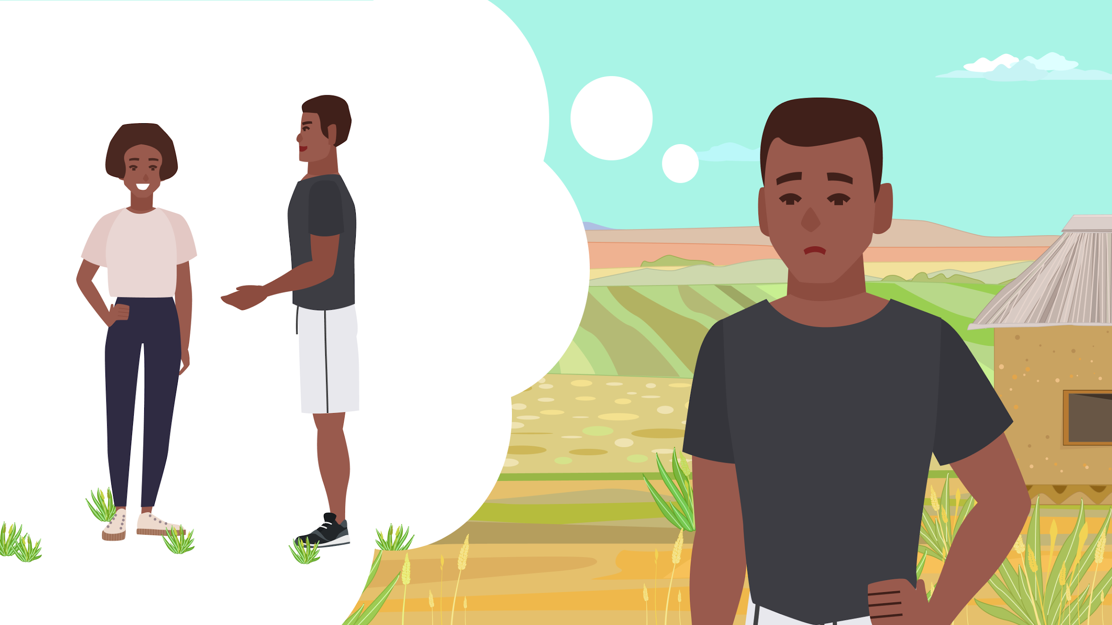
Notes:
Frame 1: Abu is shown daydreaming about Nazeefa. He likes her, but he feels nervous when he’s around her, and doesn’t know how to ask her out.

Slide 15
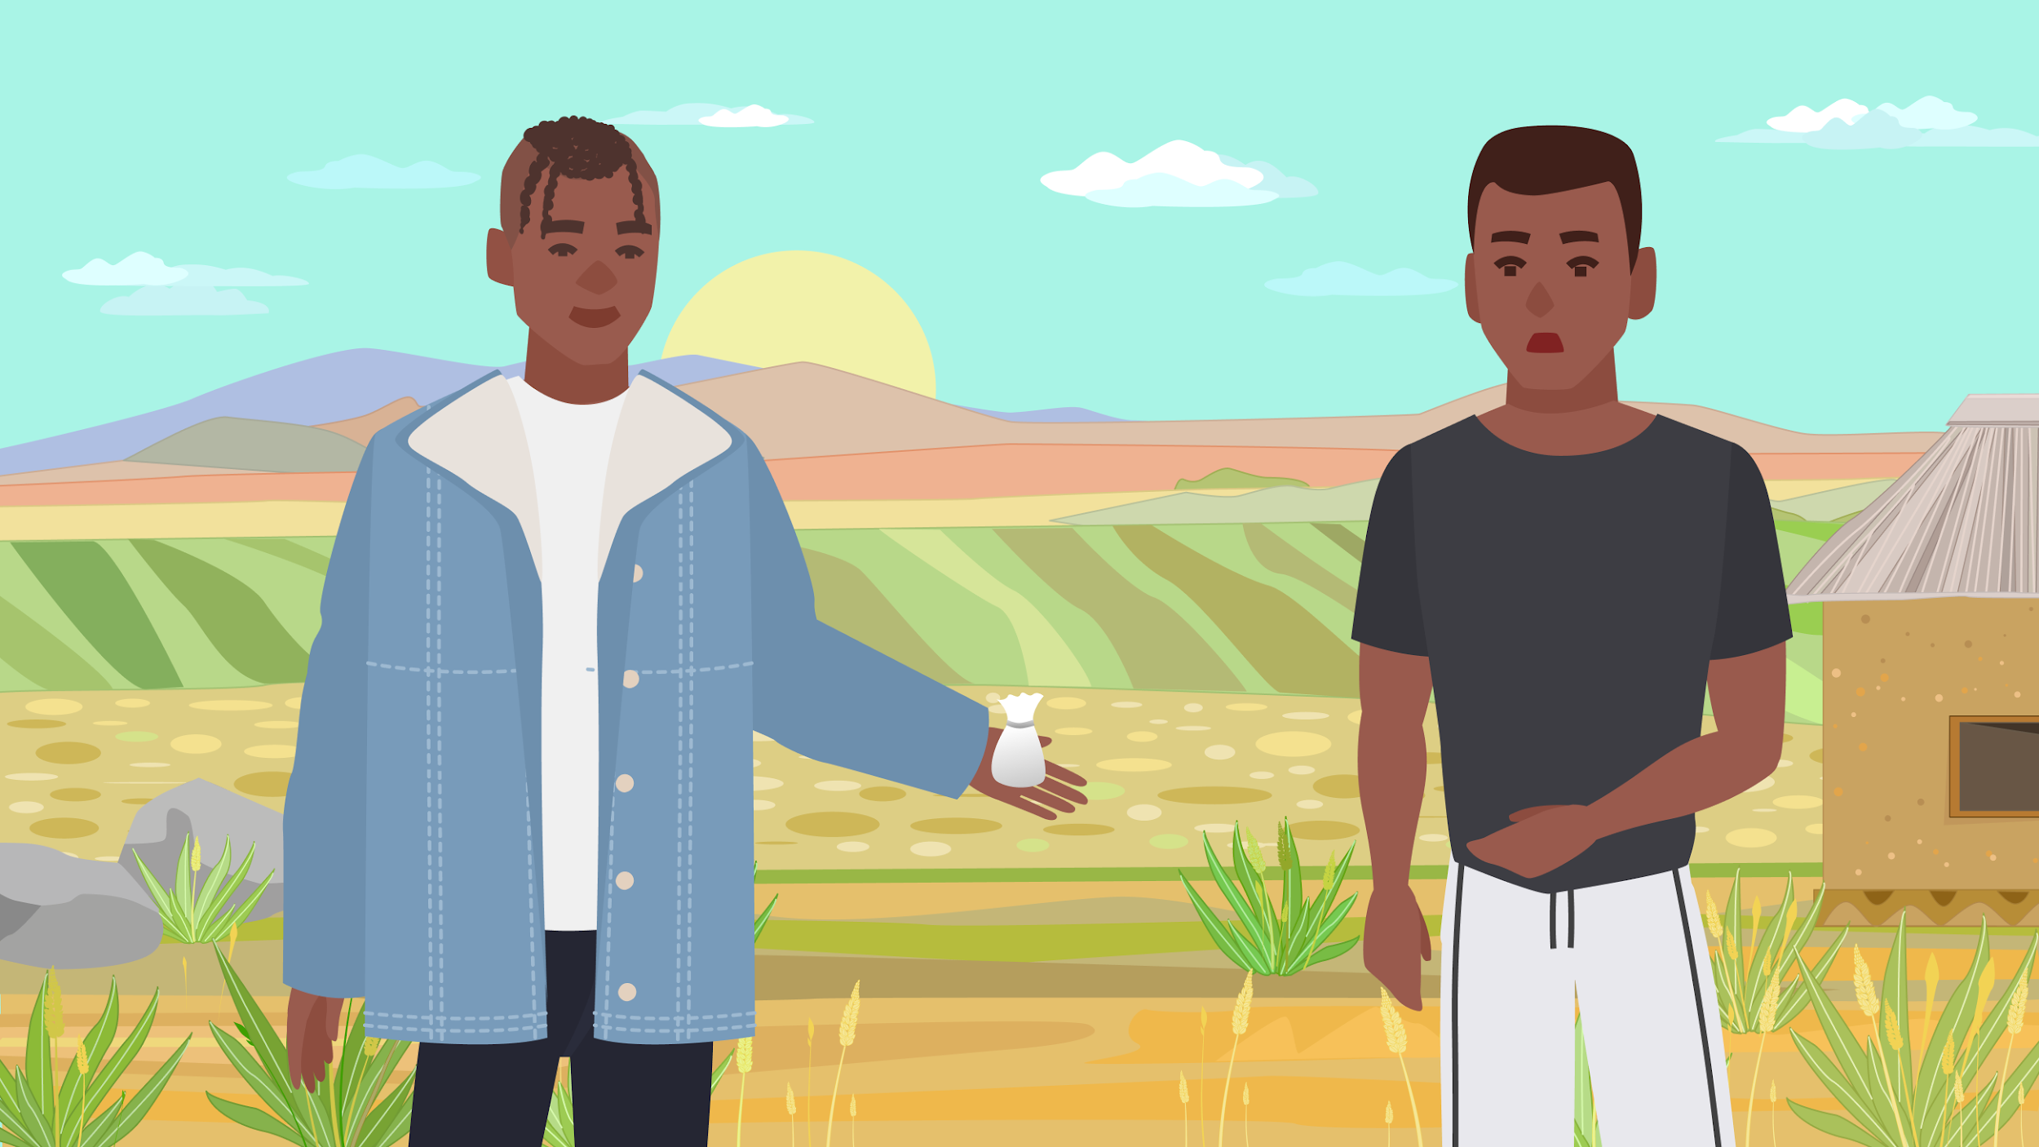
“Aget some pill bi. Efit boost your confidence like maddd."
Notes:
Abu runs into his friend Shaker:
Shaker - “Yo bro, you for watch where you dey go. What dey wrong you?”
Abu – “Bro amake sorry waa. I had a lot on my mind….I just keep trying to talk to this girl, but my mind just gets messed up every time I see her.”
Shaker – “Aget some pill bi. Efit boost your confidence like madddd. You take am aa, you fit runn Nazeefa make she fall give you quarter quarter.”

Slide 16
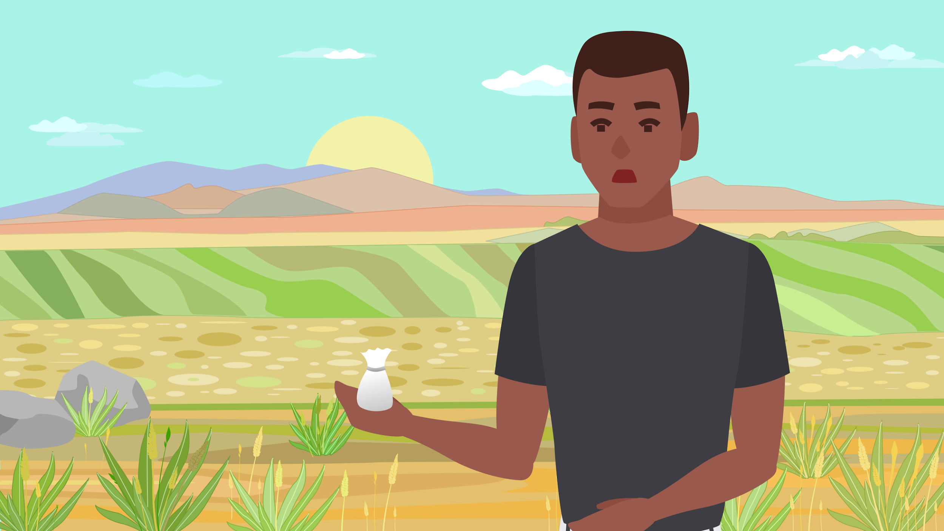
Notes:
Abu thinks. He’s heard about some bad associations with drugs – that they can cause a lot of problems….but he really needs some help talking with Nazeefa!

Slide 17
What have you heard about students using drugs to increase confidence or cope with stress? Are there any risks you’ve heard about? Any benefits?

Slide 18
Cultural and Social Factors
What are some reasons why young people in our community might start using drugs?
  Are there things in our culture or society that make it seem okay?
  Are there things in our culture or society that make it hard to talk about freely? Any factors specific to boys or young men?

Slide 19
Drug use and mental health
Do you think there’s a connection between using alcohol/drugs and mental health problems?
Why or why not?

Slide 20
What should Abu do next?
Should he take the pills so he can ask Nazeefa out on a proper date?
Is there another option?
It’s just one pill, what’s the harm?
Thanks, but no thanks.

Slide 21
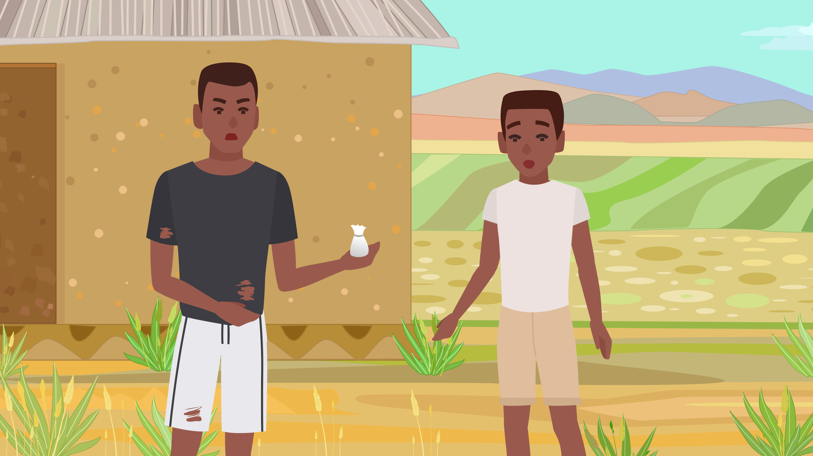
1 year later…
What if Abu had made another choice?
21
Notes:
Abu decides to take the drugs and in fact, he found that it did help him relax. However, he soon found that he was turning to using pills to relax more and more. Soon, he found that he needs more and more of the pills to get the same effect.
Within a year, Abu has dropped out of school. He’s spending all his money on more pills, and now has started selling pills to other students to support his habit.

Slide 22
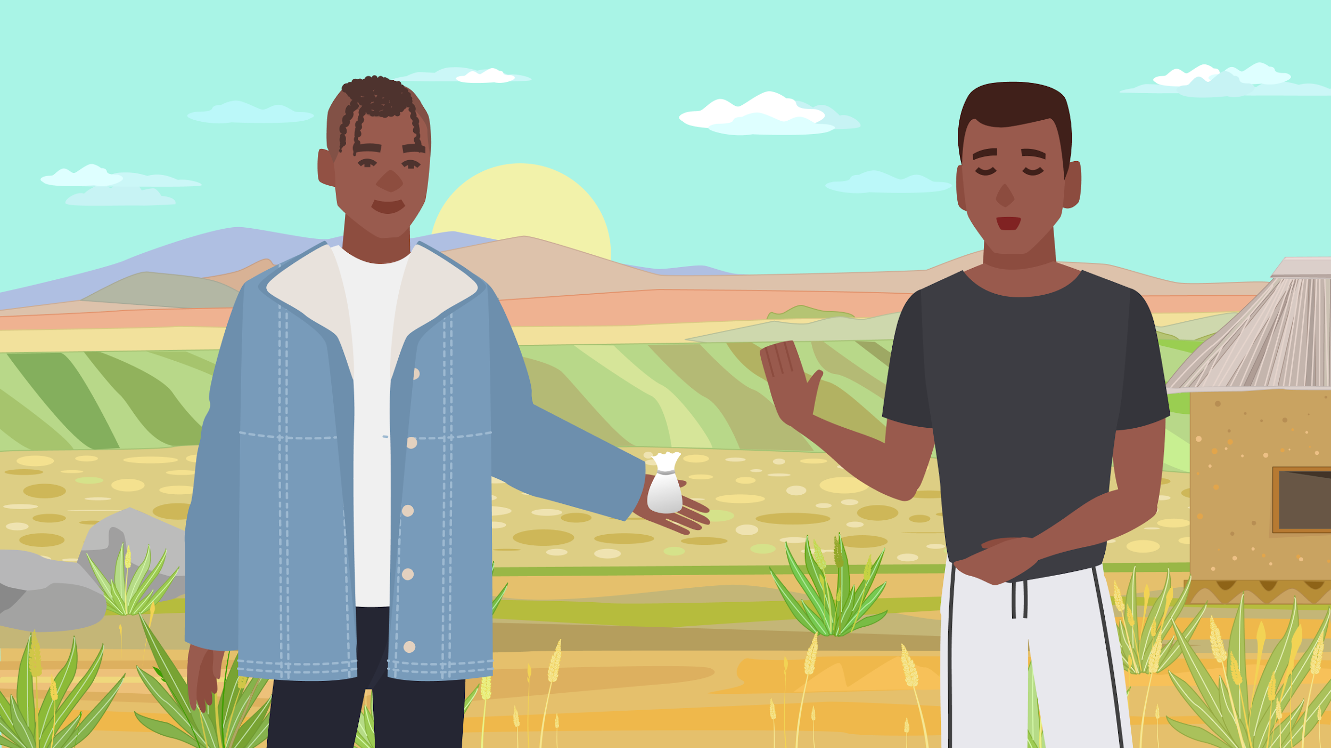
“Thanks, but I’m okay. Do you want to go play some football?
That’ll help me get my mind off of things.”
Notes:
Abu thinks about it – but he remembers some of the dangers of drugs that he learned about in schools. ”Thanks, but no thanks. Do you want to go play some football?”

Slide 23
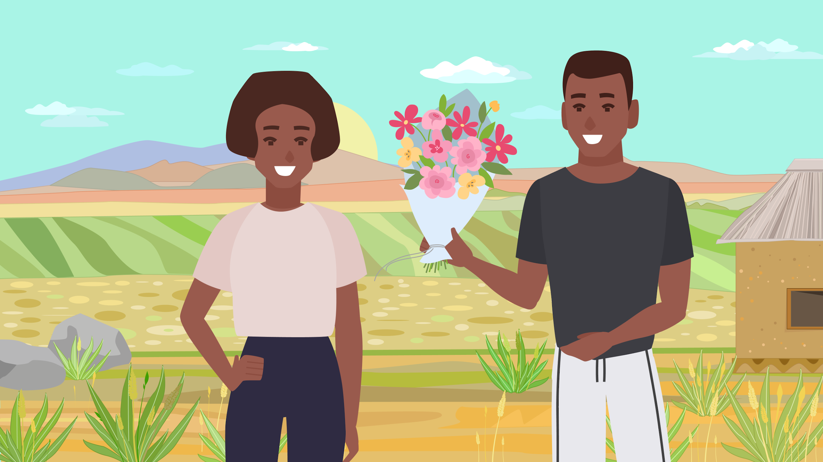
Notes:
Later, Abu works up some confidence and decides to buy Nazeefa some flowers and asks her on a date.

Slide 24
Resources
In your school, how do students learn about the risks and consequences of substance use?
  Are these programs useful?
  What could make them more effective?

Slide 25
Resources
In your school, what is the attitude towards students who struggle with substance use?
  Is there stigma, or is it supportive?
  How can schools make it easier for students who use drugs or alcohol to ask for help?

Slide 26
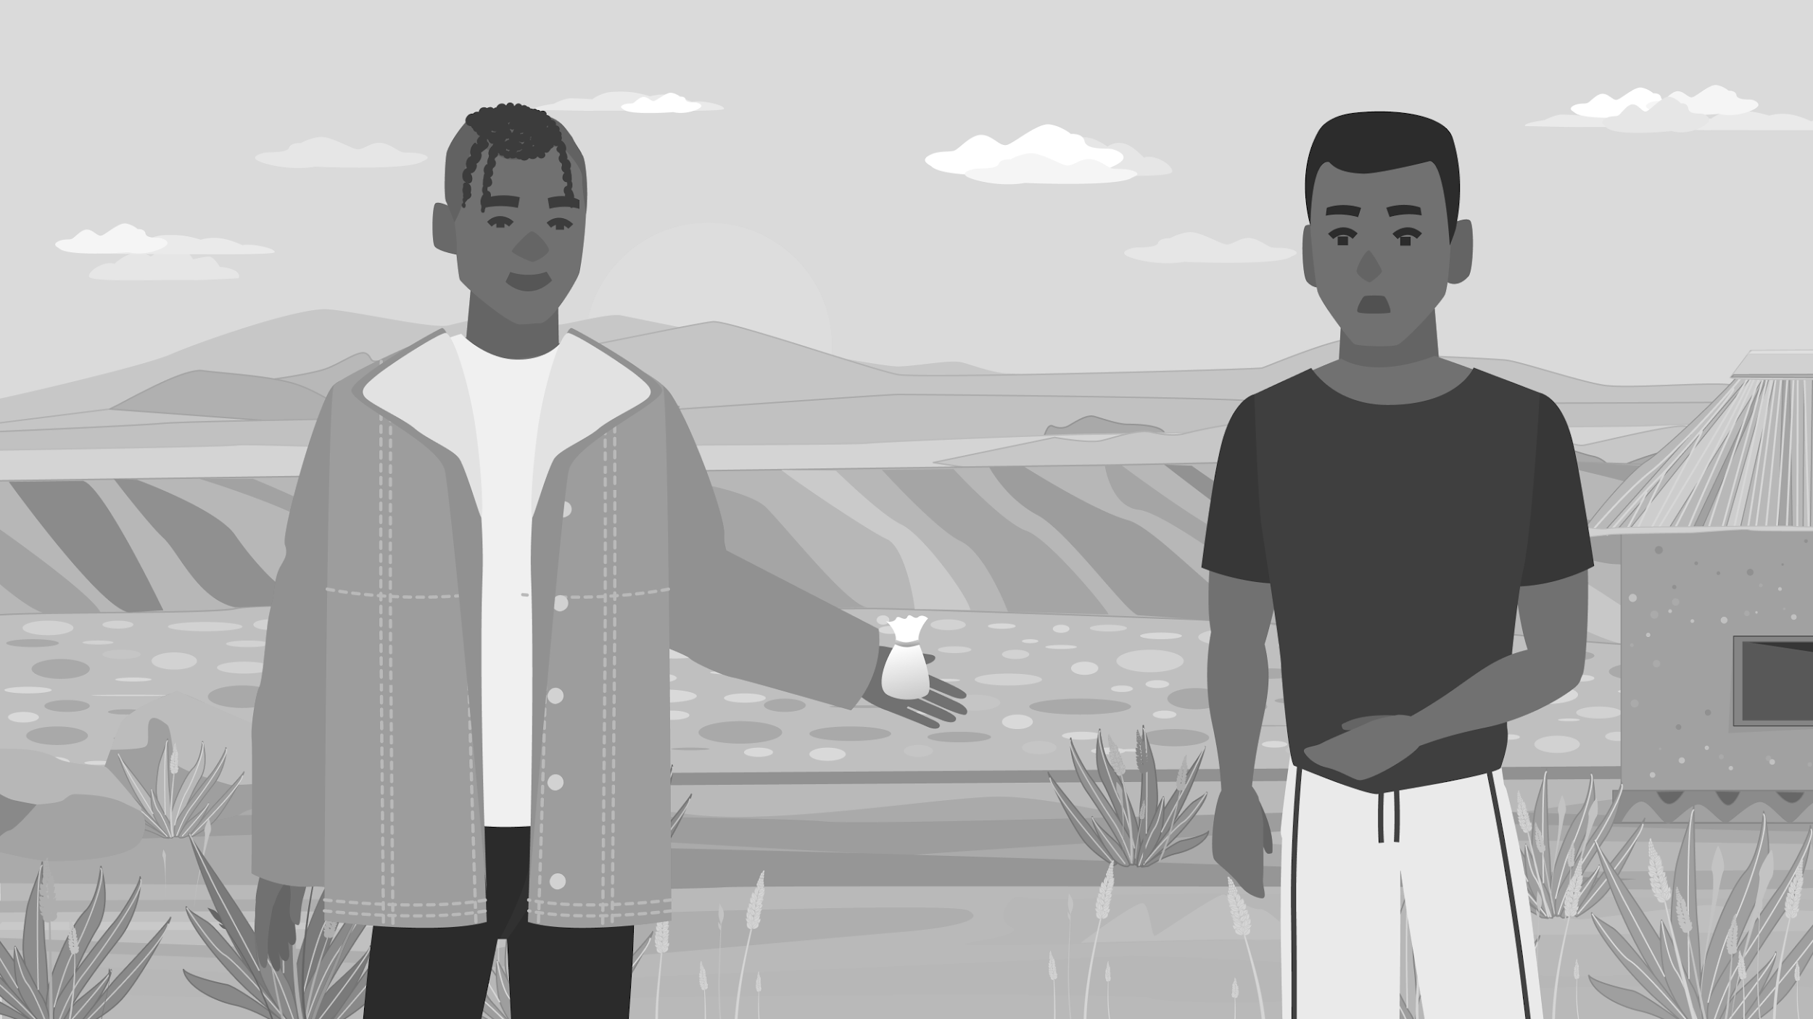
Peer Pressure
Think of a time when it was hard to say "no" to friends. What made that difficult?
What are some ways you’ve learned, or think could help students stand up to peer pressure?
  How can these be supported or enhanced by school programs?

Slide 27
Peer Pressure
How do you think young people (especially young men) can support each other in making positive decisions when faced with peer pressure?

Slide 28
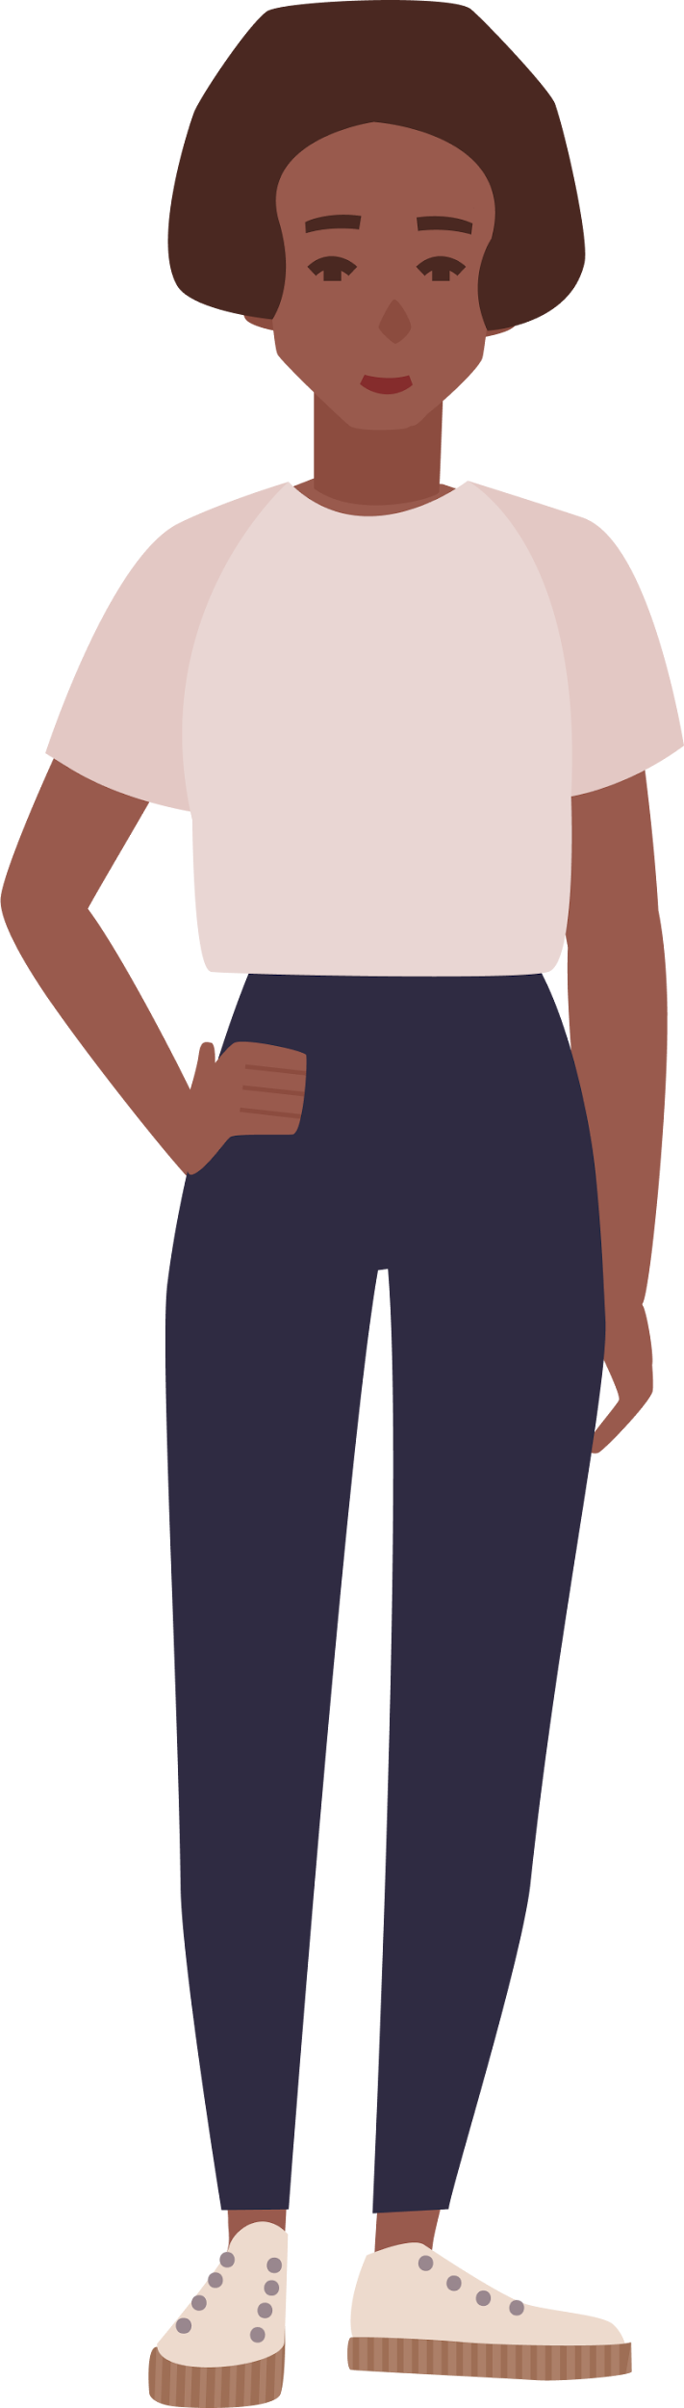
Case 2B
Ama

Slide 29
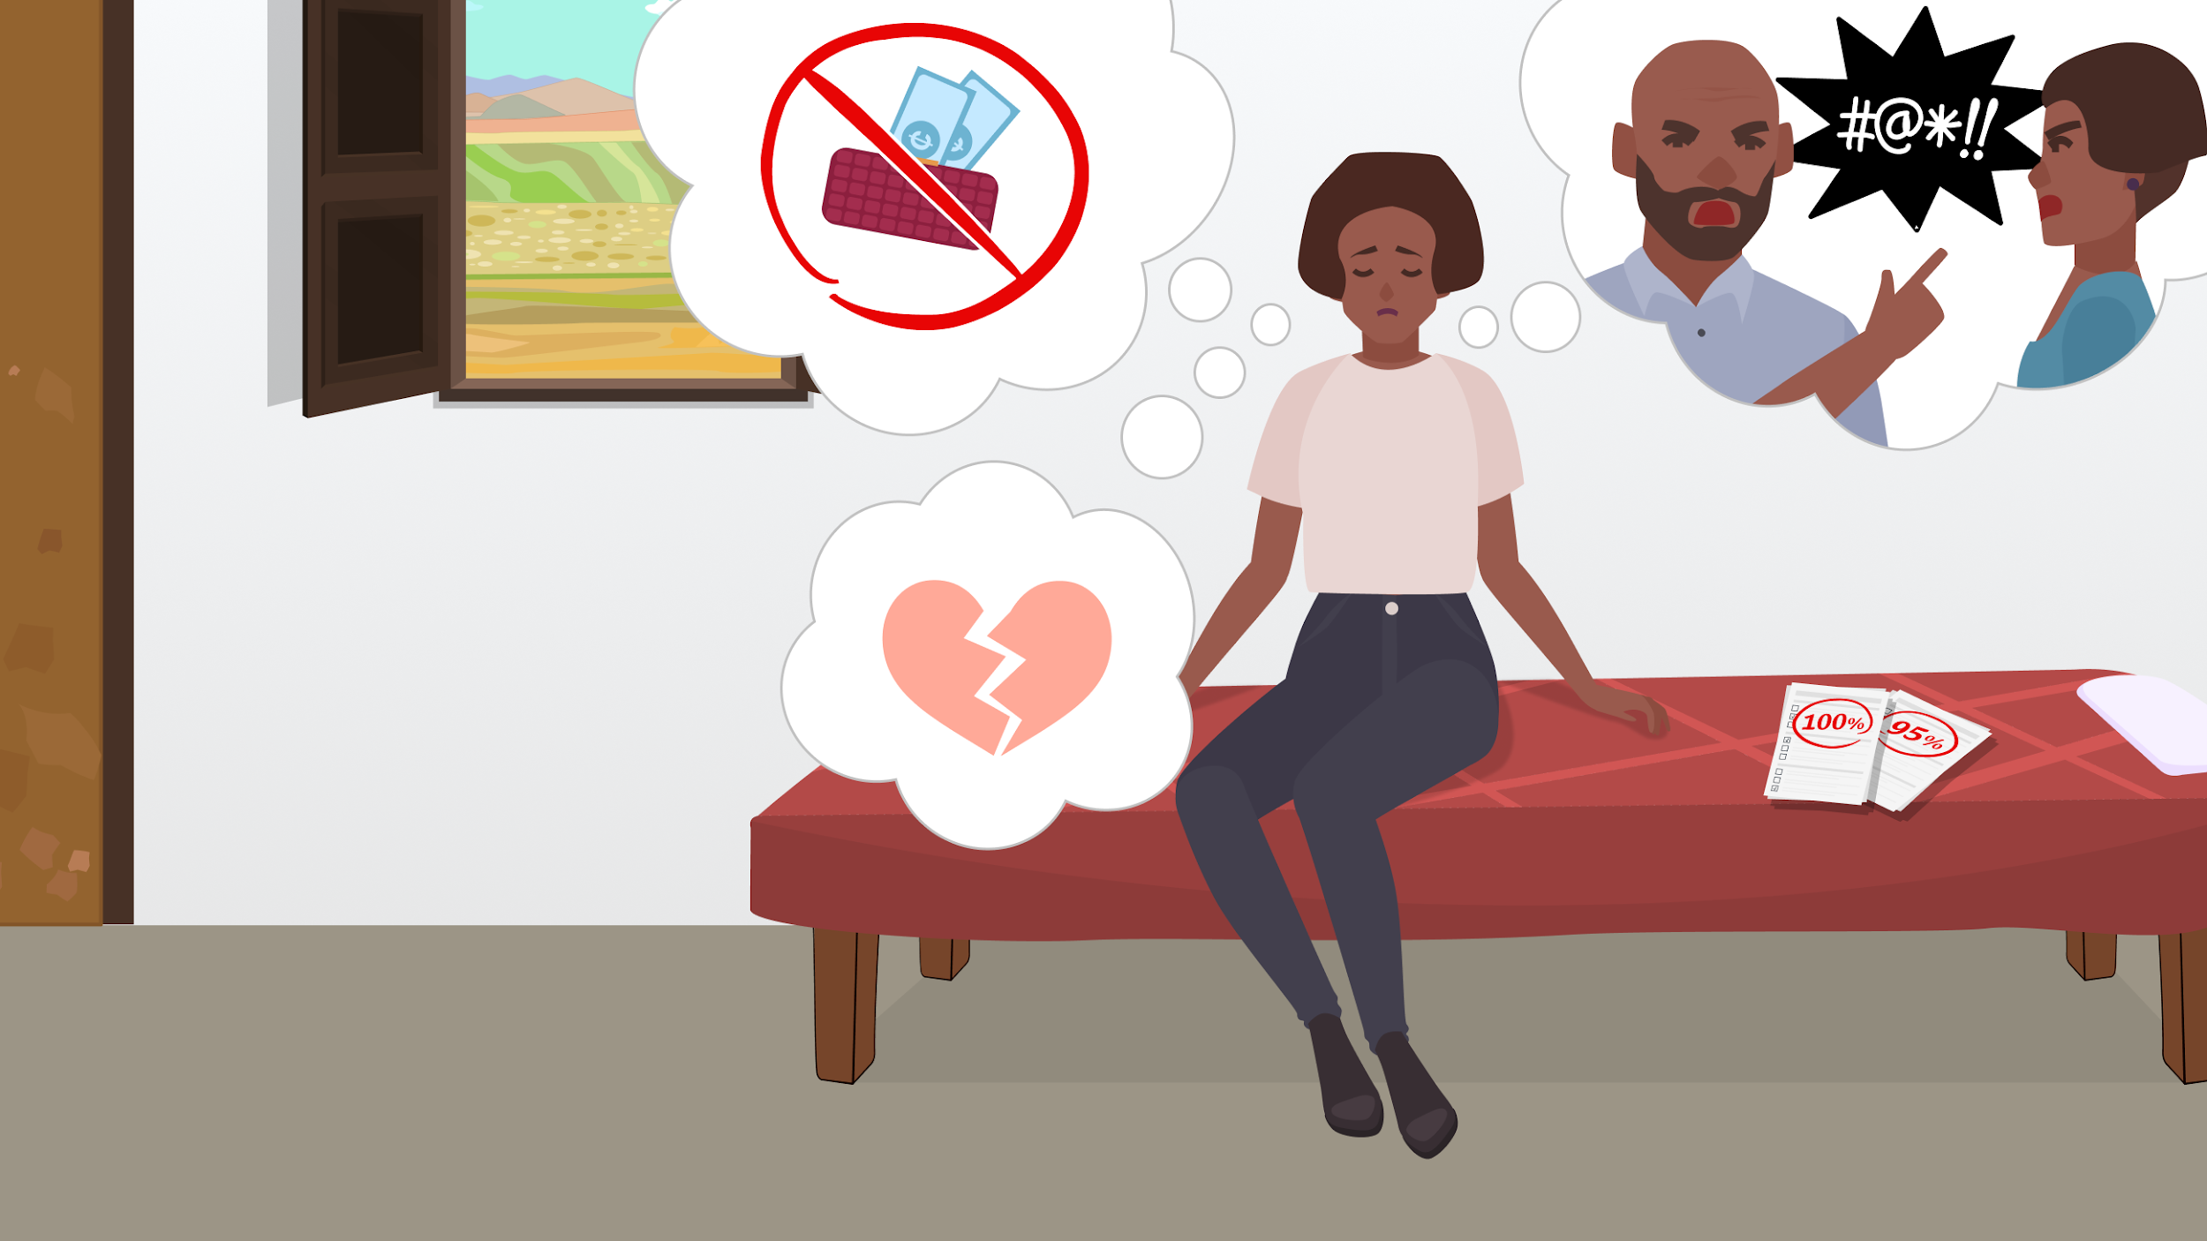
Notes:
Frame 1: Ama looking distressed amid visual cues of her troubled home life and personal issues.
Ama is an SHS student in her final year. On the outside, she appears put together and is excelling in school. But back at home, her parents are fighting all the time, finances are tight, and her boyfriend broke up with her last week. After emotionally and physically grueling week, Ama decides to hang out with some friends Ella and Kwame to destress.

Slide 30
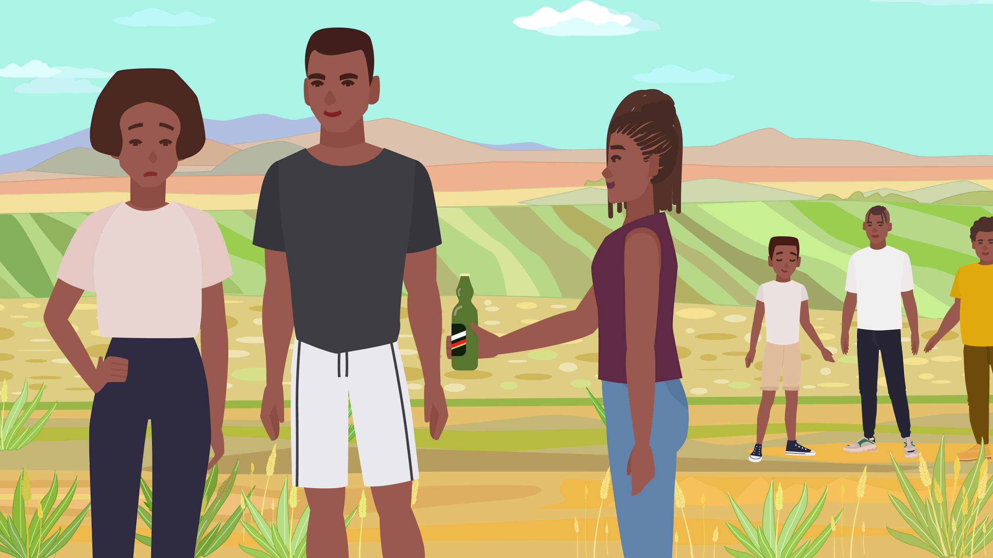
Notes:
Frame 2 (at a hangout, with other students in the background): Ama with Ella and Kwame, being offered an alcoholic drink, highlighting the moment of peer influence.
Kwame – “you don’t look too well Ama. Is everything alright?”
Ama – “Hm, there’s just a lot going on in my life. BUT, I don’t want to talk about it! Tonight is for unwinding!”
Kwame – “cheers to that!”
Ella – “in the spirit of that, let’s get you a drink.” She hands Ama a drink.

Slide 31
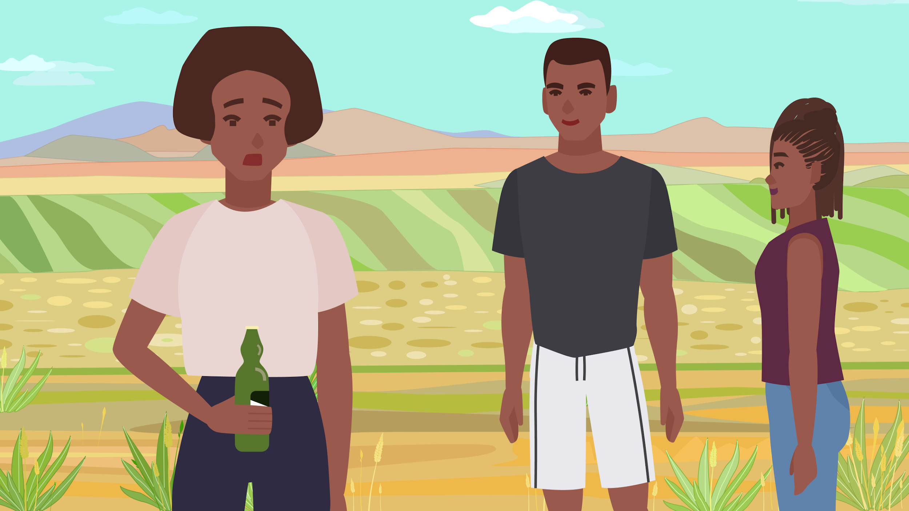
Notes:
Frame 3 (Zoom in on Ama, who sniffs the drink nervously): Ama looks nervous, and states, “mm I don’t know, this smells like alcohol.” Ella, “yes, its time to unwind! Let your problems go!” Kwame: drink! Drink! Drink! Drink!

Slide 32
Knowledge and risks of drugs
What have you heard about students using drugs to increase confidence or cope with stress?
Are there any risks? Any benefits?
Notes:
Shisha

Slide 33
Cultural and Social Factors
What are some reasons why young people in our community might start using drugs?
  Are there things in our culture or society that make it seem okay?
  Are there things in our culture or society that make it hard to talk about openly? Any factors specific to girls or young women?

Slide 34
Drug use and mental health
Do you think there’s a connection between using things like alcohol and drugs, to mental health problems? Why or why not?

Slide 35
What should Ama do next?
Should she drink with her friends and just forget her problems?
Is there another option?
It’s just one drink, what’s the harm?
Thanks, but no thanks.

Slide 36
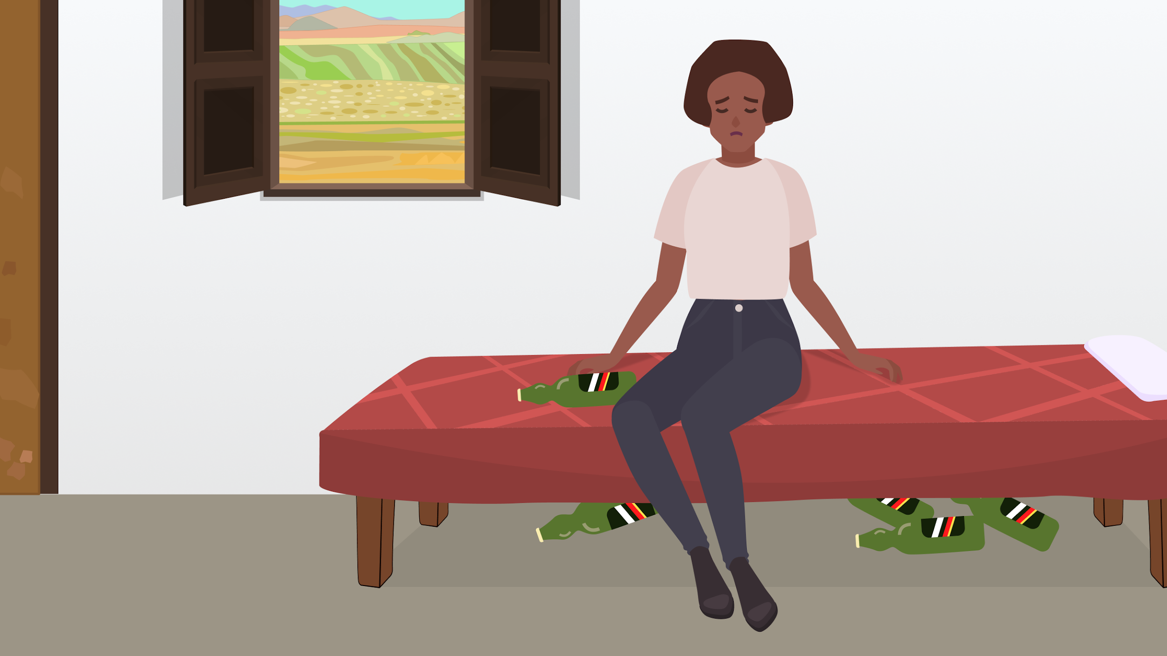
Six months later…
Notes:
Ama just takes one drink that night, but later, she finds that she turns more and more often to alcohol to help her forget her problems. About 6 months later, she is still feeling isolated from her friends, and feels more and more reliant on alcohol to help her deal with her stress at school and home.

Slide 37
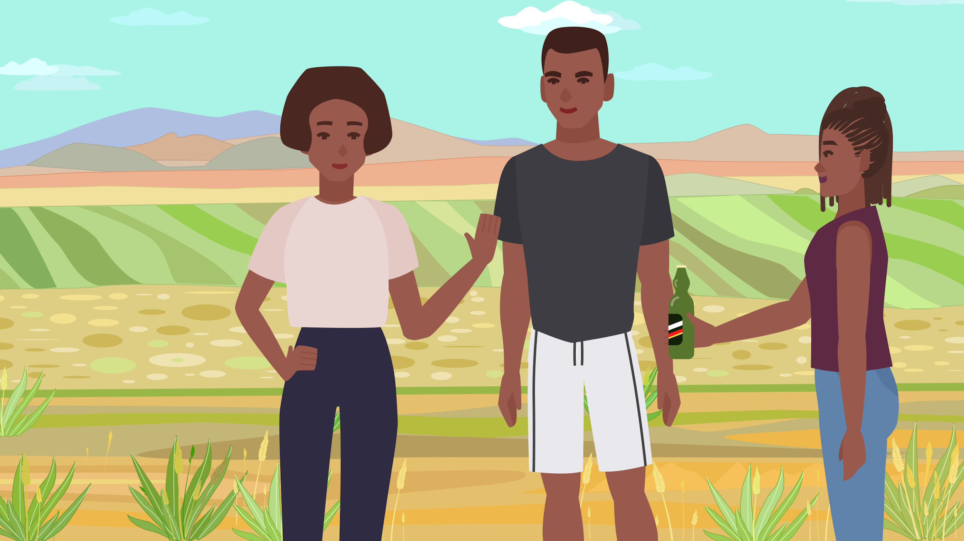
“Thanks, but I’m okay. Just talking with you guys is helping me to feel better.”

Slide 38
Resources
In your school, how do students learn about the risks and consequences of substance use?
  Are these programs useful?
  What could make them more effective?

Slide 39
Resources
In your school, what is the attitude towards students who struggle with substance use?
  Is there stigma, or is it supportive?
  How can schools make it easier for students who use drugs or alcohol to ask for help?

Slide 40
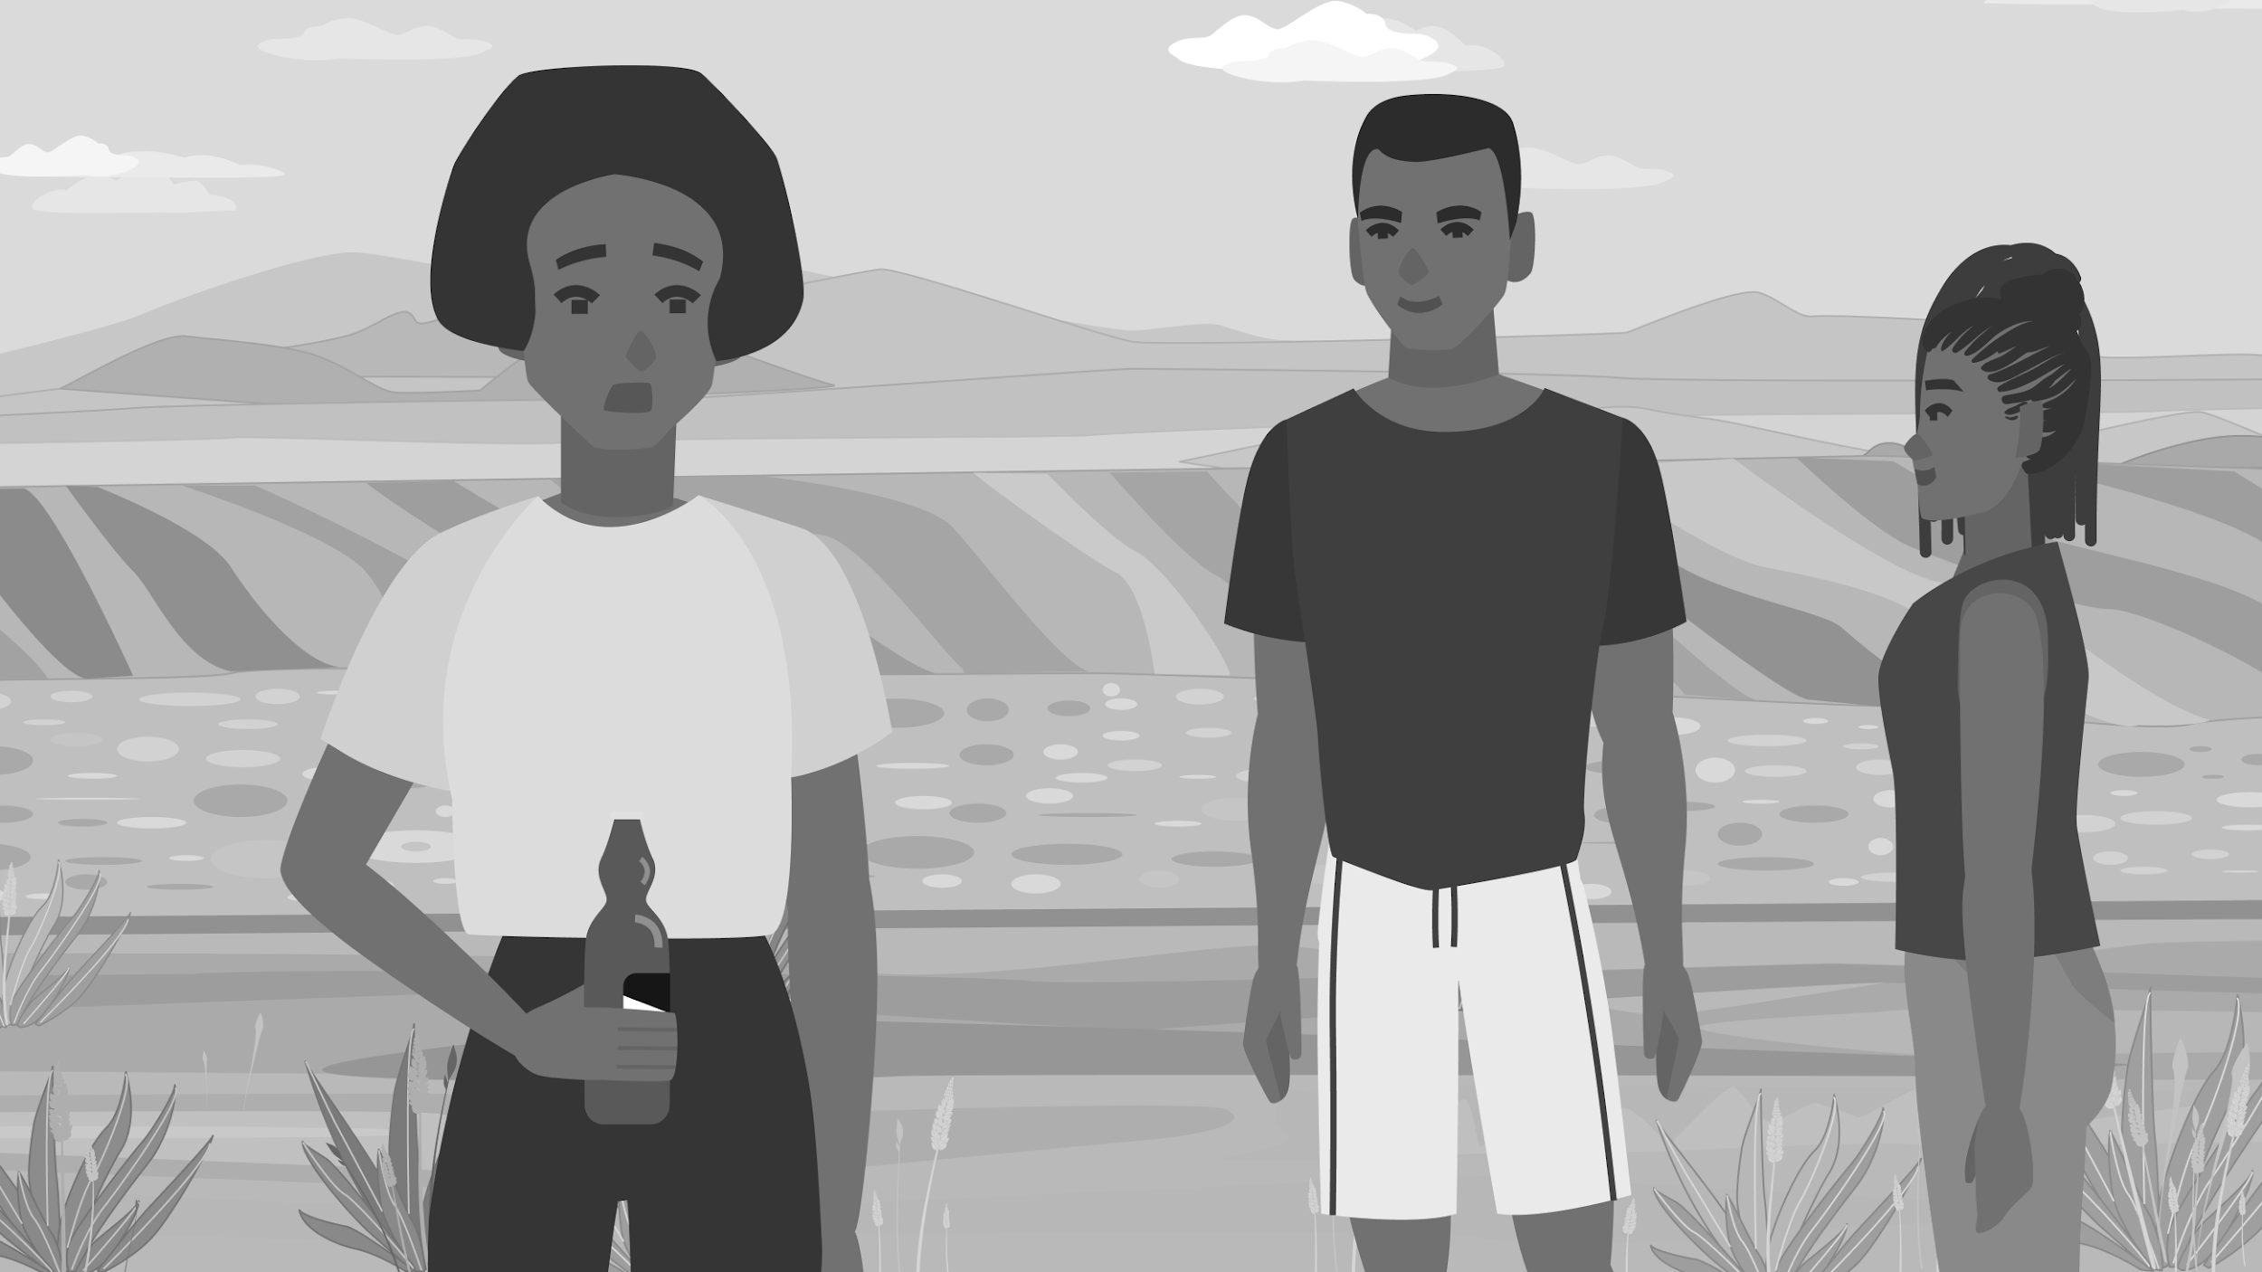
Peer Pressure
Think of a time when it was hard to say "no" to friends? What made that difficult?
What are some ways you’ve learned, or think could help students stand up to peer pressure?
  How can these be supported or enhanced by school programs?

Slide 41
Peer Pressure
How do you think young people (especially young women) can support each other in making positive decisions when faced with peer pressure?

Slide 43
Snack break until 12:50

Slide 44
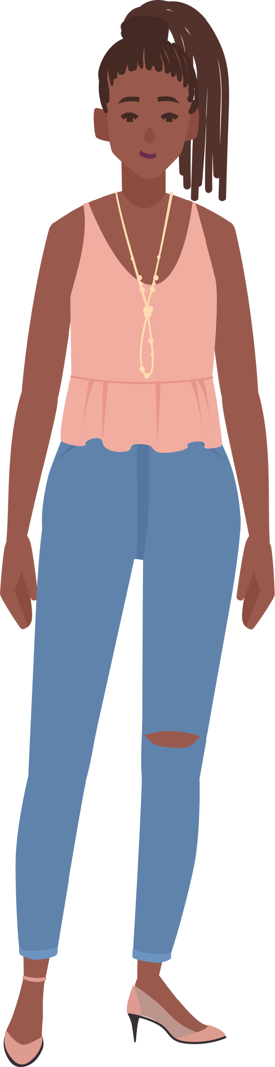
Case 3
Samira

Slide 45
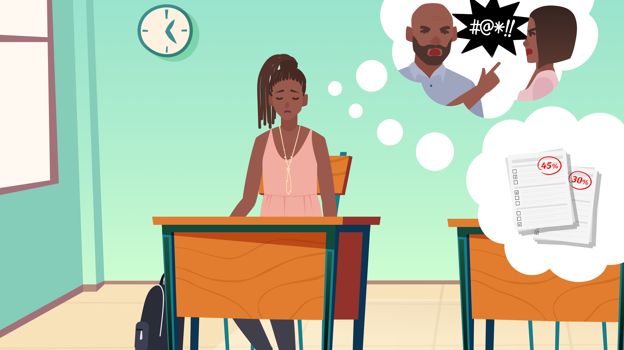
Notes:
Samira, a first year SHS student. She is part of the team for the National Science and Maths Quiz. She feels overwhelmed with her many studies and responsibilities. Over the last several months, her grades have started to fall.

Slide 46
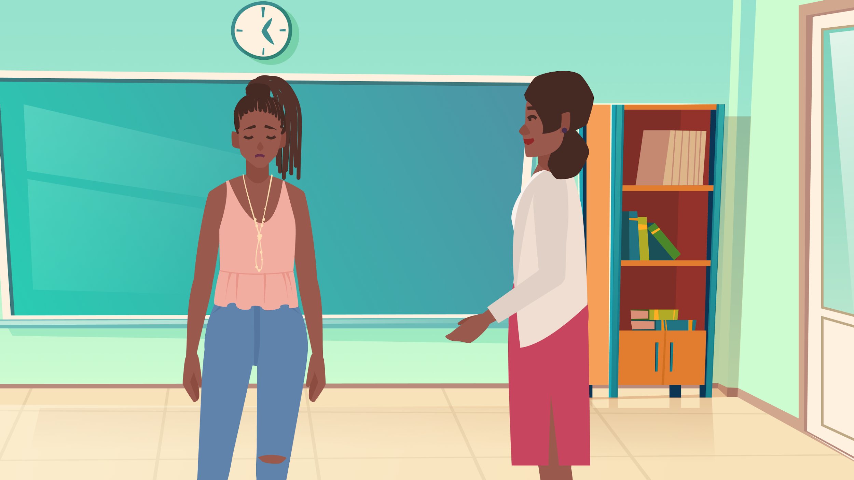
Notes:
Mrs. Abugri, her English teacher, calls her to her office. “Samira, what’s going on in your grades? You used to be a better student.”

Slide 47
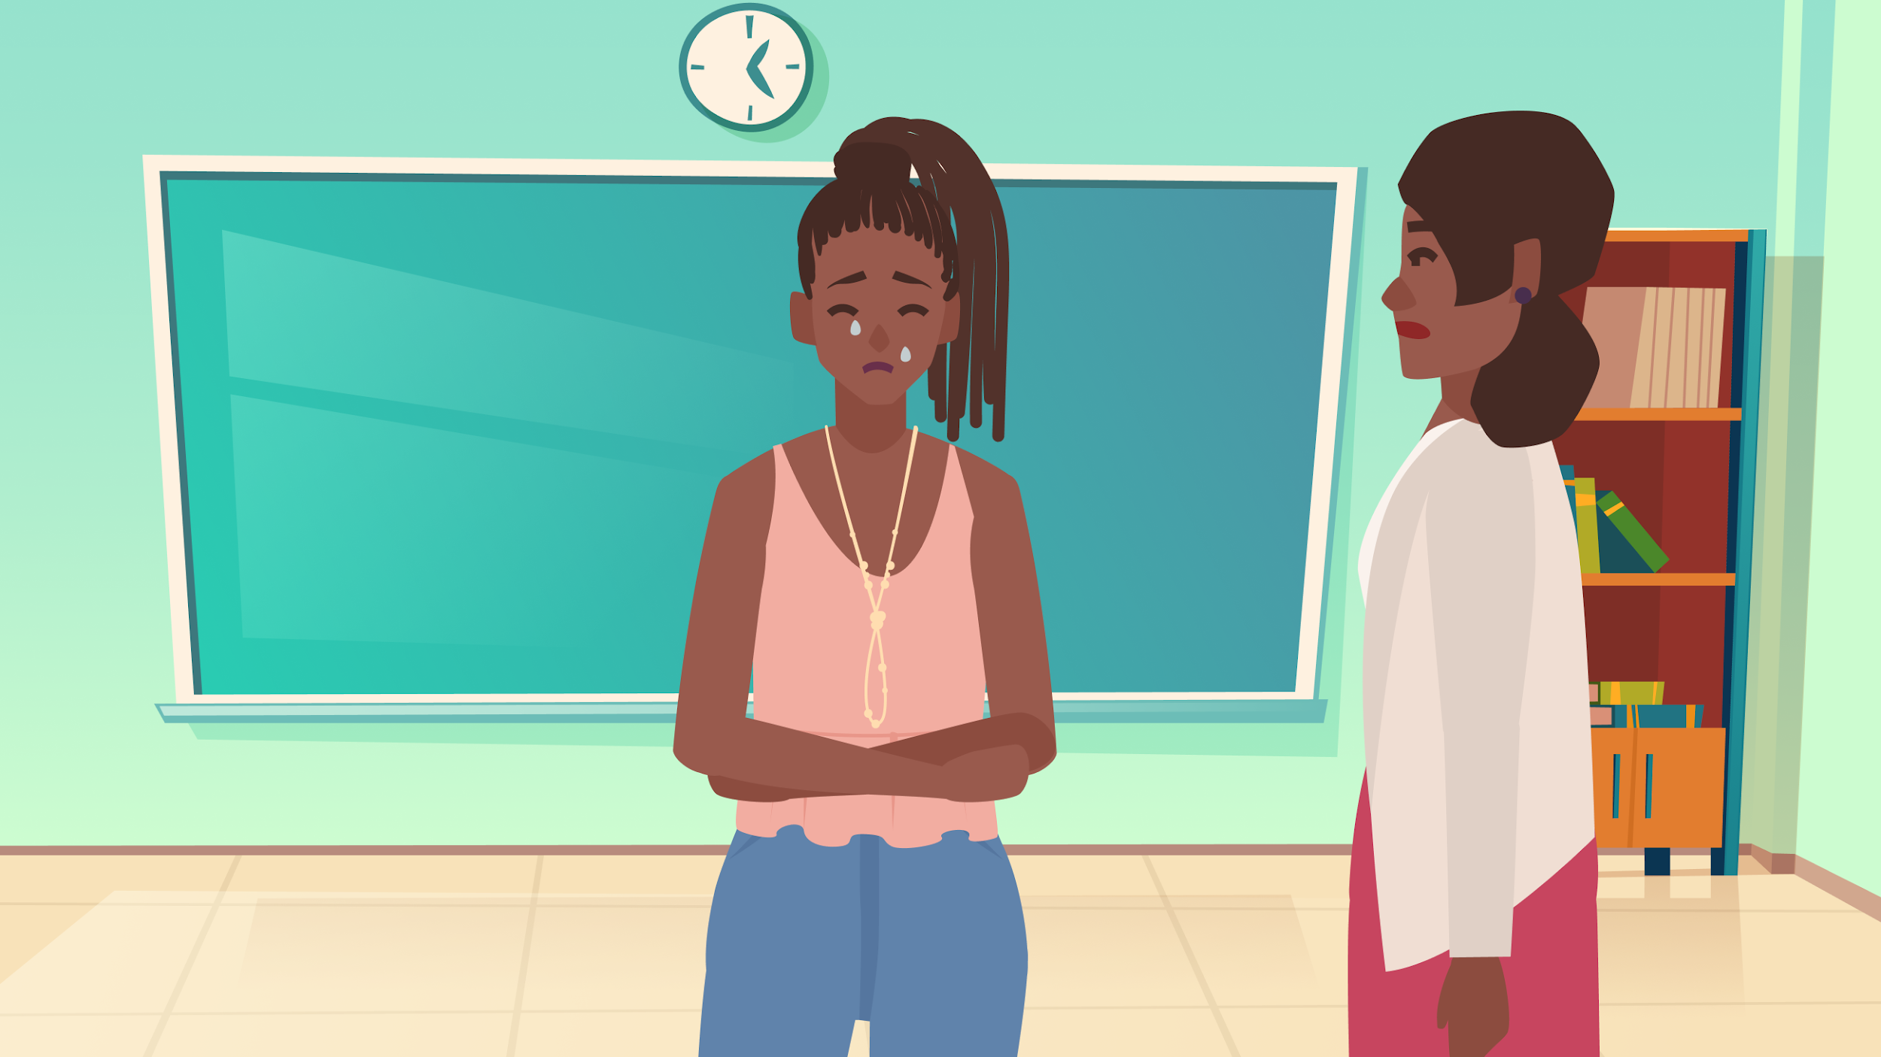
“Mrs. Abugri, I am sad all the time and I don’t understand why.
I don’t like dancing or hanging out with my friends anymore. I can’t pay attention in class or study well.
I just want to sleep all the time.
Sometimes, I feel like I just don’t want to live anymore.”
Notes:
Samira starts opening up to Mrs. Abugri. She’s vulnerable and crying. “Mrs. Abugri, I am sad all the time and I don’t understand why. Things I used to enjoy like dancing or hanging out with my friends I don’t enjoy anymore. I can’t pay attention in class or study well. I just want to sleep all the time. Sometimes, I feel like I just don’t want to live anymore.”

Slide 48
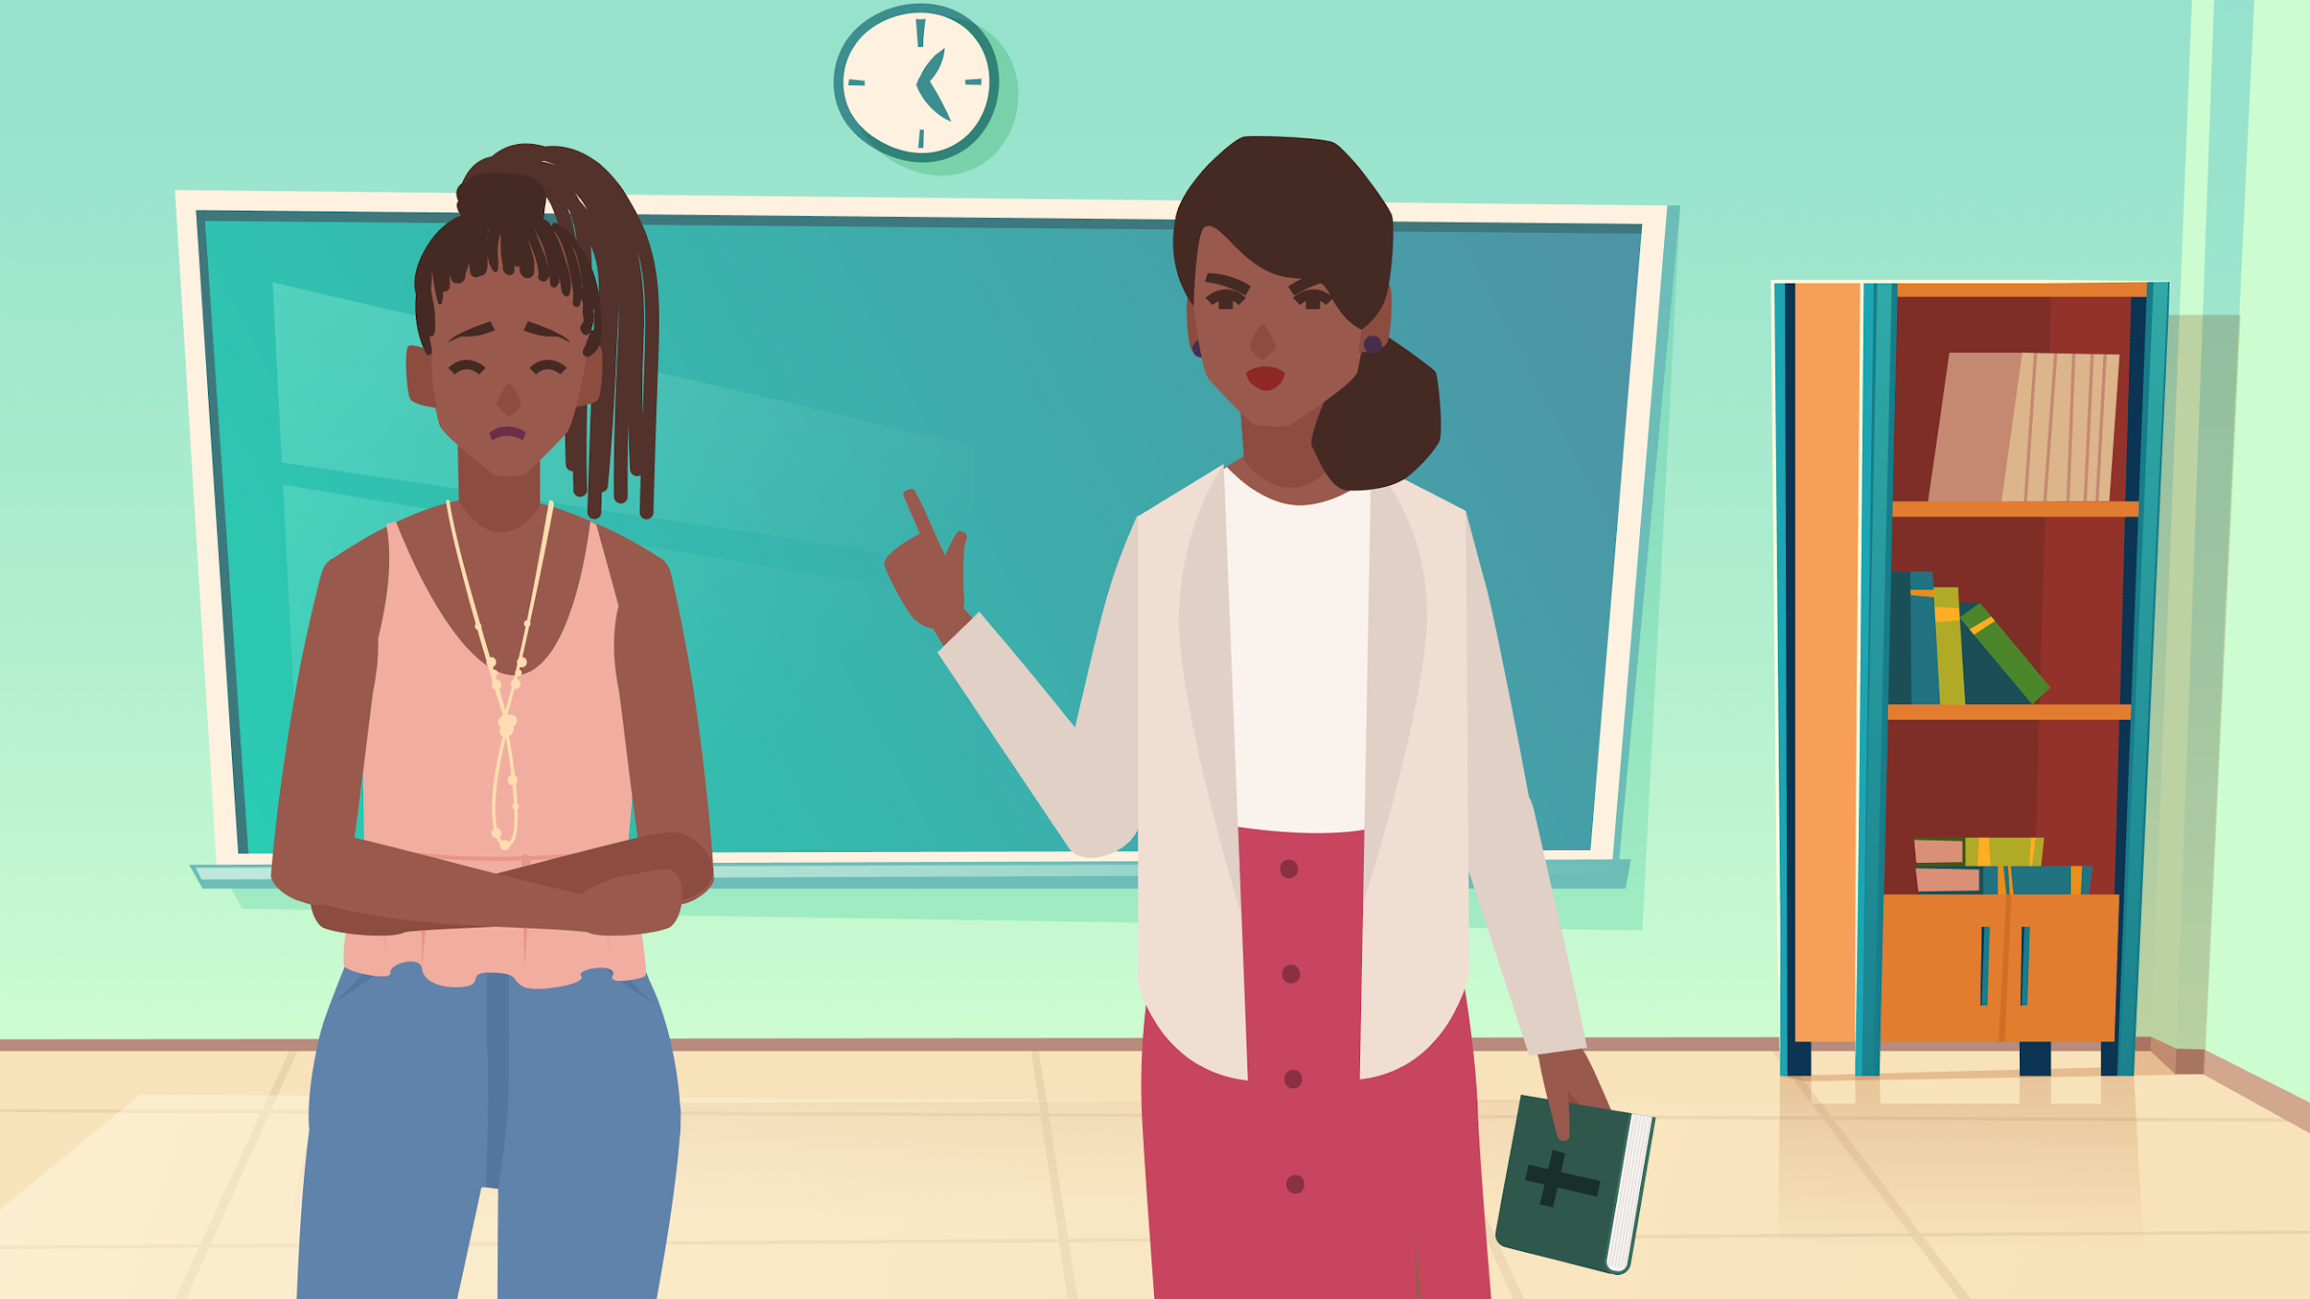
“Stop making excuses!
You just need to study harder so you don’t fail.
Go ask the school chaplain to pray for you and all your problems will go away!”
Notes:
“Sad all the time? It looks like your house people are sitting on your happiness. Stop making excuses - you just need to study harder so you don’t fail. Just ask the school Imam [or chaplain] to pray for you and you will be cured!”

Slide 49
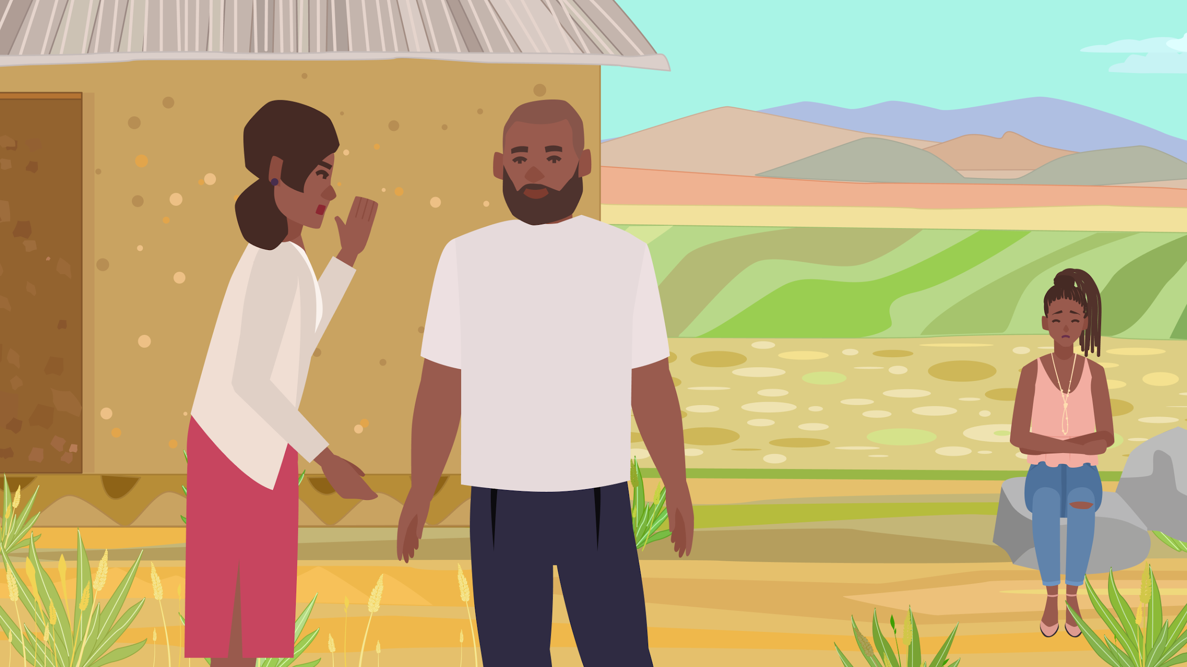
Notes:
Samira goes off by herself, still feeling sad and lonely. Later, during break down, she hears Mrs. gossiping about her problems with one of the other teachers.

Slide 50
Stress, anxiety, and mental health
Think about a time when you felt pressured by school or other responsibilities. How did it affect you?
Notes:
Question 1: prompt – your mental wellness/mental health? Your schoolwork or other activities?

Slide 51
Stress, anxiety, and mental health
At your school, do you think students and teachers are aware of any connection between stress and mental wellbeing?
  What are some things schools should do to help students who are feeling stressed/overwhelmed?
Notes:
Question 1: prompt – your mental wellness/mental health? Your schoolwork or other activities?

Slide 52
Teacher awareness
Think of a time when you felt a teacher didn’t understand someone’s feelings or problems. Is there anything that could’ve helped the teacher respond better?
What do you think schools should do to help teachers respond better to student’s mental health problems?

Slide 53
Confidentiality
Why do you think it’s important for conversations with teachers/counselors about personal or emotional issues to be kept confidential?
  Do you think there should be any exceptions to this?
  What steps can schools take to ensure confidentiality is respected?

Slide 54
Seeking help
Unfortunately, Samira didn’t get a good response from her teacher in this case. What are other ways you might advise her to get help?
Notes:
If resources – how did you learn about these resources?

Slide 55
Resource availability
Are you aware of any resources in your schools or communities for students like Samira to get help?
  Are these resources well-known and accessible to all students?
  Are there any challenges in accessing these resources?

Slide 56
Resources
In your opinion, do you think your schools prioritize mental health or mental wellness for students? Can you provide some examples of why or why not?

Slide 57
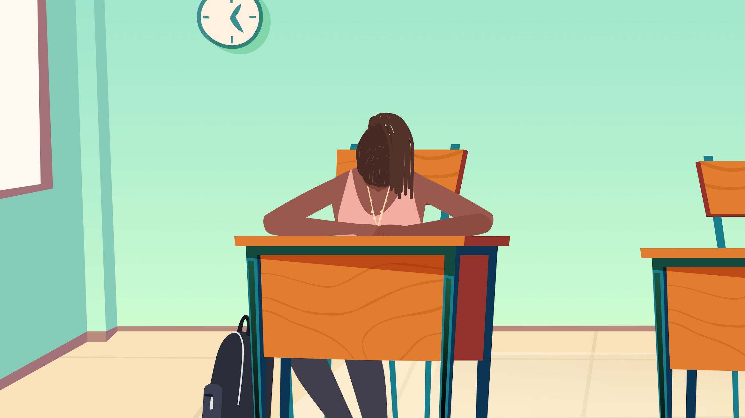
Notes:
Show Samira again, looking miserable, isolated and overwhelmed. She continues to find it difficult to concentrate it class.

Slide 58
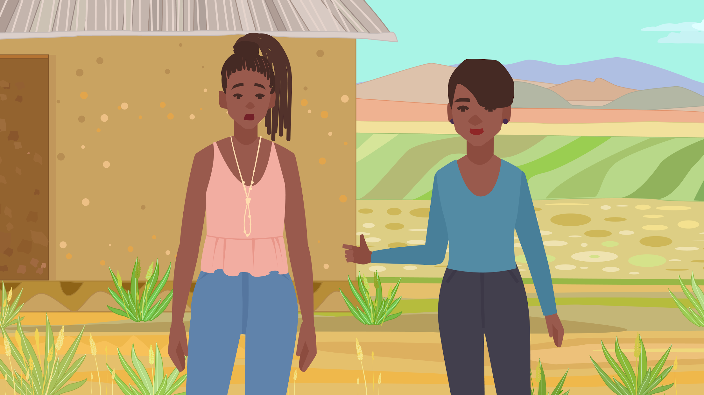
Notes:
She is approached by her friend, Fadila, who is a Peer Counselor. “Samira, you don’t seem like you’re doing well. What’s going on?” At first, Samira at first is guarded and hesitant. But Fadila is a good friend, and is kind and inviting.

Slide 59
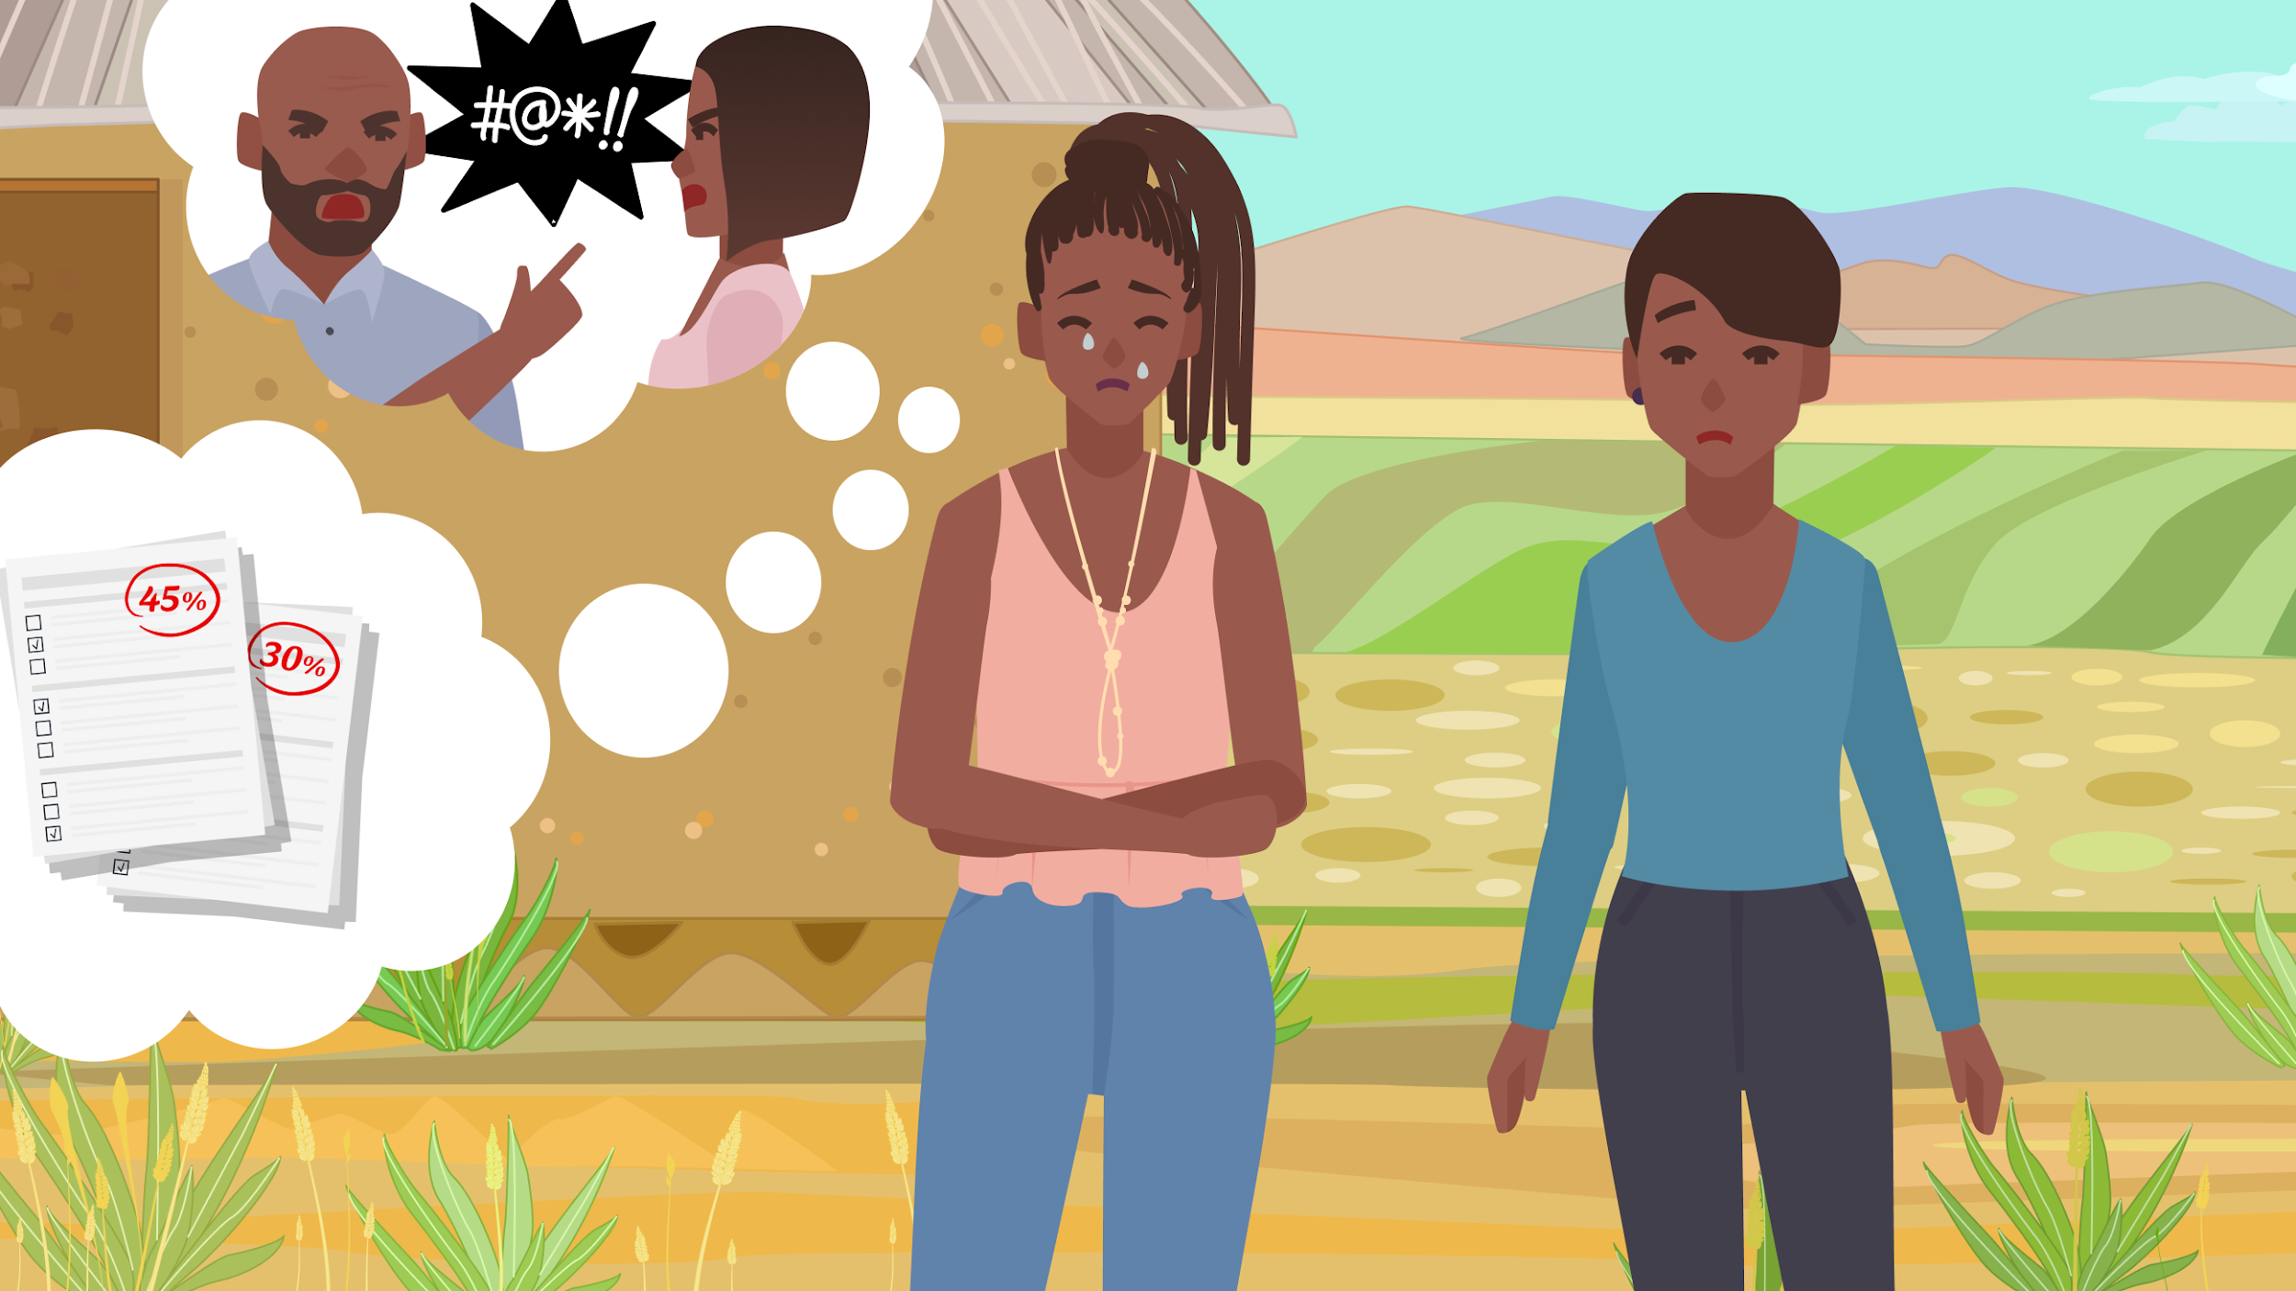
Notes:
Samira opening up to Fadila, depicted by a speech bubble filled with her worries, showing the moment of vulnerability. Fadila shares some advice and coping strategies, with visual elements like a calendar for planning, a book for relaxation, and friends for support. “…. I also think you should see Ms. Cathy, the guidance counsellor. She is a professional and will help you with better strategies cope, especially with the stress and feeling overloaded.”

Slide 60
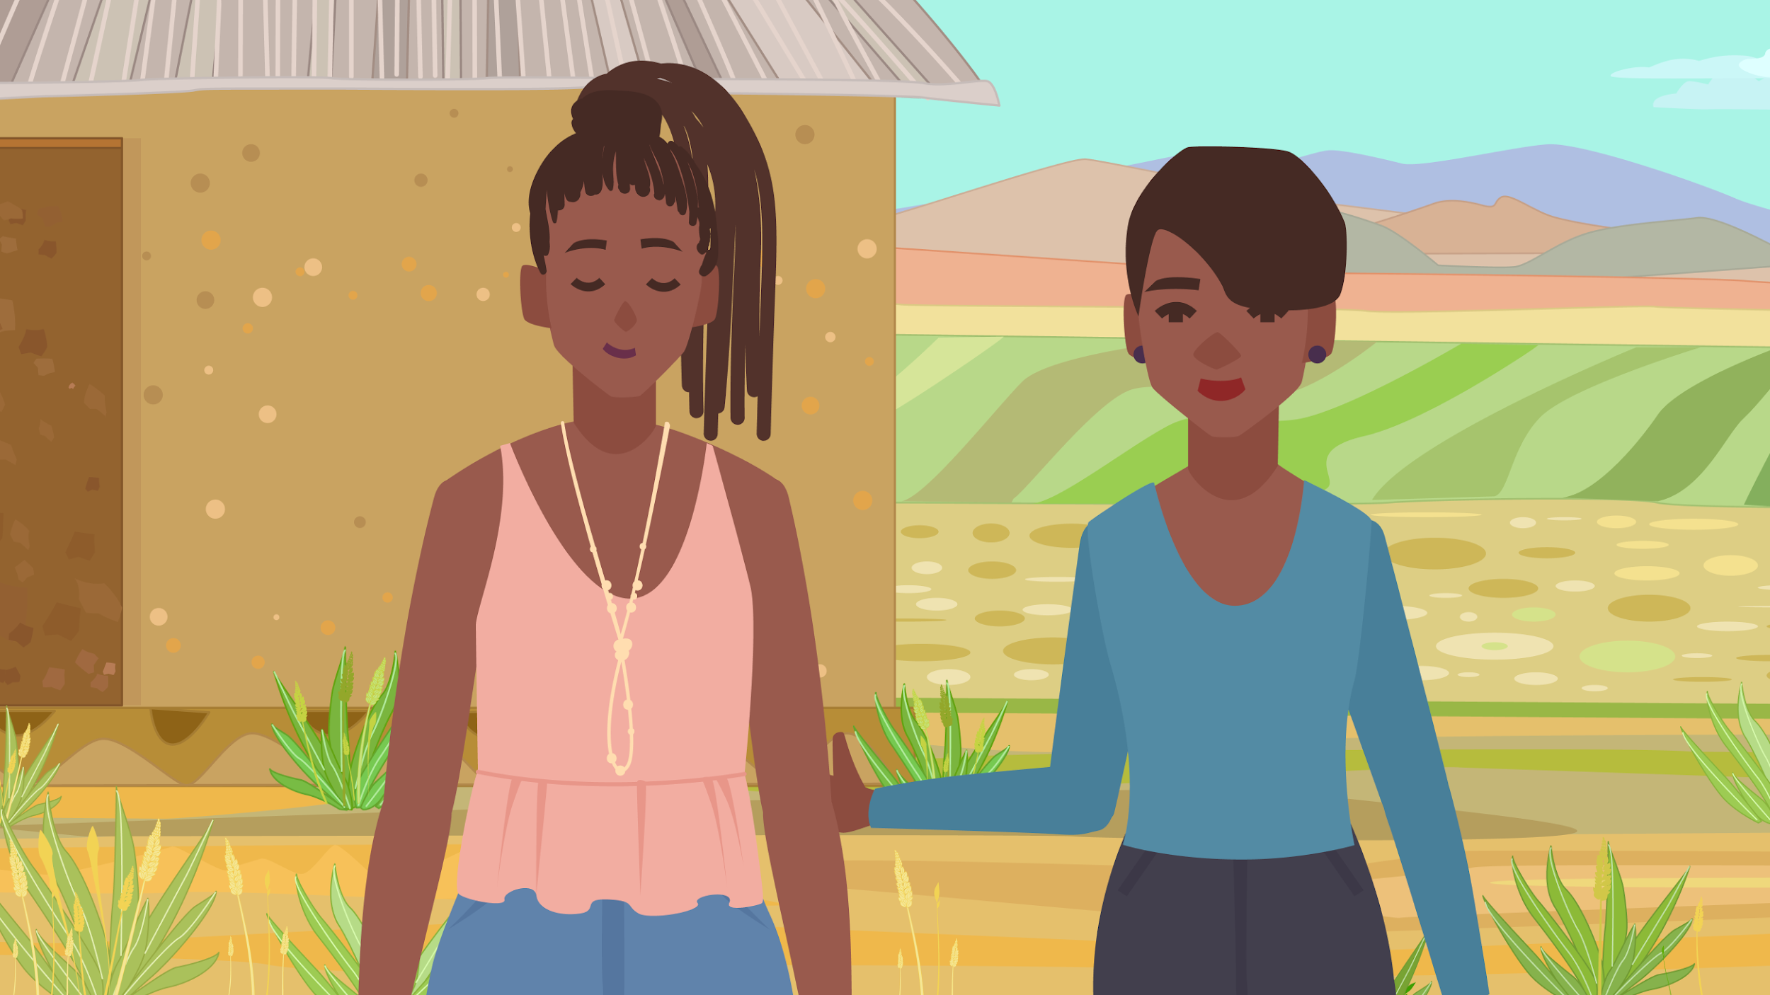
Notes:
Samira feeling relieved and hopeful, with visual cues like a lightened load of books and a visible smile, representing her newfound coping strategies and support system.

Slide 61
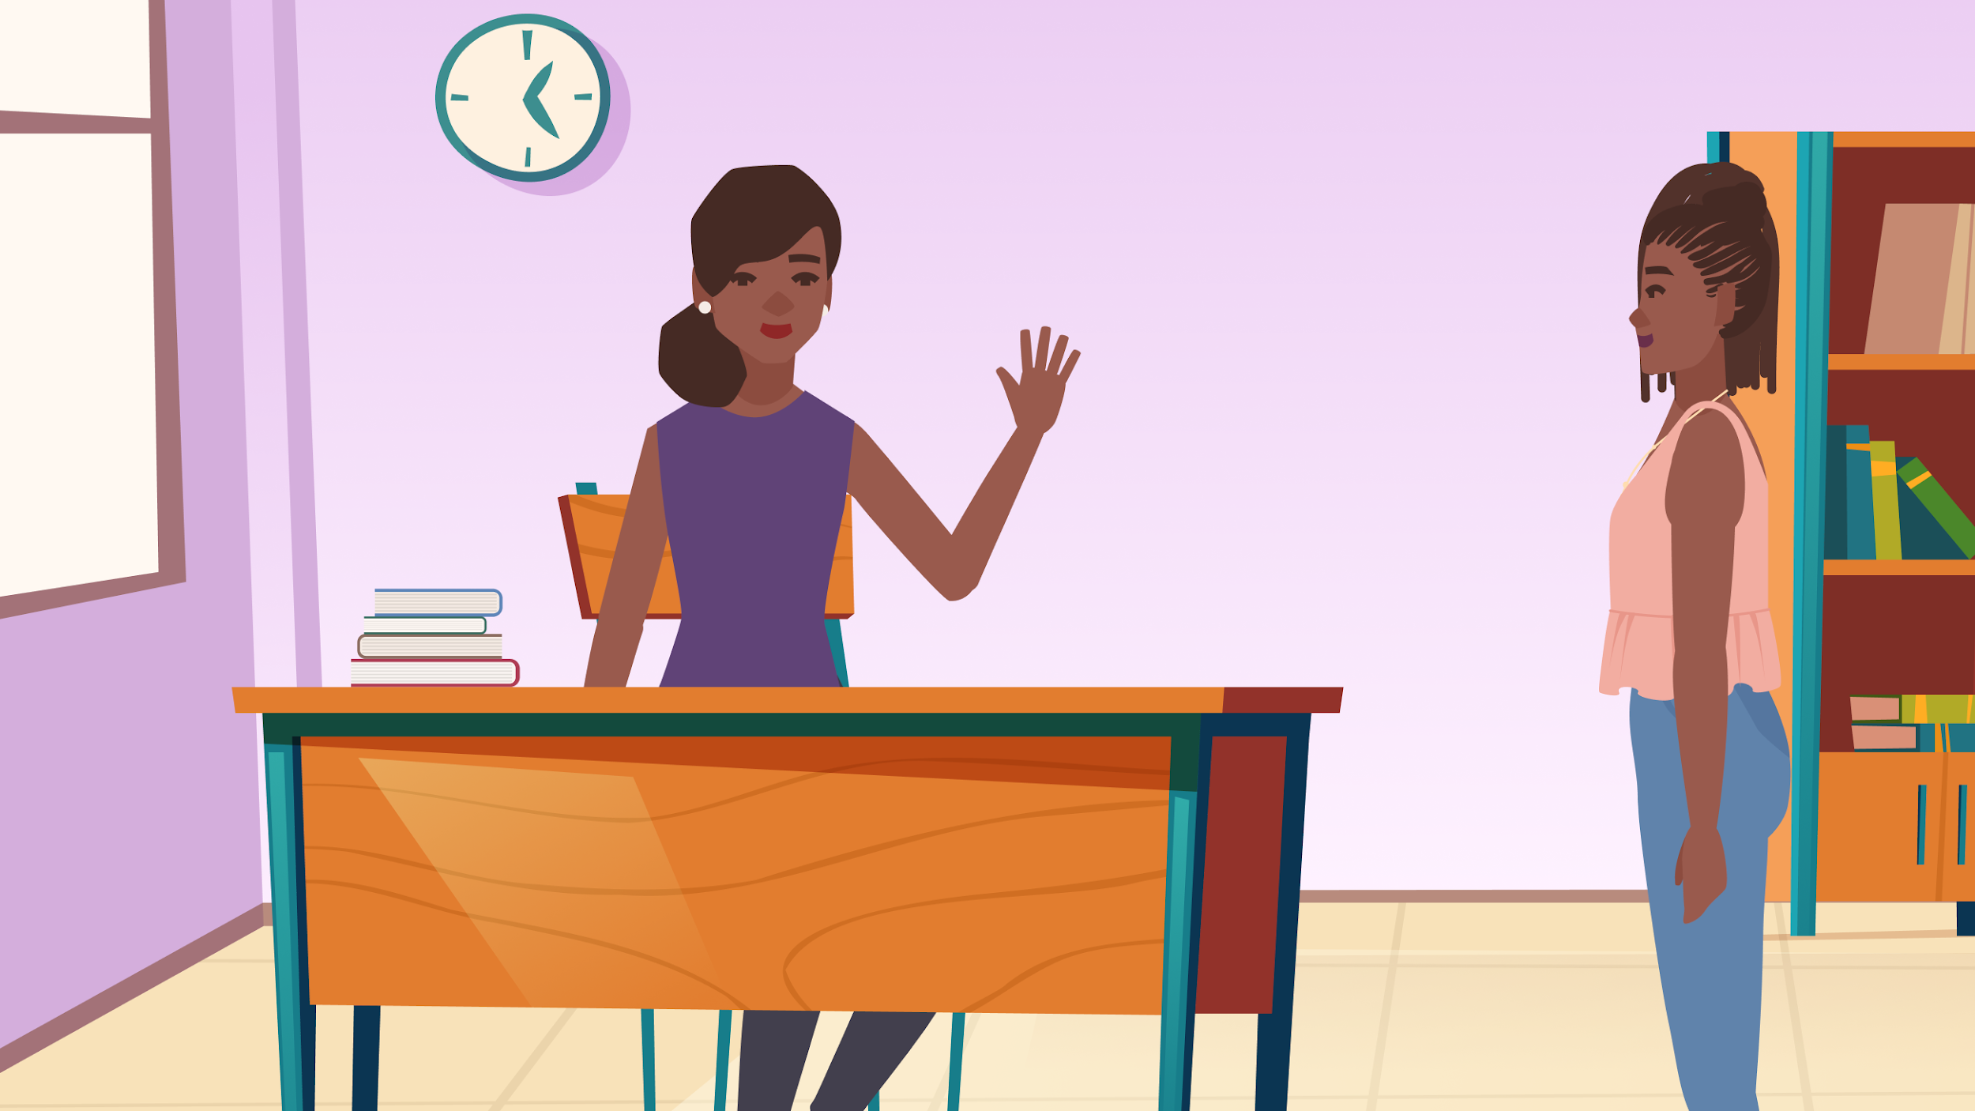
Notes:
Samira approaching the Guidance and Counseling Unit office to meet with Ms. Cathy.

Slide 62
Asking for help
Samira was hesitant at first when Fadila approached her. Why do you think someone might be shy to talk about their struggles?
  Are there any specific reasons why Samira might be hesitant to talk to a guidance counselor?
  How can schools/counselors address these concerns to be more approachable?

Slide 63
Asking for help
What attributes make a peer, teacher, or counselor trustworthy when seeking help? Is there anything someone might say or do that makes them more trustworthy?
Notes:
[who would you choose to trust and why?]

Slide 64
Coping and Resiliency
Think of a time when you had to be strong or bounce back from a difficult situation. What personal strengths or resources helped you through it?
  Have you had any classes or other programs that taught you tools to navigate difficult situations?
Notes:
If yes, what kind of workshop? What was good about it and why?
If no, is that something you think would be helpful to you?

Slide 65
Coping and Resiliency
What are some ways that schools and communities can support young people when they go through hard times?
Notes:
Consider differentiating schools and communities
Specifically when they’re struggling with mental health or mental wellness?

Slide 66
Peer counselors
How do peer counselors like Fadila influence the well-being of their friends or classmates?
  What are some unique qualities of peer counselors that might be different from guidance counselors or teachers?
  Do these qualities make them more or less trustworthy?

Slide 67
Peer counselors
What might be some difficulties a peer counselor might encounter at a school like yours?
If your school already has a peer counselor program, what can be done to make them more effective?

Slide 68
Final thoughts and ideas
Do you have any other ideas of trainings or programs that you think should be implemented at your schools or community to support students’ mental wellness?

