Slide 1
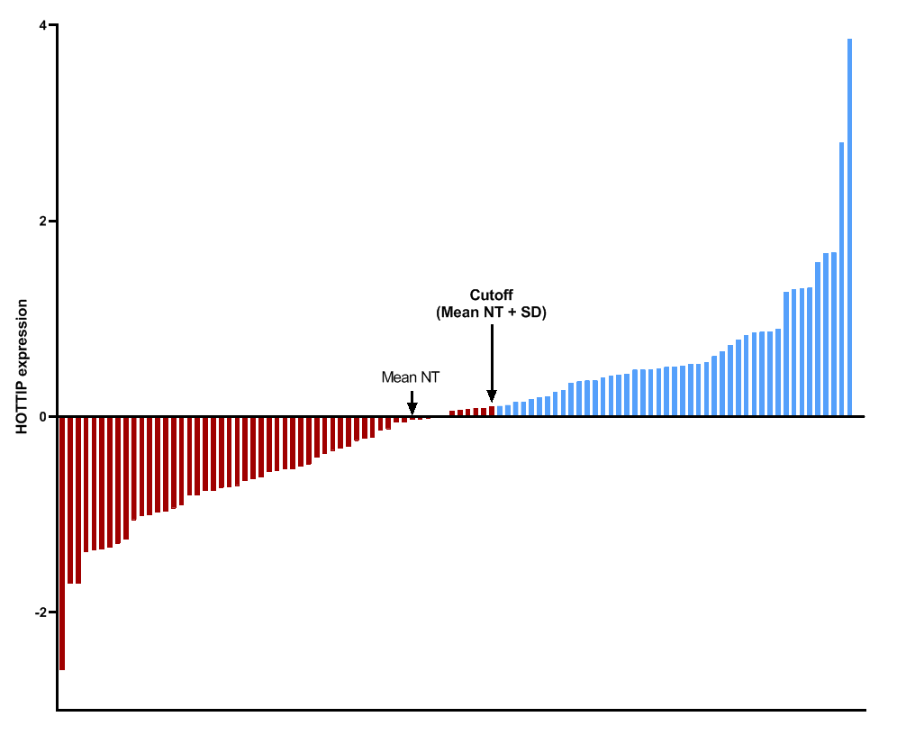
Supplementary Figure 1
Low HOTTIP levels
High HOTTIP levels

