Slide 1
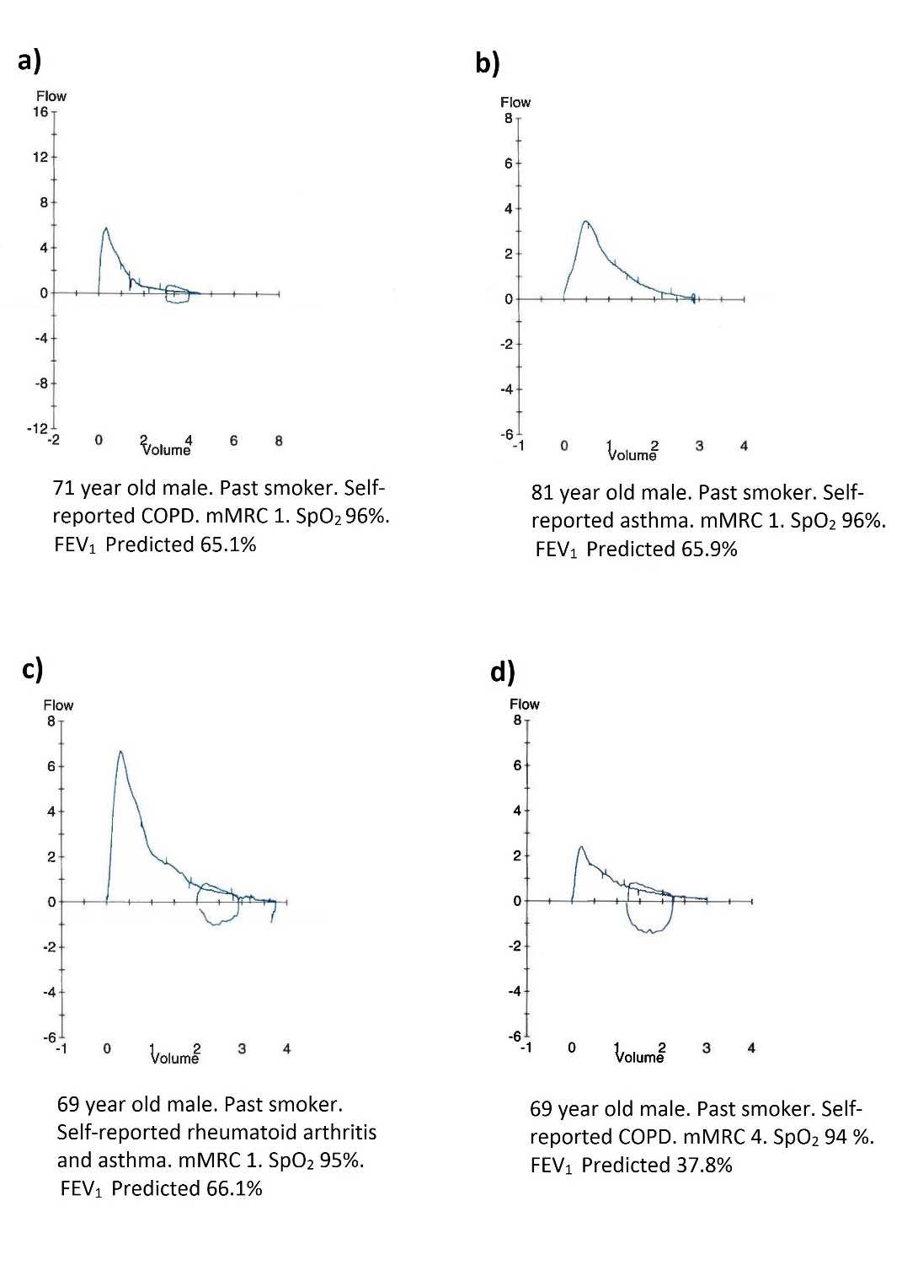

Online Figure 2.- Spirogram and clinical information of four participants with presence of adventitious lung sounds in the recordings.

