Slide 1
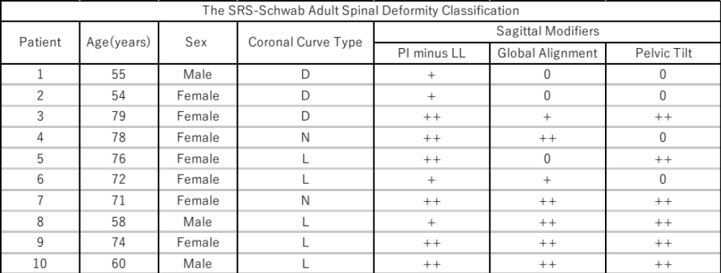
Patients Demographics

Slide 2
