Slide 1
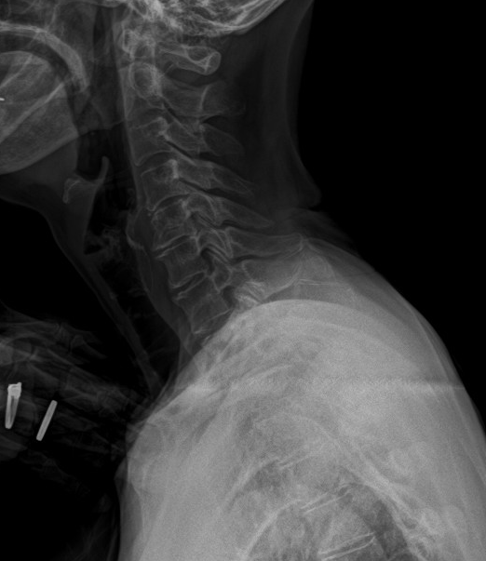
X-ray lateral view of cervical thoracic junction.
The T1 upper endplate is recognizable, but the T1 lower endplate and T2 upper endplate are difficult to distinguish.
C7
T1

