Slide 1


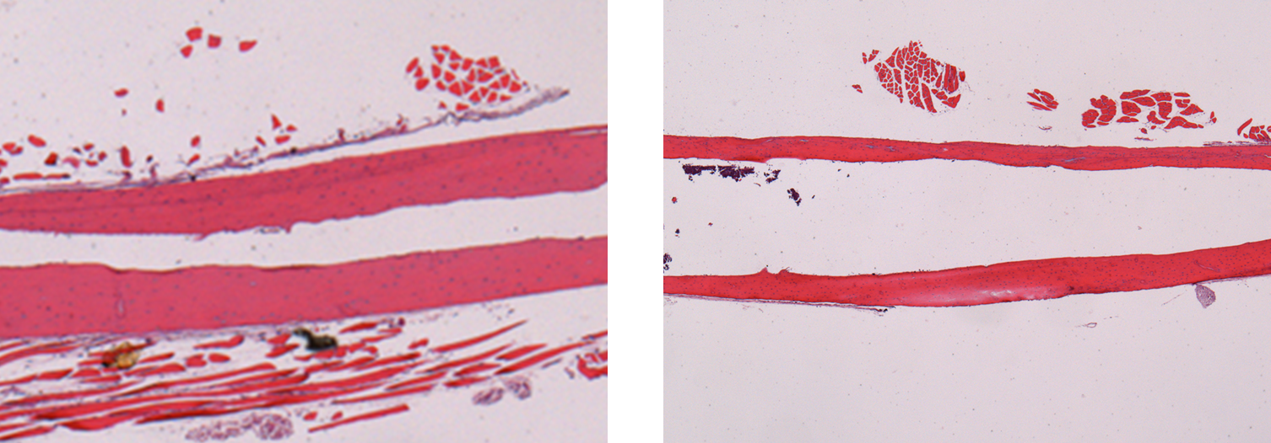
Supplemental Data. c
LT-HG (-)
LT-HG (+)
Supplemental Data. c
Femoral bone image. The upper panels show radiological images and the lower panels show hematoxylin-eosin images. The right panels show mice with long-term hyperglycaemia (LT-HG) and the left panels show mice without LT-HG. The femoral cortex is stained pink. The femoral bone of mice with LT-HG are markedly thinned.
Notes:
50μ

