Slide 1
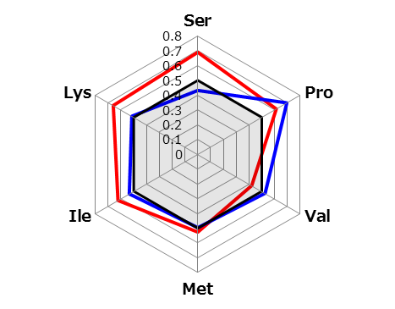
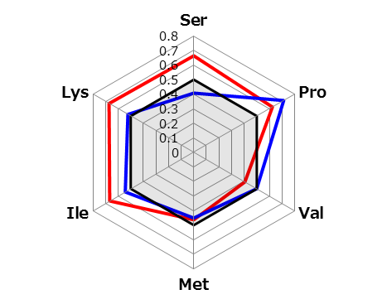
^{Additional Fig.1}
a) Pre-op AICS rank B+C
b) Pre-op AICS rank C
Healthy control
Pre-op
Post-op

