Slide 1
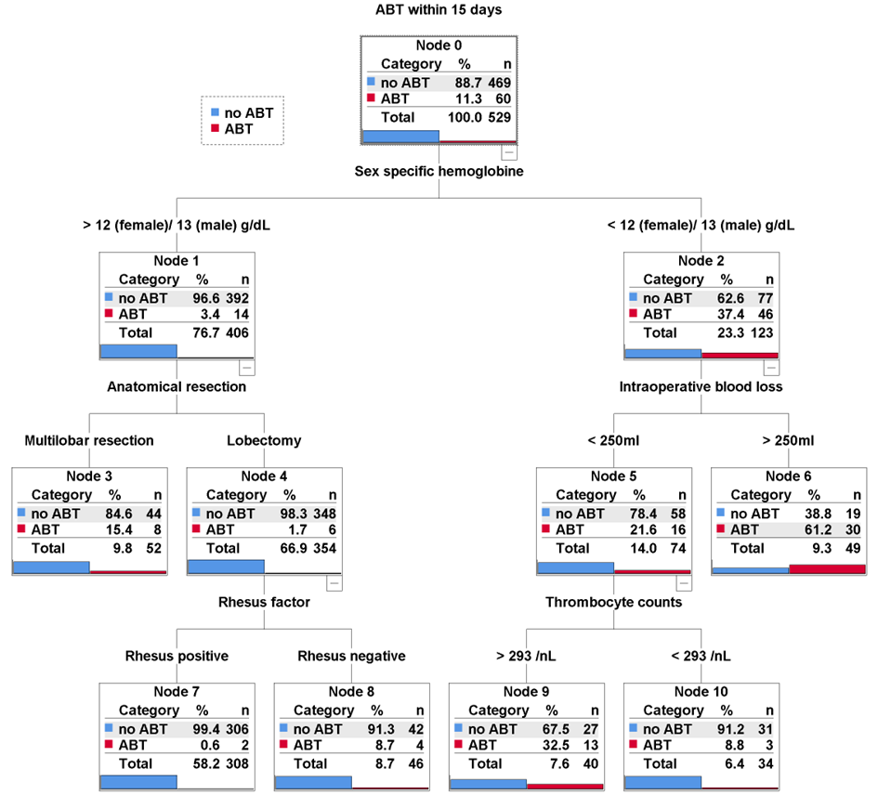
Decision tree illustrating the pre- and intraoperative determinants of postoperative ABT
Additional Fig. S3: In non-anemic patients, multilobar resections and Rhesus factor negativity were associated with increased odds for postoperative ABT. In anemic patients, blood loss >250 ml, and thrombocytes >293.5 /nL were associated with increased odds of postoperative ABT. Bars represent percentages of groups in the respective knots. P-values are also given. The results obtained with the estimation procedure Exhaustive CHAID are shown, but those obtained with the alternative estimation procedures CRT and QUEST were the same.

