Slide 1
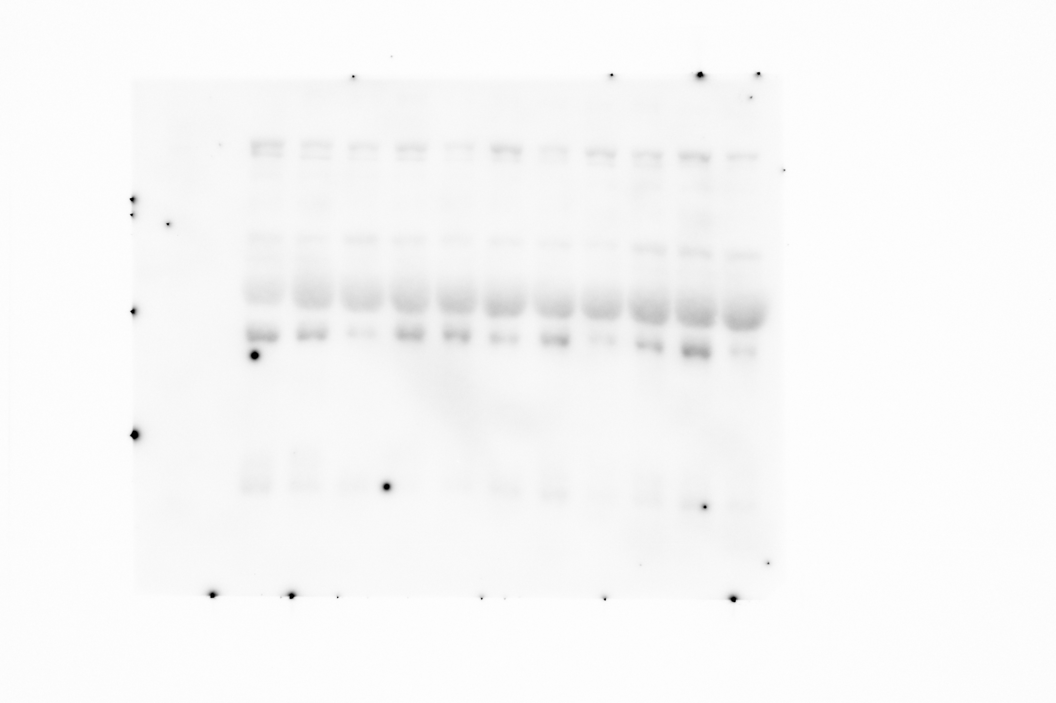
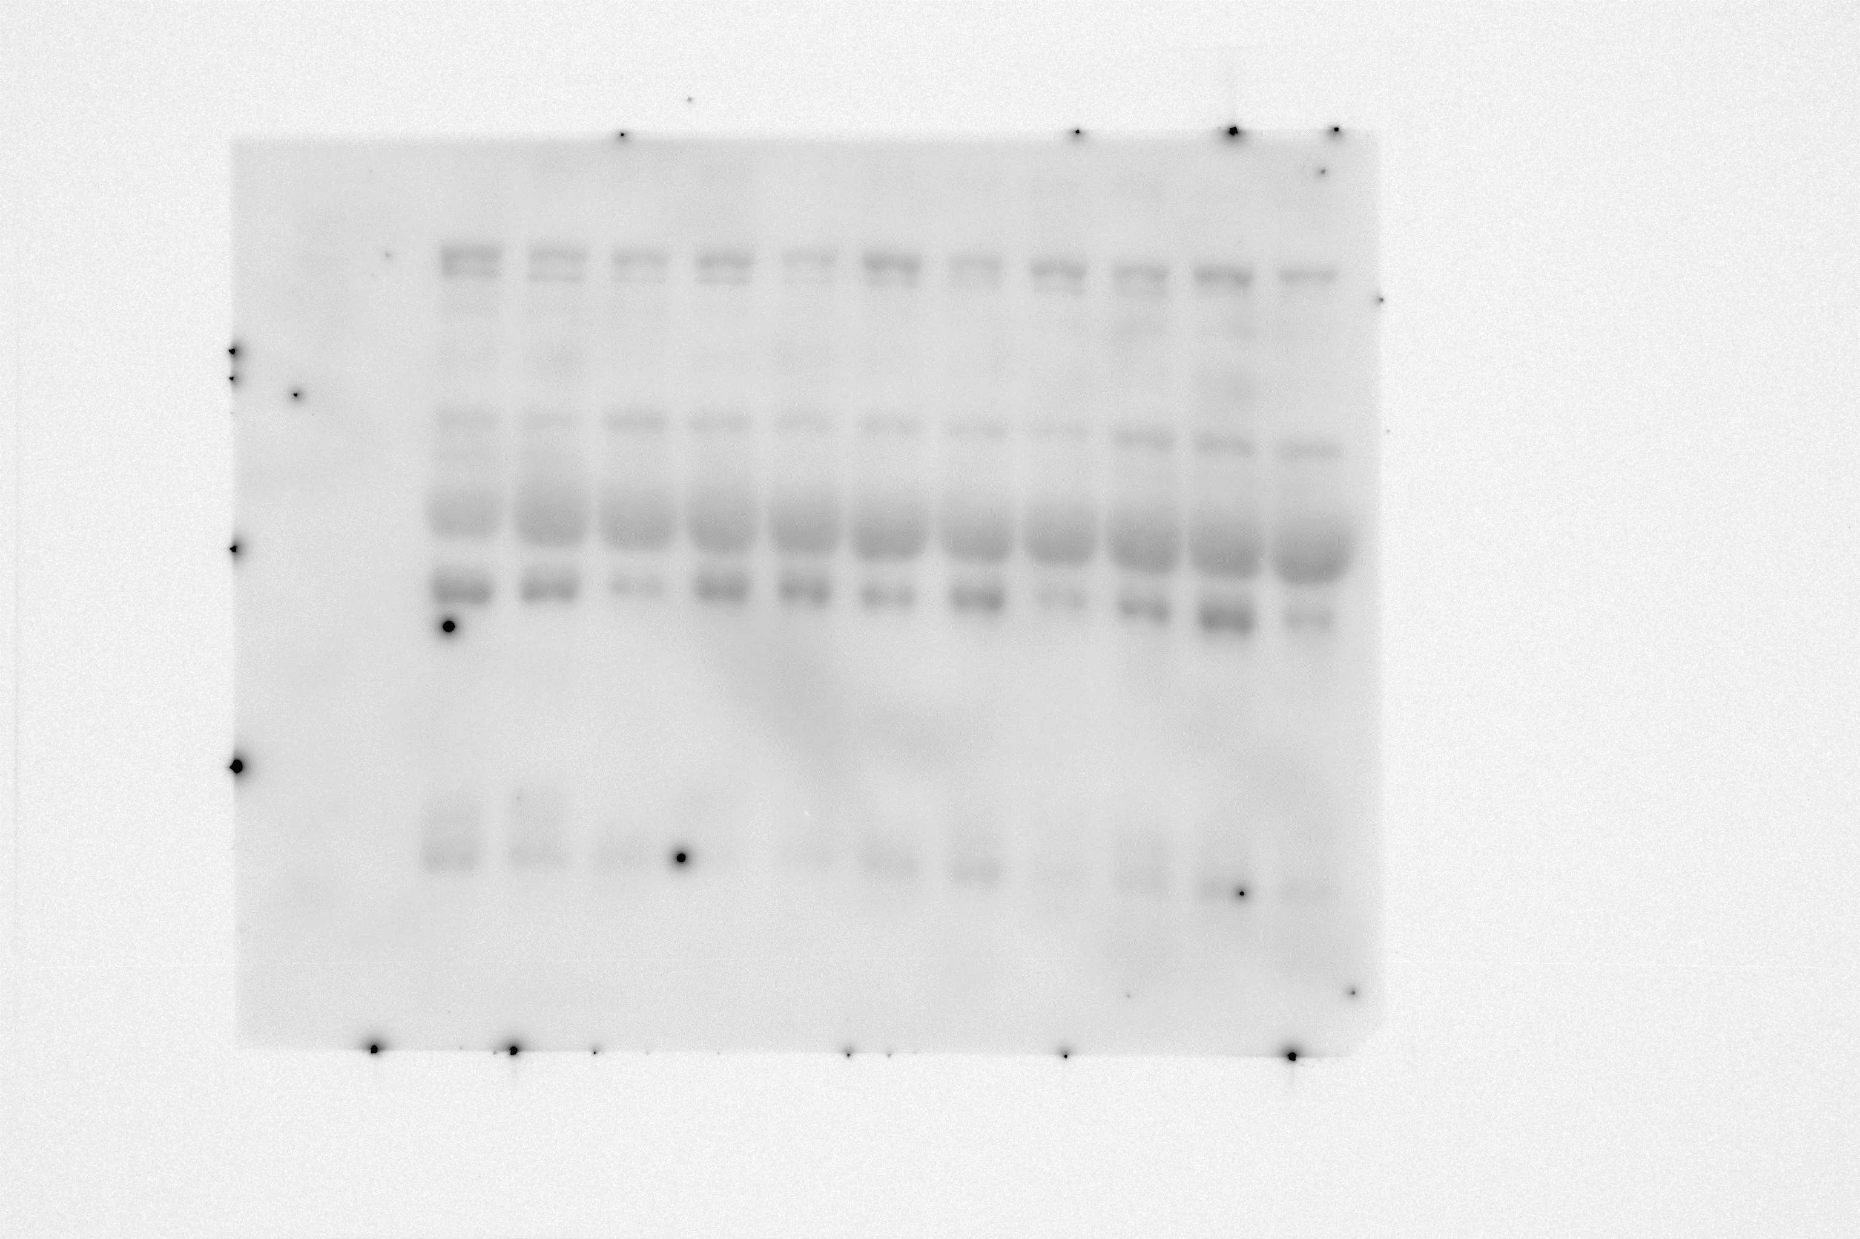
Figure S2
Transferrin
Transferrin
Contrast:-50

