Slide 1
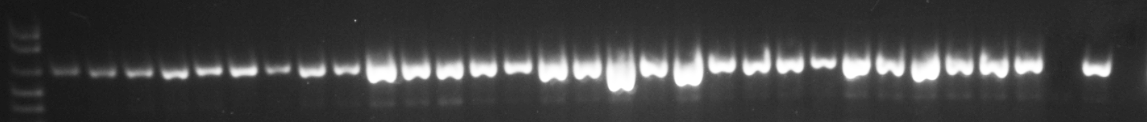
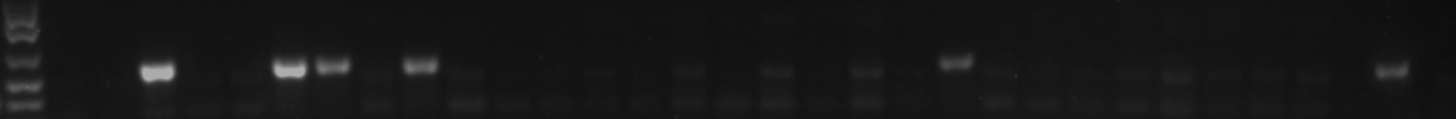
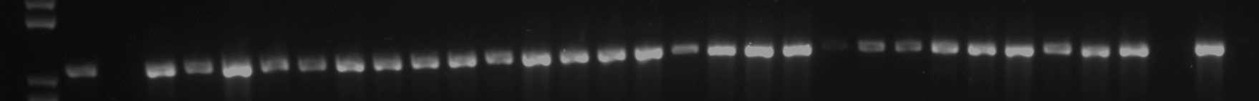
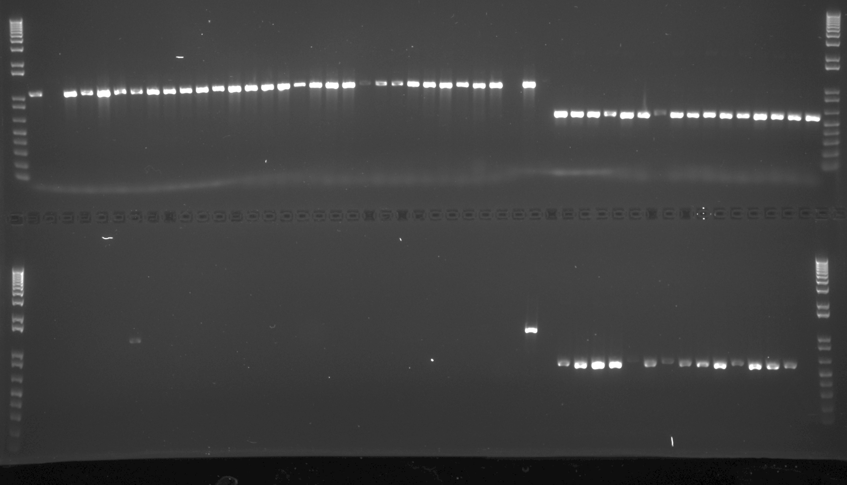
cw15, C58C1, pAgroLucR
Amplicon 3
1024 bp
Amplicon 4
1172 bp
LB
RB
--
--
T1
Paro
P1
P2
Luciferase
T2
pAgroLucR
LB
Amplicon 1
626 bp
Amplicon 2
528 bp
Amplicon 1
wt P C-
29/29
Amplicon 2
wt P C-
5/29
Amplicon 3
wt P C-
27/29
Amplicon 4
wt P C-
1/29

