Slide 1
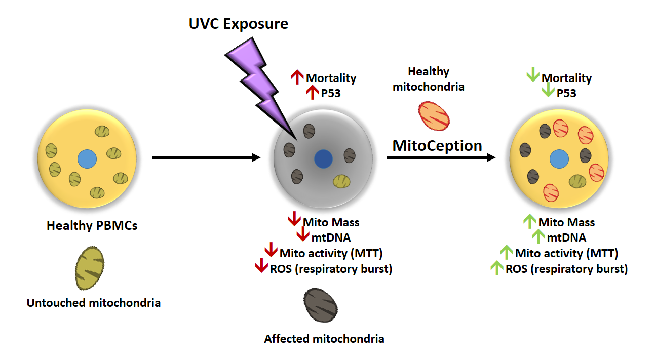
Supplementary Figure 2. Schematic representation of the UVR damage and PAMM MitoCeption rescue of PBMCS. Healthy PBMCs were exposed to UVC which increased cell mortality and p53 expression. Mitochondrial mass, mtDNA, metabolic activity, and ROS production decreased because of radiation. After MitoCeption with exogenous mitochondria from different donors, the cell profile reverted, such that mortality and p53 expression decreased, while mitochondrial mass, mtDNA, metabolic activity, and ROS production increased.

