Slide 1
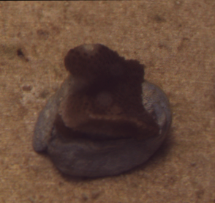
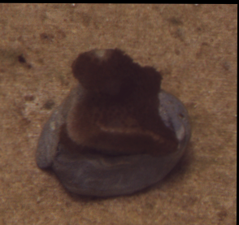
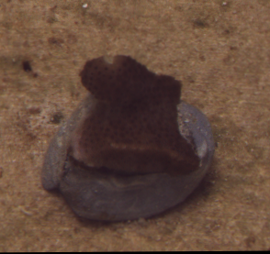
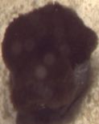
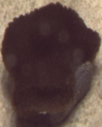
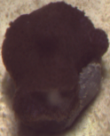
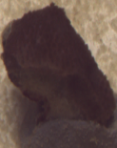
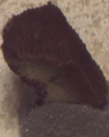
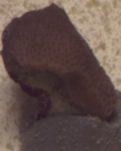
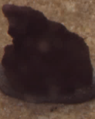
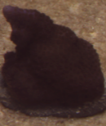
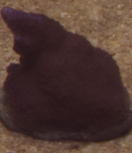
Figure S1
a.
CT-CL
CT-HL
HT-CL
HT-HL
Temperature
(°C)
Light (μmol quanta m⁻² s⁻¹)
b.
Days
Days
Days
Days
Time series photos
(Low-μ_{s}ʹ_{,m} : S. pistillata)
-1 4 11
-1 4 11
-1 4 11
-1 4 11
c.
Day
Day
Day
Day
Holobiont Reflectance
(Low-μ_{s}ʹ_{,m}: S. pistillata)
0.8
Day
Day
Day
Day
0.7
R_{s}
0.6
R_{s}
R_{s}
Chl a
Chl a
0.5
R_{s}
0.4
Chl a
0.3
Chl a
0.2
0.1
450
500
550
600
650
700
450
500
550
600
650
700
450
500
550
600
650
700
450
500
550
600
650
700
d.
Wavelength (nm)
Wavelength (nm)
Wavelength (nm)
Wavelength (nm)
Time series photos
(High-μ_{s}ʹ_{,m} : M. digitata)
-1 4 11
-1 4 11
-1 4 11
-1 4 11
Holobiont Reflectance
(High-μ_{s}ʹ_{,m} : M digitata)
Day
Day
Day
Day
e.
0.8
Day
Day
Day
Day
0.7
R_{s}
0.6
R_{s}
0.5
R_{s}
R_{s}
0.4
0.3
Chl a
Chl a
Chl a
Chl a
0.2
0.1
450
500
550
600
650
700
450
500
550
600
650
700
450
500
550
600
650
700
450
500
550
600
650
700
f.
Wavelength (nm)
Wavelength (nm)
Wavelength (nm)
Wavelength (nm)
Holobiont Reflectance
(at 675 nm)
Day
Day
Day
Day
Pre-stress control conditions
Temperature
Light
Low-µ_{S}ʹ_{,m} corals
High-µ_{S}ʹ_{,m} corals

