Slide 1
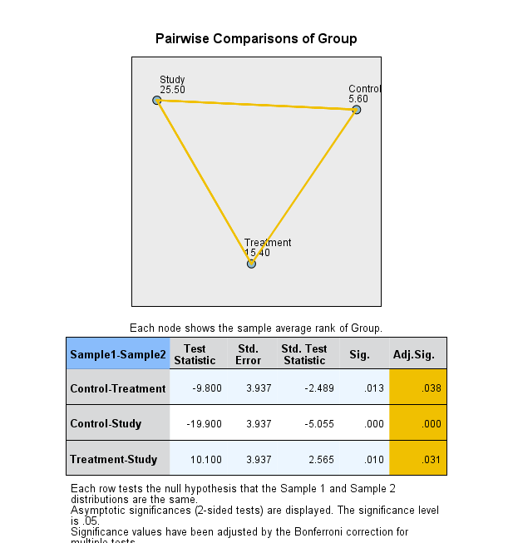
MDA

Slide 2

IL-B

Slide 3
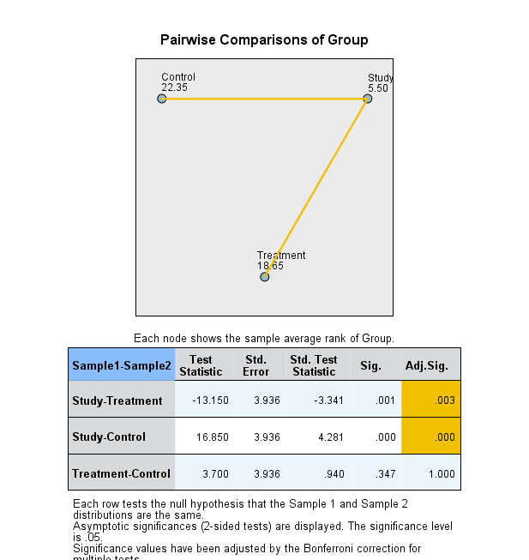
Surface area

