Slide 1
Supplementary figures

Slide 2
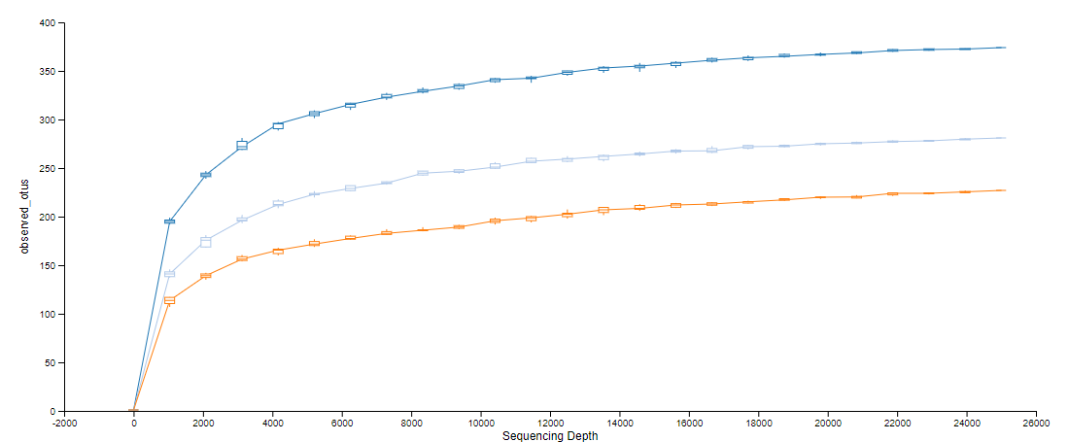

Figure 1S(a)

Slide 3
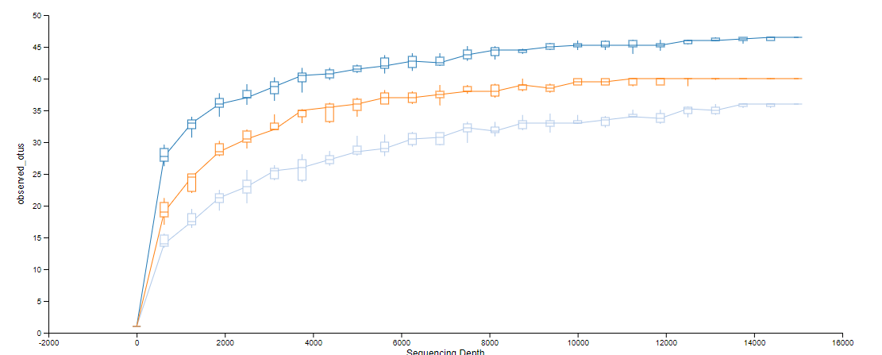
Figure 1S(b)

Slide 4
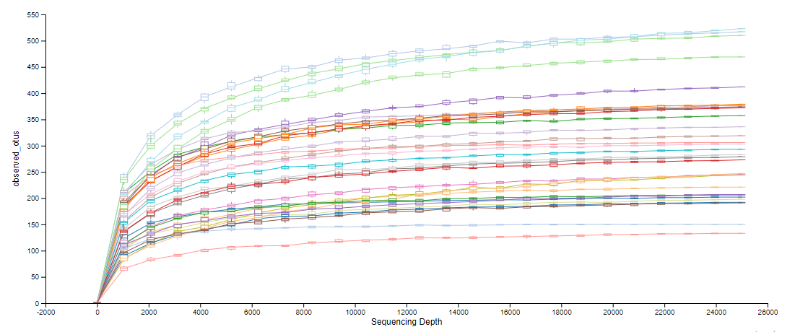

Figure 2S(a)

Slide 5
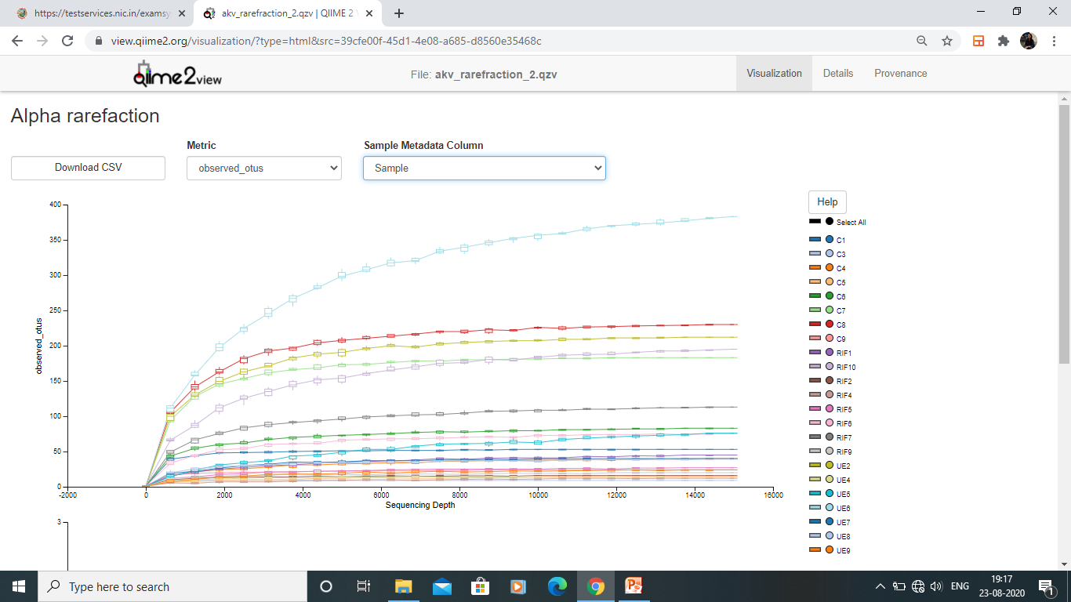
Figure 2S(b)

Slide 6
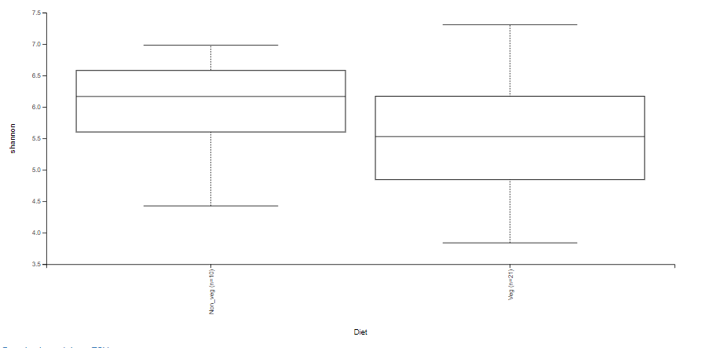
Figure 3S
Kruskal-Wallis , P=0.150; H =2.06

Slide 7
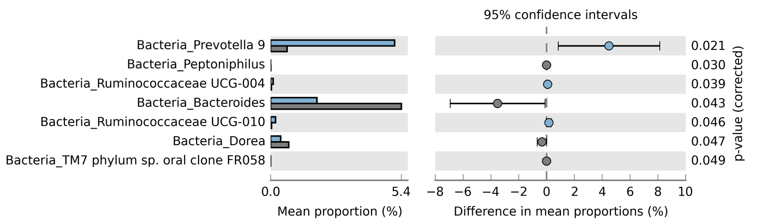
Figure 4S

