Slide 1
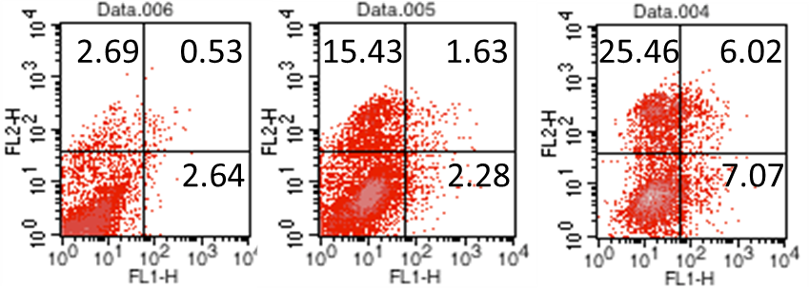
Supplement Figure 2
CTRL
AM 25 μg/ml
AM 50 μg/ml
MCF-7
Notes:
Supplement Figure 2. Analysis of cell apoptosis induced by AM extract in MCF-7 for 48 hours. MFC-7 breast cancer cells were treated with 25 μg/ml and 50 μg/ml of AM extract for 48 hours, and cell apoptosis was assessed by flow cytometry with FITC-Annexin V/PI Staining.

