Slide 1
NK cell-mediated immunostimulatory effects of ethanol extract of Morinda citrifolia (noni) fruit
Supplementary Information File
Supplementary figures

Slide 2
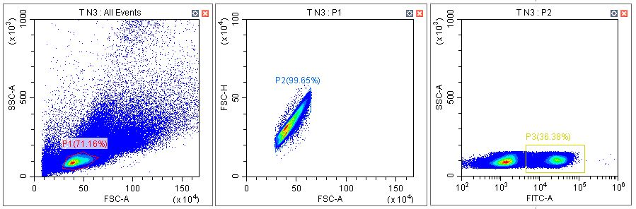
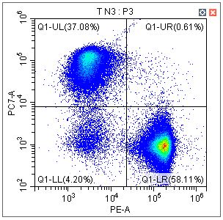
Supplementary Figure 1
(A)
CD3+ T cell, CD3+/CD4-/CD8+ Tc cell, CD3+/CD4+/CD8- Th cell
CD3+ T cell
CD3+/CD4-/CD8+ Tc cell
CD3
CD8
CD3+/CD4+/CD8- Th cell
CD4

Slide 3
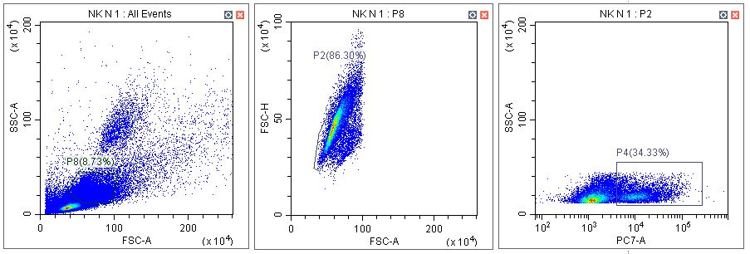
Supplementary Figure 1
(B)
F4/80+ Macrophage
F4/80+ macrophage
F4/80

Slide 4
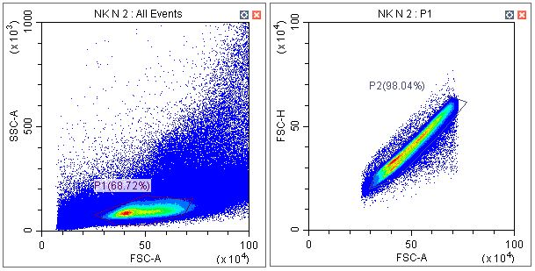
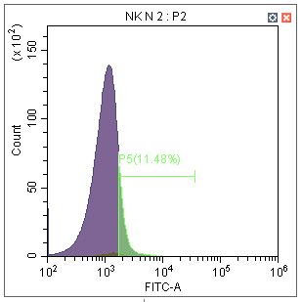
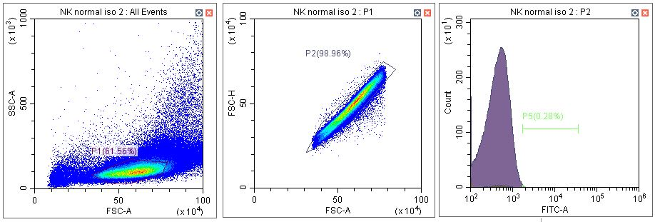
Supplementary Figure 1
(C)
CD11c+ Dendritic cell
CD11c
isotype
CD11c
Notes:
Supp Figure 1c: This is not standard gating for CD11c+ DCs. The authors must use a recognized gating strategy to determine these subsets. For example CD11c+ DCs should be lineage neg (example NK1.1-CD3-CD19-), siglecF negative, Ly6C negative, B220 negative, CD11b negative and CD11c+. The gating used in this figure on total cells and single cells is not appropriate.
- Due to the limitation of the number of possible lasers, only CD11c was used as a marker for dendritic cells. Actually, it has no effect and I think it is okay to just remove it. If it is okay, can you ask the professor at the lab meeting?

Slide 5
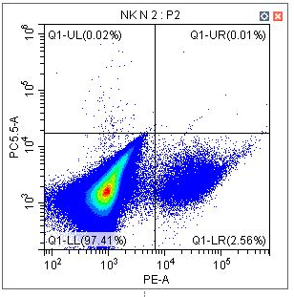
Supplementary Figure 1
(D)
NK cell
IFN-γ
NKp46

