Slide 1
pTau S396
HIPPOCAMPUS

Slide 2
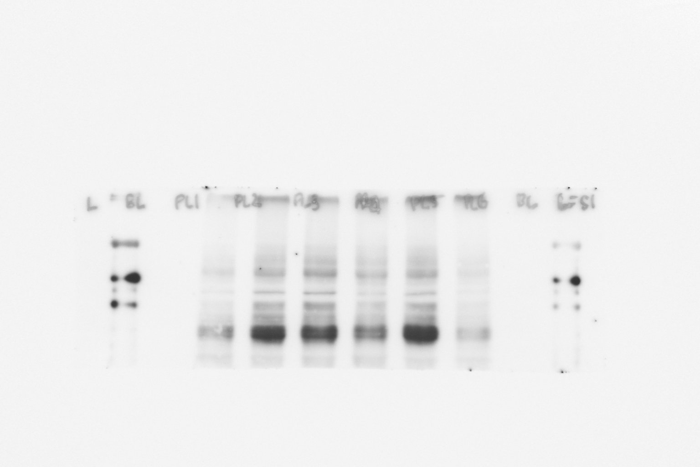
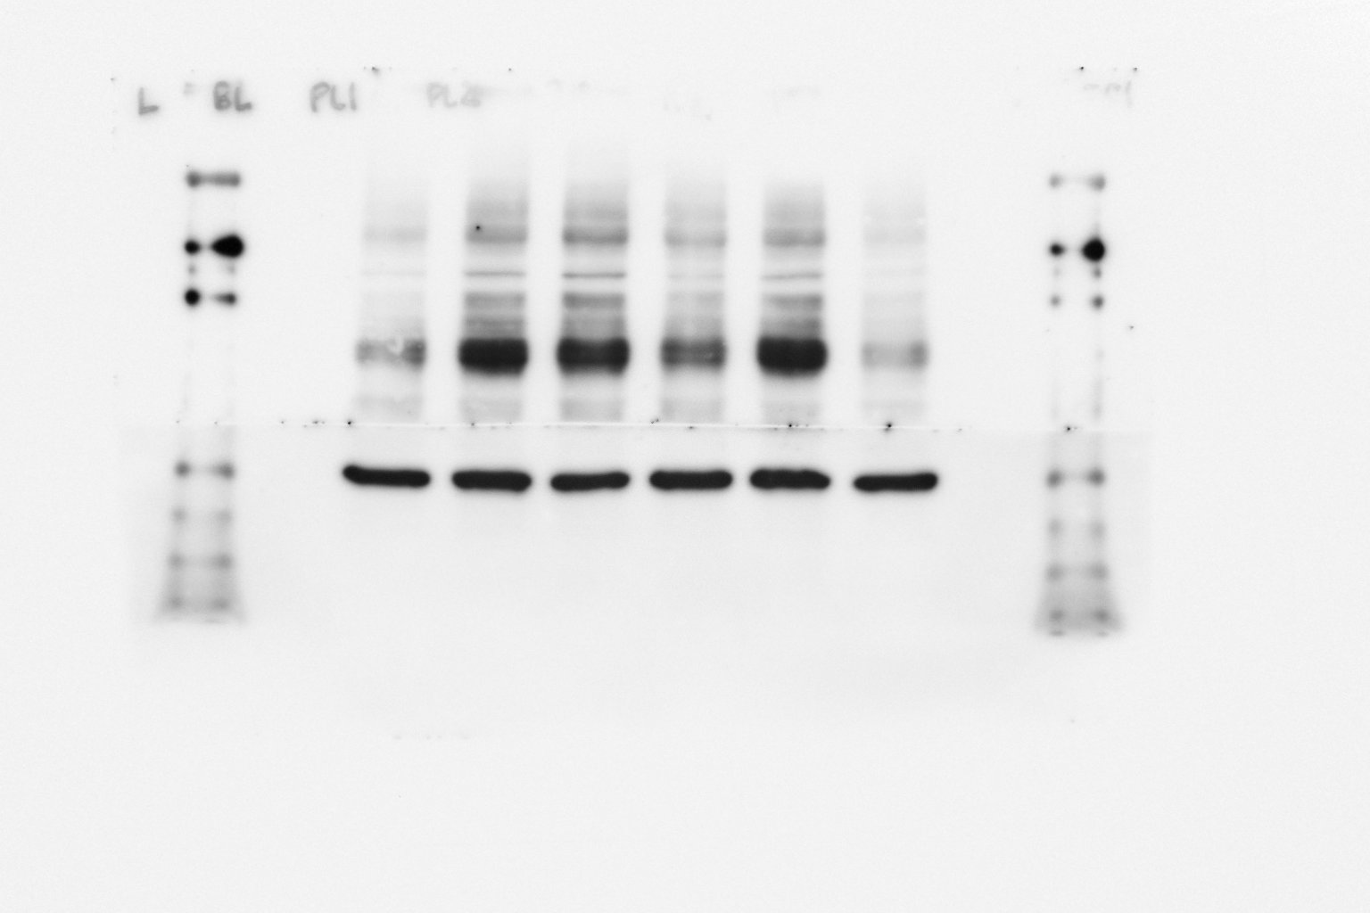
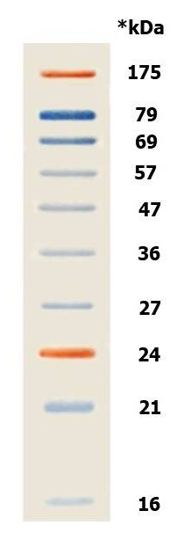
Raw Picture in Fig. 5A, the blue and red box position indicates the cutting position and both blots were running on the same gel
N1 S396
Sham A𝛃 A𝛃+Don A𝛃+INAA A𝛃+POAA3 A𝛃+POAA30
pTau S396
GAPDH
Sham A𝛃 A𝛃+Don A𝛃+INAA A𝛃+POAA3 A𝛃+POAA30
Exposure time 30s
Exposure time 2 min

Slide 3
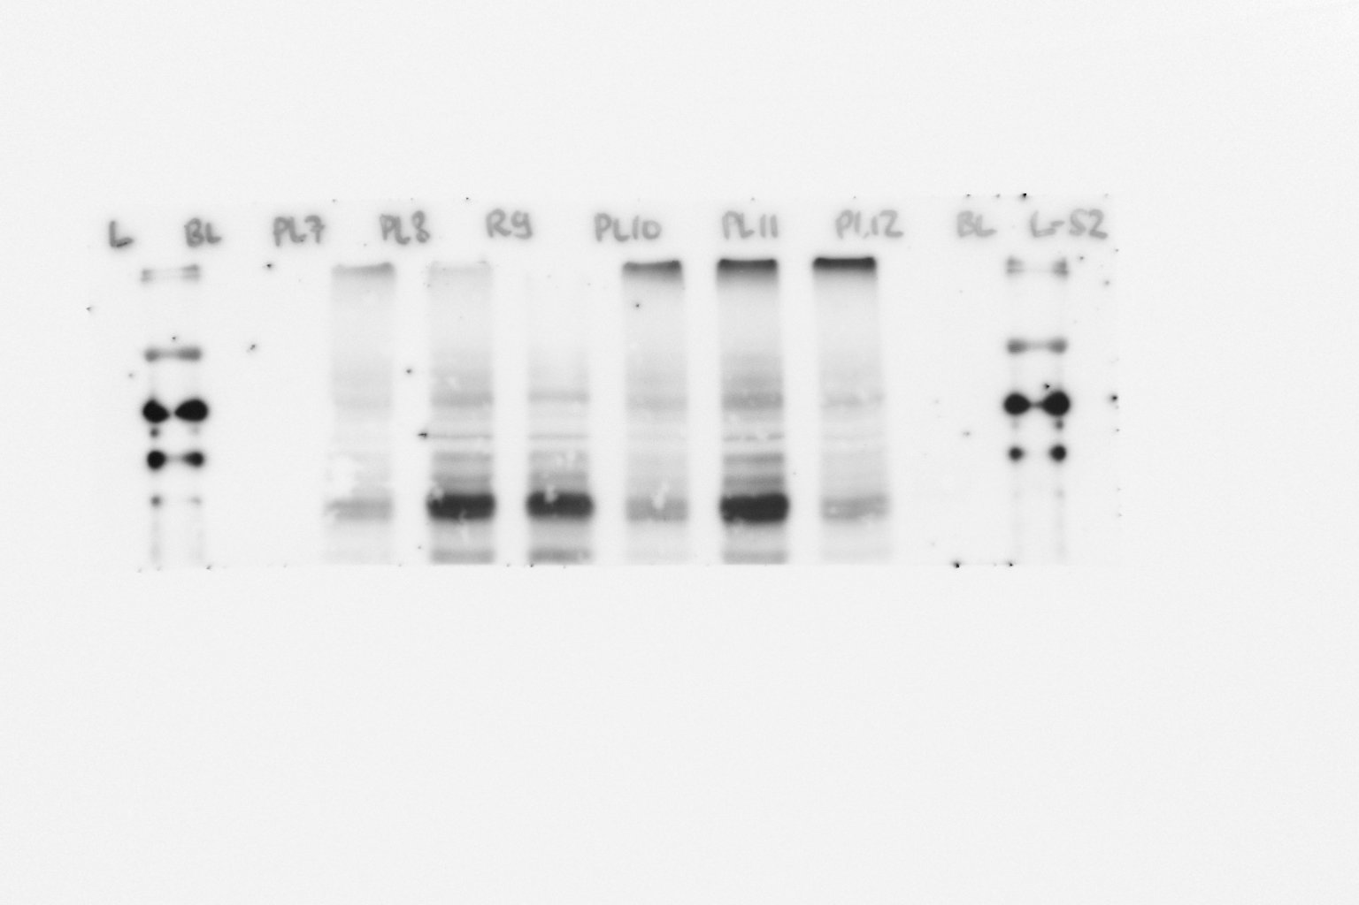
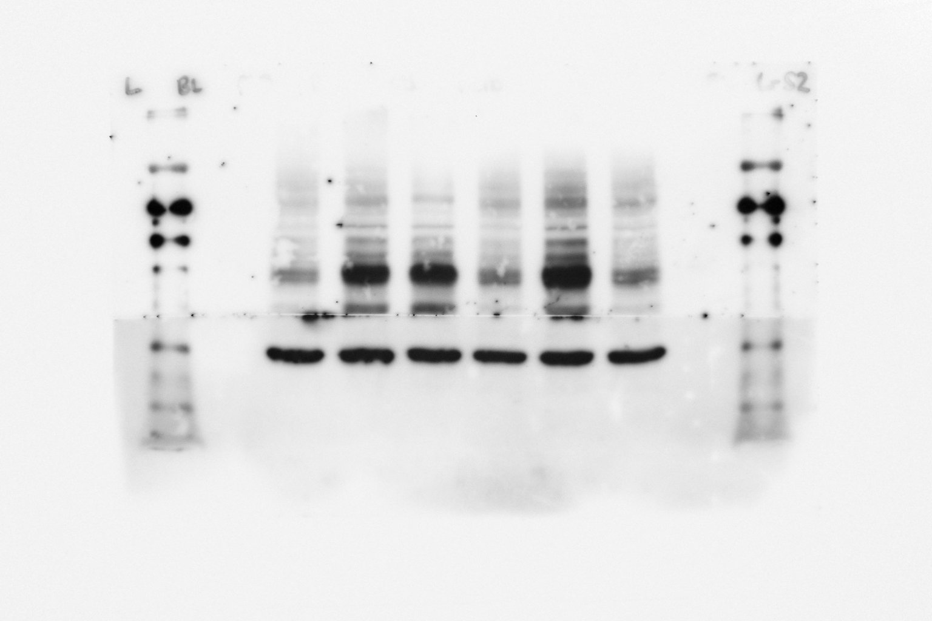
N2 S396
pTau S396
Sham A𝛃 A𝛃+Don A𝛃+INAA A𝛃+POAA3 A𝛃+POAA30
GAPDH
Sham A𝛃 A𝛃+Don A𝛃+INAA A𝛃+POAA3 A𝛃+POAA30
Exposure time 30s
Exposure time 2 min

Slide 4
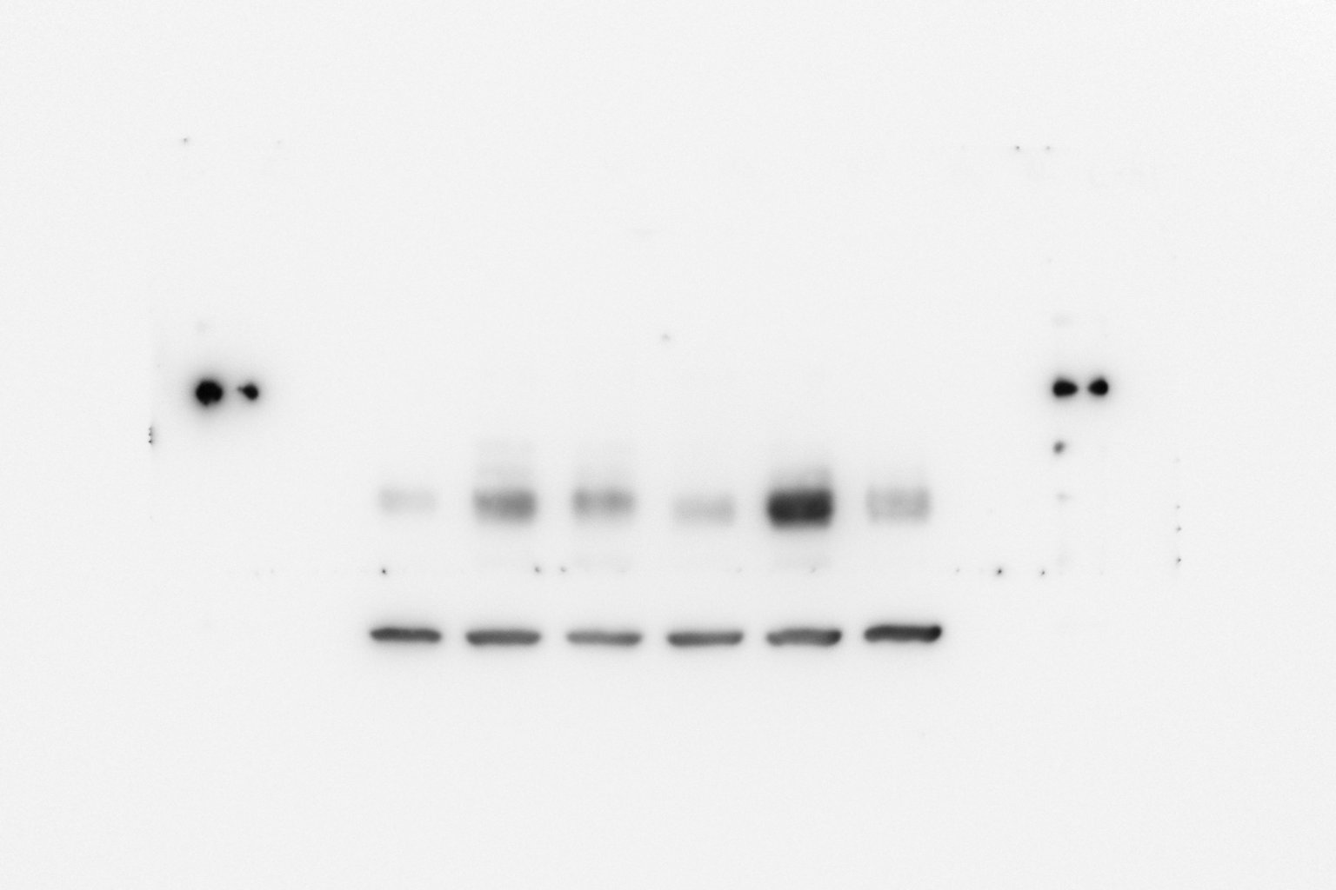
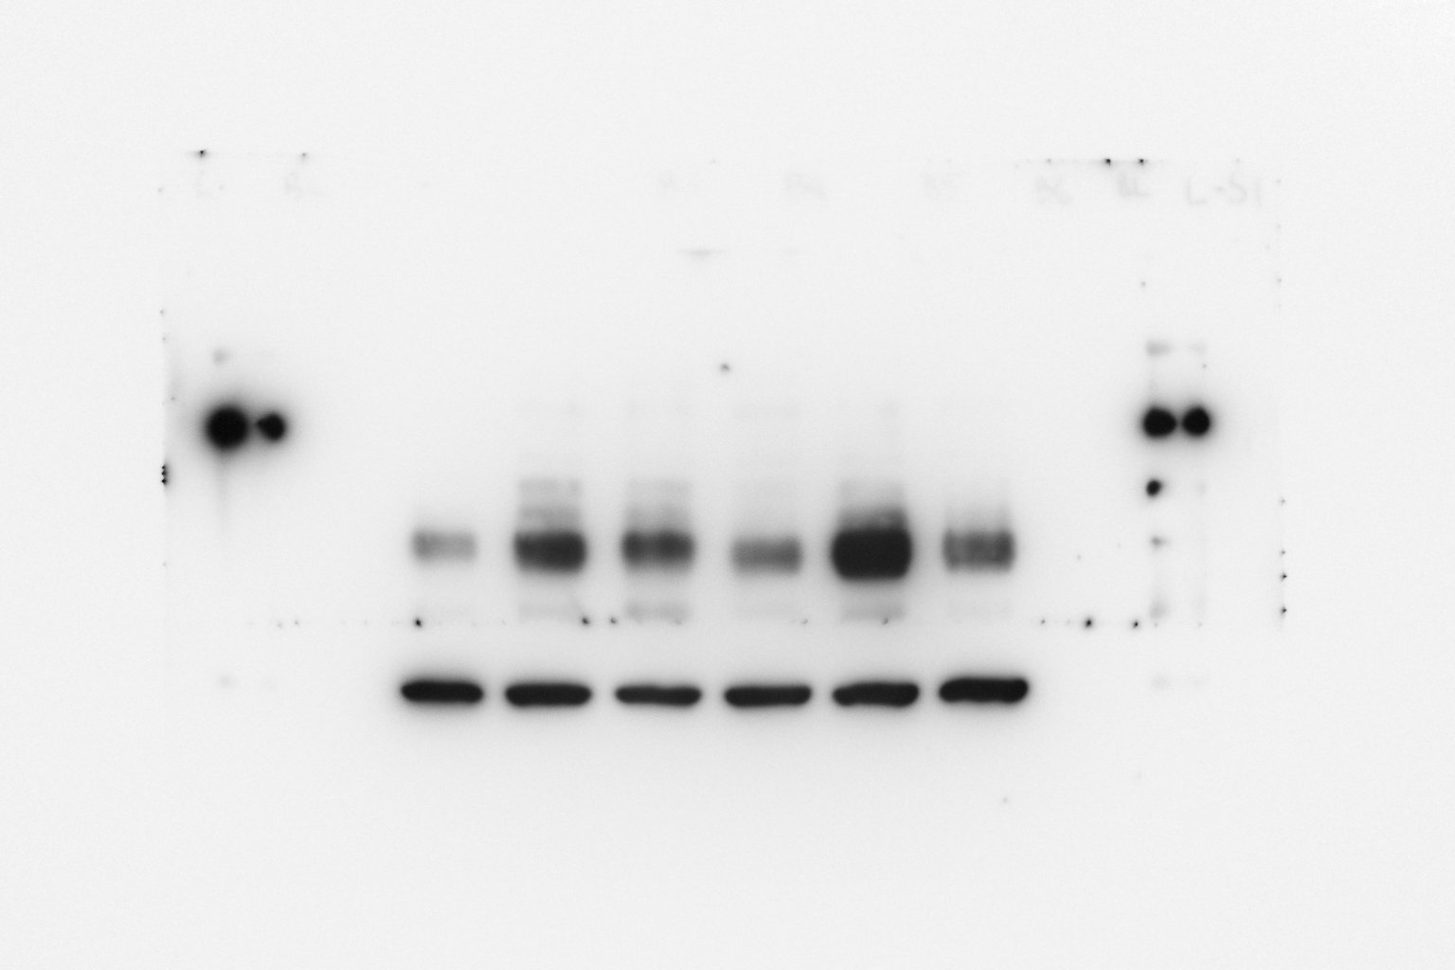
N3 S396
pTau S396
GAPDH
Sham A𝛃 A𝛃+Don A𝛃+INAA A𝛃+POAA3 A𝛃+POAA30
Sham A𝛃 A𝛃+Don A𝛃+INAA A𝛃+POAA3 A𝛃+POAA30
Exposure time 30s
Exposure time 2 min

Slide 5
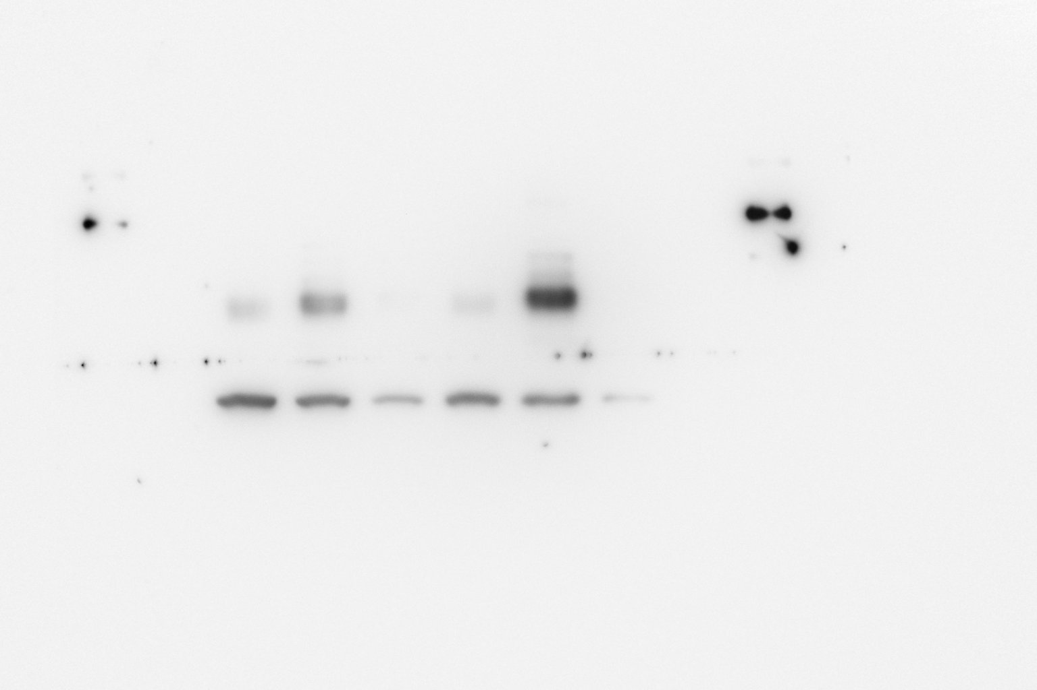
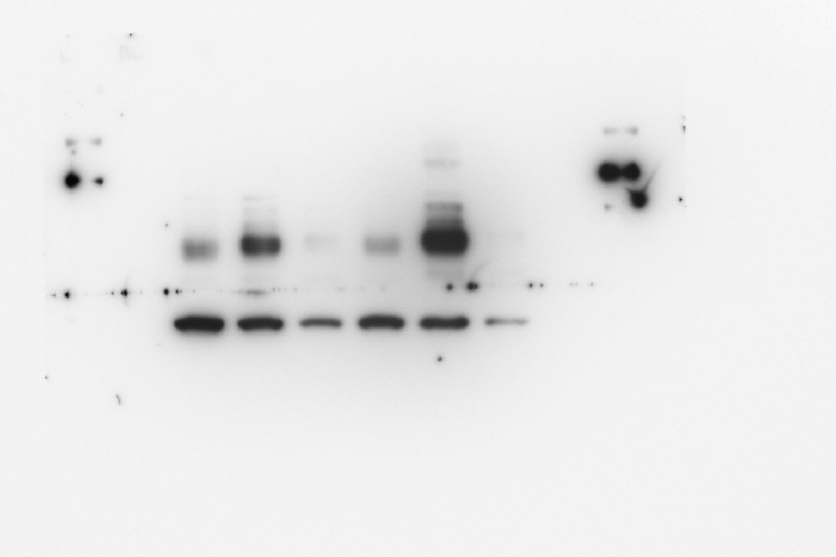
N4 S396
pTau S396
GAPDH
Sham A𝛃 A𝛃+Don A𝛃+INAA A𝛃+POAA3 A𝛃+POAA30
Sham A𝛃 A𝛃+Don A𝛃+INAA A𝛃+POAA3 A𝛃+POAA30
Exposure time 30s
Exposure time 2 min

Slide 6
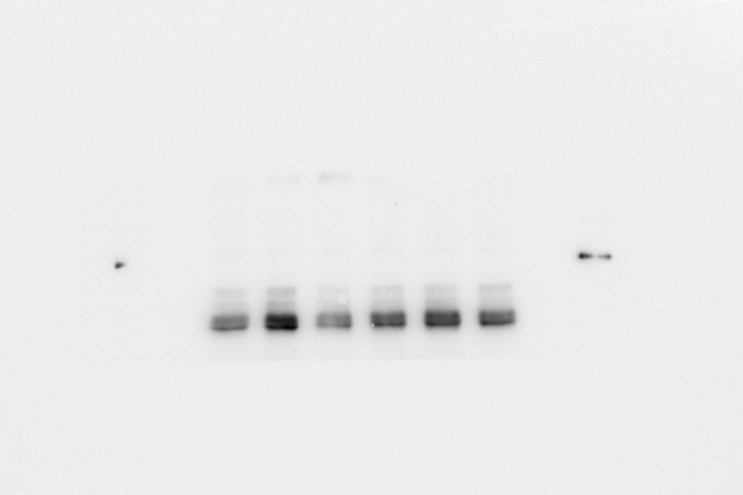
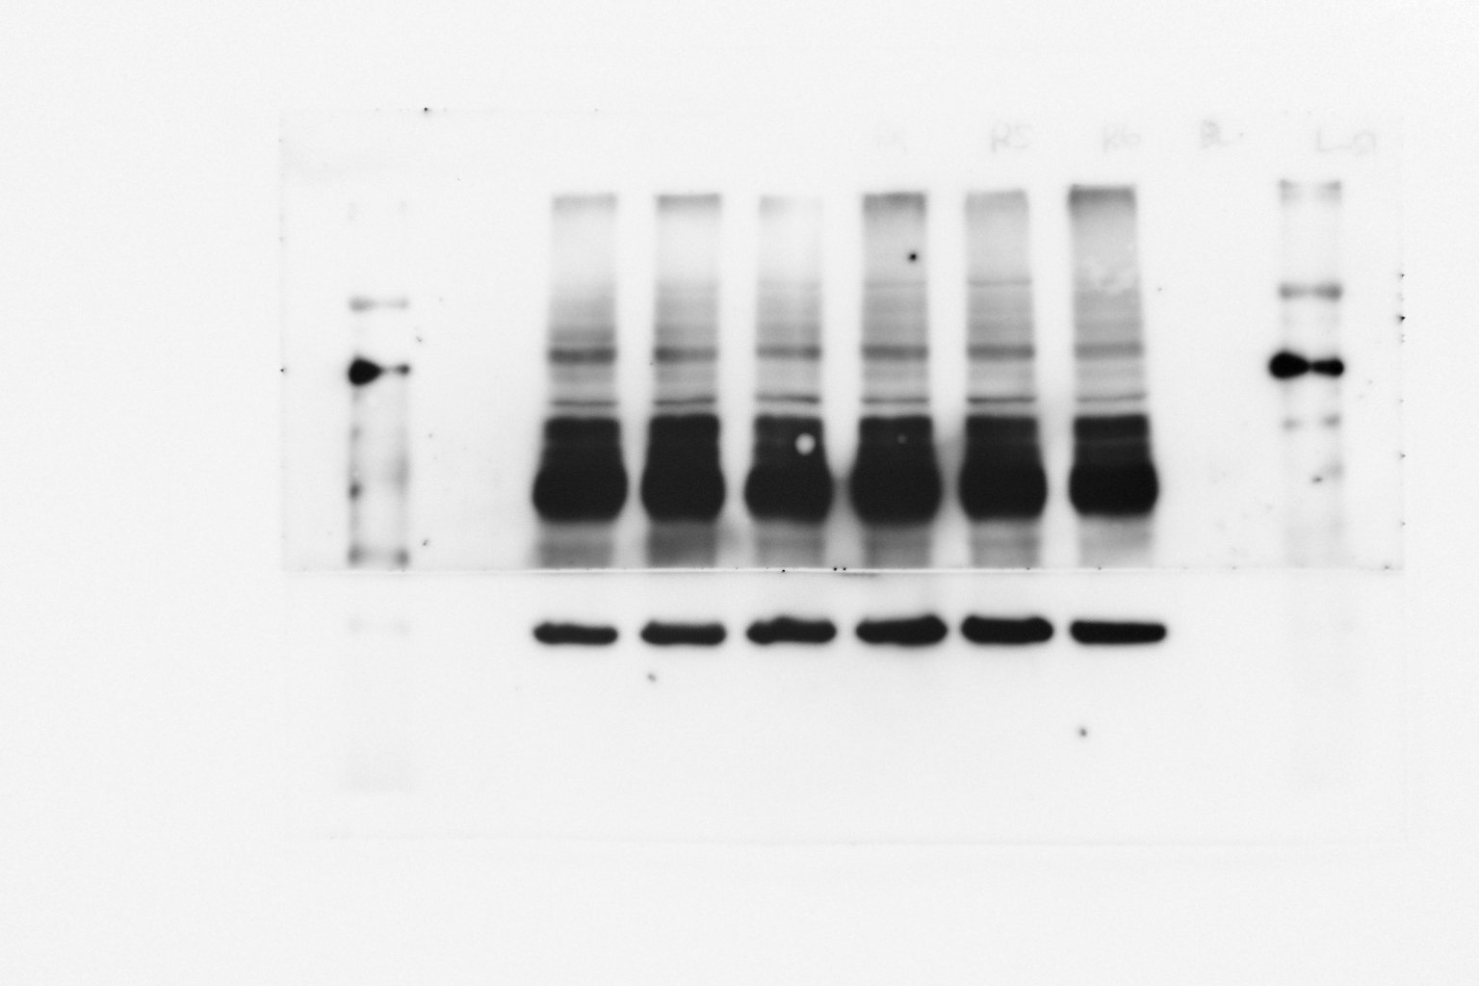
N5 S396
pTau S396
GAPDH
Sham A𝛃 A𝛃+Don A𝛃+INAA A𝛃+POAA3 A𝛃+POAA30
Sham A𝛃 A𝛃+Don A𝛃+INAA A𝛃+POAA3 A𝛃+POAA30
Exposure time 30s
Exposure time 2 min

Slide 7
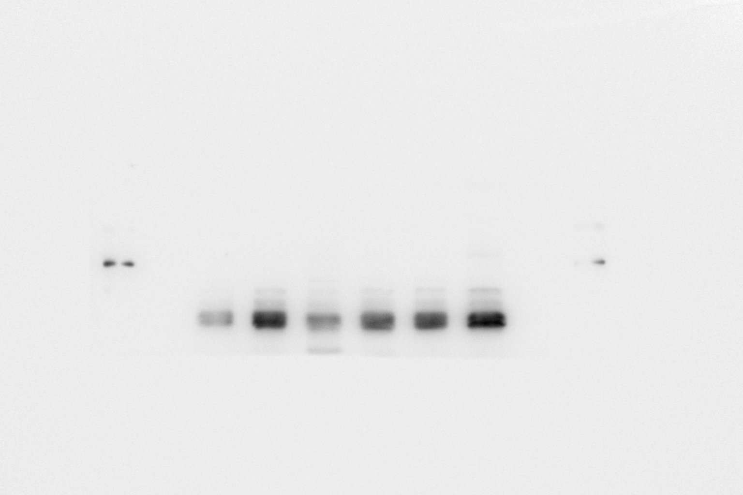
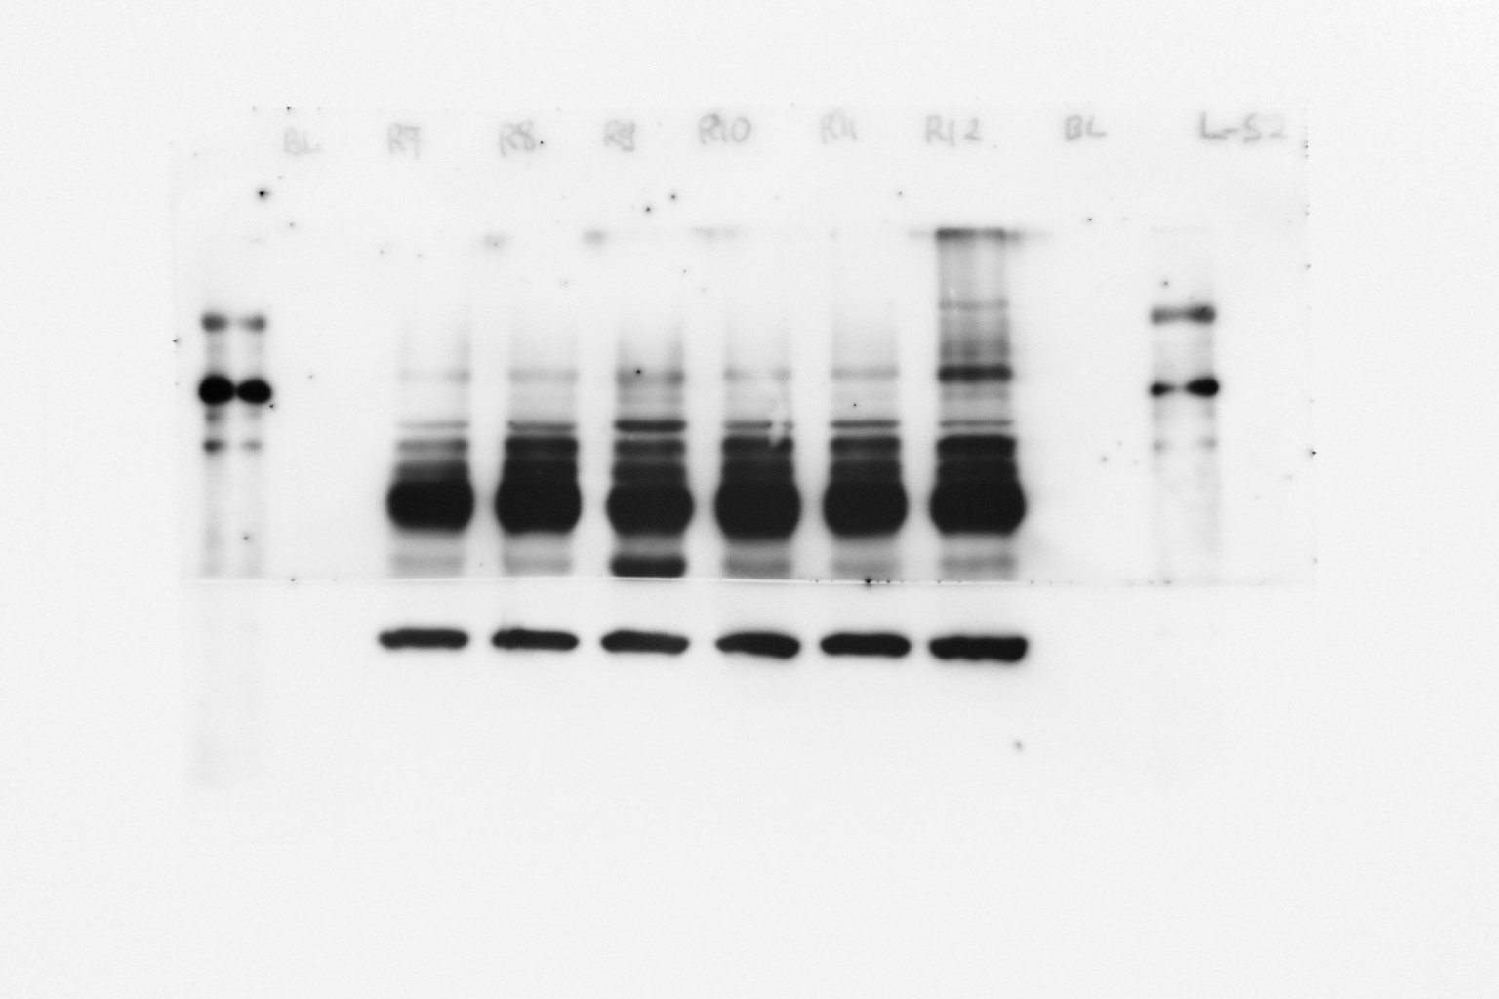
N6 S396
pTau S396
GAPDH
Sham A𝛃 A𝛃+Don A𝛃+INAA A𝛃+POAA3 A𝛃+POAA30
Sham A𝛃 A𝛃+Don A𝛃+INAA A𝛃+POAA3 A𝛃+POAA30
Exposure time 30s
Exposure time 2 min

Slide 8
pTau T231
HIPPOCAMPUS

Slide 9
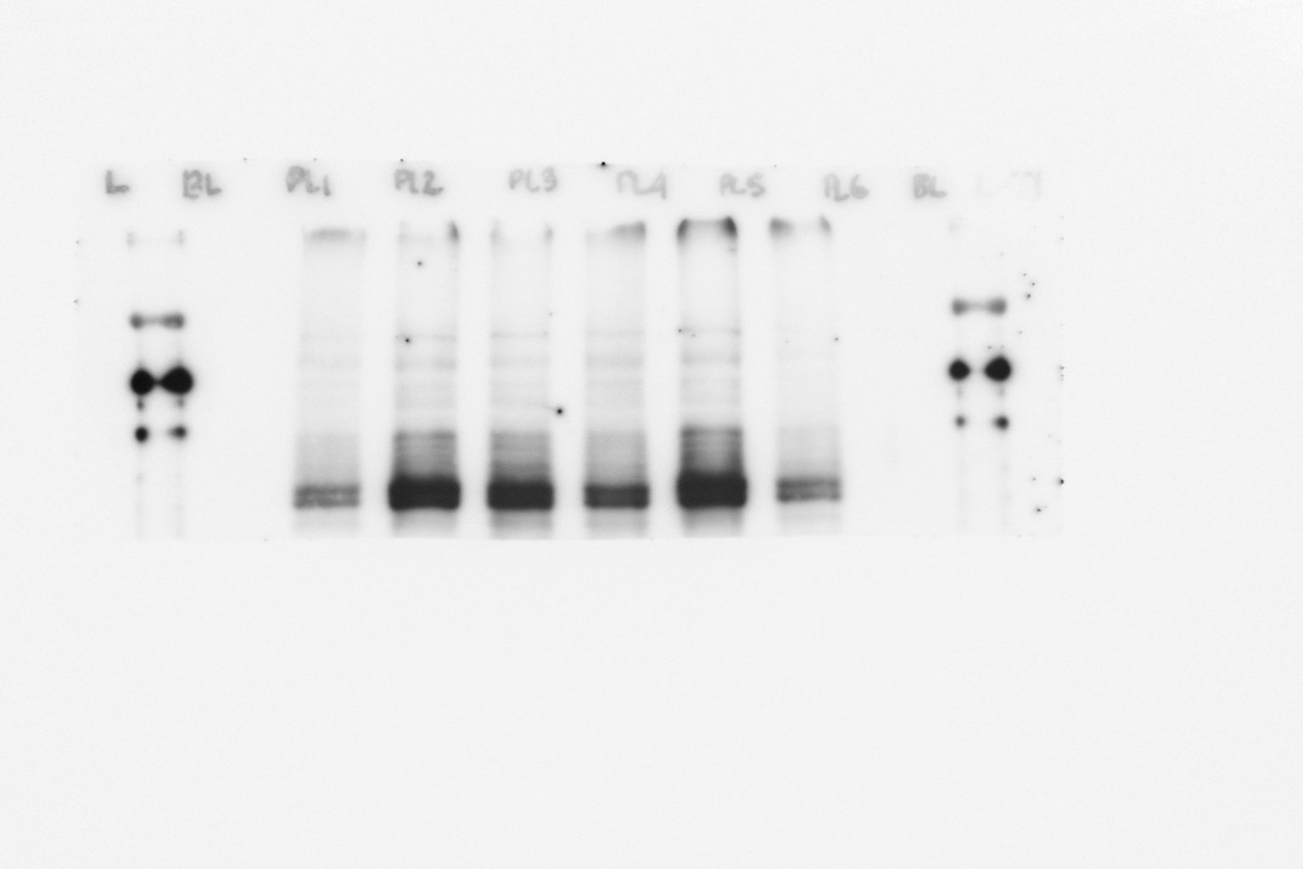
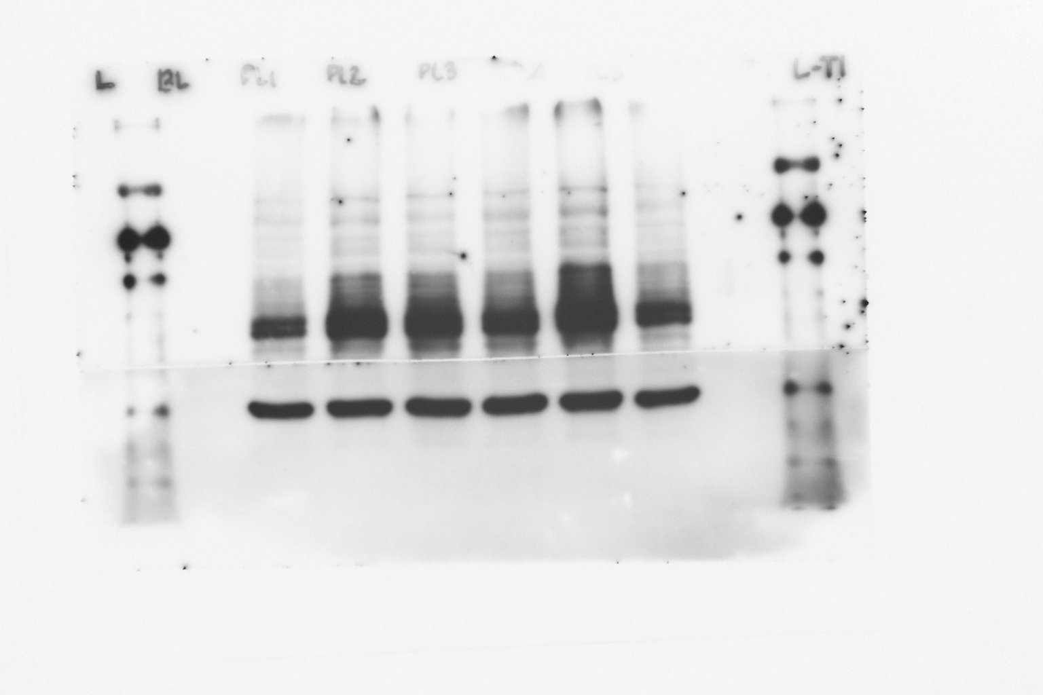
Raw Picture in Fig. 5B, the blue and red box position indicates the cutting position and both blots were running on the same gel
N1 T231
pTau T231
Sham A𝛃 A𝛃+Don A𝛃+INAA A𝛃+POAA3 A𝛃+POAA30
GAPDH
Sham A𝛃 A𝛃+Don A𝛃+INAA A𝛃+POAA3 A𝛃+POAA30
Exposure time 30s
Exposure time 2 min

Slide 10
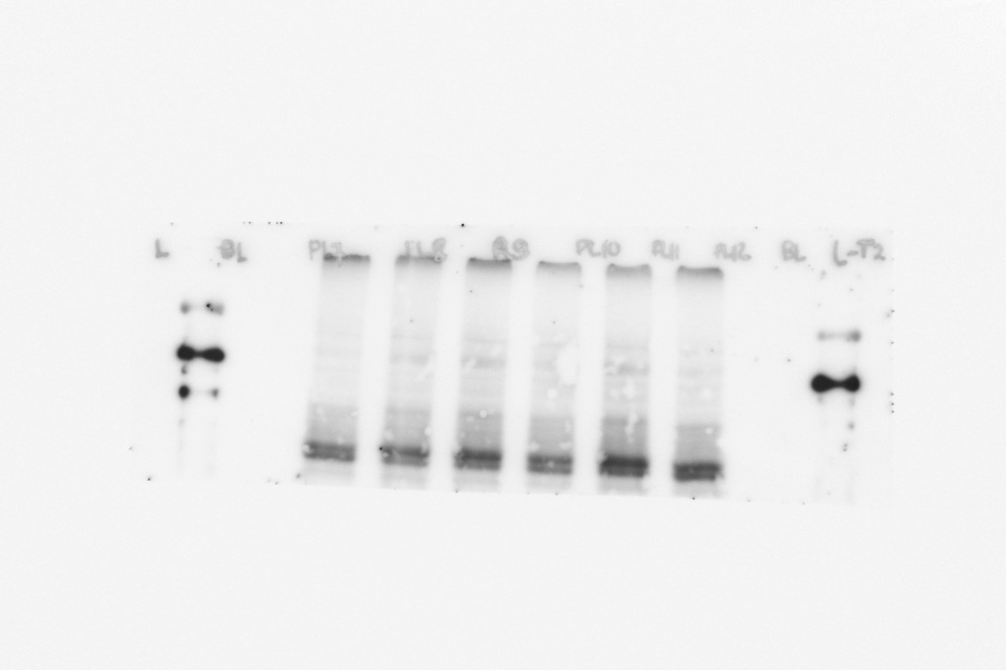
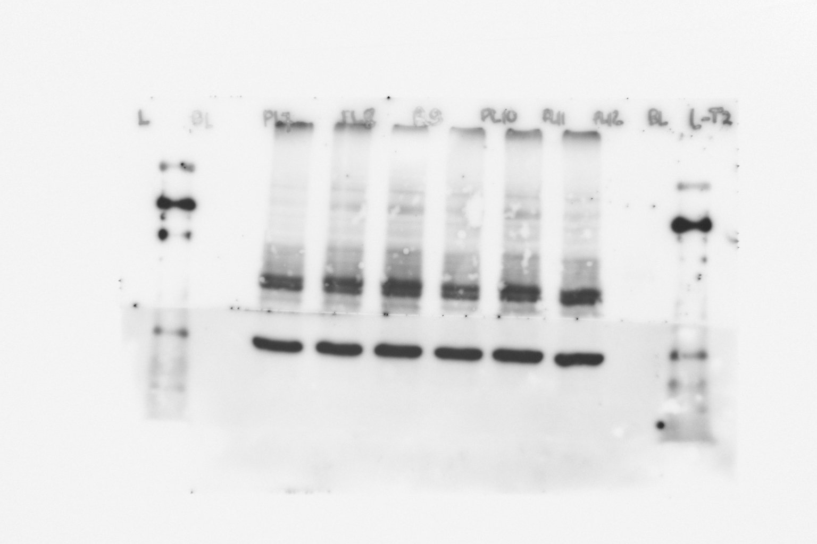
N2 T231
pTau T231
GAPDH
Sham A𝛃 A𝛃+Don A𝛃+INAA A𝛃+POAA3 A𝛃+POAA30
Sham A𝛃 A𝛃+Don A𝛃+INAA A𝛃+POAA3 A𝛃+POAA30
Exposure time 30s
Exposure time 2 min

Slide 11
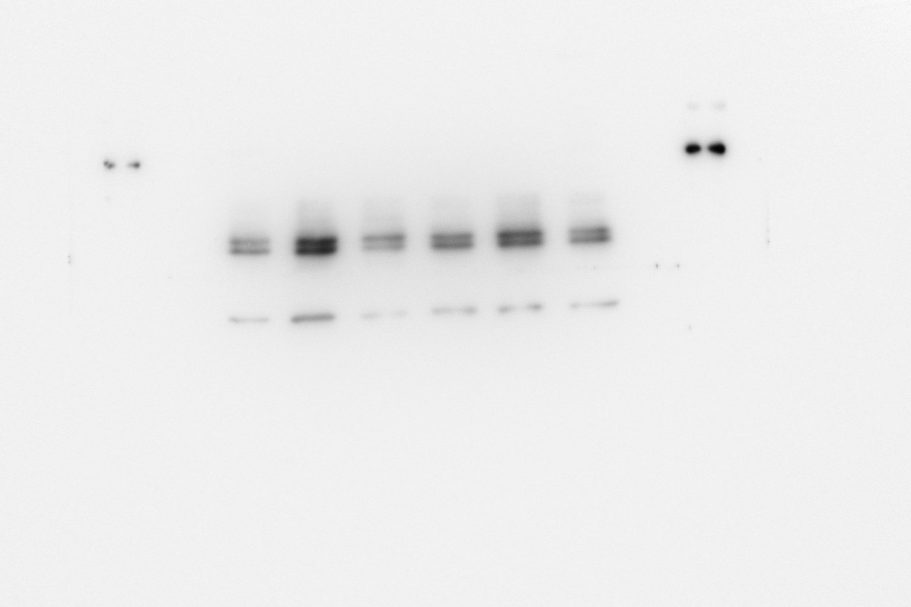
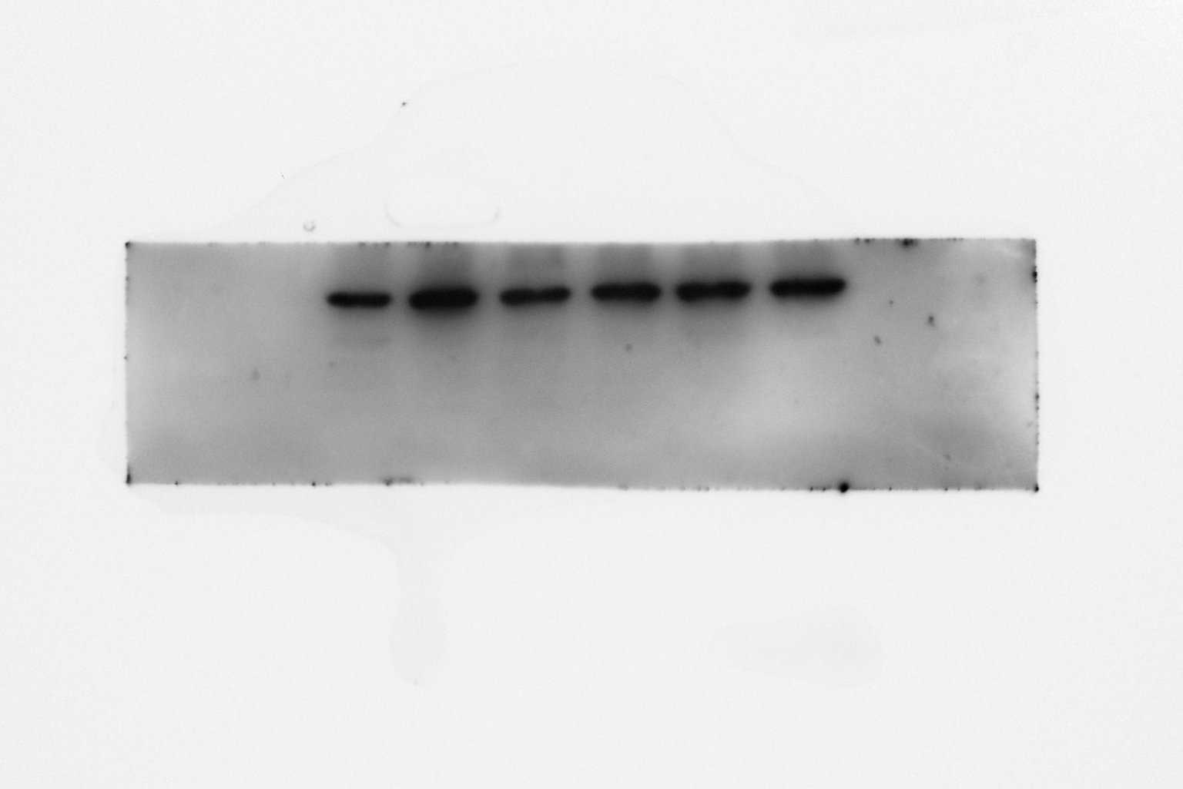
N3 T231
pTau T231
GAPDH
Sham A𝛃 A𝛃+Don A𝛃+INAA. A𝛃+POAA3 A𝛃+POAA30
Sham A𝛃 A𝛃+Don A𝛃+INAA A𝛃+POAA3 A𝛃+POAA30
Exposure time 30s
Exposure time 2 min

Slide 12
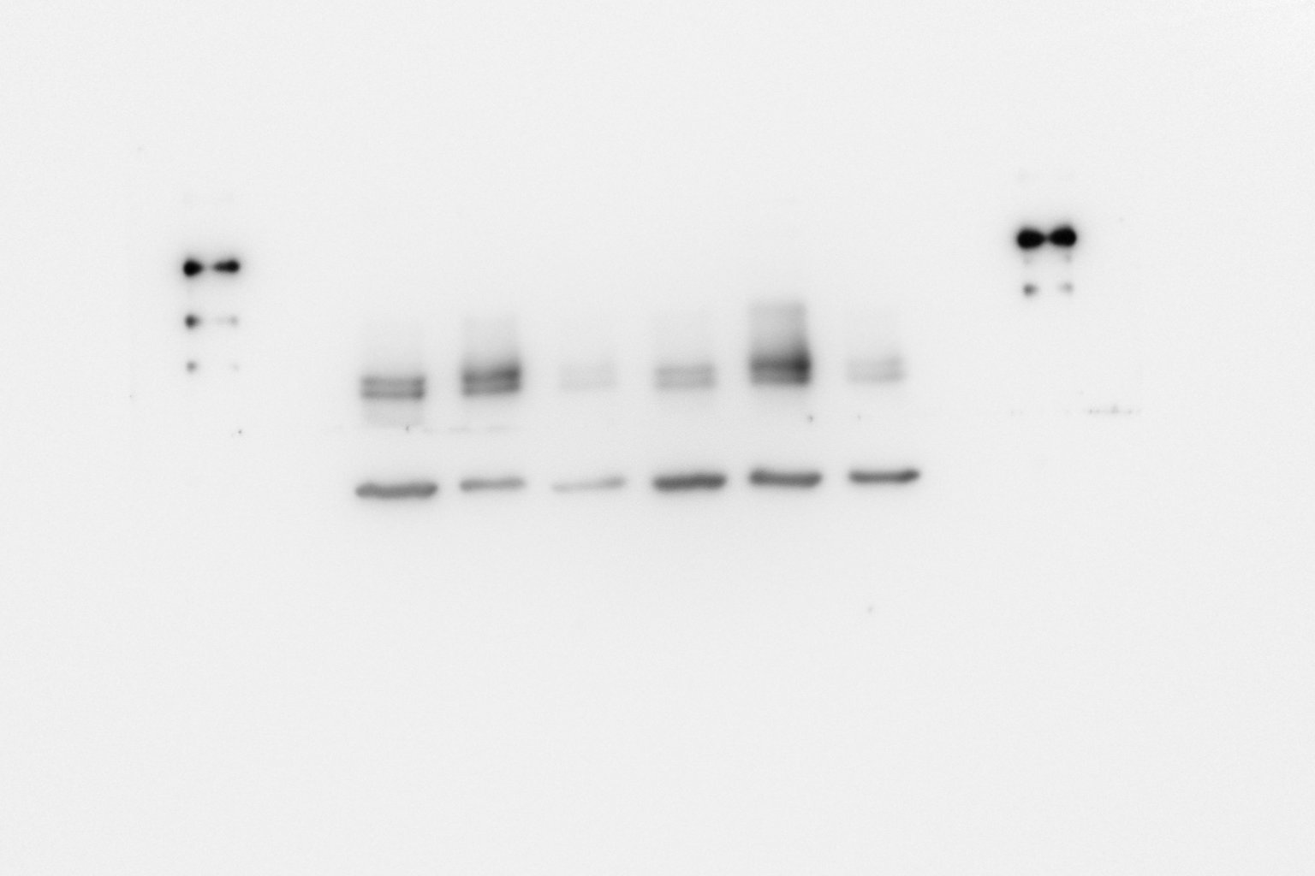
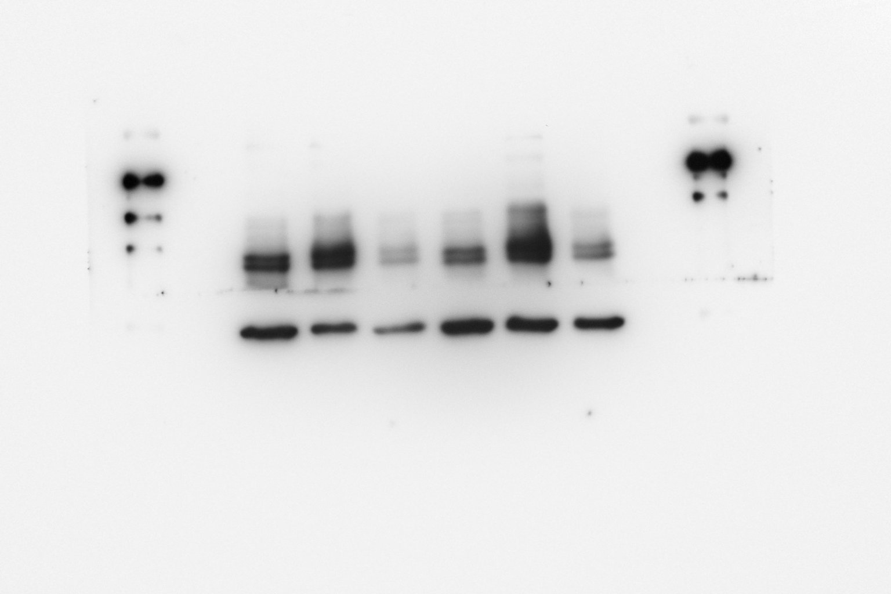
N4 T231
GAPDH
pTau T231
Sham A𝛃 A𝛃+Don A𝛃+INAA. A𝛃+POAA3 A𝛃+POAA30
Sham A𝛃 A𝛃+Don A𝛃+INAA. A𝛃+POAA3 A𝛃+POAA30
Exposure time 30s
Exposure time 2 min

Slide 13
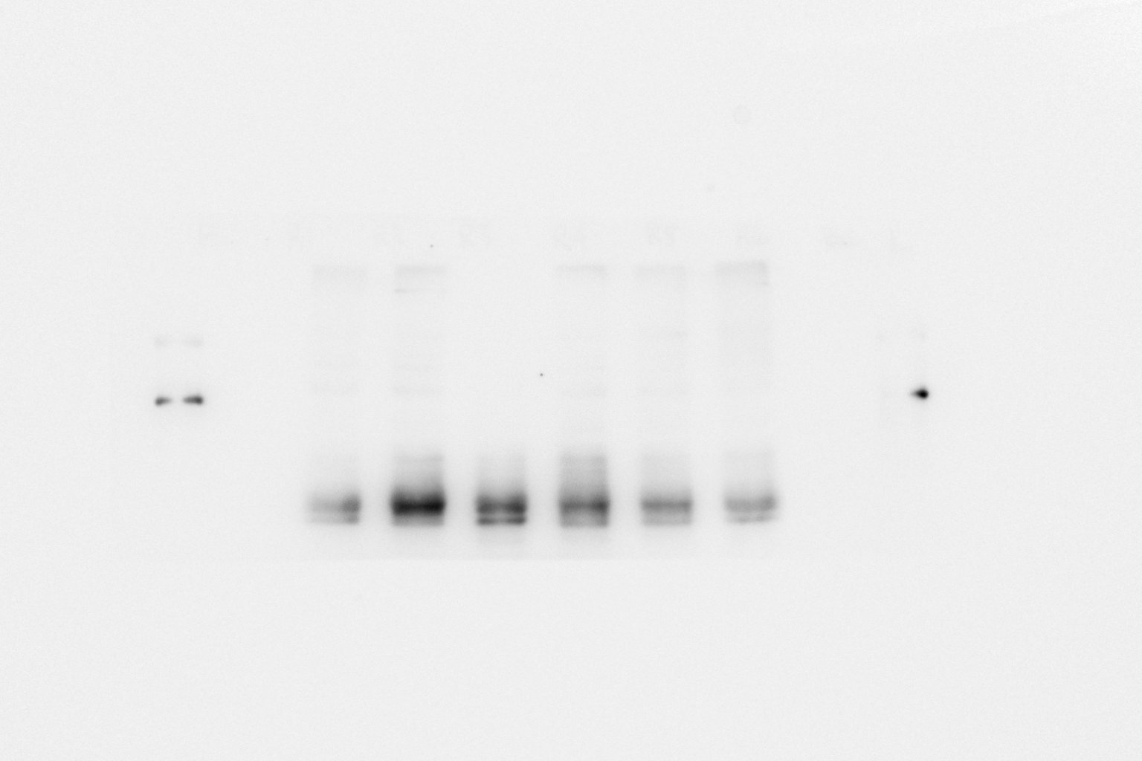
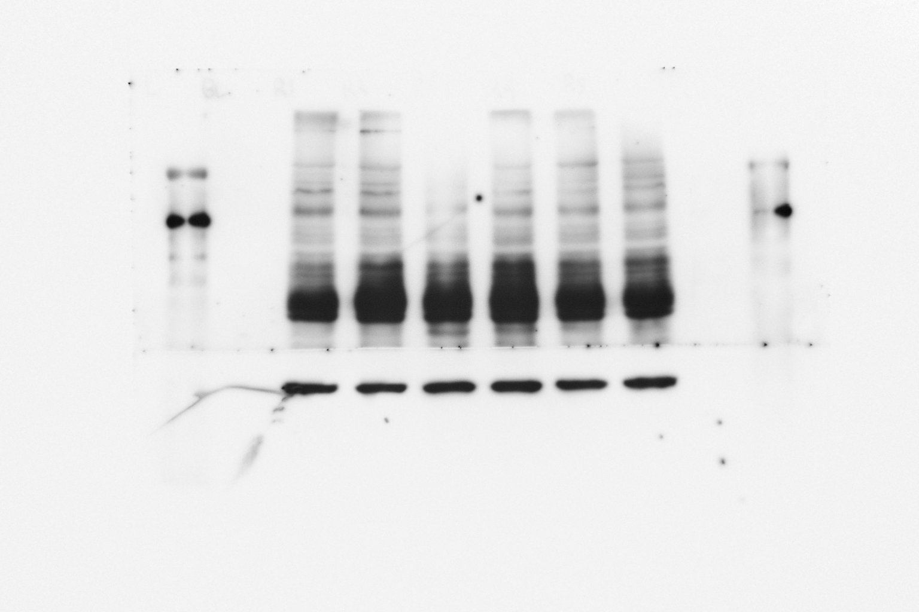
N5 T231
pTau T231
GAPDH
Sham A𝛃 A𝛃+Don A𝛃+INAA. A𝛃+POAA3 A𝛃+POAA30
Sham A𝛃 A𝛃+Don A𝛃+INAA. A𝛃+POAA3 A𝛃+POAA30
Exposure time 30s
Exposure time 2 min

Slide 14
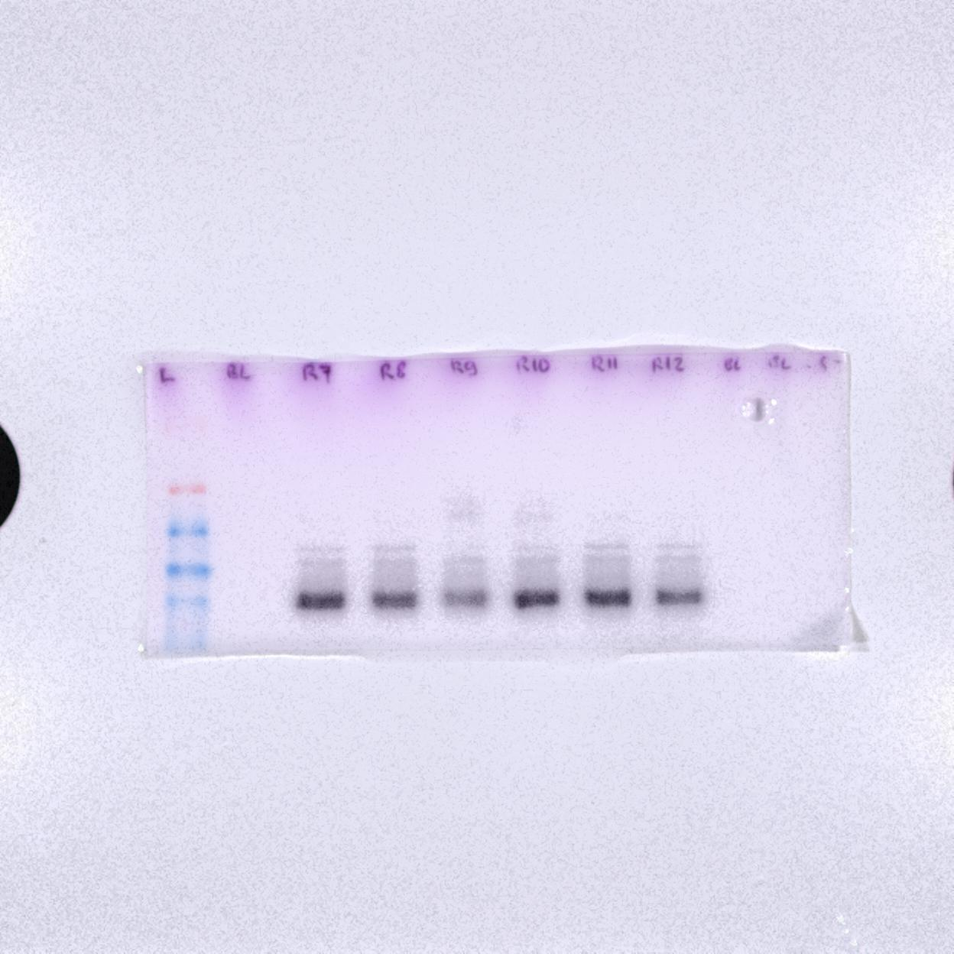
N6 T231
pTau T231
GAPDH
A𝛃+Don
A𝛃+POAA3
Sham A𝛃
A𝛃+INAA
A𝛃+POAA30
A𝛃+Don
A𝛃+INAA
Sham A𝛃
A𝛃+INAA
A𝛃+POAA30
Exposure time 30s
Exposure time 2 min

Slide 15
pTau S396
Prefrontal cortex

Slide 16
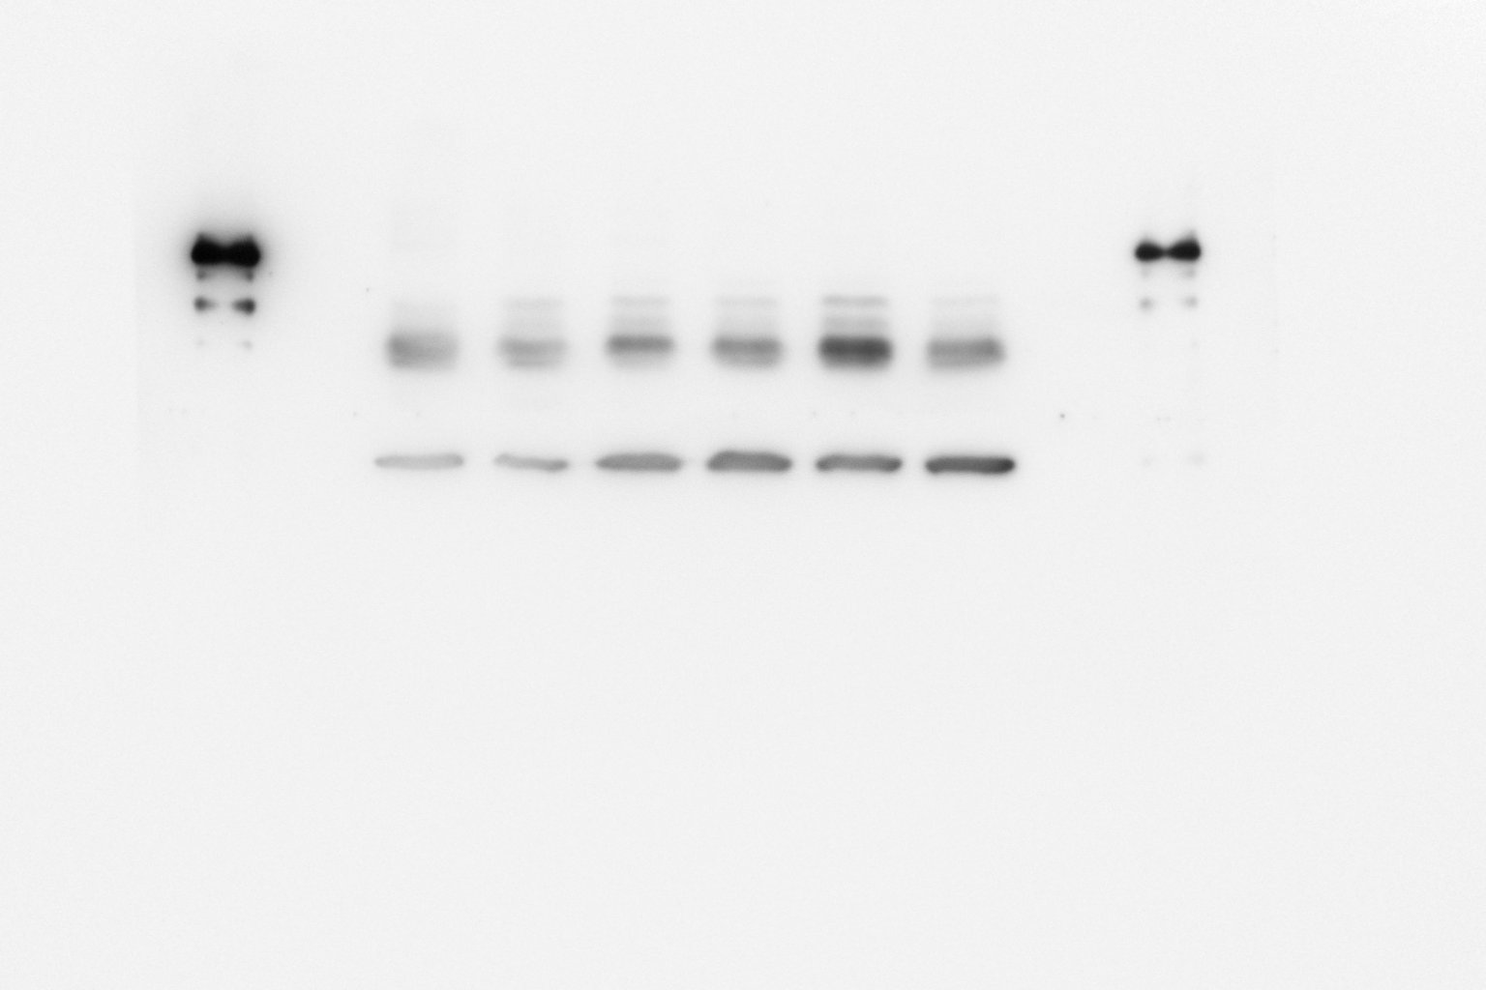
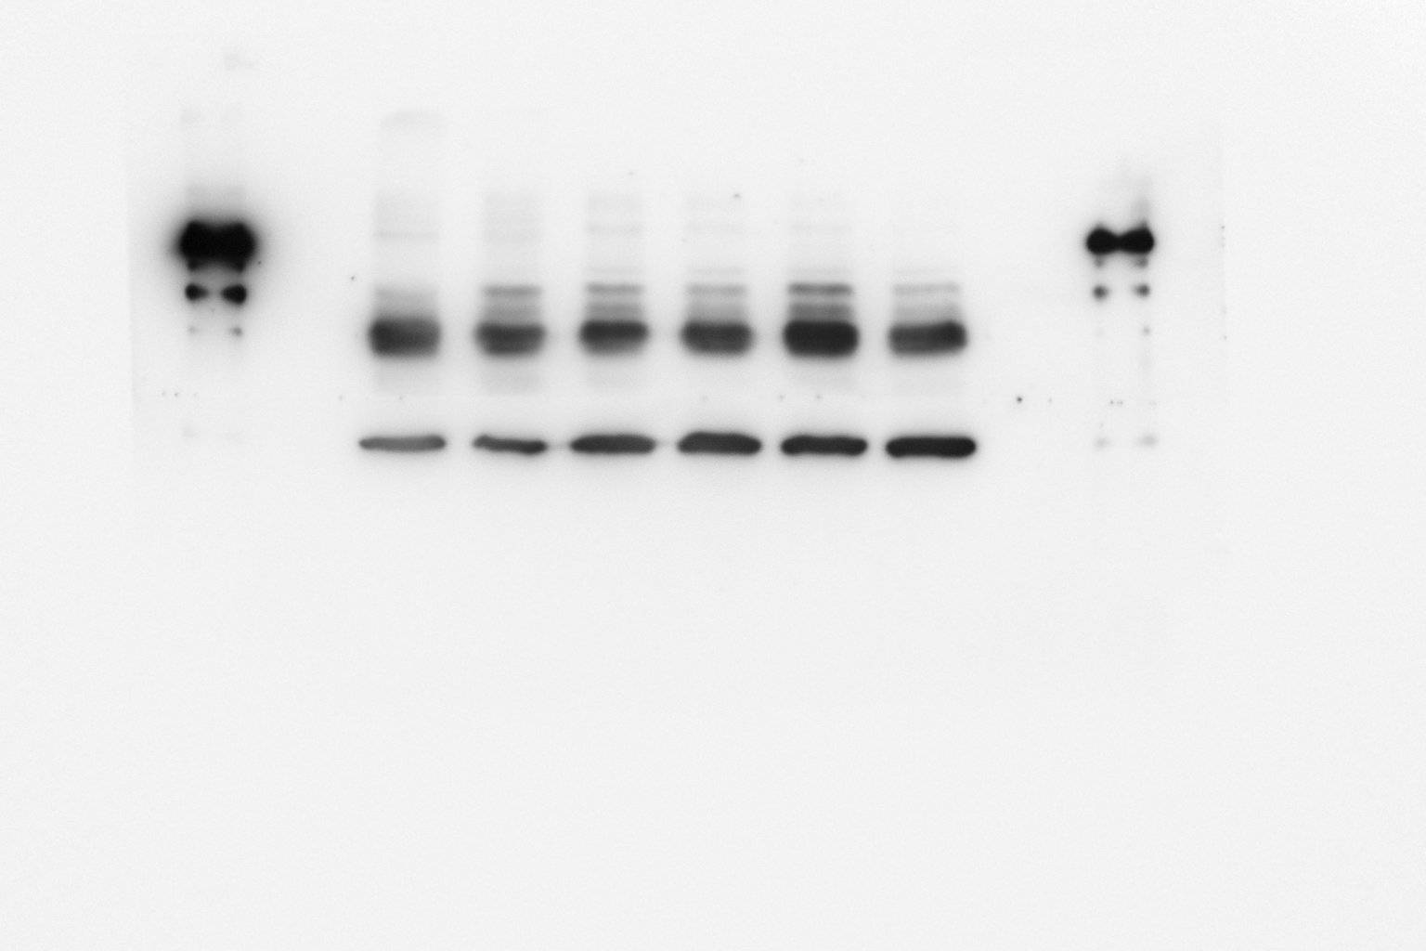
N1 S396
GAPDH
pTau S396
Sham A𝛃 A𝛃+Don A𝛃+INAA. A𝛃+POAA3 A𝛃+POAA30
Sham A𝛃 A𝛃+Don A𝛃+INAA A𝛃+POAA3 A𝛃+POAA30
Exposure time 30s
Exposure time 2 min

Slide 17
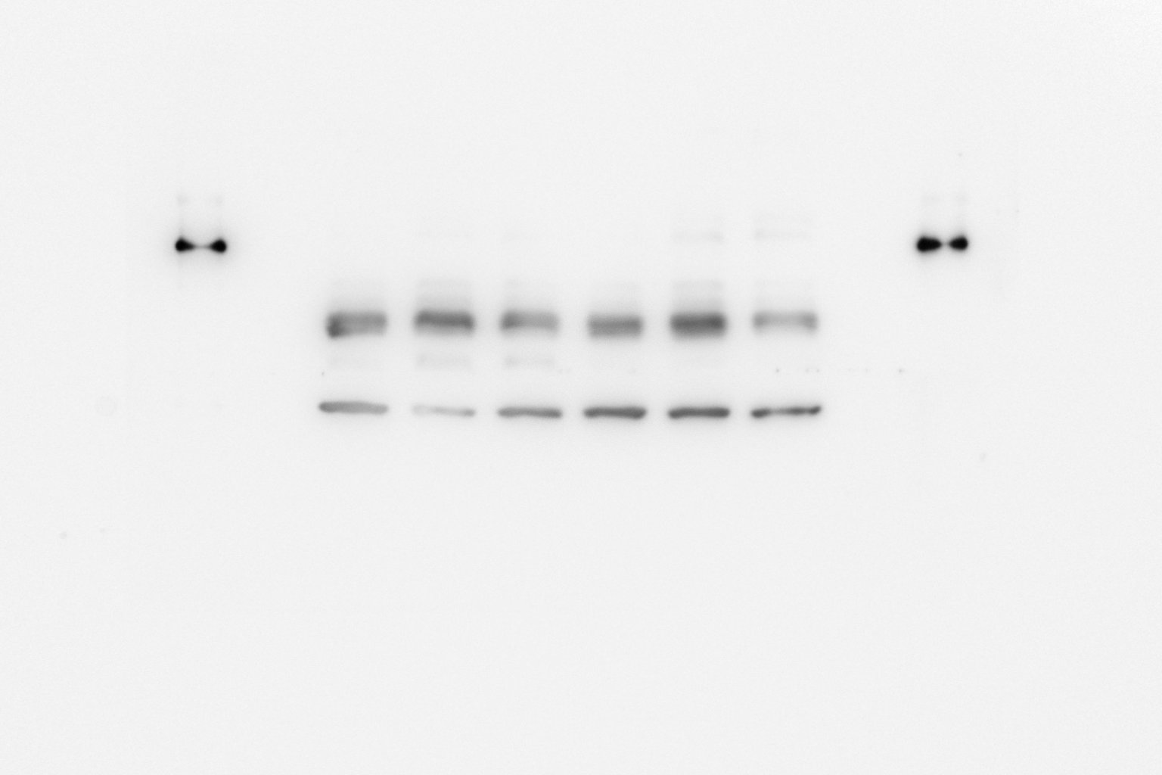
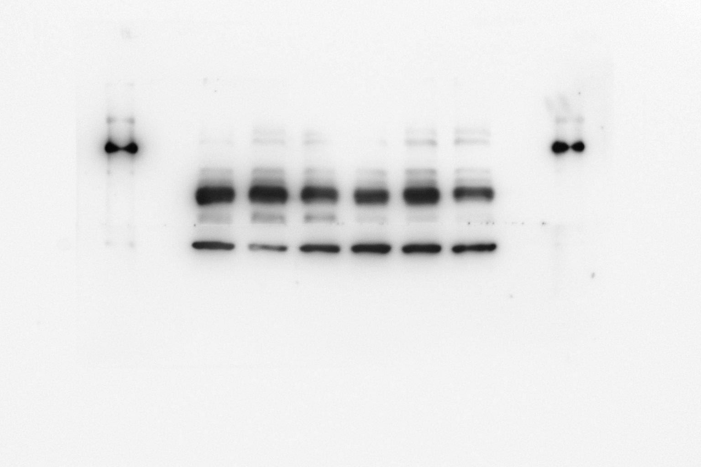
Raw Picture in Fig. 5C, the blue and red box position indicates the cutting position and both blots were running on the same gel
N2 S396
pTau S396
GAPDH
Sham A𝛃 A𝛃+Don A𝛃+INAA A𝛃+POAA3 A𝛃+POAA30
Sham A𝛃 A𝛃+Don A𝛃+INAA A𝛃+POAA3 A𝛃+POAA30
Exposure time 30s
Exposure time 2 min

Slide 18
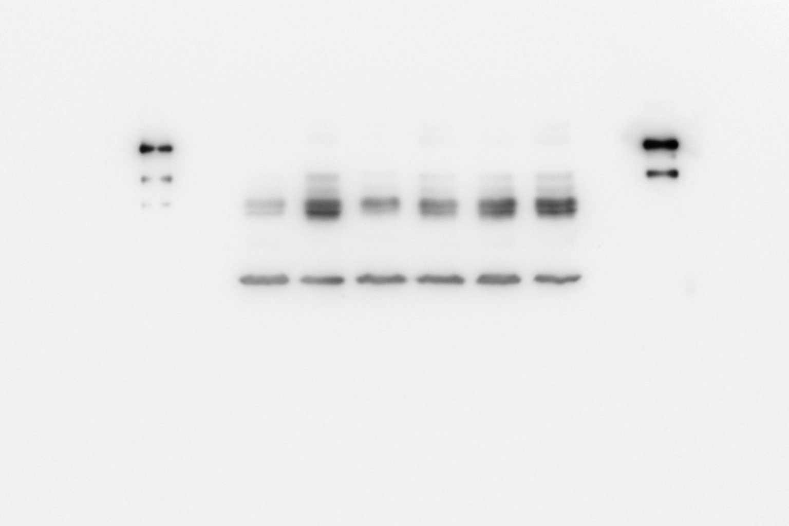
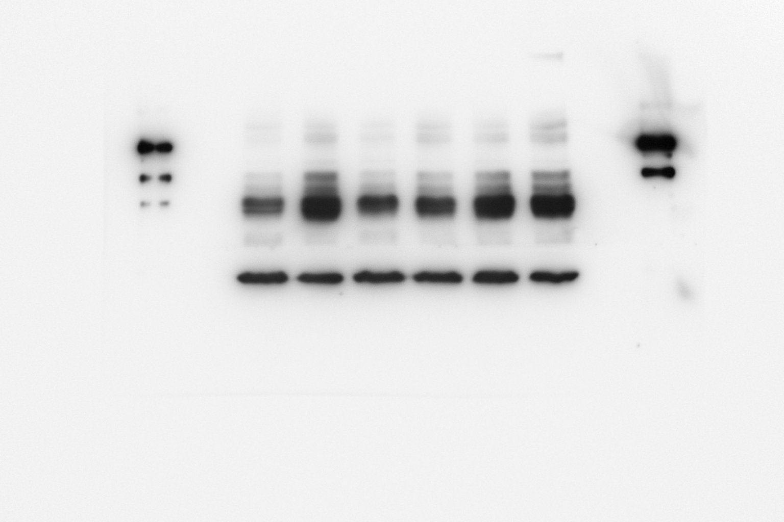
N3 S396
pTau S396
GAPDH
Sham A𝛃 A𝛃+Don A𝛃+INAA A𝛃+POAA3 A𝛃+POAA30
Sham A𝛃 A𝛃+Don A𝛃+INAA A𝛃+POAA3 A𝛃+POAA30
Exposure time 30s
Exposure time 2 min

Slide 19
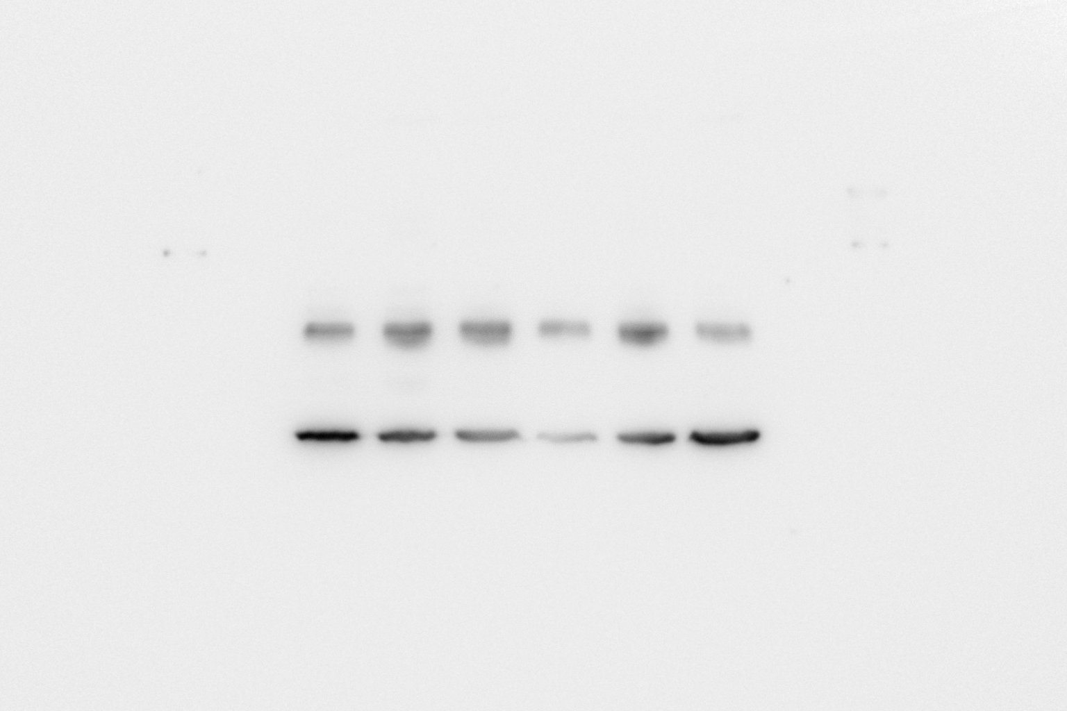
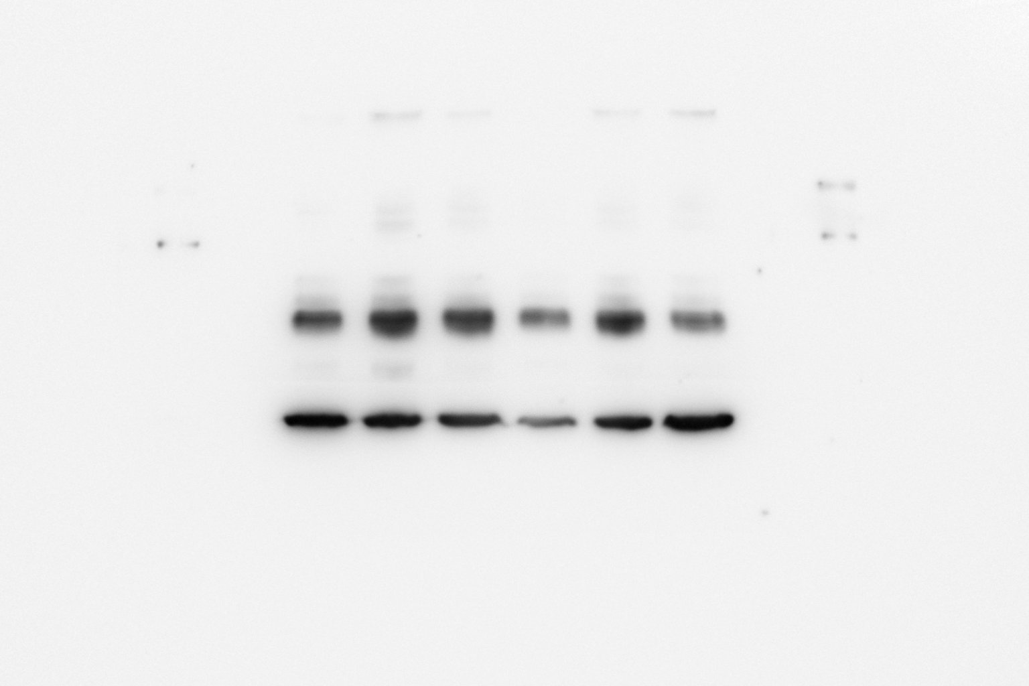
N4 S396
GAPDH
pTau S396
Sham A𝛃 A𝛃+Don A𝛃+INAA A𝛃+POAA3 A𝛃+POAA30
Sham A𝛃 A𝛃+Don A𝛃+INAA A𝛃+POAA3 A𝛃+POAA30
Exposure time 30s
Exposure time 2 min

Slide 20
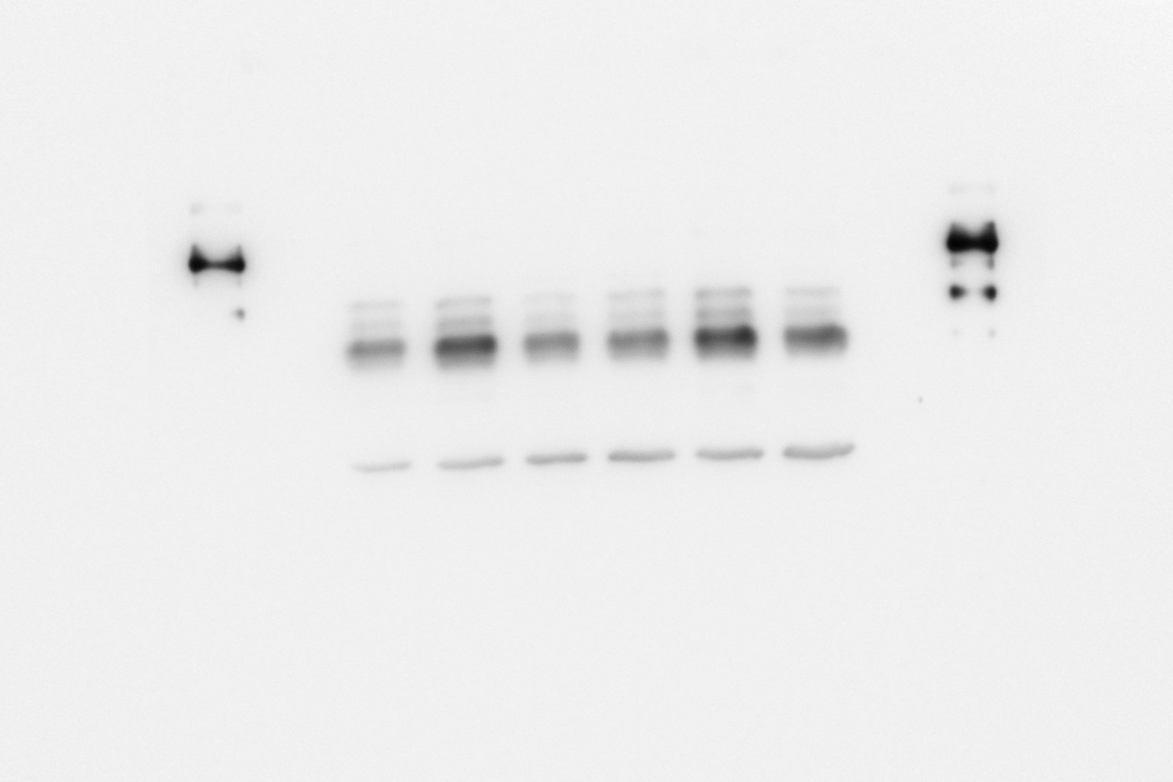
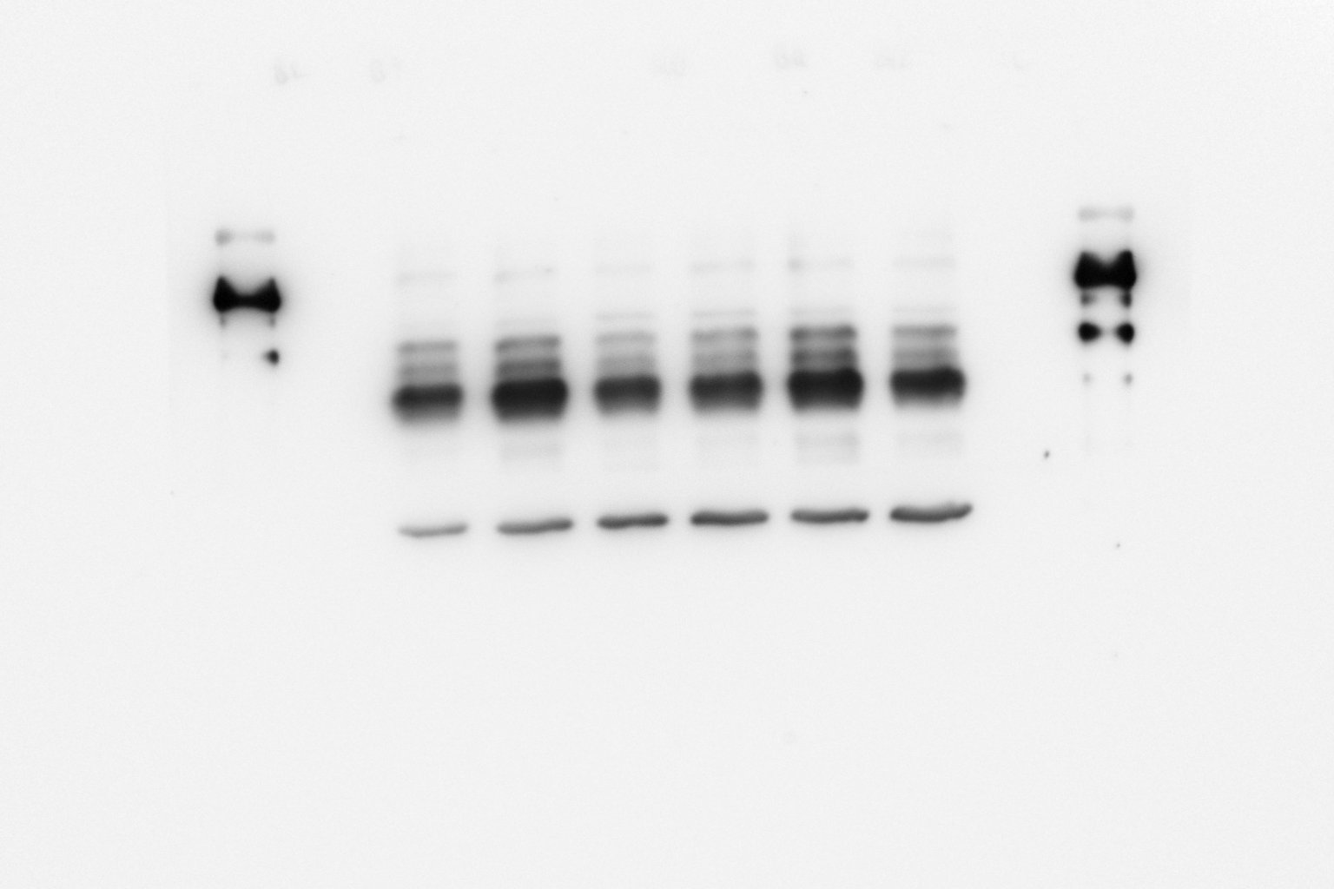
N5 S396
GAPDH
pTau S396
Sham A𝛃 A𝛃+Don A𝛃+INAA A𝛃+POAA3 A𝛃+POAA30
Sham A𝛃 A𝛃+Don A𝛃+INAA A𝛃+POAA3 A𝛃+POAA30
Exposure time 30s
Exposure time 2 min

Slide 21
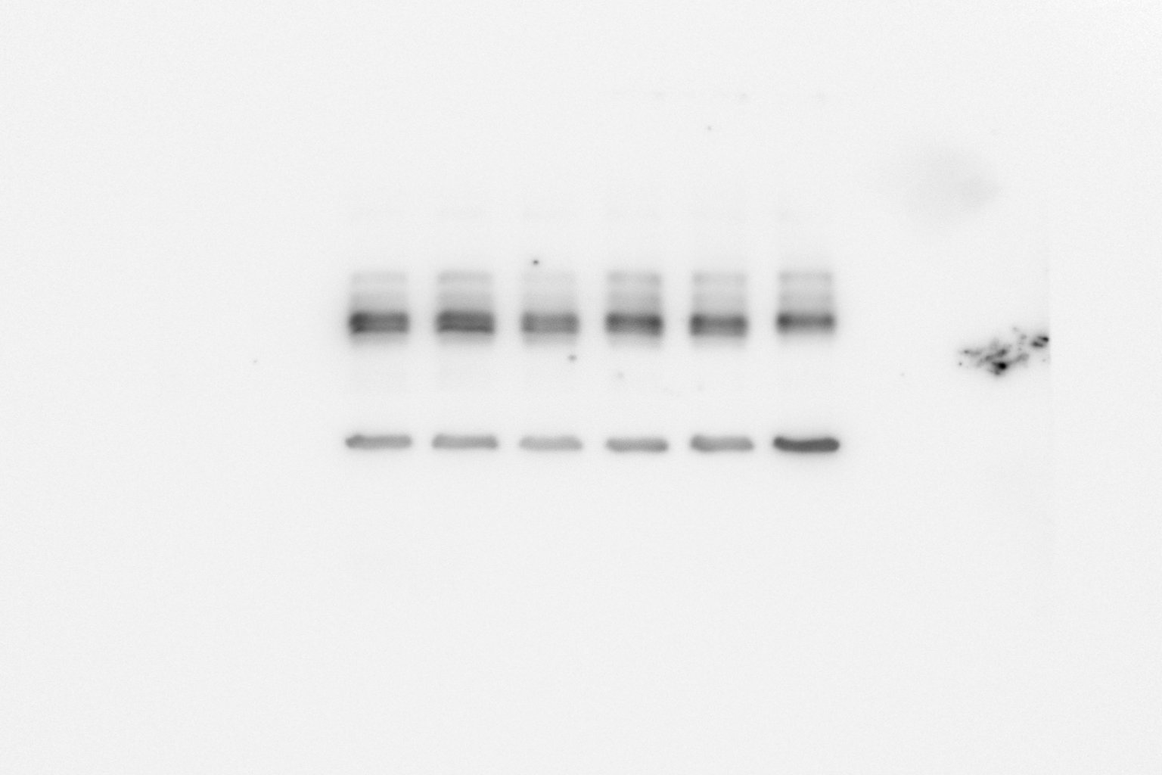
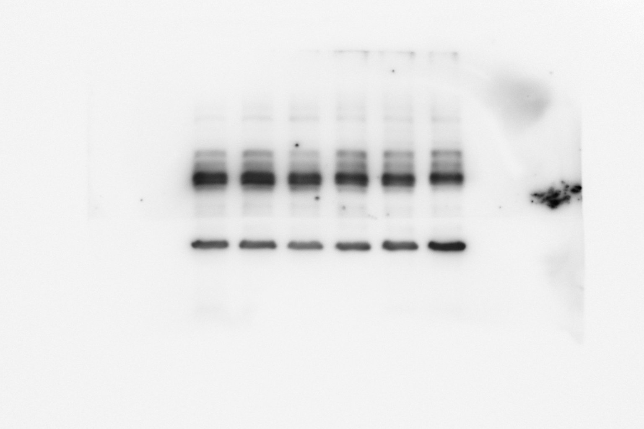
N6 S396
pTau S396
GAPDH
Sham A𝛃 A𝛃+Don A𝛃+INAA A𝛃+POAA3 A𝛃+POAA30
Sham A𝛃 A𝛃+Don A𝛃+INAA A𝛃+POAA3 A𝛃+POAA30
Exposure time 30s
Exposure time 2 min

Slide 22
pTau T231
Prefrontal cortex

Slide 23
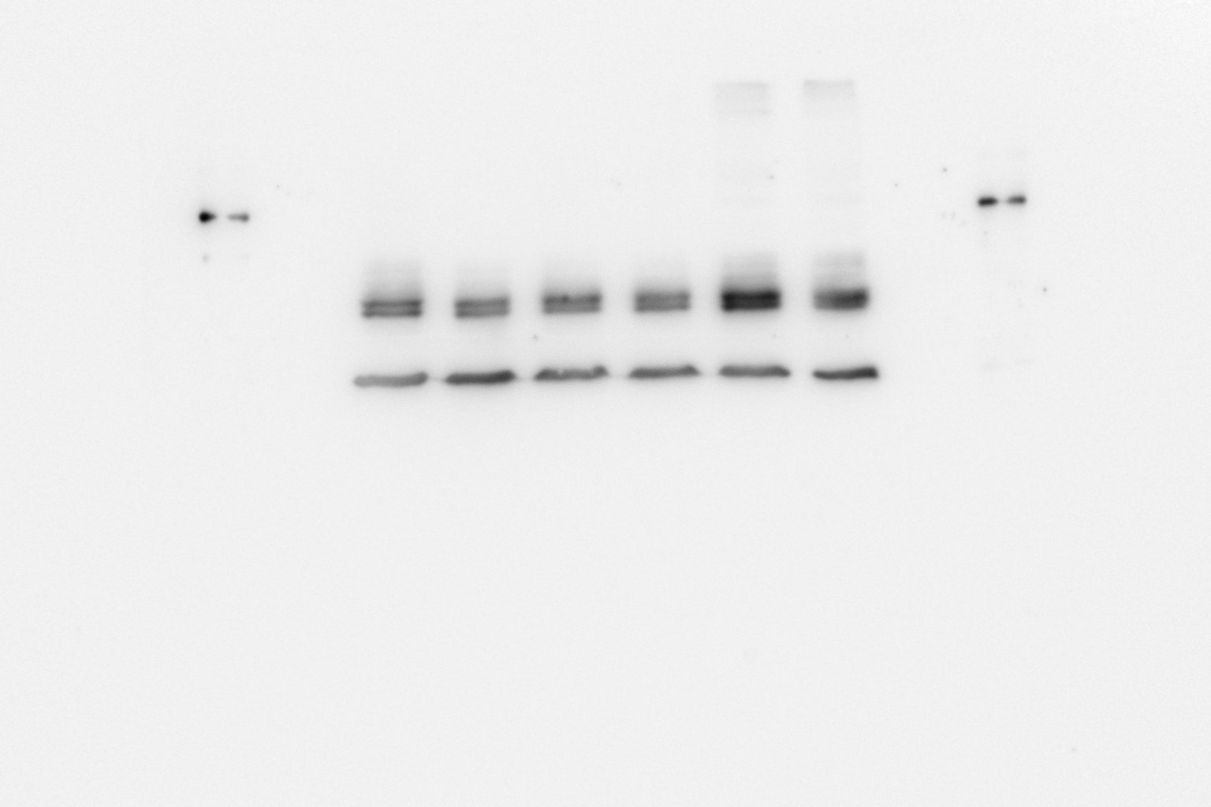
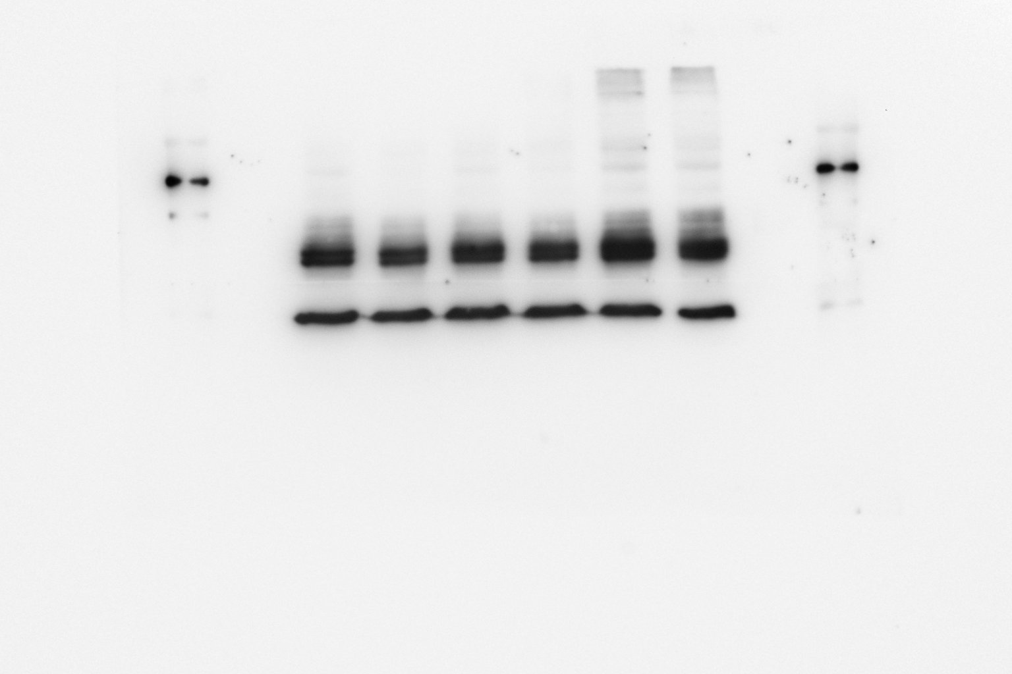
N1 T231
GAPDH
pTau T231
Sham A𝛃 A𝛃+Don A𝛃+INAA A𝛃+POAA3 A𝛃+POAA30
Sham A𝛃 A𝛃+Don A𝛃+INAA A𝛃+POAA3 A𝛃+POAA30
Exposure time 30s
Exposure time 2 min

Slide 24
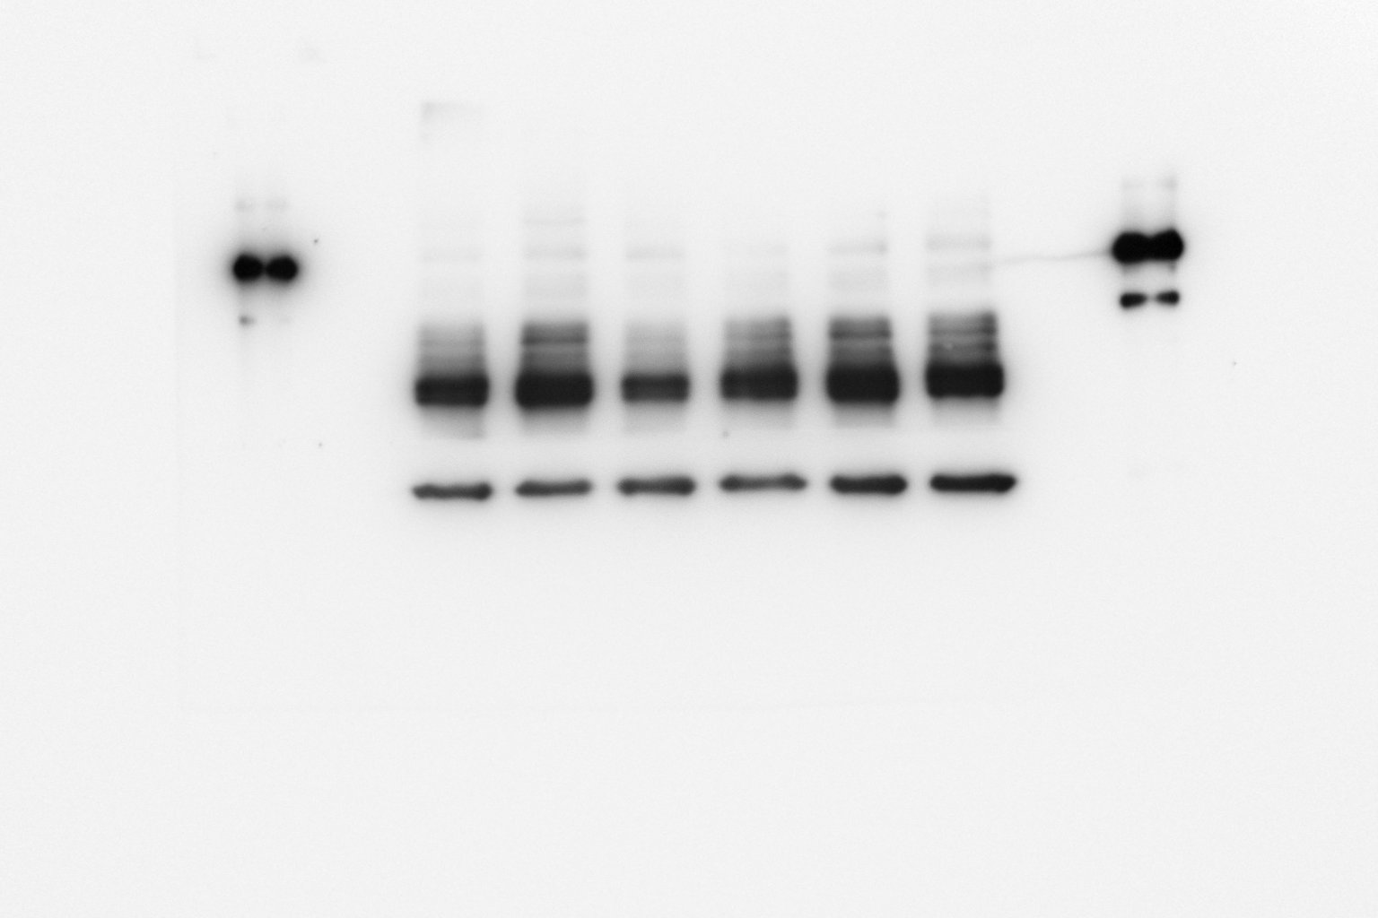
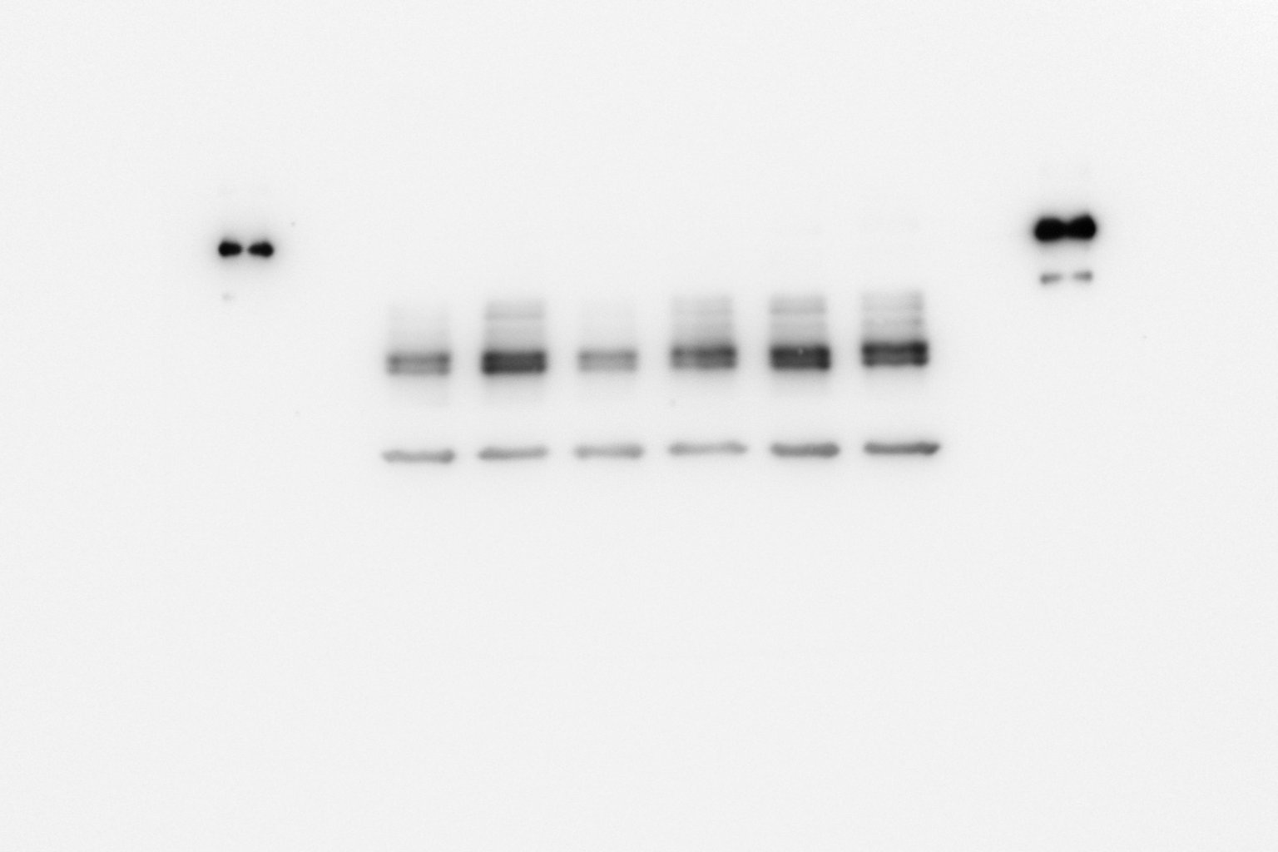
Raw Picture in Fig. 5D, the blue and red box position indicates the cutting position and both blots were running on the same gel
N2 T231
GAPDH
pTau T231
Sham A𝛃 A𝛃+Don A𝛃+INAA A𝛃+POAA3 A𝛃+POAA30
Sham A𝛃 A𝛃+Don A𝛃+INAA A𝛃+POAA3 A𝛃+POAA30
Exposure time 30s
Exposure time 2 min

Slide 25
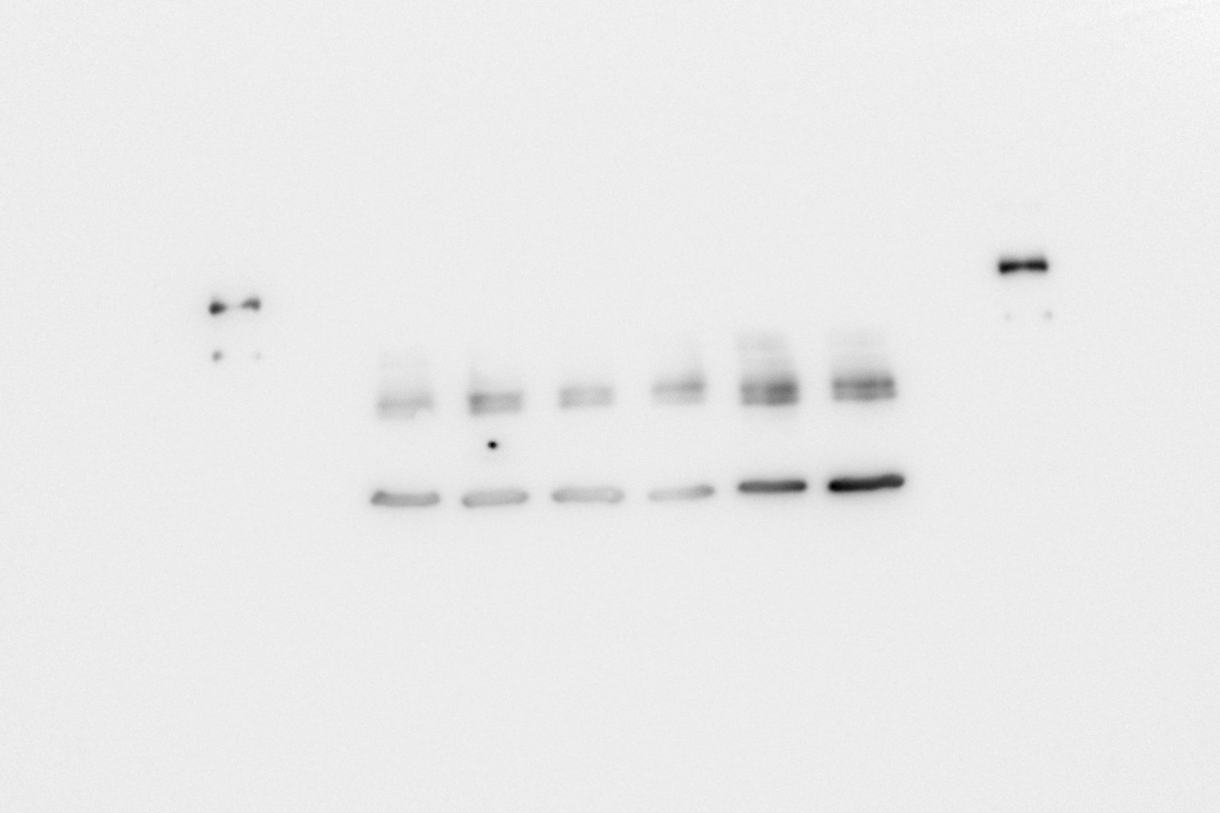
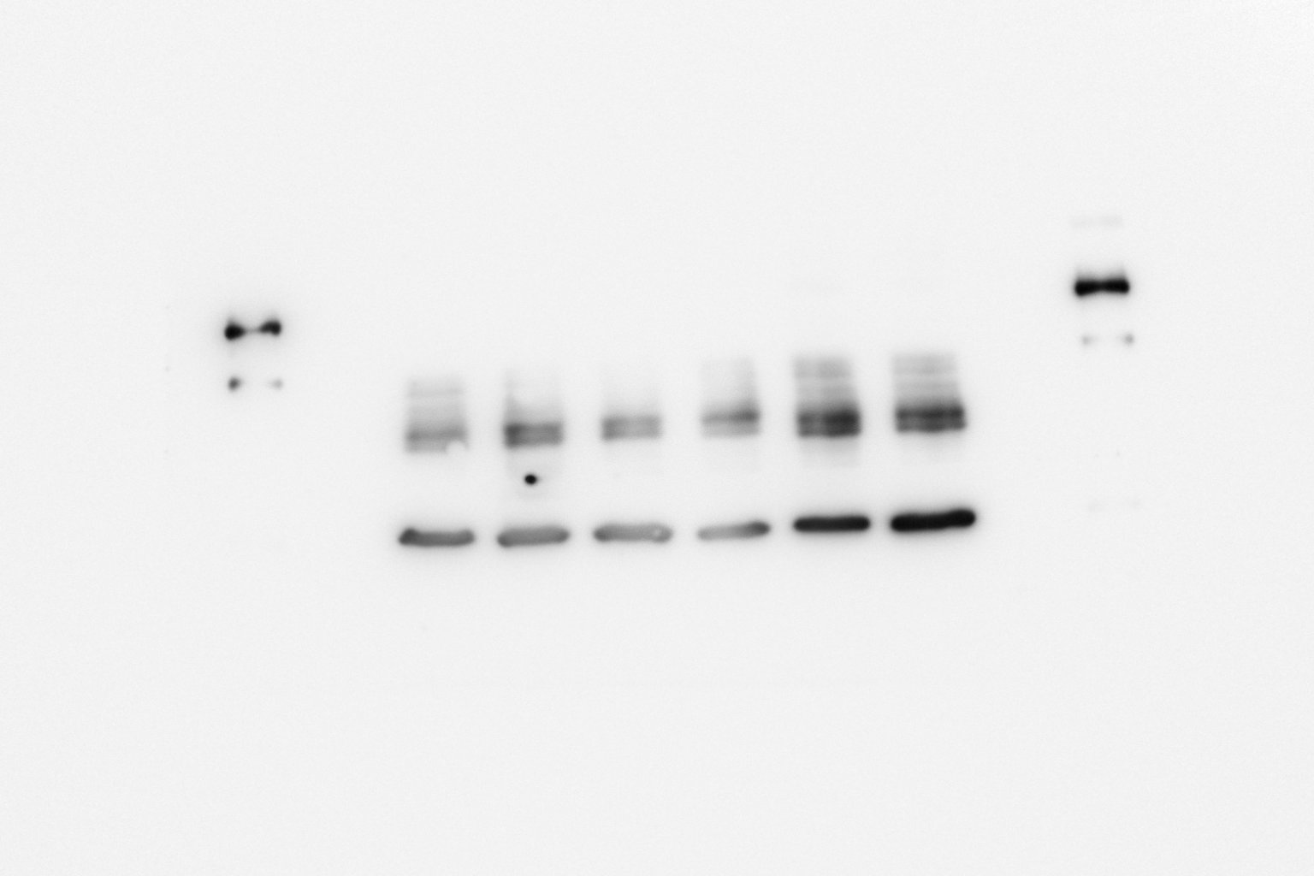
N3 T231
pTau T231
GAPDH
Sham A𝛃 A𝛃+Don A𝛃+INAA A𝛃+POAA3 A𝛃+POAA30
Sham A𝛃 A𝛃+Don A𝛃+INAA A𝛃+POAA3 A𝛃+POAA30
Exposure time 30s
Exposure time 2 min

Slide 26
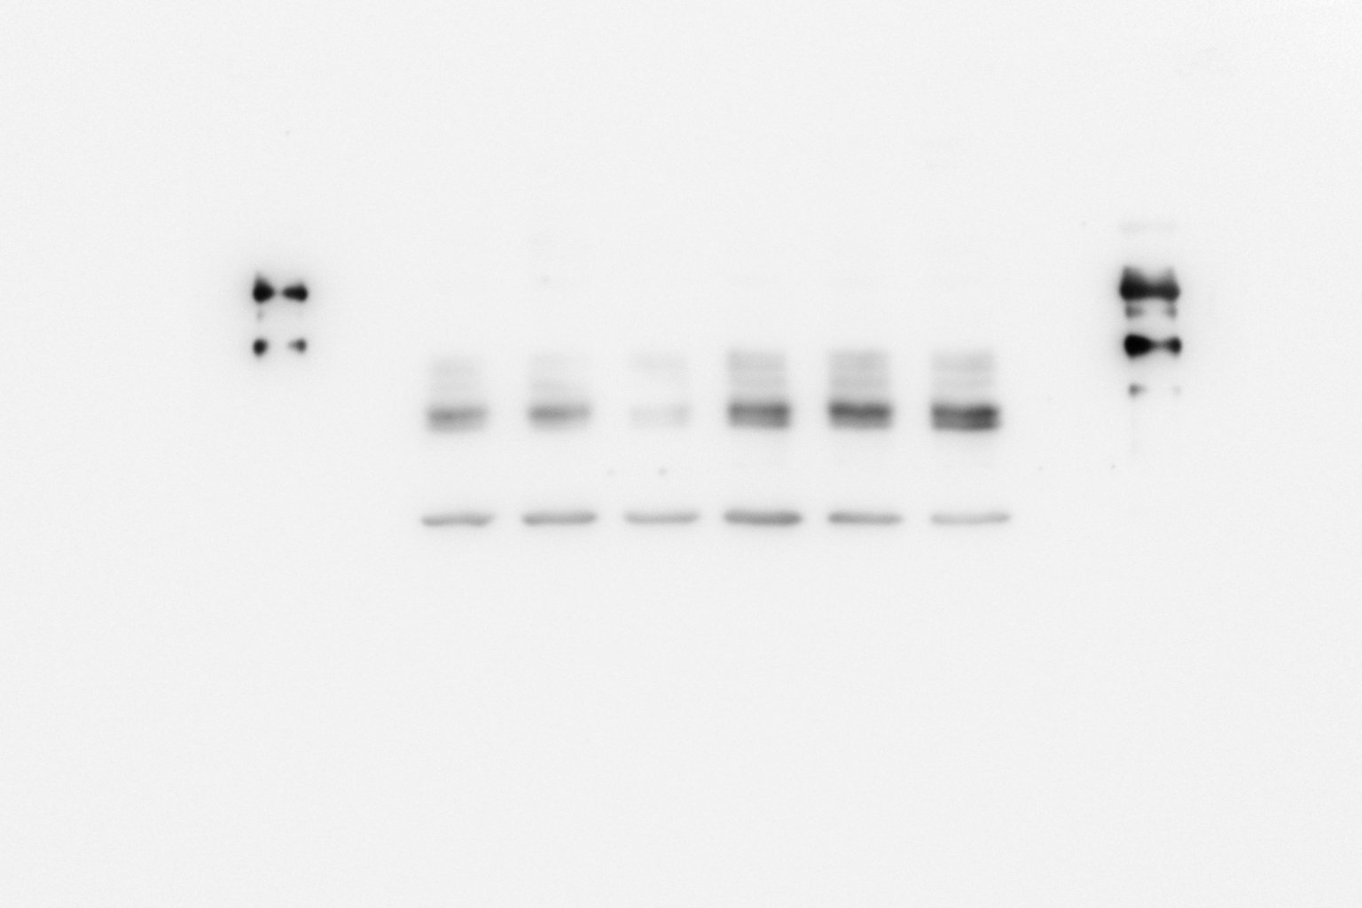
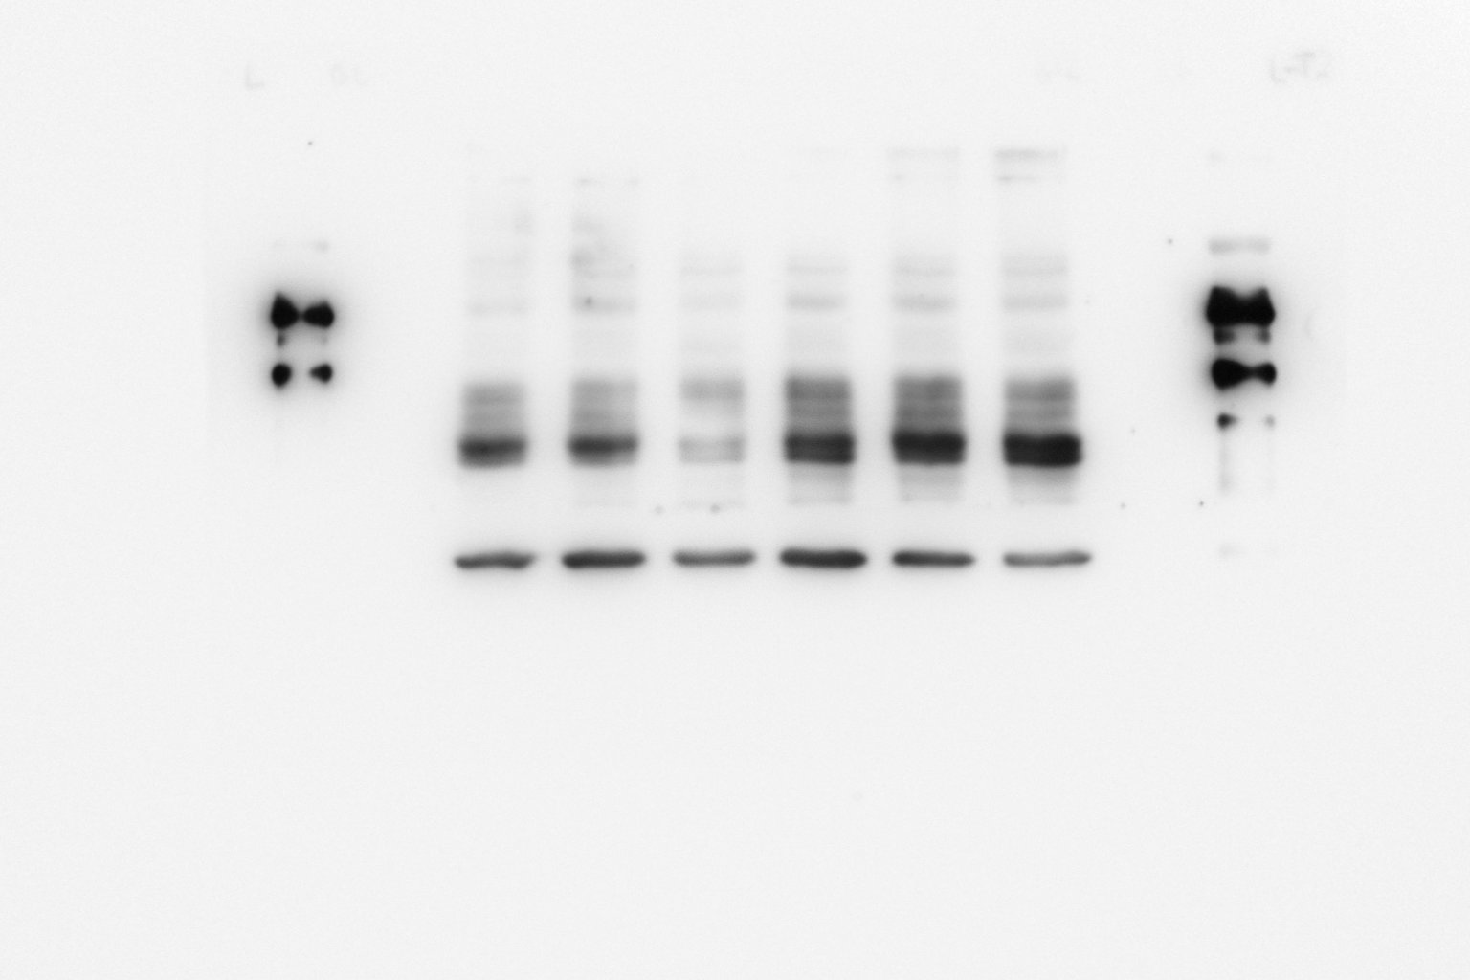
N4 T231
pTau T231
GAPDH
Sham A𝛃 A𝛃+Don A𝛃+INAA A𝛃+POAA3 A𝛃+POAA30
Sham A𝛃 A𝛃+Don A𝛃+INAA A𝛃+POAA3 A𝛃+POAA30
Exposure time 30s
Exposure time 2 min

Slide 27
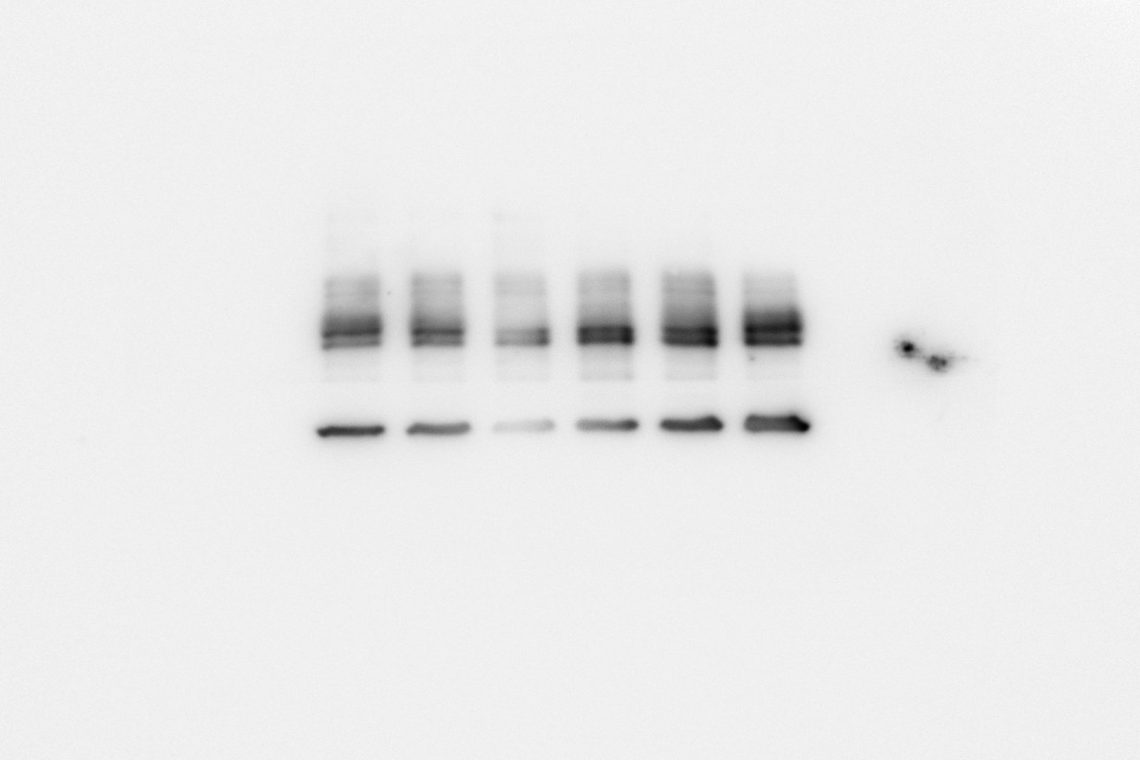
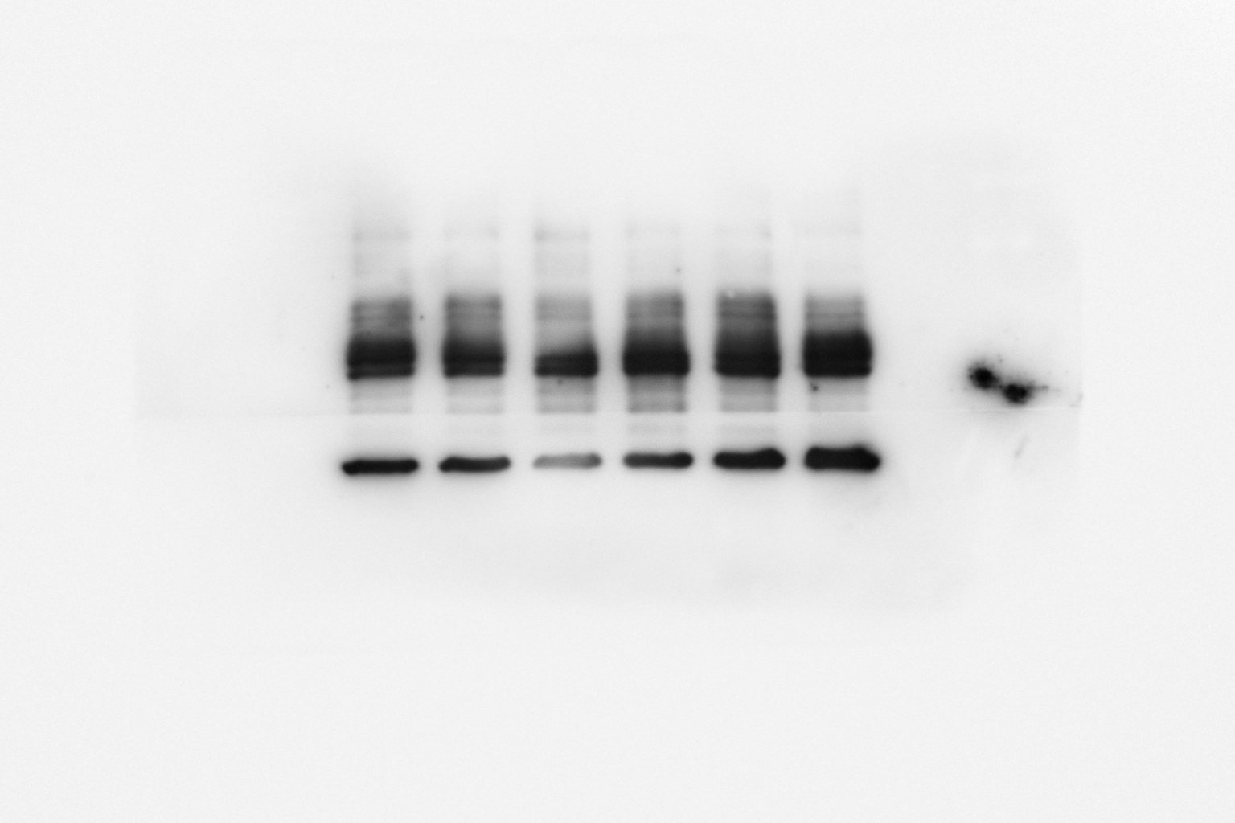
N5 T231
pTau T231
GAPDH
Sham A𝛃 A𝛃+Don A𝛃+INAA A𝛃+POAA3 A𝛃+POAA30
Sham A𝛃 A𝛃+Don A𝛃+INAA A𝛃+POAA3 A𝛃+POAA30
Exposure time 30s
Exposure time 2 min

Slide 28
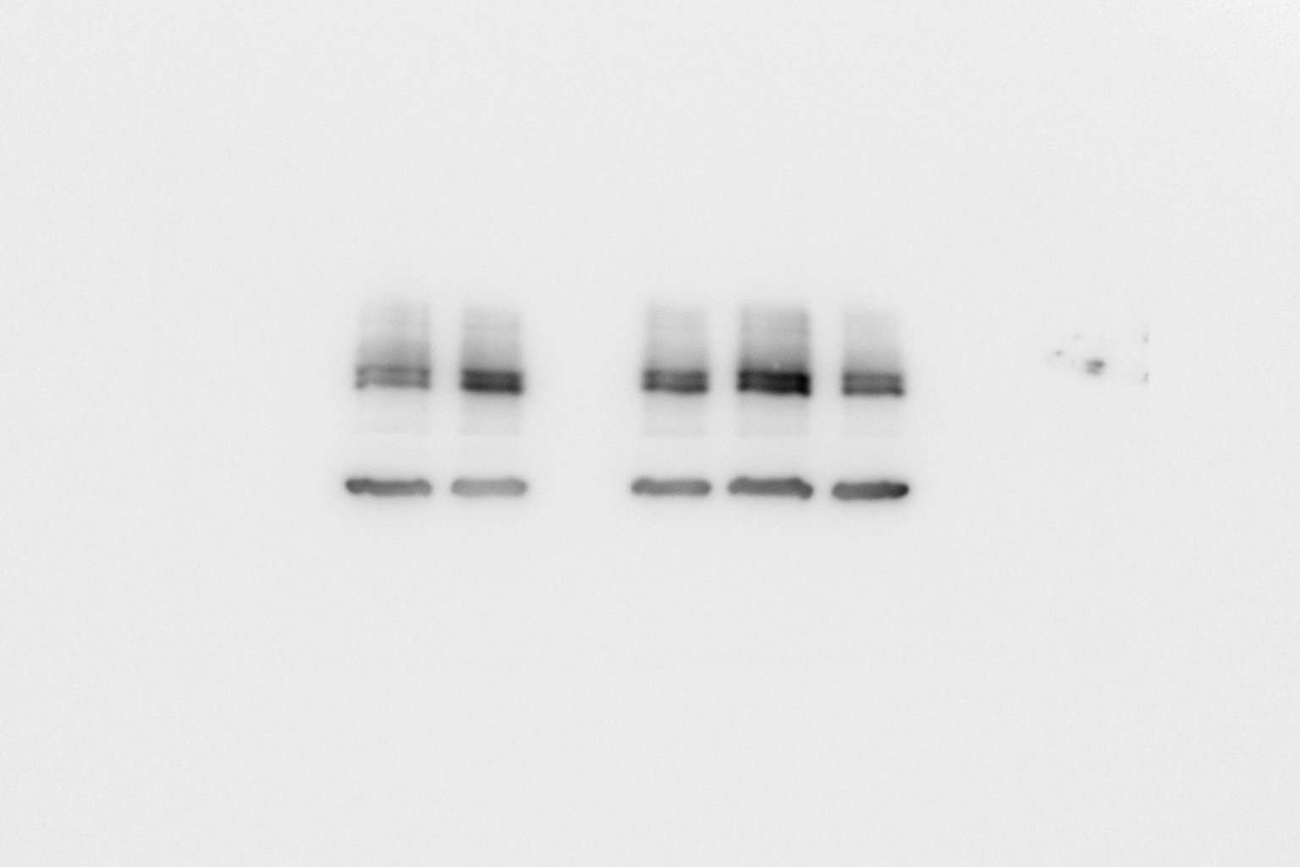
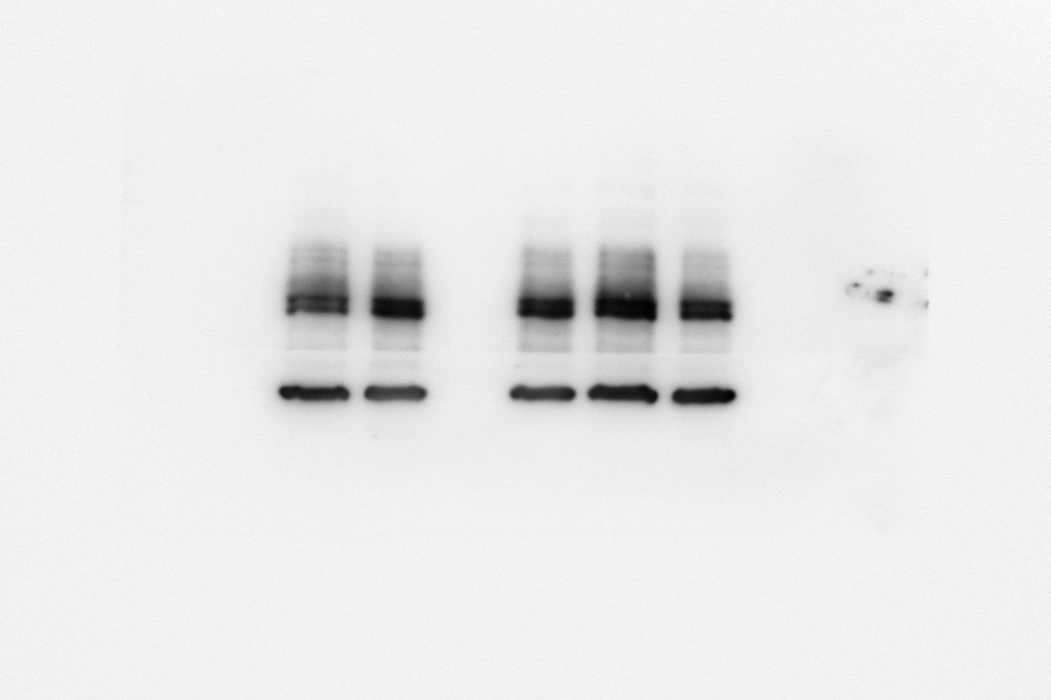
N6 T231
pTau T231
GAPDH
Sham A𝛃 A𝛃+INAA A𝛃+POAA3 A𝛃+POAA30
Sham A𝛃 A𝛃+INAA A𝛃+POAA3 A𝛃+POAA30
Exposure time 30s
Exposure time 2 min

