Slide 1
Radiographic interpretation of bone lesions

Slide 2
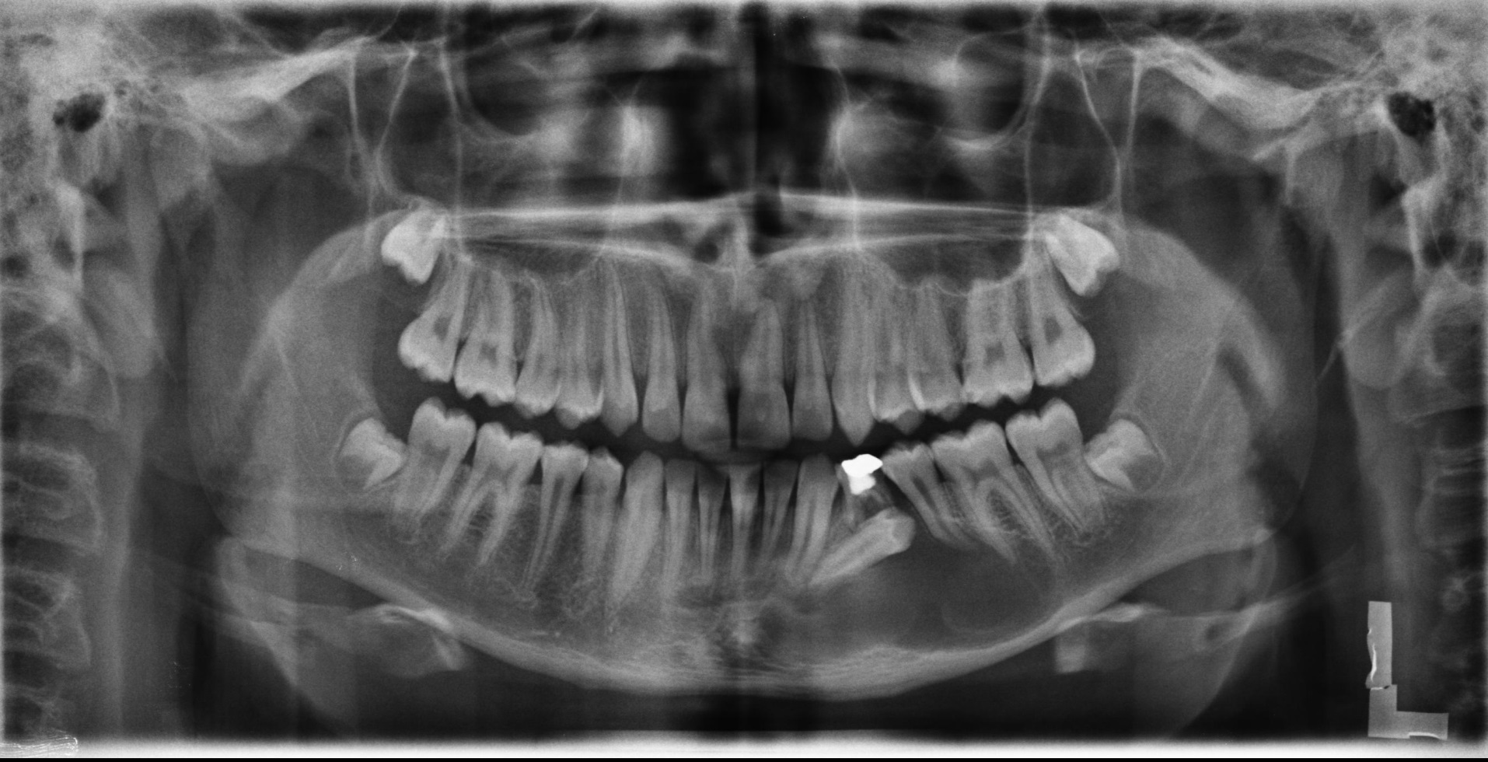
Do you see any abnormality on this panoramic view? If so, please interpret it and provide the list of differential diagnoses

Slide 3
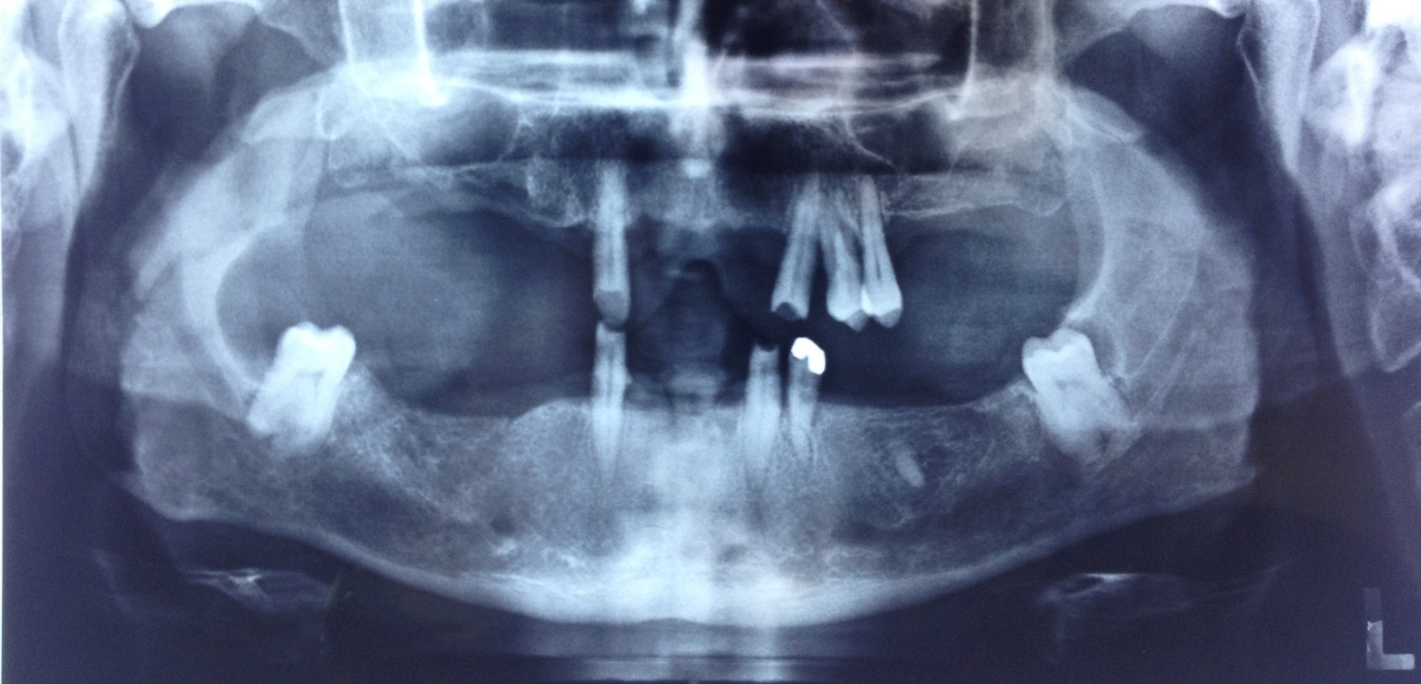
Do you see any abnormality on this panoramic view? If so, please interpret it and provide the list of differential diagnoses

Slide 4
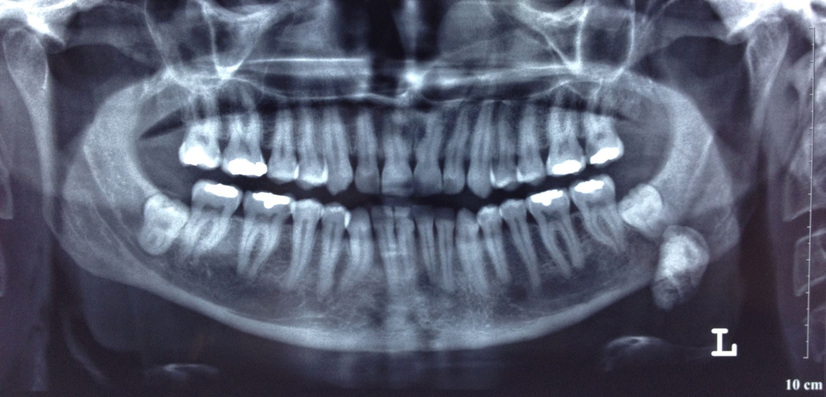
Do you see any abnormality on this panoramic view? If so, please interpret it and provide the list of differential diagnoses

Slide 5
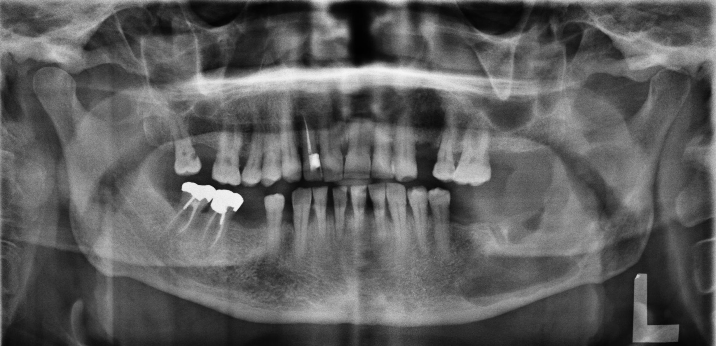
Do you see any abnormality on this panoramic view? If so, please interpret it and provide the list of differential diagnoses

Slide 6
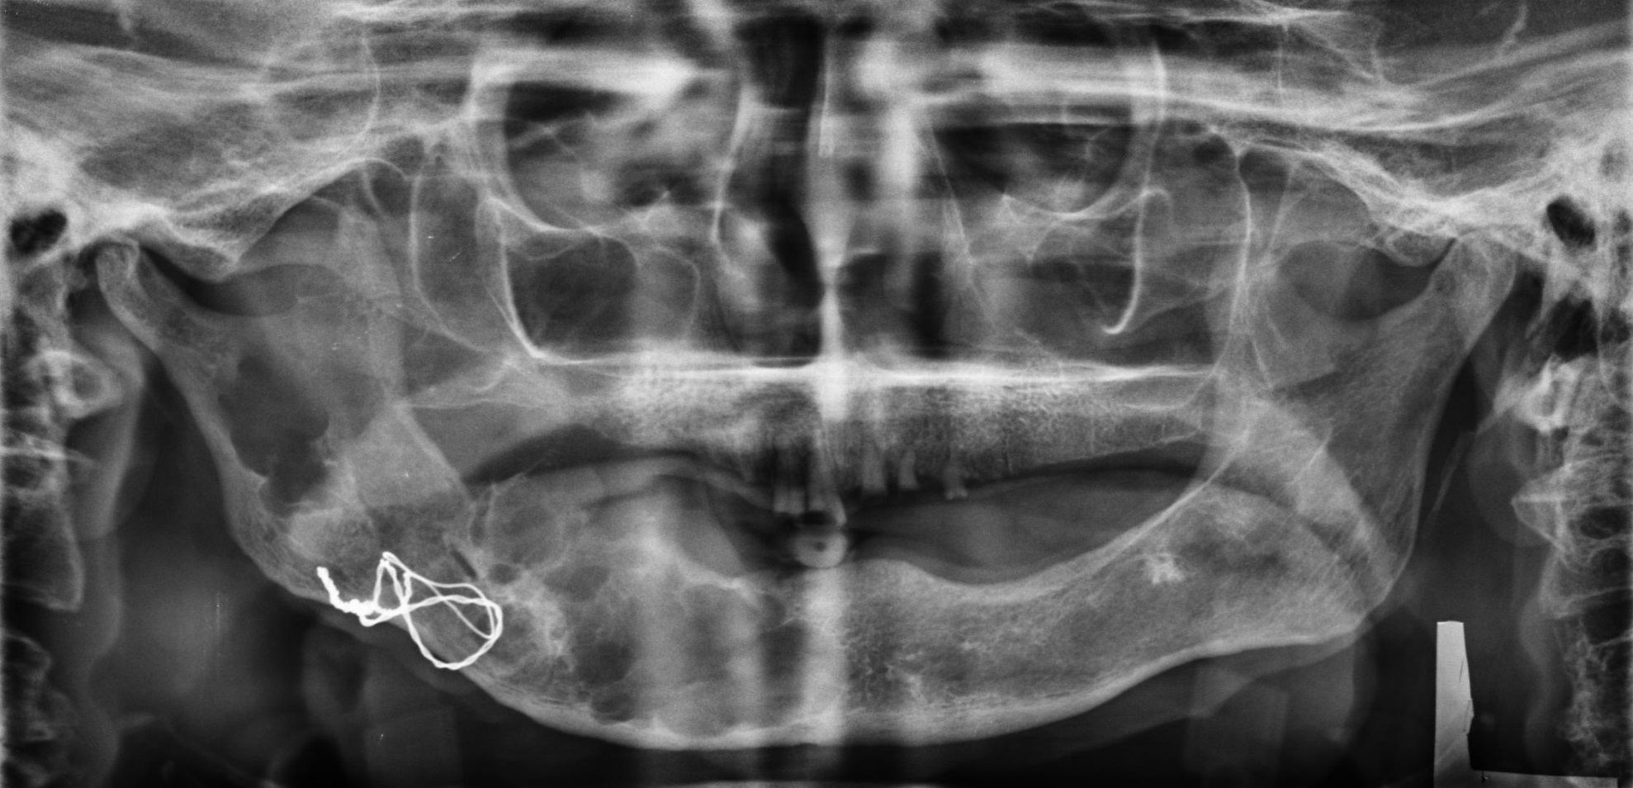
Do you see any abnormality on this panoramic view? If so, please interpret it and provide the list of differential diagnoses

Slide 7
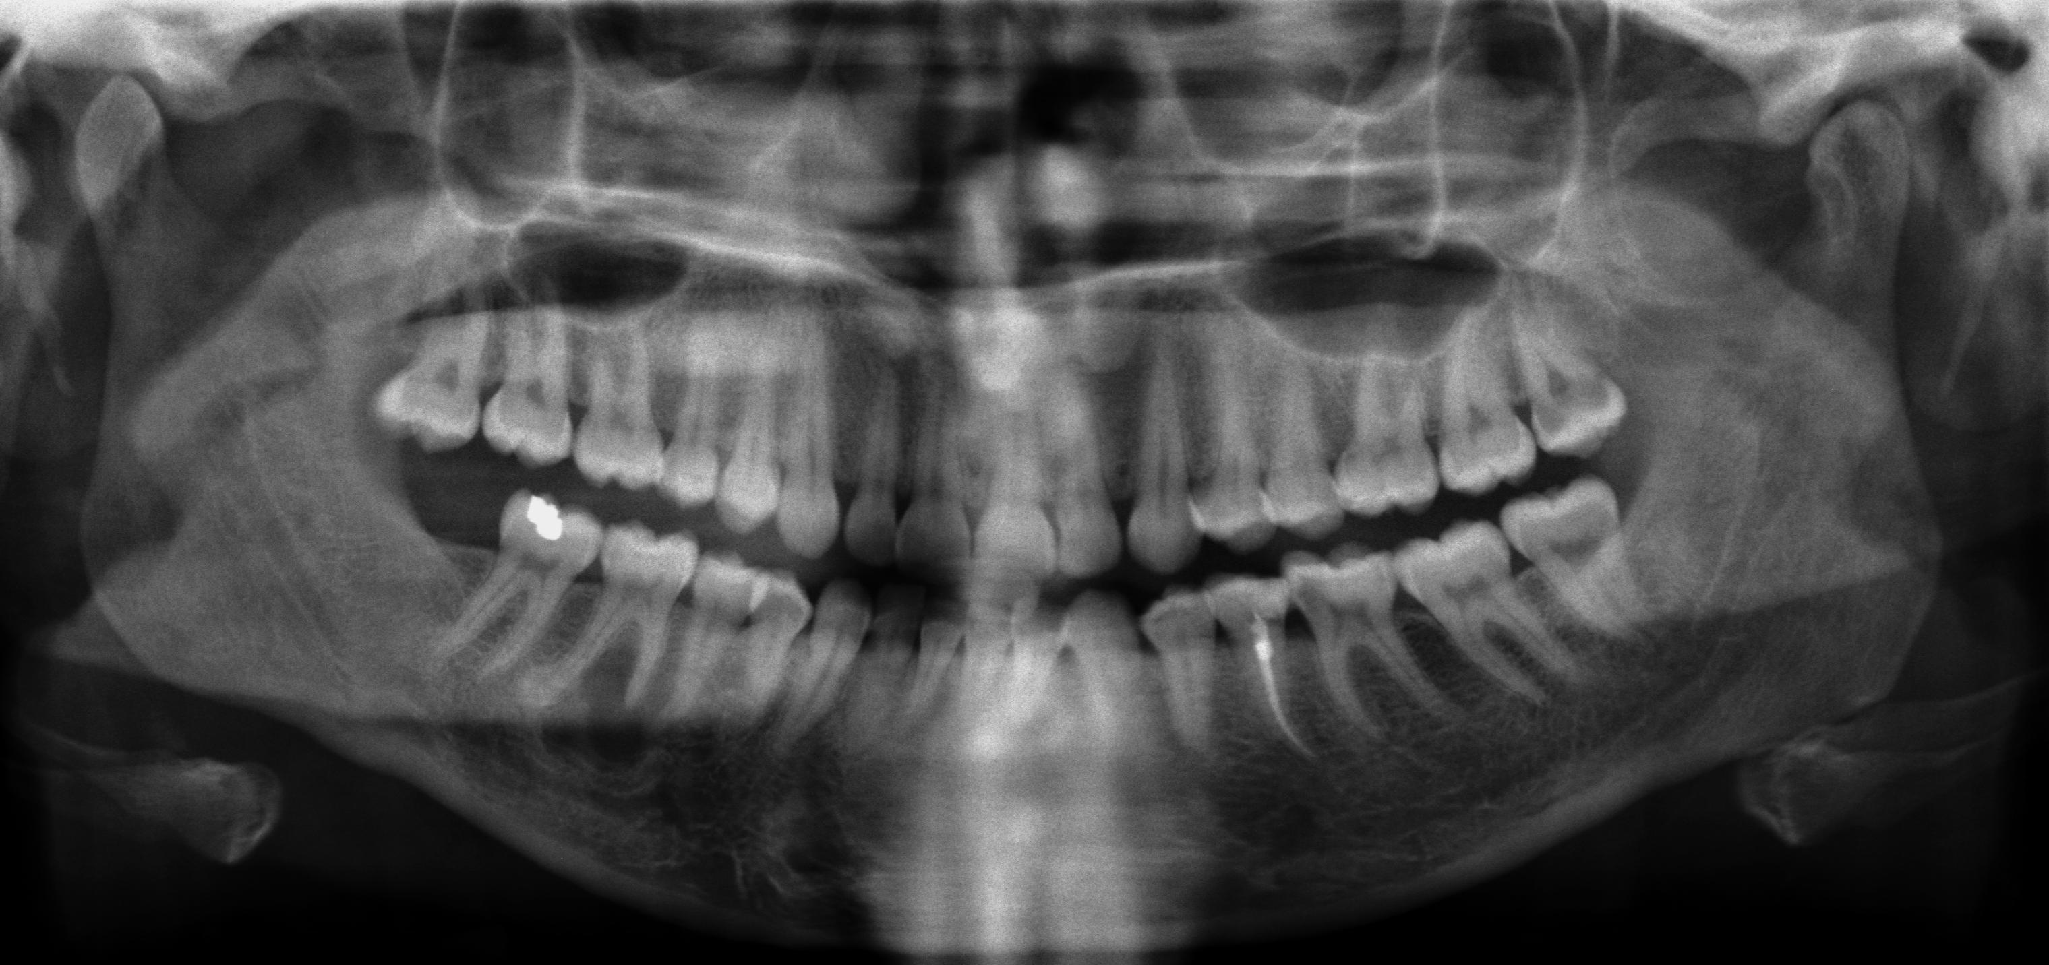
Do you see any abnormality on this panoramic view? If so, please interpret it and provide the list of differential diagnoses

Slide 8
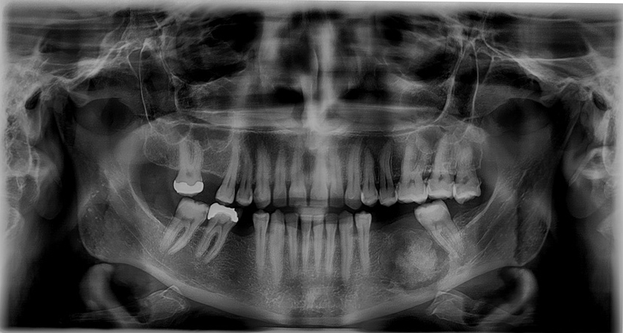
Do you see any abnormality on this panoramic view? If so, please interpret it and provide the list of differential diagnoses

Slide 9
Good luck!

