Slide 1

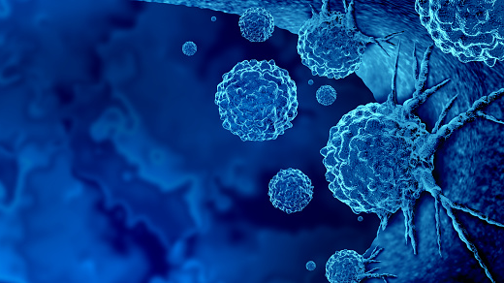
Game Play
Introduction
More
CANCER HALLMARK

Slide 2




CANCER HALLMARK
Introduction
Game Play
More
Escape
Room
Empire State Building
1,250 feet
Empire State Building, steel-framed skyscraper rising 102 stories that was completed in New York City in 1931 and was the tallest building in the world until 1971. The Empire State Building is located in Midtown Manhattan, on Fifth Avenue at 34th Street.

Slide 3

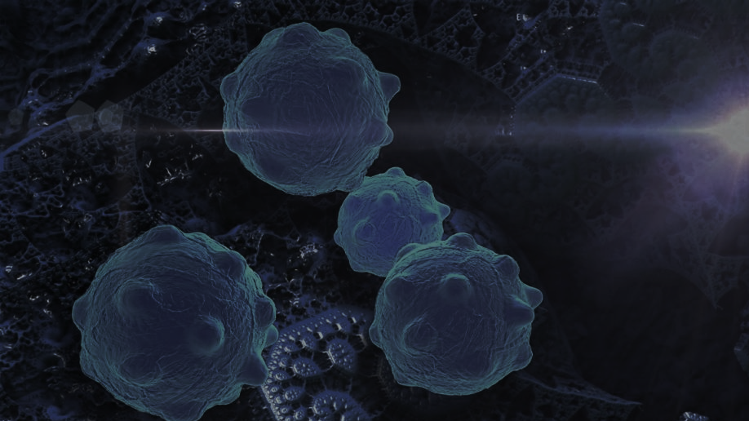
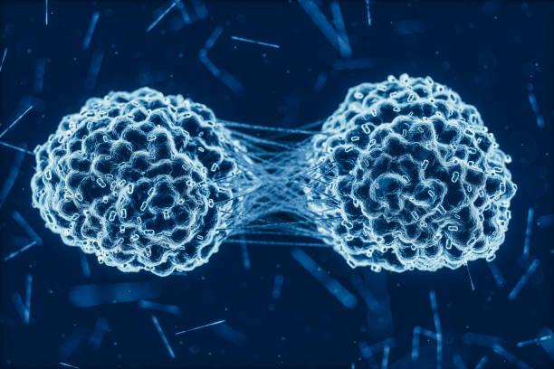
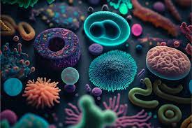
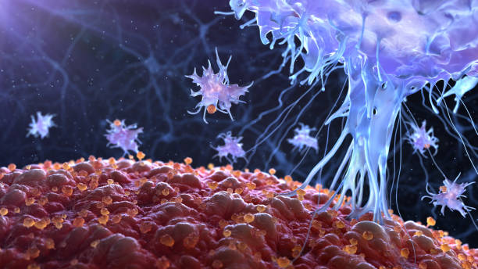
Escape
Introduction
Game Play
More
Room
Escape to Remission
You and your classmates are newly dividing cells. Wait... Look out!
You nearly survive an initial attack from the immune system and there seems to be immune soldiers nearby. Now more than ever it's important to embark on a quest to find a new home. Along the way, you will be challenged! Each challenge will provide you with a password! Successfully collect all passwords to complete your quest!
See more
Notes:
The students are cells looking to evade the immune system and colonize to a new site.
Any incorrect answers or expired time will result in 1 cell (student) to be isolated from the group and work on another assignment for the betterment of the group.
However, if the class can answer correctly checkpoint answers they can bring back one student.

Slide 4
Escape
Introduction
Game Play
More
Room
Escape to Remission
Beware, incorrect answers or running out of time will result in one cell being temporarily isolated for another assignment, working towards the team's success.
However, correct answers at the checkpoints bring back a student. Time is ticking, and the fate of the cells is in your hands. Will you triumph over the immune system? Let the quest begin! ☺
See more
Notes:
The students are cells looking to evade the immune system and colonize to a new site.
Any incorrect answers or expired time will result in 1 cell (student) to be isolated from the group and work on another assignment for the betterment of the group.
However, if the class can answer correctly checkpoint answers they can bring back one student.

Slide 5
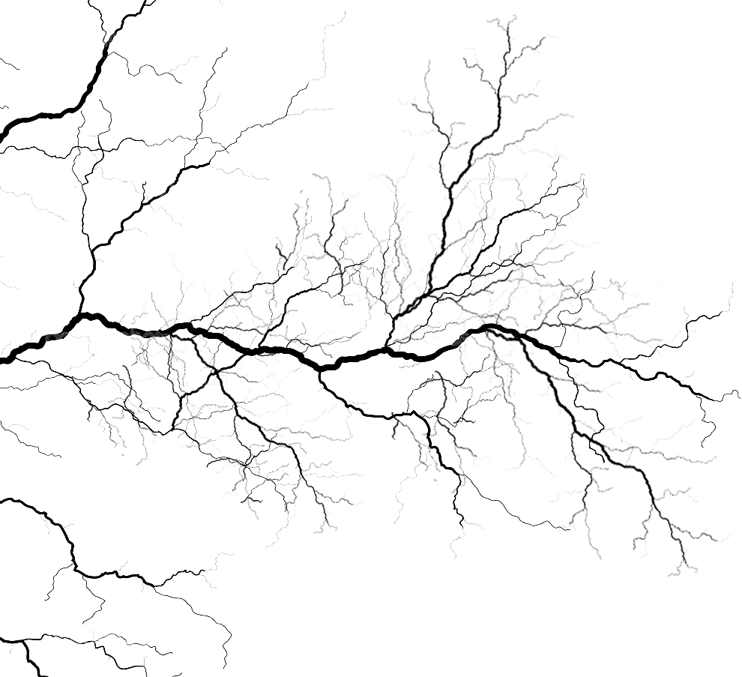
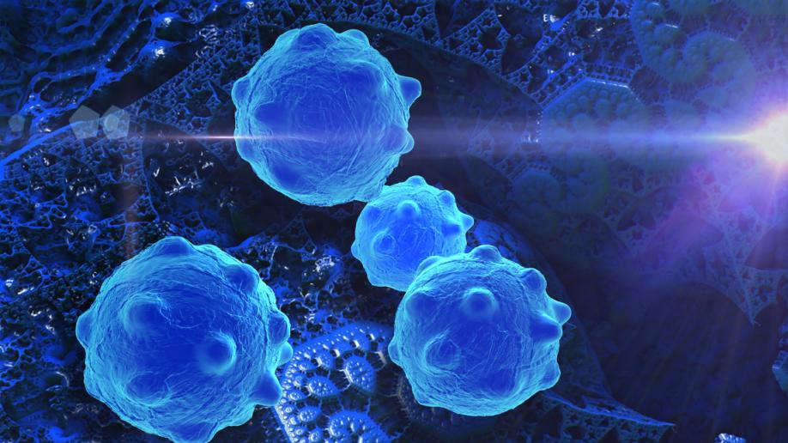


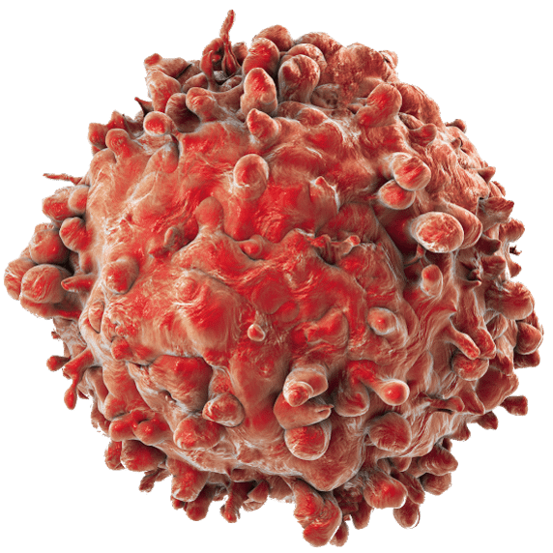
Decode the Cure
2 Words
ONE
1
2
3
You lose the cell that uses the clue
Notes:
You lose the cell that uses the clue
The students are to guess the phrase. Each clue used results in a cell to be isolated

Slide 6
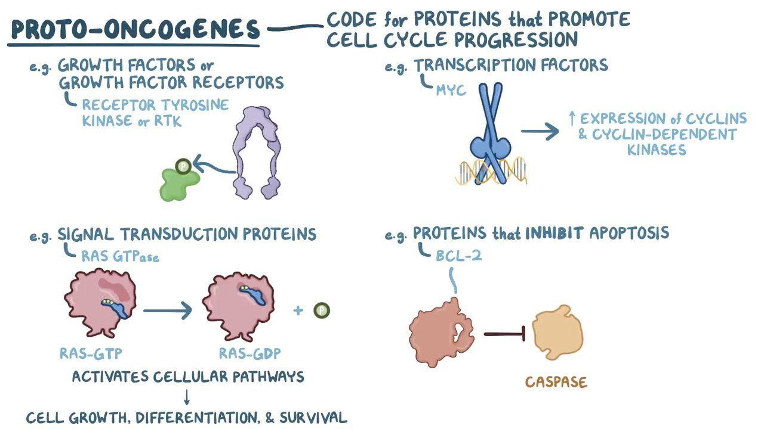
C
L
U
E
1
The process where cells lose tumor suppressors genes and gain oncogene activation to promote cancer.

Slide 7
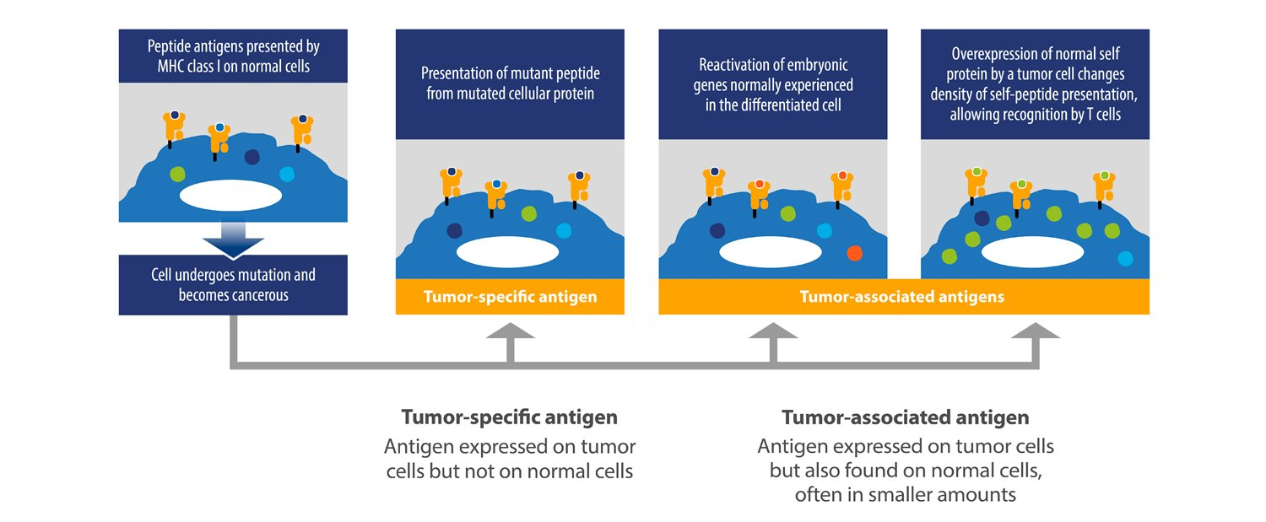
C
L
U
E
2

Slide 8
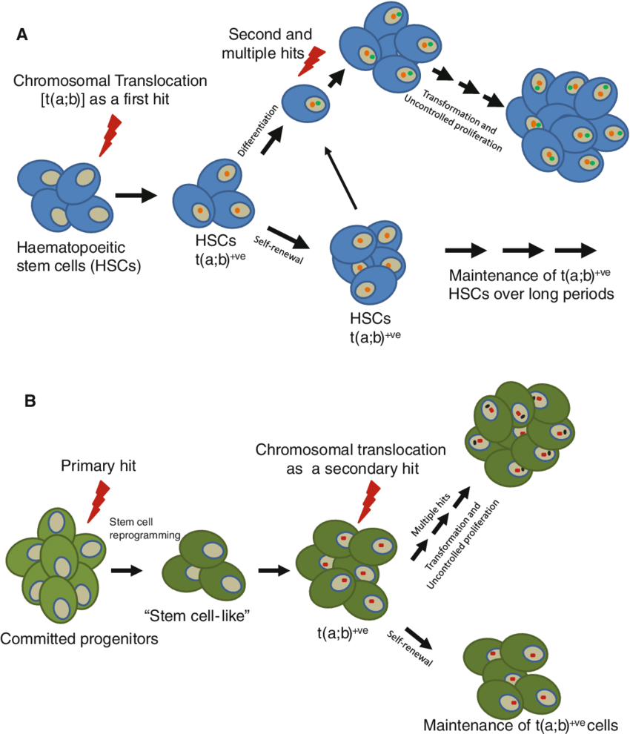
C
L
U
E
3
Series of 4 steps that leads to the formation of cancer

Slide 9
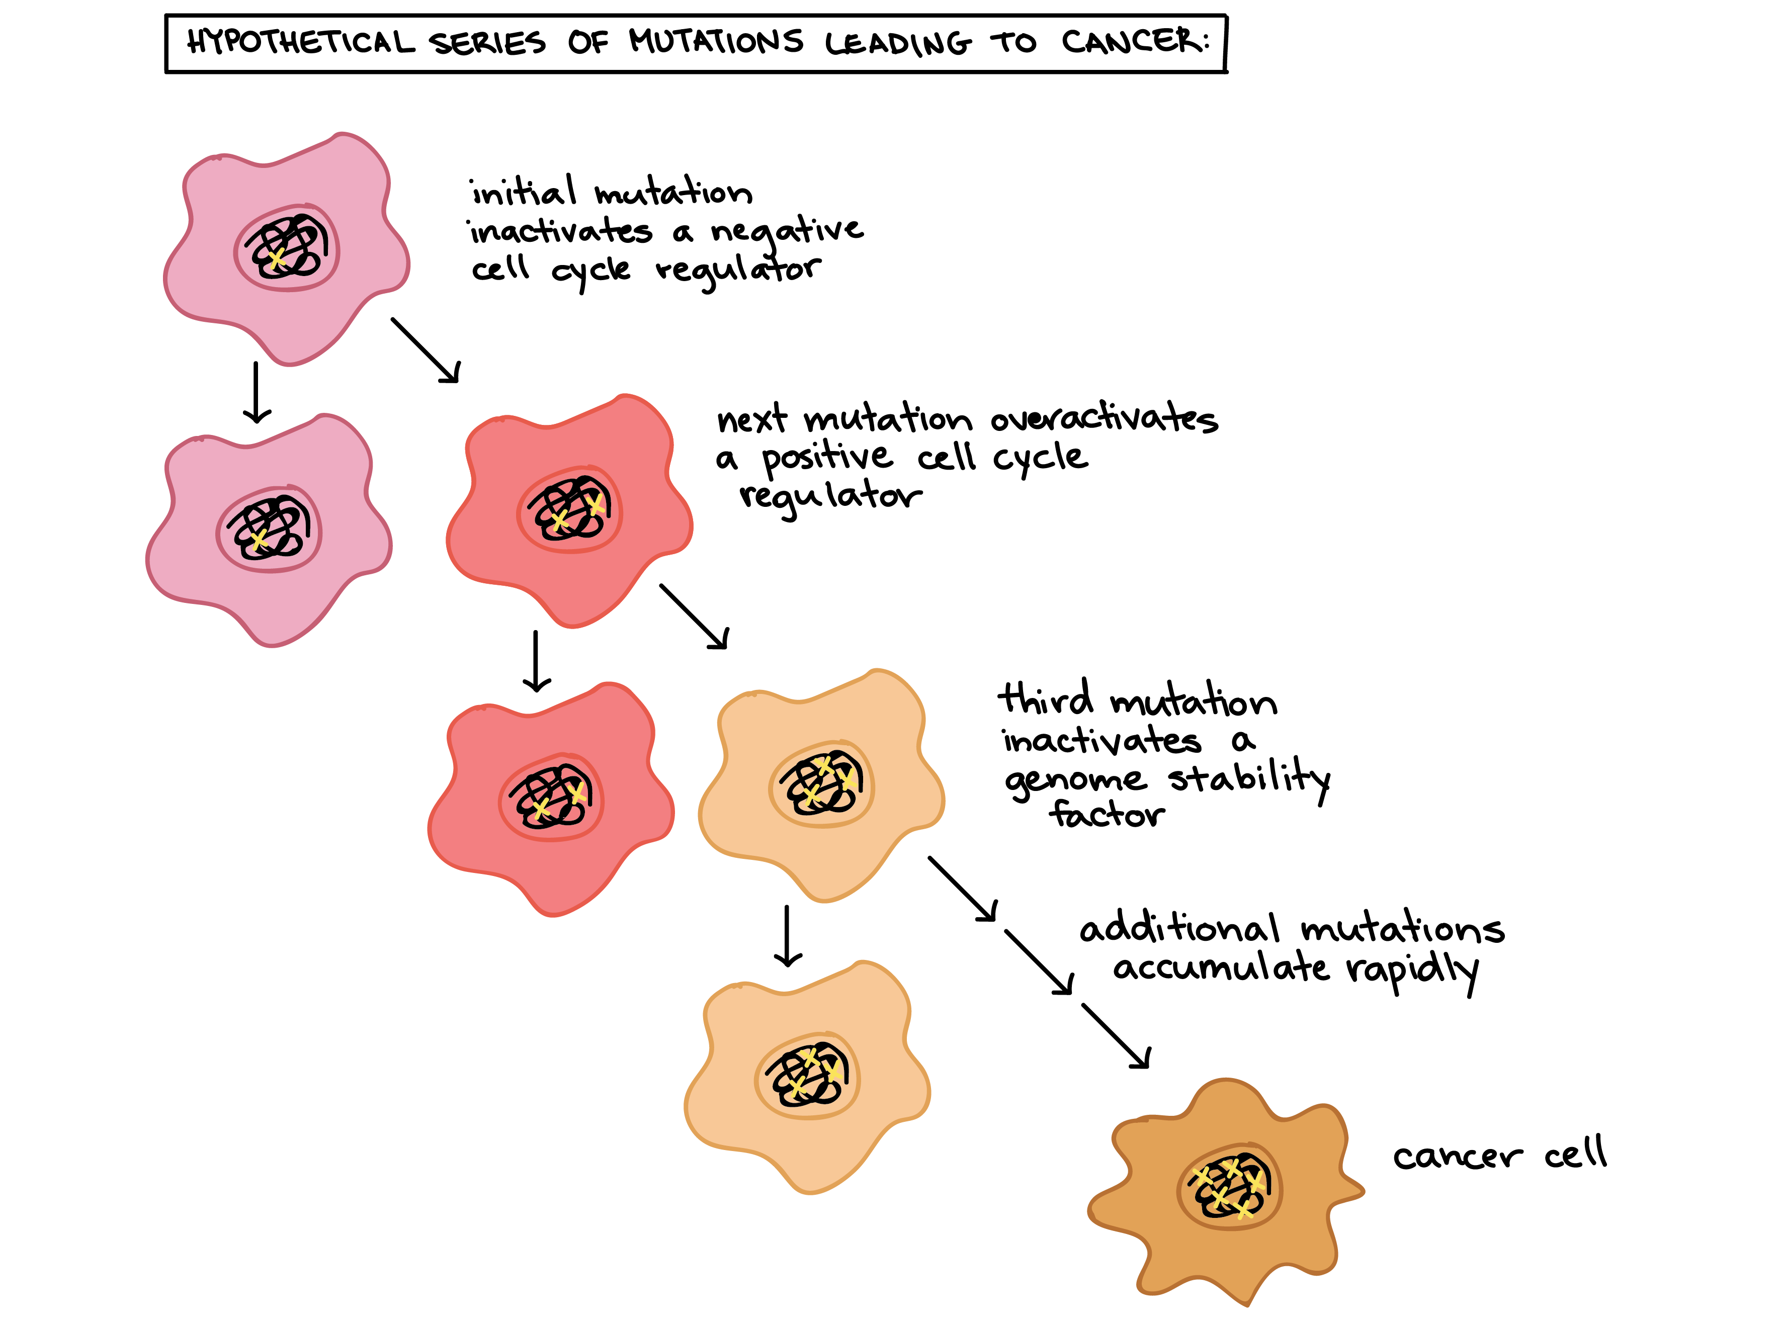
ONE
Cancer TRANSFORMATION
Notes:
You lose the cell that uses the clue
the process by which CELLS acquire the properties of cancer

Slide 10
Immune Escape
TWO
_ _ _ _ _ _ _ _ _ _ _ _ _ _ _ _ _ _ _ _ _ _ _ _ _
A
B
C
D
E
F
G
H
I
J
K
L
M
N
O
P
Q
R
S
T
U
V
W
X
Y
Z
You lose the cell that uses the clue
Notes:
You are undergoing immune escape however a few cells may be sacrificed in the process
Uncontrolled (12) proliferation (13)

Slide 11
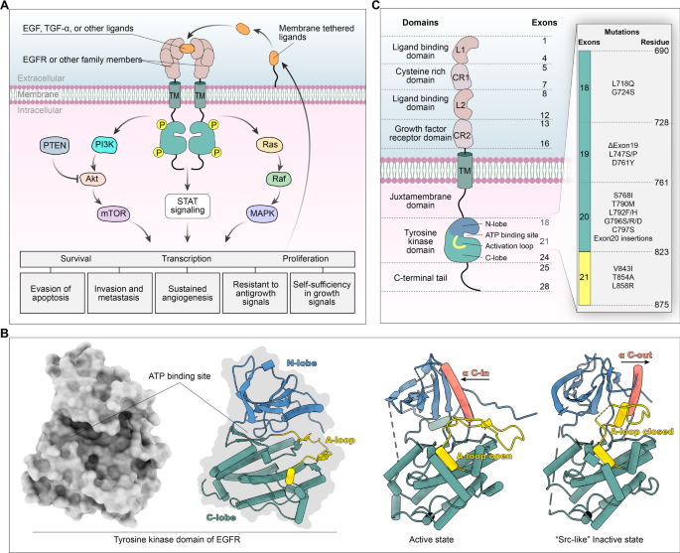
C
L
U
E
1
Remind me to uncover this

Slide 12
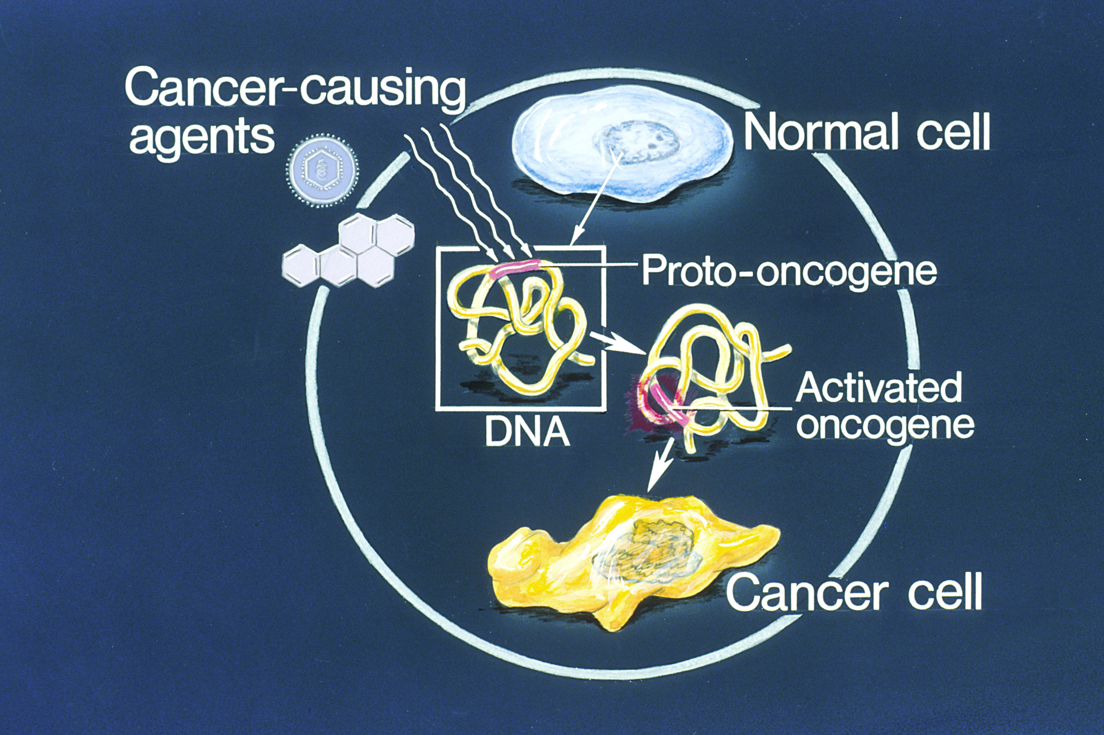
C
L
U
E
2

Slide 13
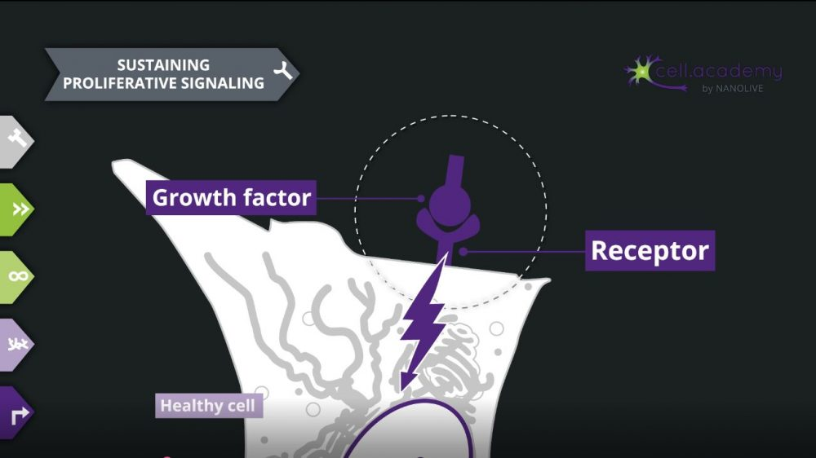
C
L
U
E
3

Slide 14
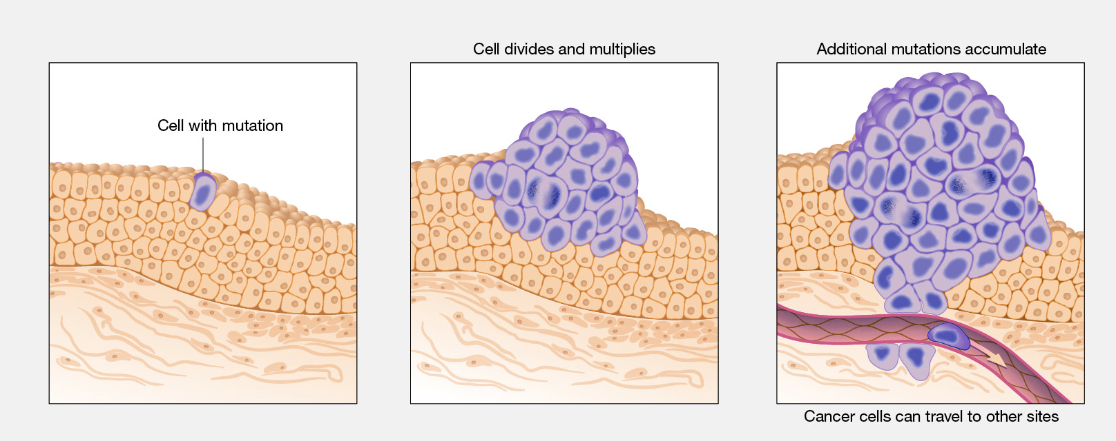
TWO
U n c o n t r o l l e d p r o l I f e r a t I o n
Notes:
You lose the cell that uses the clue

Slide 15
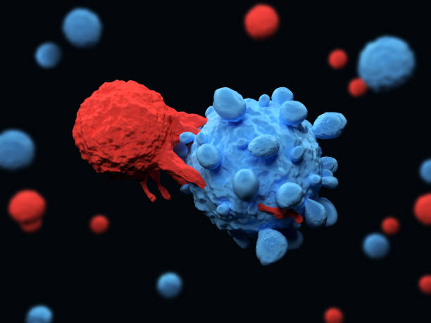
TRY AGAIN

Slide 16
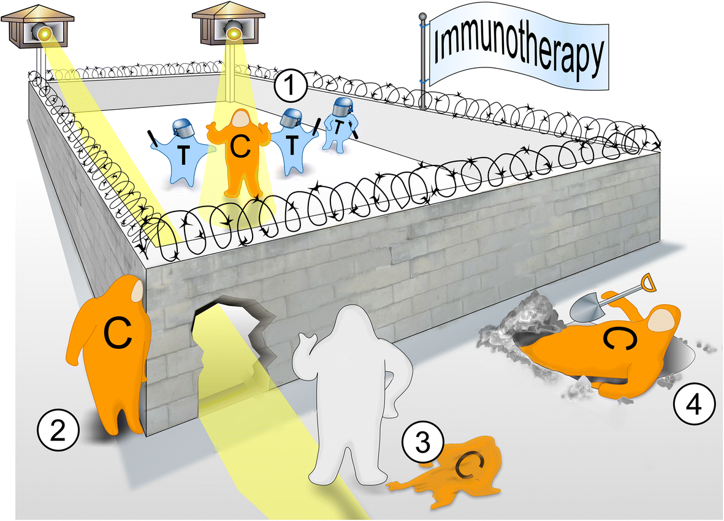
CORRECT

Slide 17

Hot Seat
Two of you will be randomly selected and given 1/2 the passcodes.
The person in the hotseat can only answer yes or no
However, there will be others among you to sabotage!
Figure out who has the passcode and eliminate the imposter among you.
THREE
You lose the cell that uses the clue
Notes:
Therapeutic Index
Firmicutes (fur-rmuh-kyoots)

Slide 18
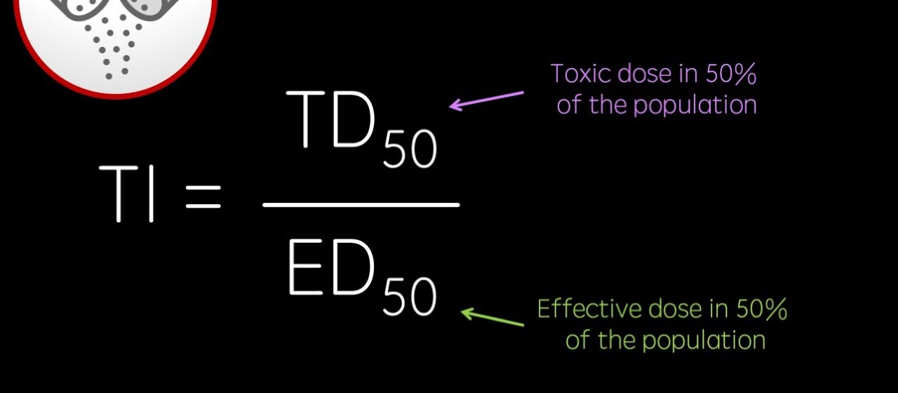

C
L
U
E
1

Slide 19
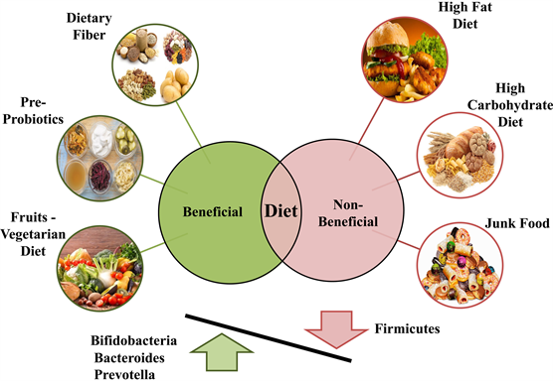

C
L
U
E
2
AHHHHHHHHHH

Slide 20
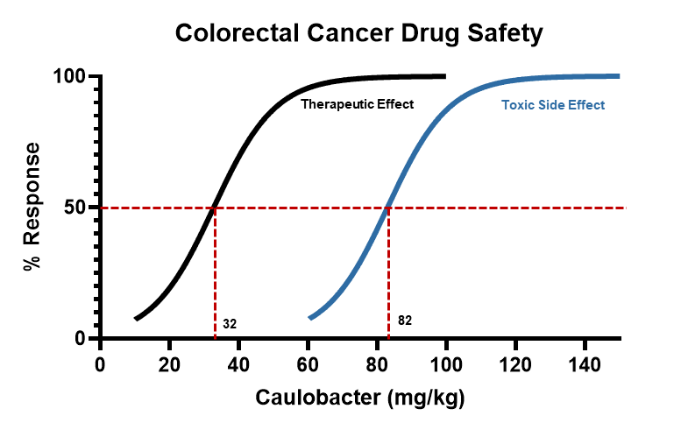
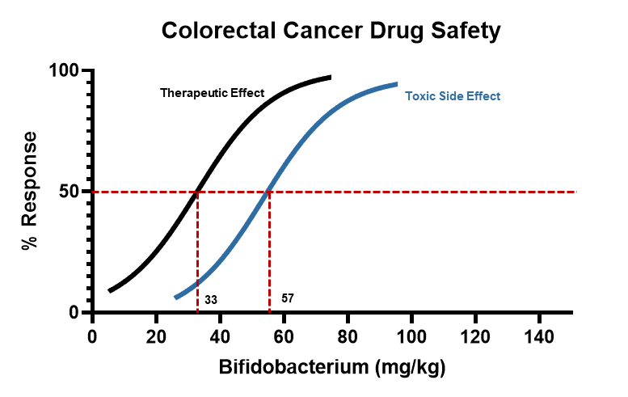
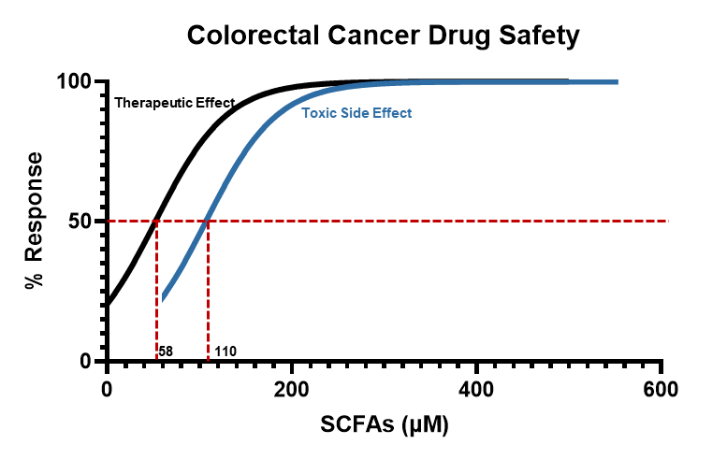
C
L
U
E
3
What are the therapeutic index of the three
Which treatment is the most and least tolerable
Notes:
82/32 = 2.6
57/33 = 1.7
110/58 = 1.9
Most Caulobacter/ least Bifodecterium

Slide 21
Therapeutic Effect
Toxic Side Effect
Therapeutic Effect
Toxic Side Effect
32
82
33
57
Therapeutic Effect
Toxic Side Effect
58
110

Slide 22
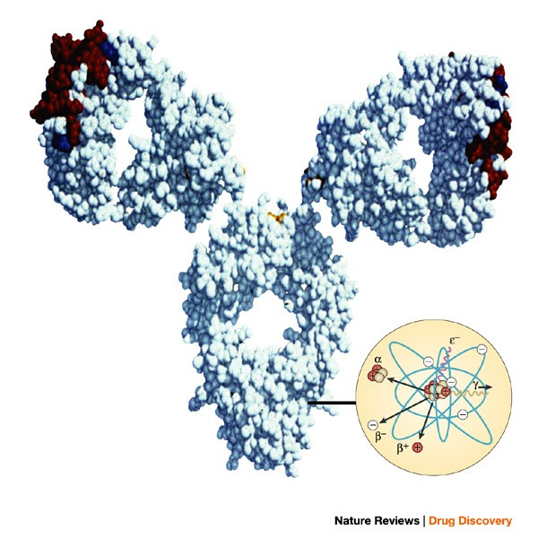
Invent A Solution
FOUR
Introducing "ImmunoPrimeX": A novel therapeutic solution designed to boost immune response. ImmunoprimeX is a combination therapy that combines immune checkpoint inhibitors with personalized cancer vaccines.
You lose the cell that uses the clue
Notes:
You lose the cell that uses the clue

Slide 23
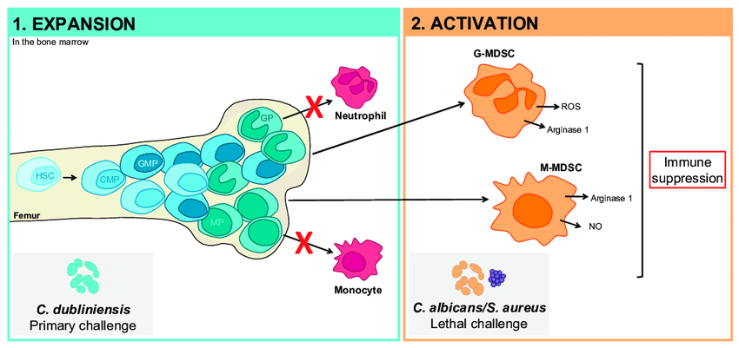
C
L
U
E
1
Overcoming
Chronic Inflammation
Notes:
Anti-inflammatory Medications: Nonsteroidal anti-inflammatory drugs (NSAIDs) or corticosteroids may be used to alleviate inflammation in certain cancer cases. However, their use should be carefully considered, as they can have potential side effects and interactions with other cancer treatments.
Targeted Therapies: Targeted therapies that specifically inhibit inflammatory pathways or signaling molecules involved in chronic inflammation can be employed. These therapies can help disrupt the inflammatory cascade and reduce inflammation within the tumor microenvironment.
Immunomodulatory Agents: Immune-modulating drugs, such as immune checkpoint inhibitors, can potentially help regulate the immune response and dampen chronic inflammation. By blocking immune checkpoints, these agents can unleash the immune system to target cancer cells and reduce inflammation.

Slide 24

C
L
U
E
2
Overcoming
Immune Desert
Notes:
Immunotherapy Combinations: Combining different immunotherapies can help overcome immune deserts. For example, using immune checkpoint inhibitors in combination with other treatments like targeted therapies, chemotherapy, or radiation therapy can enhance the immune response by creating a more favorable tumor microenvironment.
Tumor Microenvironment Modulation: Strategies to modify the tumor microenvironment include the use of agents that reduce immunosuppressive factors, such as regulatory T cells or myeloid-derived suppressor cells. Additionally, treatments that promote the infiltration of immune cells into the tumor, such as cytokines or chemokines, can be explored.
Targeted Therapies: Some targeted therapies can indirectly affect the immune response by modulating signaling pathways within cancer cells. These therapies may sensitize the tumor to immune attack or disrupt immune-suppressive signaling, thus promoting anti-tumor immune responses.
Vaccines and Cell Therapies: Therapeutic cancer vaccines, such as dendritic cell vaccines or neoantigen vaccines, can be developed to stimulate an immune response specifically against tumor antigens. Similarly, adoptive cell therapies, like CAR-T cell therapy, can be utilized to infuse modified immune cells into the patient to enhance the anti-tumor immune response.
Combination Approaches: Combining multiple treatment modalities, such as immunotherapies with targeted therapies or other emerging therapies like oncolytic viruses or immune agonists, can increase the chances of overcoming immune deserts by activating different aspects of the immune response and targeting multiple vulnerabilities within the tumor.

Slide 25
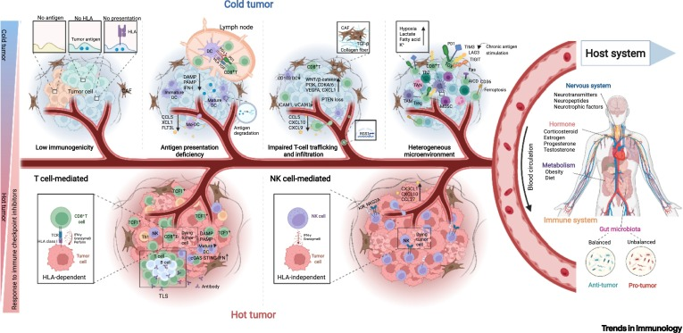
C
L
U
E
3
Overcoming
Immune Exclusion
Notes:
Combination Immunotherapies: Combining different immunotherapies, such as immune checkpoint inhibitors, cytokines, and immune cell therapies, can help overcome immune exclusion by targeting multiple aspects of the immune response. Combination therapies can enhance immune cell infiltration into the tumor and promote a more effective anti-tumor immune response.
Tumor Microenvironment Modulation: Strategies aimed at modifying the tumor microenvironment can help overcome immune exclusion. This can involve reducing immunosuppressive factors, such as regulatory T cells or myeloid-derived suppressor cells, and promoting the infiltration of immune cells into the tumor by targeting chemokine receptors or utilizing cytokines.
Targeted Therapies: Some targeted therapies can indirectly affect immune exclusion by modulating signaling pathways within cancer cells. These therapies can sensitize the tumor to immune attack or disrupt immune-suppressive signaling, thus allowing immune cells to infiltrate the tumor and mount an effective response.
Stromal Modulation: The tumor stroma can play a role in immune exclusion. Modulating the tumor stroma using agents that target fibroblasts or extracellular matrix components can potentially enhance immune cell infiltration and activation within the tumor.
Personalized Approaches: Adopting personalized medicine approaches, such as neoantigen-based vaccines or adoptive cell therapies targeting specific tumor antigens, can help overcome immune exclusion by training the immune system to recognize and attack tumor cells more effectively.

Slide 26
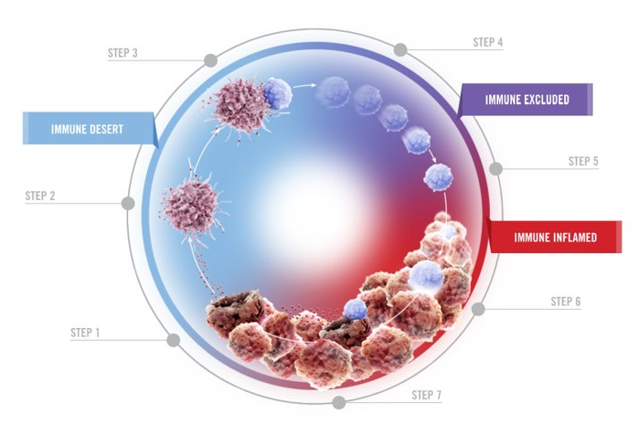
Cancer Immunity Cycle
FOUR
Notes:
You lose the cell that uses the clue

Slide 27

Tumor Buster Showdown
FIVE
Name _________
City Defense ________
Tumor Suppressor Power 1. ________
Tumor Suppressor Power 2. ________
Tumor Suppressor Power 3. ________
You lose the cell that uses the clue
Notes:
Transported into a alternate reality
Tumor suppressor gene (pick a name) novel
Do u suppress apoptosis…
cell proliferation, inhibiting angiogenesis, or preventing metastasis.

Slide 28

BOSS BATTLE
C
L
U
E
1
Cancer Wonder Warrior
EGFR Mutation Activation
DNA Damage
Anti-Inflammatory Substances

Slide 29

BOSS BATTLE
C
L
U
E
2
Killula Kanzer
KRAS Mutation 2 Activation
Promotes proliferation
DNA Repair Agents

Slide 30
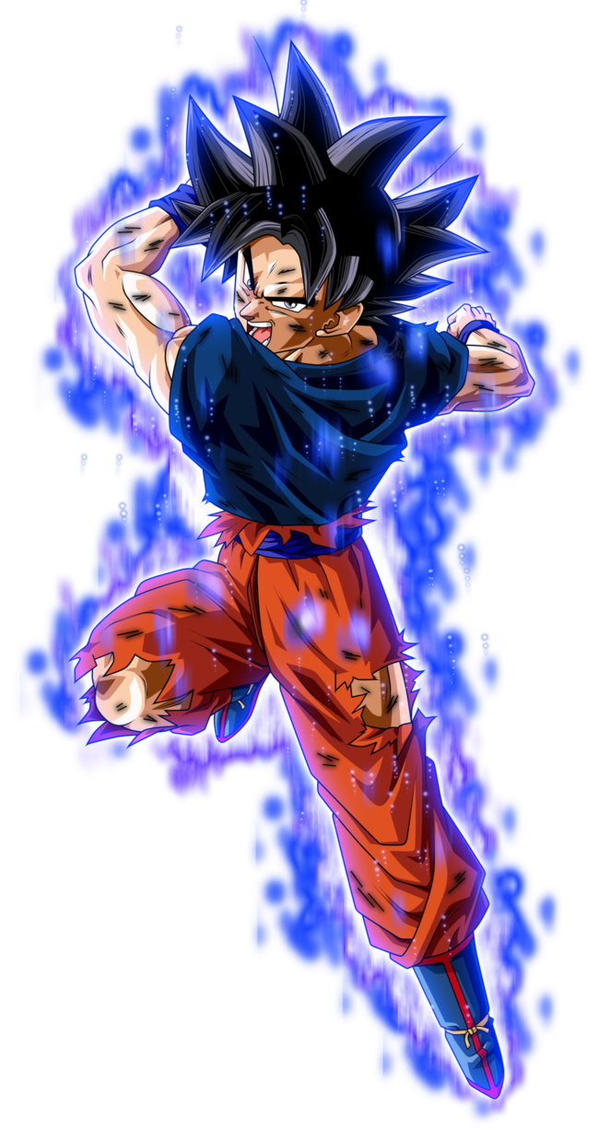
Bypass anti-survival mechanism
BOSS BATTLE
C
L
U
E
3
Son CaKu
Downregulates p53 and its functions
Targeted Therapy Targeting KRAS
Notes:
DNA Damage Response:
Cell Cycle Regulation
Apoptosis Induction
Suppression of Tumor Formation:
Senescence Promotion:

Slide 31

Nature's Guardians
SIX
You lose the cell that uses the clue
Notes:
You lose the cell that uses the clue

Slide 32
C
L
U
E
1
Draw a schematic of the immune response.

Slide 33
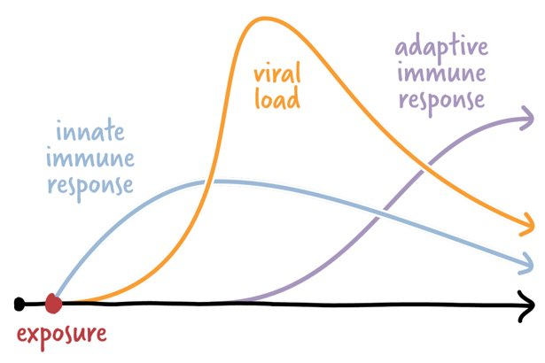
C
L
U
E
2
Explain differences between innate and adaptive immune responses and point out when each of them kicks in after exposure.

Slide 34
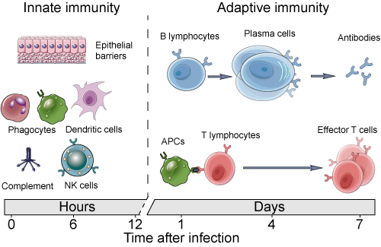
SIX
Notes:
You lose the cell that uses the clue

Slide 35
SEVEN
Epigenetic Detective Showdown
You lose the cell that uses the clue
Notes:
You lose the cell that uses the clue

Slide 36
C
L
U
E
1
Active or Inactive
DNA Methylation
Histon H3K4 Methylation
TET Overexpression
Histon H3K27 Methylation
Notes:
45 seconds to answer. Any incorrect answers results in cell inactivation
DNA Methylation – Suppress
TET Overexpression – Activation
Histone H3K4 Methylation – Activation
Histone H3K27 gene suppression
For extra points how to read H3K27

Slide 37
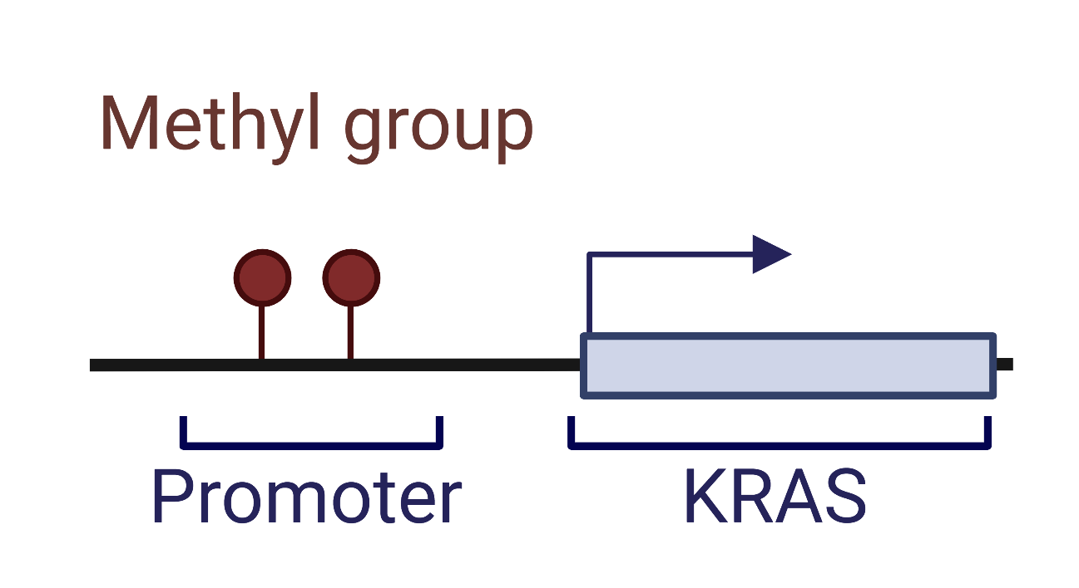
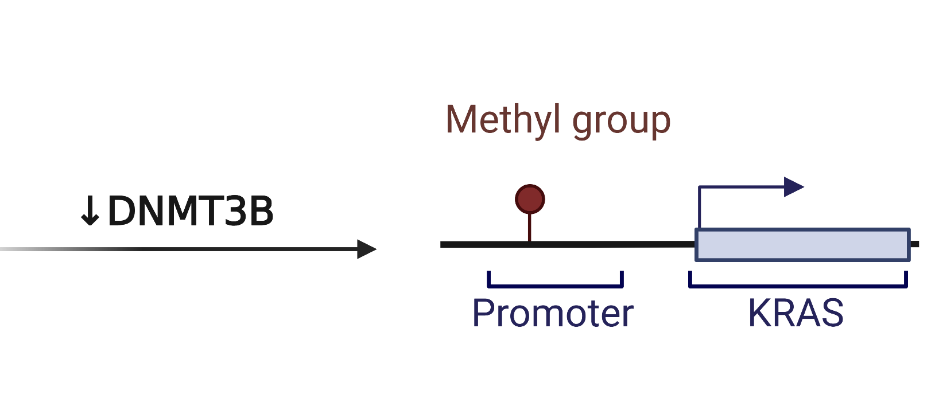
C
L
U
E
2
Active or Inactive
Notes:
Inactive
Active –reduces methyltransferase activity

Slide 38
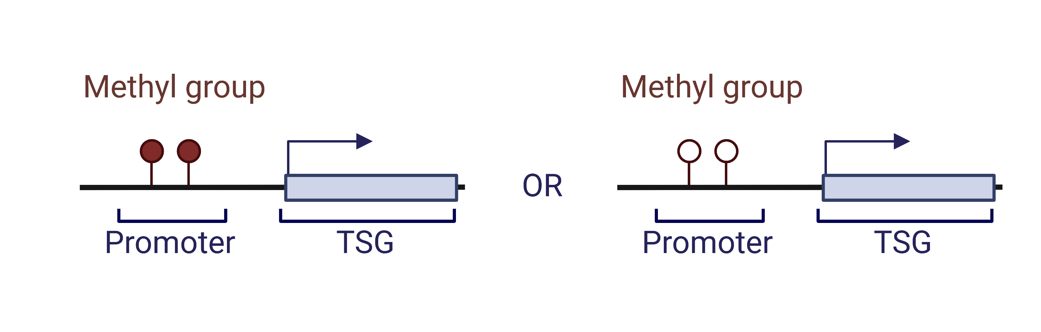
C
L
U
E
2
Active or Inactive
Notes:
The right

Slide 39



Search room level…
The End
Menu
Sustaining Proliferative Signaling
Avoiding Immune Destruction
Nonmutational Epigenetic Reprogramming
Avoiding Immune Destruction
Evading Growth Suppressors
Genomic Instability & Mutation
Polymorphic Microbiome
Oncogenic Signaling
Damaging Mutations
Bypassing Growth Factor Activation
Adaptive Immune Response
Innate Immune Response
Therapeutic Index
Healthy Gut Microbiome
FMT
Methylation
DNMT3A
TET
Epigentic Gene Regulation
Tumor Promoting Inflammation
Immune Desert
Immune Exclusion
Cell Response
-DNA Damage
-Cell Proliferation
–Cell Survival
Oncogenic Activation
Neoantigen Presentation
Cancer Transformation
Prev
Next
Notes:
You have completed the necessary steps to proliferate, invade the immune system, and metastasize to form a new colony!!

Slide 40
Search room level…
The End
Menu
Sustaining Proliferative Signaling
Avoiding Immune Destruction
Nonmutational Epigenetic Reprogramming
Avoiding Immune Destruction
Evading Growth Suppressors
Genomic Instability & Mutation
Polymorphic Microbiome
Oncogenic Signaling
Damaging Mutations
Bypassing Growth Factor Activation
Adaptive Immune Response
Innate Immune Response
Therapeutic Index
Healthy Gut Microbiome
FMT
Methylation
DNMT3A
TET
Epigentic Gene Regulation
Tumor Promoting Inflammation
Immune Desert
Immune Exclusion
Cell Response
-DNA Damage
-Cell Proliferation
–Cell Survival
Oncogenic Activation
Neoantigen Presentation
Cancer Transformation
Prev
Next

Slide 41
Search room level…
The End
Menu
Sustaining Proliferative Signaling
Avoiding Immune Destruction
Nonmutational Epigenetic Reprogramming
Avoiding Immune Destruction
Evading Growth Suppressors
Genomic Instability & Mutation
Polymorphic Microbiome
Oncogenic Signaling
Damaging Mutations
Bypassing Growth Factor Activation
Adaptive Immune Response
Innate Immune Response
Therapeutic Index
Healthy Gut Microbiome
FMT
Methylation
DNMT3A
TET
Epigentic Gene Regulation
Tumor Promoting Inflammation
Immune Desert
Immune Exclusion
Cell Response
-DNA Damage
-Cell Proliferation
–Cell Survival
Oncogenic Activation
Neoantigen Presentation
Cancer Transformation
Prev
Next

