Slide 1
Mr. Huang's liver cancer
Clinical Case from the First Affiliated Hospital of Chengdu Medical College
(Patient's personal information is hidden to protect patient's privacy)
S1 Clinical Case

Slide 2
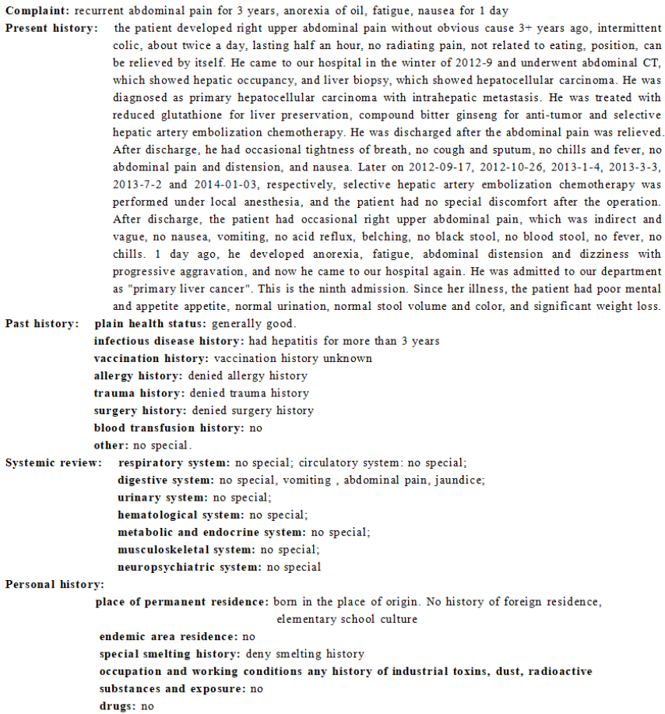
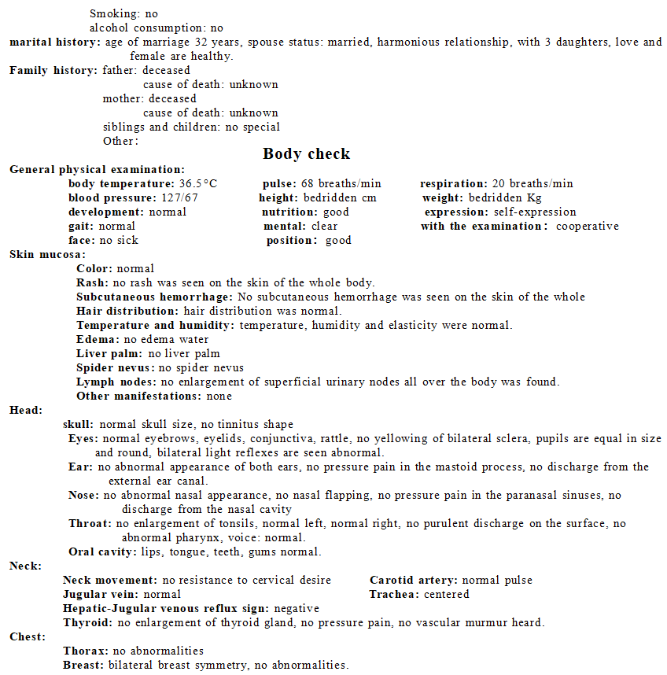
1. History of Disease
2. Body check

Slide 3
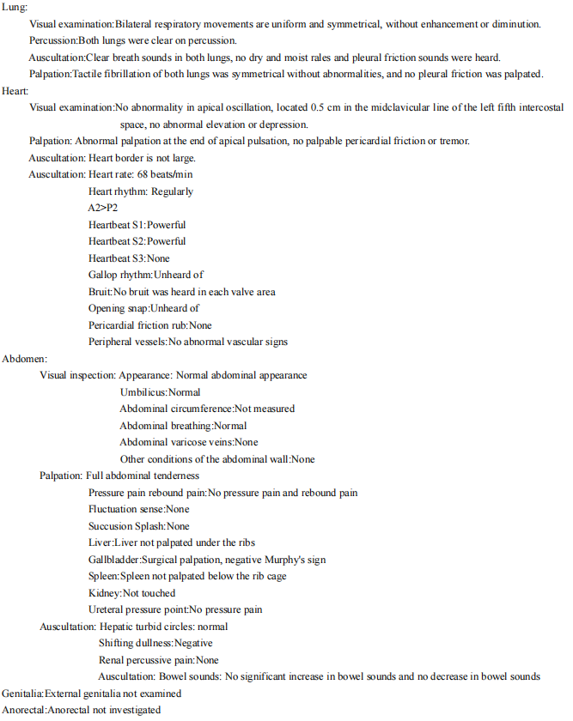
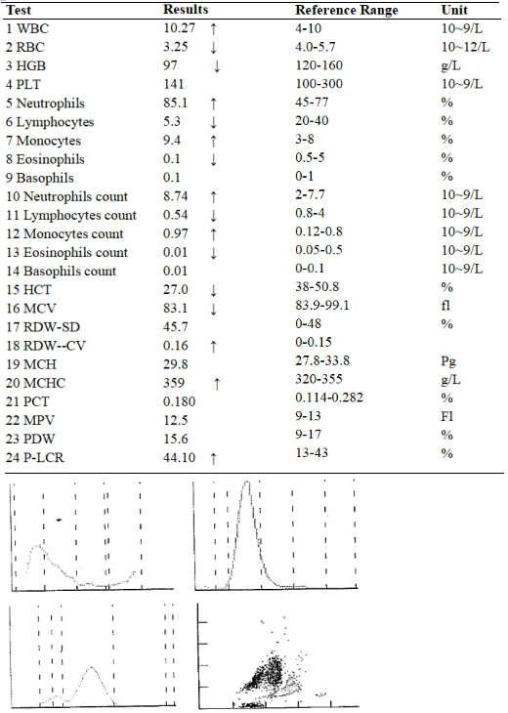
2. Body check
3. Blood analysis report form

Slide 4
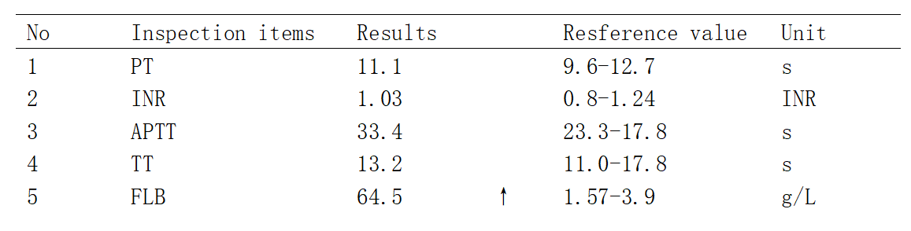
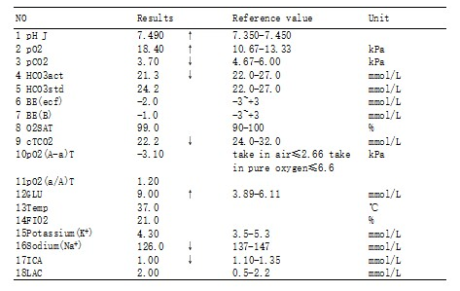
4. Arterial blood gas analysis
5. Blood coagulation function test

Slide 5
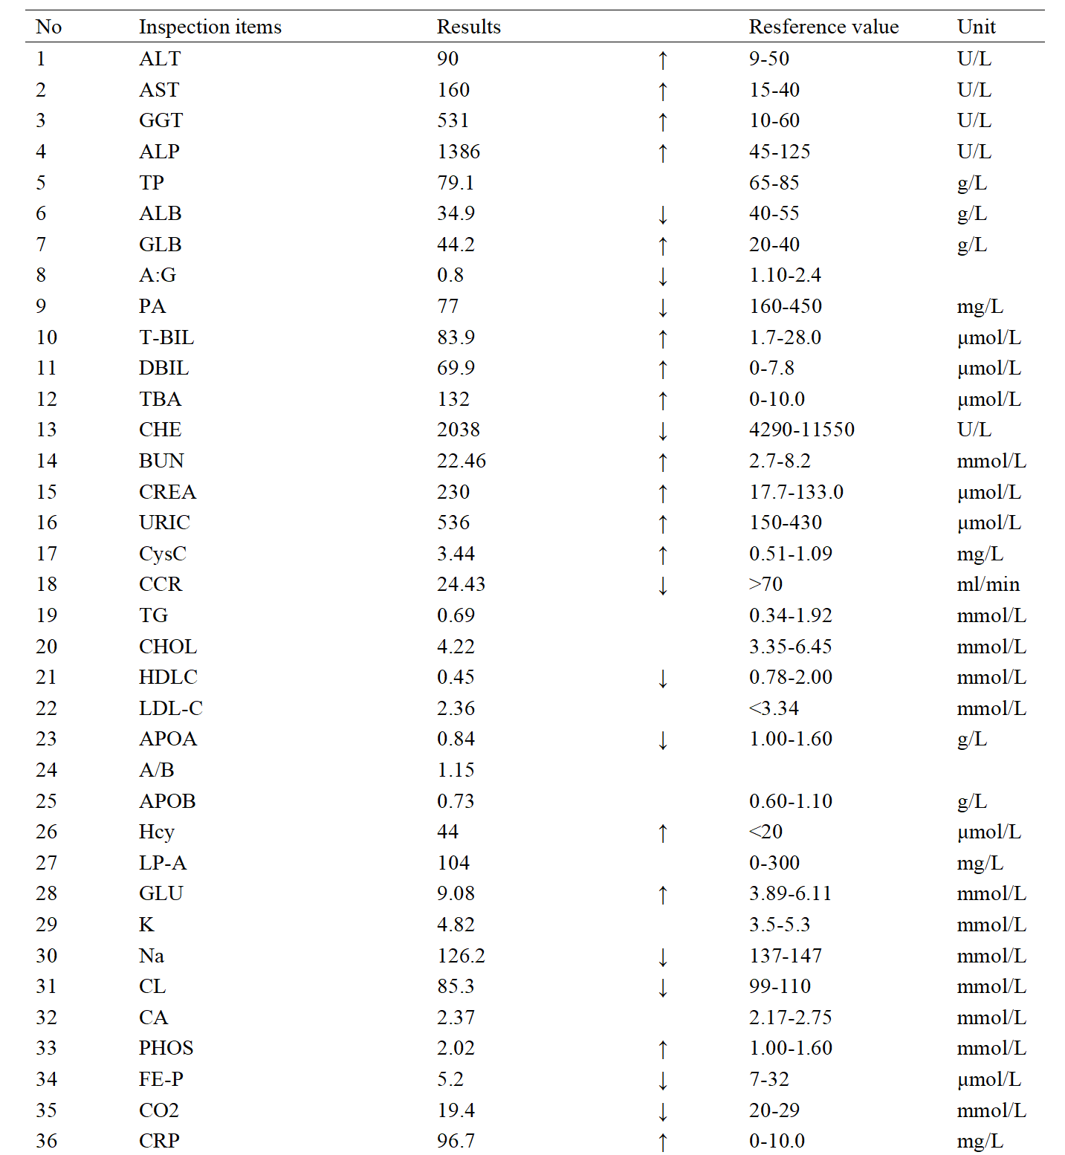
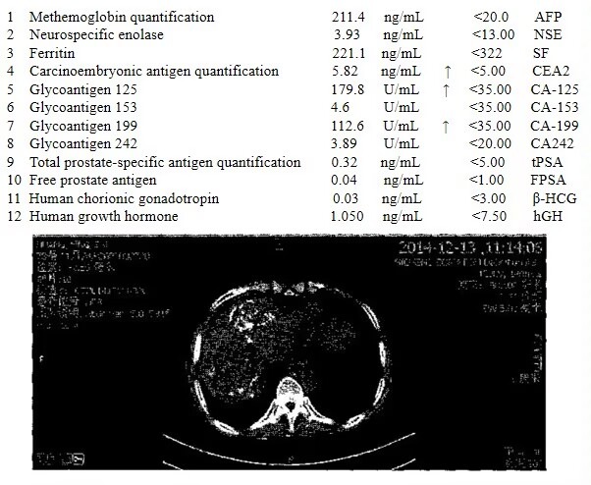
6. Liver and Kidney function test
7. Detection of tumor biomarkers

Slide 6
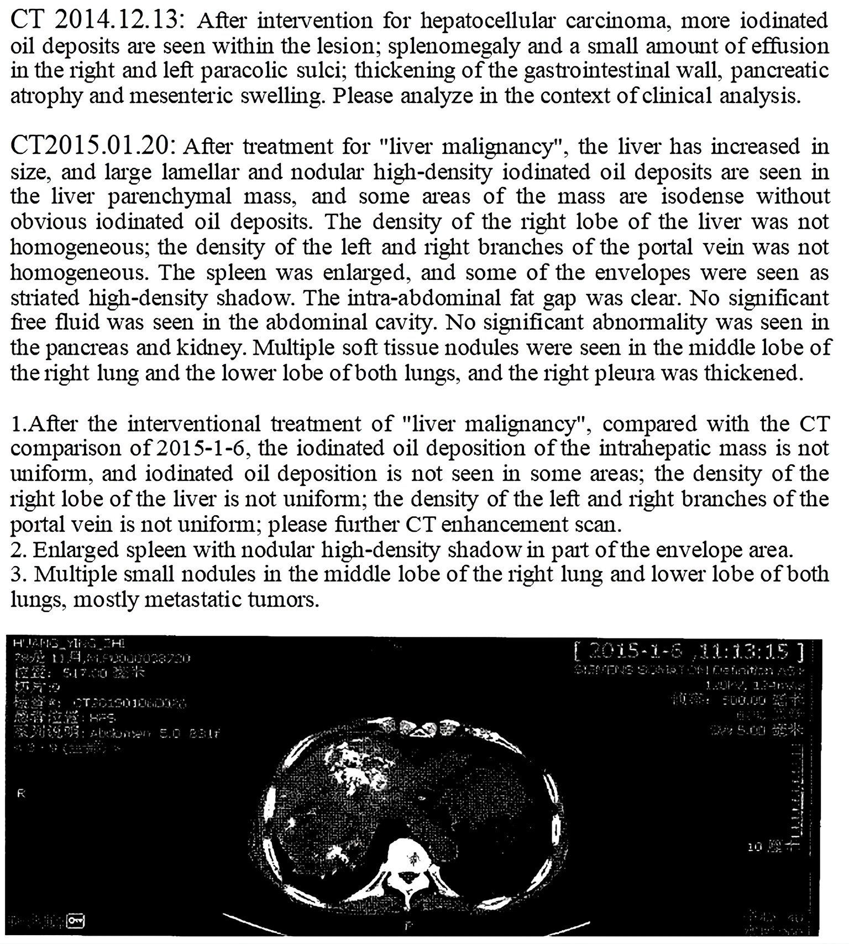
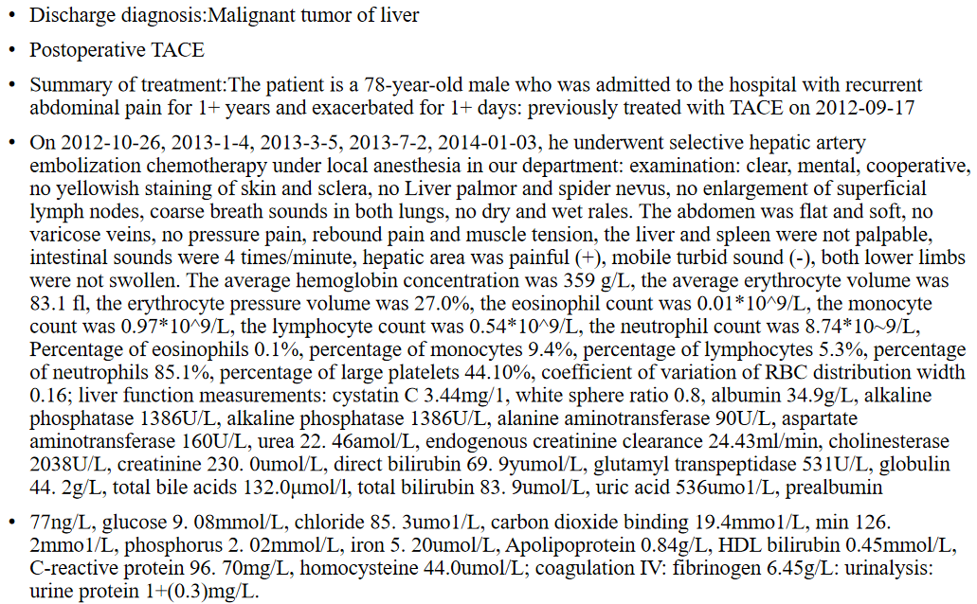
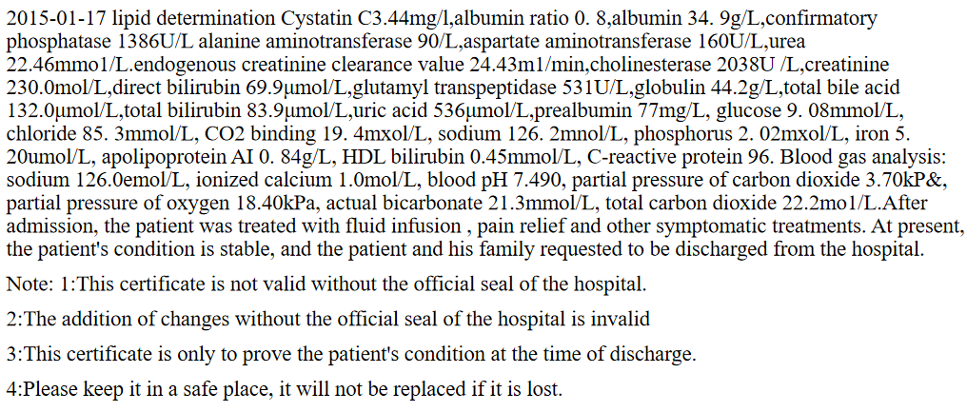
8. CT detection of tumor after interventional therapy
9. Diagnosis and treatment summary

Slide 7
Discussion section 1 (lesson 1-3)
[Distribution of patient's medical records] omitted
【 Main Discussion Direction 】
1. Abnormal lipid metabolism and clinical manifestations during hepatocellular carcinoma.
2. Abnormal glucose metabolism and clinical manifestations during the occurrence of liver cancer.
【Hint questions]】
Oil Aversion in Chief Complaint: Why do patients present with symptoms like oil aversion? Briefly explain the process of lipid digestion and absorption, and its related characteristics.
Jaundice Mechanism & Clinical Relevance: The patient has a history of jaundice. Describe the underlying mechanism of jaundice, its diagnostic methods, and its significance in liver cancer.
Blood Lipid Indicators & Clinical Interpretation: What are the key parameters in blood lipid testing? Explain the physiological role of each and their diagnostic relevance in this patient’s case.
Glucose Metabolism Abnormalities in Liver Cancer: Besides jaundice, what other glucose metabolism disorders may occur in liver cancer patients, and what are their mechanisms? Why was this patient’s blood glucose level elevated?

Slide 8
Discussion section 2 (lesson 4-6)
[Distribution of patient's medical records] omitted
【 Main Discussion Direction 】
1. Exchange and learn the key self-study problems arranged in the last discussion class.
2. Abnormal protein metabolism and clinical manifestations during hepatocellular carcinoma.
【Hint questions】
1. Hemoglobin Detection: What is the clinical significance of measuring hemoglobin levels?
2. Liver Function Tests: What are the key indicators in liver function testing, and what is their physiological importance?
3. Renal and Metabolic Markers: What is the clinical relevance of testing urea, creatinine, uric acid, and cystatin C? How do these markers relate to patients with liver cancer?
4. Liver Tumor Biomarkers: Beyond the current lab results, what other serum markers and diagnostic tests can indicate liver tumors? What is the clinical significance of each?

Slide 9
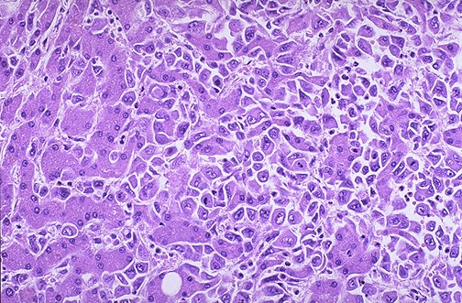
Discussion section 3 (lesson 7-9)
[Distribution of patient's medical records] omitted
【 Main Discussion Direction 】
1. Exchange and learn the key self-study problems arranged in the last discussion class.
2. Liver puncture and cytological examination of liver cancer.
【Hint questions】
Identification of Liver Cells in Histology: Based on the figure above, which cells represent normal hepatocytes and which are hepatocellular carcinoma cells? What morphological or structural features support this distinction?
Histological Subtypes of Liver Cancer: What are the major pathological subtypes of liver cancer, and how do their cellular morphologies differ?
Molecular Pathogenesis of Liver Cancer: What are the key molecular and cellular mechanisms involved in hepatocellular carcinogenesis?
HBV and Hepatocarcinogenesis: What is the oncogenic role of HBV in liver cancer development? How does HBV interact with tumor suppressor pathways, such as p53-mediated regulation?

