Slide 1
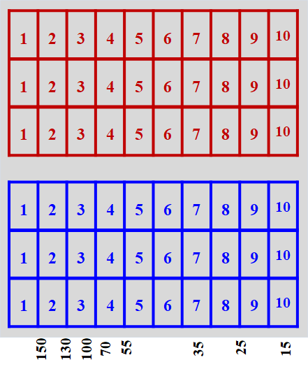
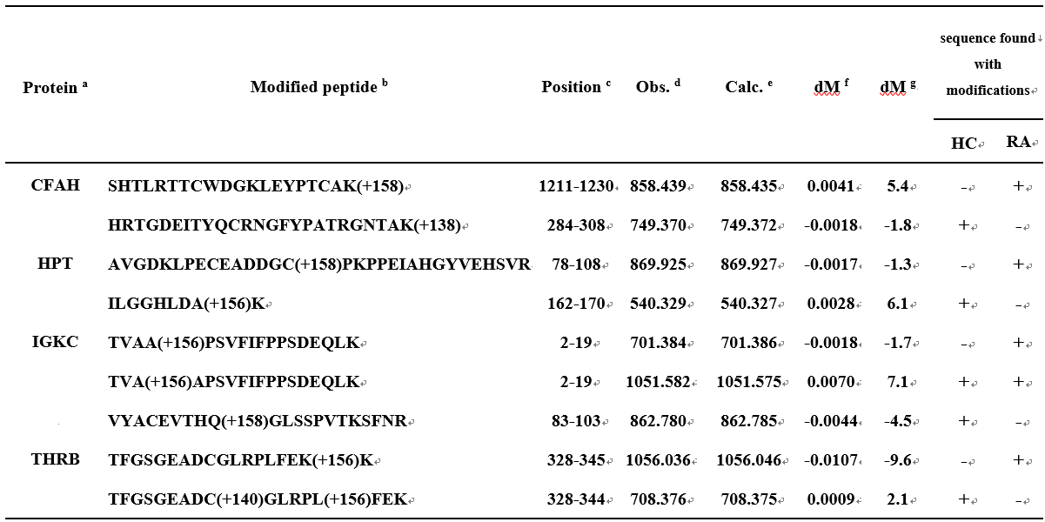
A
Pooled
RA(1,2) RAsample1
RA(3,4) RAsample2
RA(5,6) RAsample3
RA(7,8) RAsample4
RA(9,10)RAsample5
Total: RAsample1~15
Pooled
HC(1,2) HCsample1
HC(3,4) HCsample2
HC(5,6) HCsample3
HC(7,8) HCsample4
HC(9,10)HCsample5
Total: HCsample1~15
Pooled Con A-captured
serum proteins
(9 RAs vs. 9 HCs)
RA1
RA2
RA3
in-gel
PEAKS 7
Novel differential
HNE-modified peptides
RAs vs. HCs
HC1
digestion
PXD004546
HC2
HC3
LC-MS/MS
MS/MS data
ProteomeXchange
PXD004546
2018 Journal of Proteomics 170:141-150

Slide 2
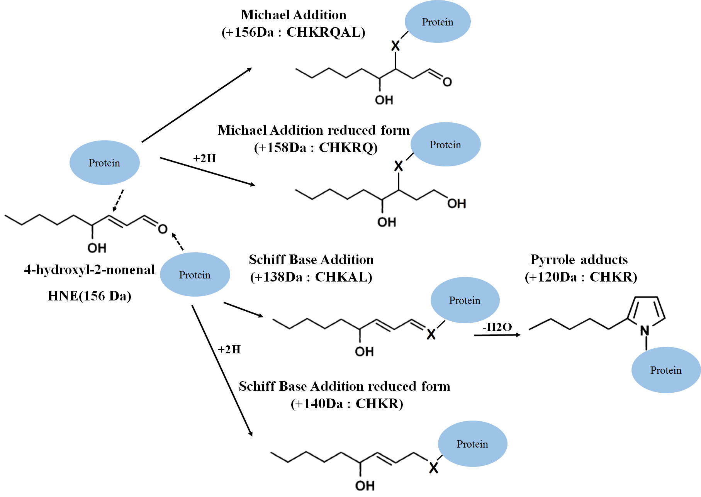
B

Slide 3
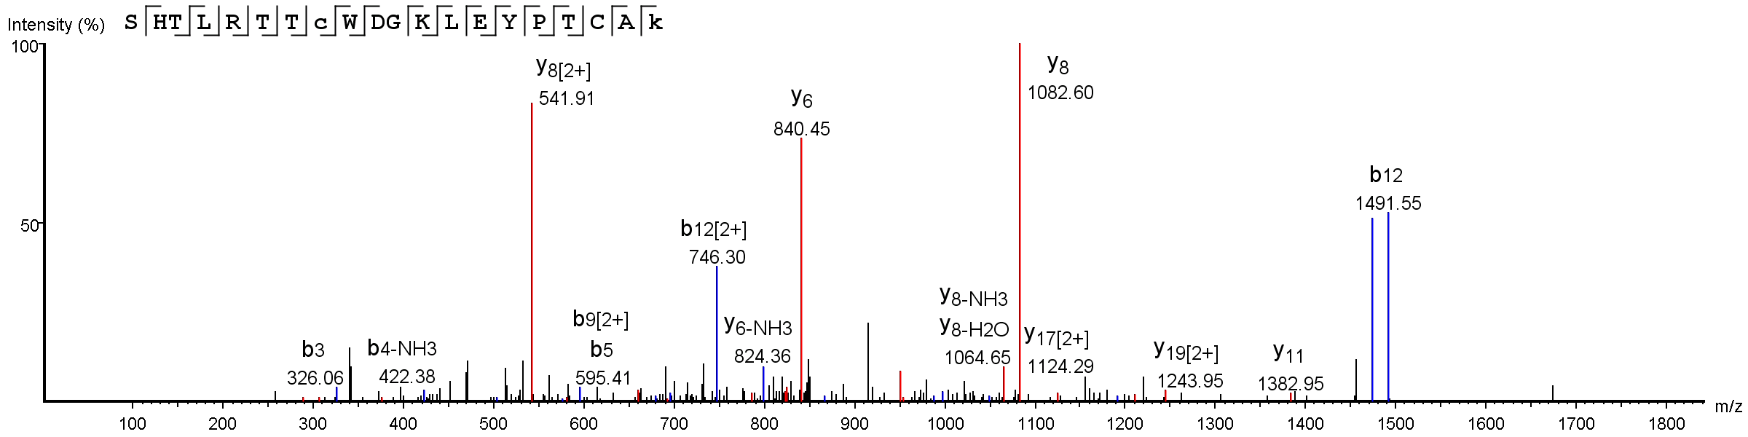
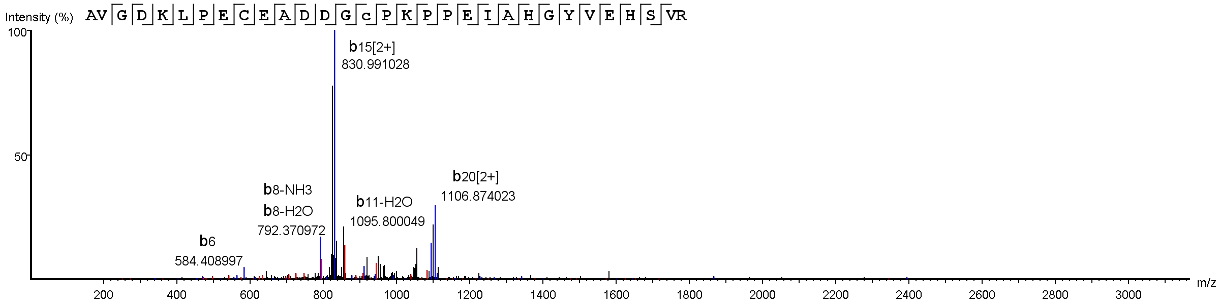
C
CFAH (RA)
19 17 12 11 9 8 7 6 5 4 2 1
y
b
3 4 5 6 7 8 9 12 14 16
D
HPT (RA)
y
29 28 23 21 20 18 1716 15 14 13 12 11 10 9 8 7 6 5 4 3 2
b
4 5 6 7 8 9 10 11 12 14 15 16 1718 20 21 2223 29

Slide 4
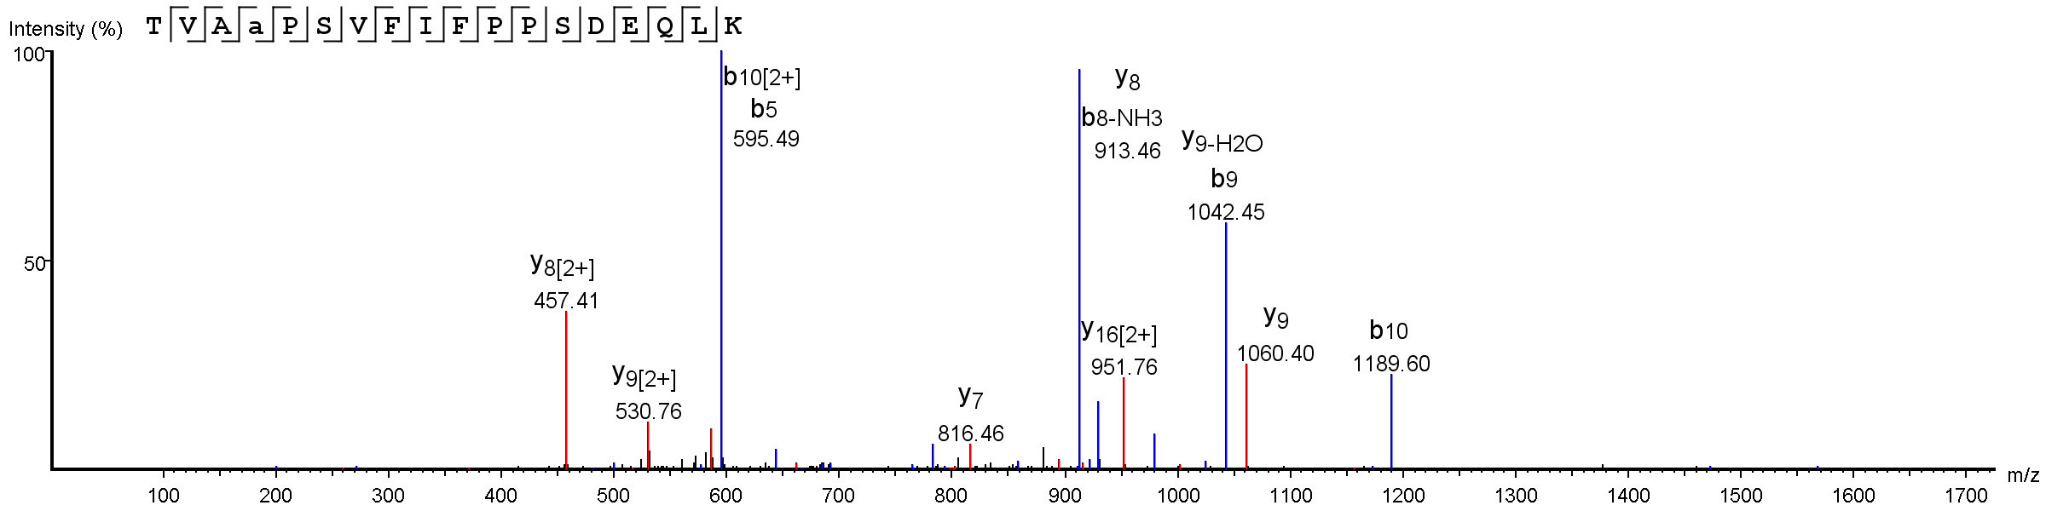
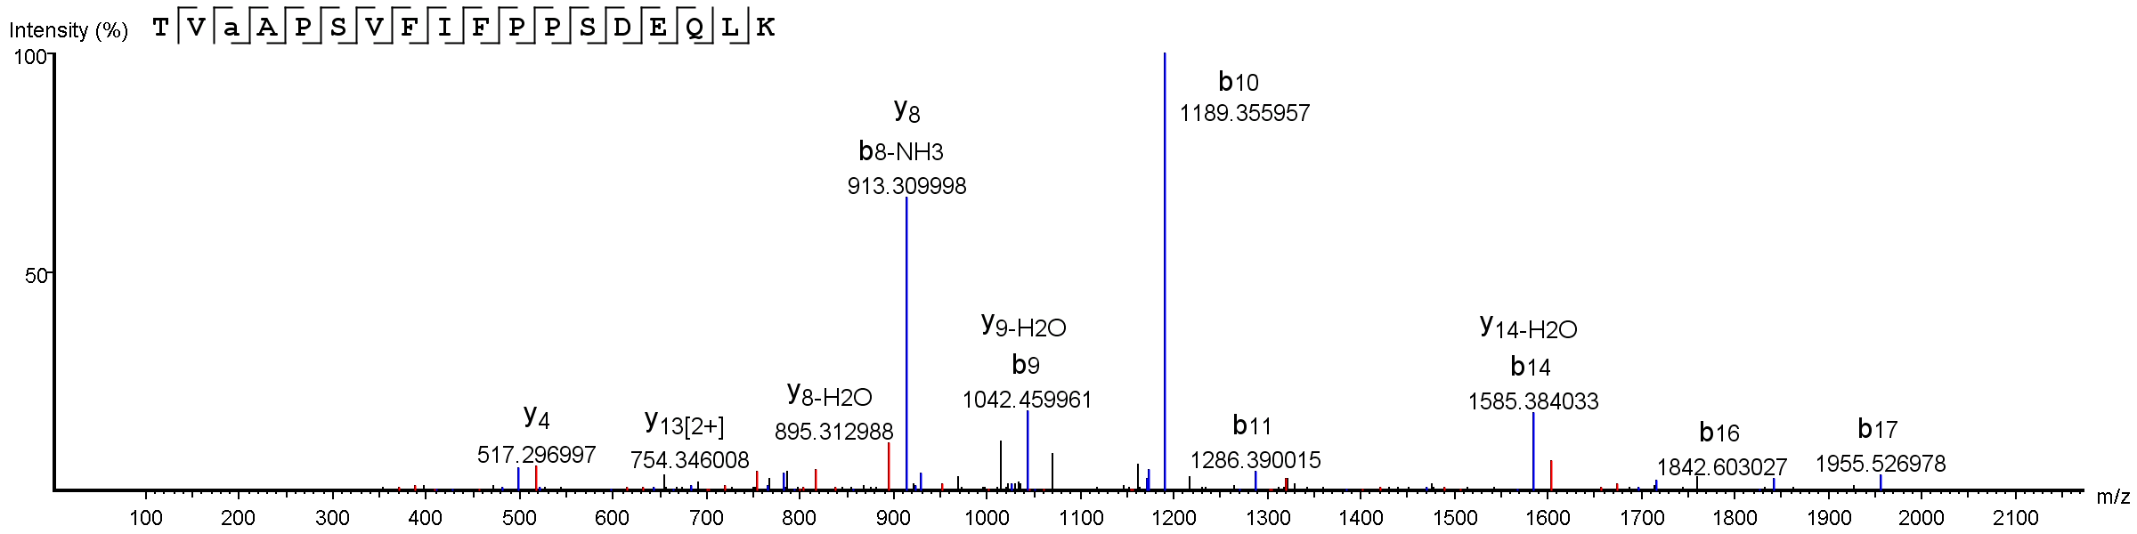
E
IGKC (RA, HC)
y
RA
17 16 15 14 11 10 9 8 7 4 3 2
b
2 3 4 5 6 7 8 9 10 11 12 13 14 15 16 17
17 16 15 14 13 12 11 10 9 8 7 6 5 4 3
y
3 4 5 6 7 8 9 10 11 12 13 14 15 16 17
RA, HC
b

Slide 5
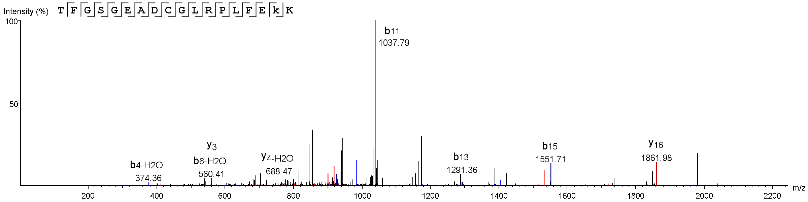
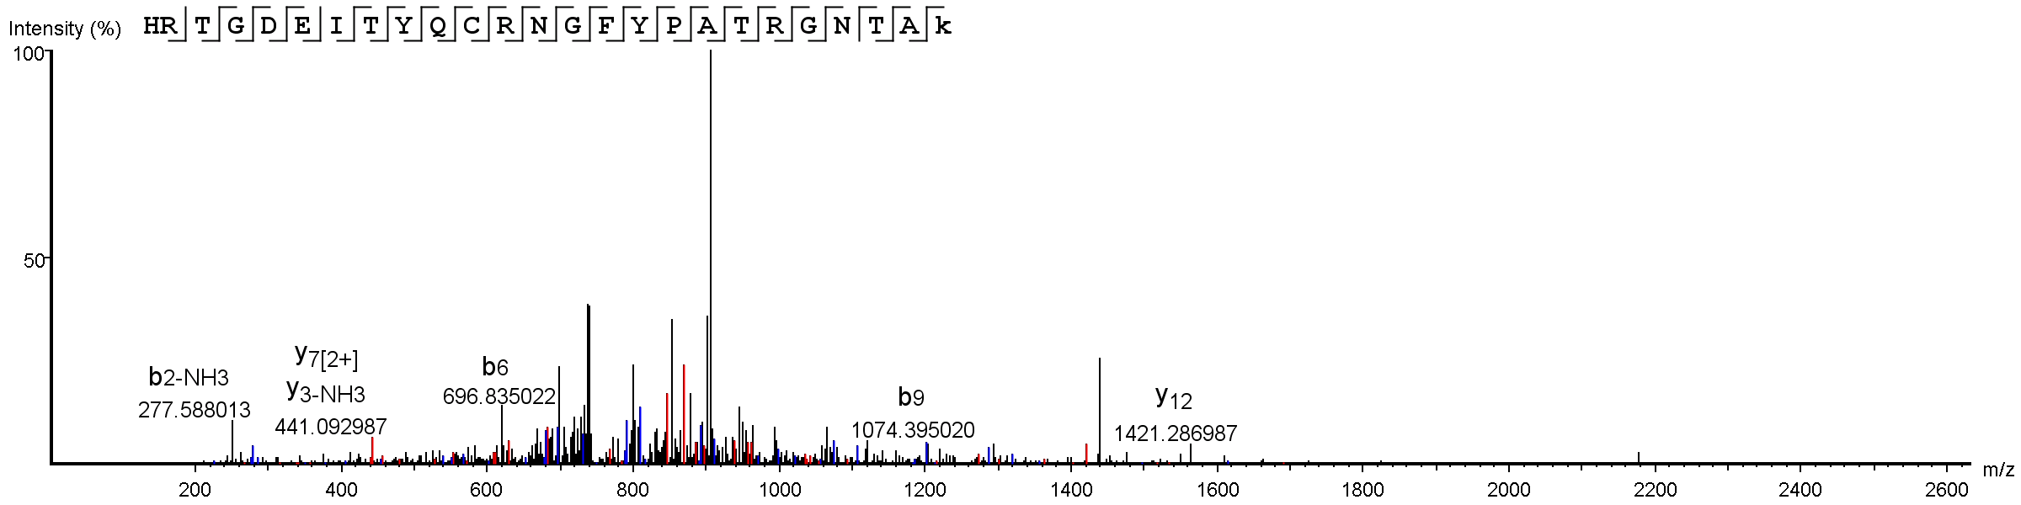
F
THRB (RA)
y
17 16 15 14 13 12 11 10 9 8 7 6 5 4 3 2
b
3 4 5 6 7 8 9 10 1112 13 14 15 17
G
CFAH (HC)
y
22 21 20 18 17 16 15 14 13 12 11 10 9 8 7 6 5 4 3 2 1
b
3 4 5 6 7 8 9 10 11 12 13 14 15 16 17 18 19 20 21 23 24

Slide 6
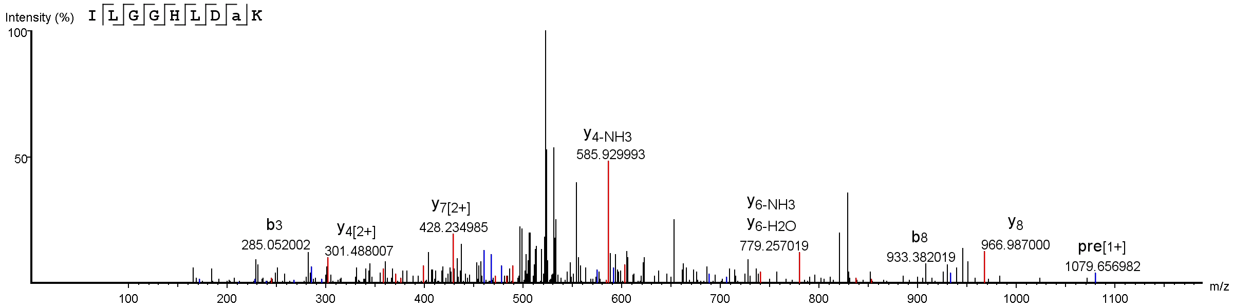
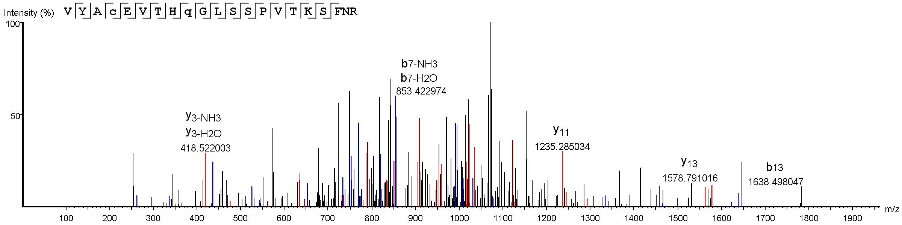
H
HPT (HC)
y
8 7 6 5 4 3 2
b
2 3 4 5 6 7 8
I
IGKC (HC)
y
20 18 17 16 15 13 12 11 10 9 8 7 6 5 4 3
b
2 4 5 6 7 8 10 11 12 13 17 18

Slide 7
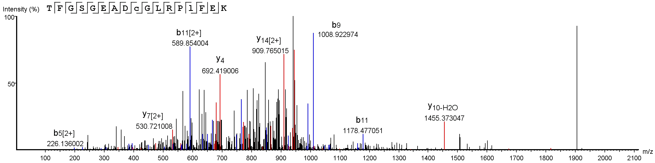
J
THRB (HC)
16 15 14 13 12 11 10 9 8 7 6 5 4 3
y
b
3 4 5 6 7 8 9 10 11 12 14 15 16

