Slide 1
Mrs. Nesrin decided to visit a doctor because of the constant swelling in her hand, skin shrinkage, deformity, and a few other symptoms.
What cancer was Mrs. Nesrin diagnosed with? Get the right diagnosis using the letters provided to you.

Slide 2
Combine the puzzle pieces to get an image. Then, examine the image.
In the image, you need to find the signs and symptoms of breast cancer. Remove the letters in the bag. Use the letters to display on the table three randomly selected signs-symptoms from the signs-symptoms in the image.

Slide 3
Mrs. Nesrin, who had her breast surgically removed, felt angry because she had cancer and lost tissue at a young age, and her body deteriorated. She was very nervous and fearful about what would happen next, whether she would recover or not, and what kind of effects the treatment would have on her. What are the right dialogues to have with her in this difficult situation?
We have included some sentences in the bag for you to use during the dialogues. Choose three correct dialogues from the bag and display them on the corkboard.

Slide 4
The nurse should take personal protective measures for chemotherapy preparation, administration, and termination.
Find the right materials for "personal protective measures" hidden in the room.

Slide 5
According to imaging analysis, Mrs. Nesrin has a tumor the size of a hazelnut (4-5 cm in size) and at least 5-6 lymph nodes on one side. There is no evidence of distant metastasis.
What stage of cancer does Mrs. Nesrin have? Use the visuals and choose the right letters and numbers to display her cancer stage on the table.

Slide 6
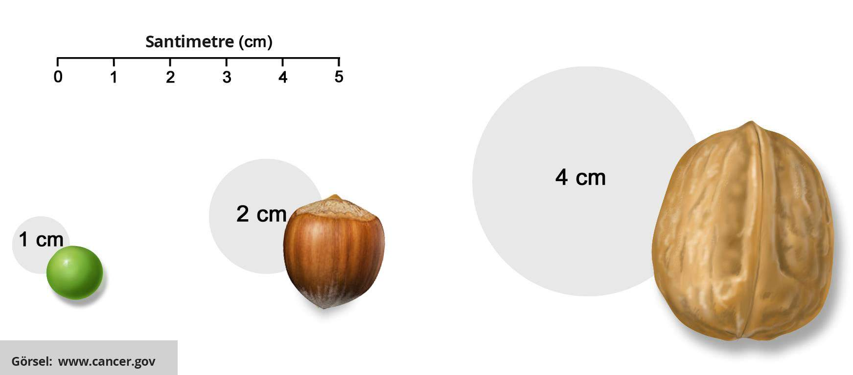

Slide 7
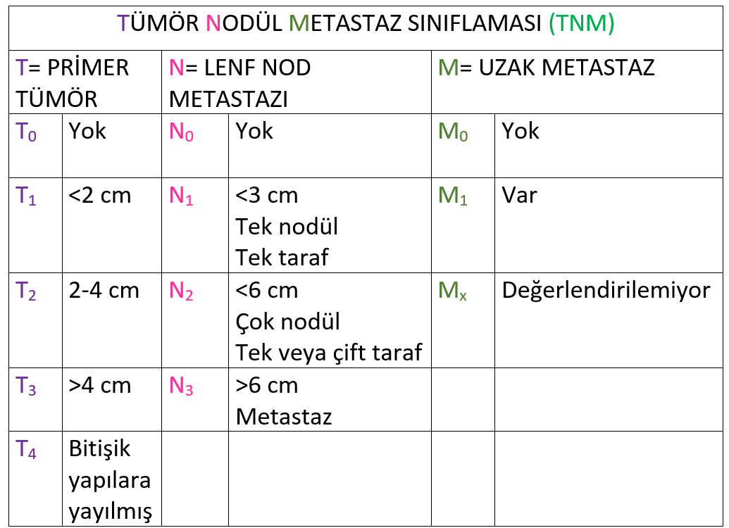

Slide 8
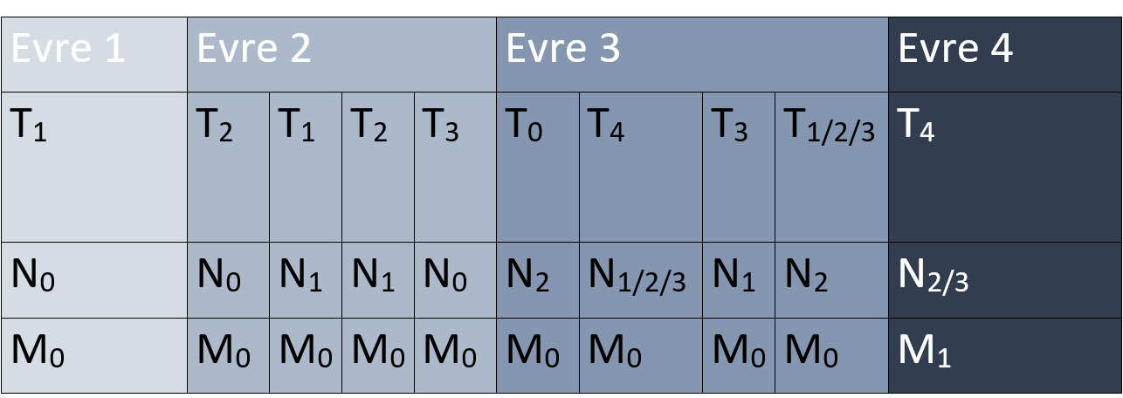

Slide 9
Mrs. Nesrin felt pain, soreness, and burning in her arm while she was receiving her seventh course of chemotherapy. When you checked, you saw that she had redness along the forearm. Put the photos in order according to the guide for intervention in extravasation.
On the blank space on this sheet, list the numbers on the photographs you have arranged in order of intervention.

Slide 10
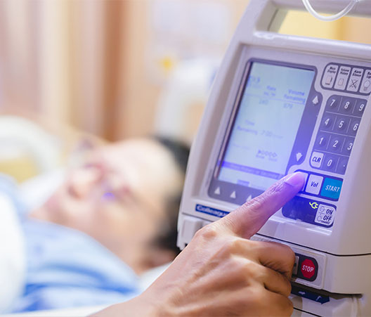
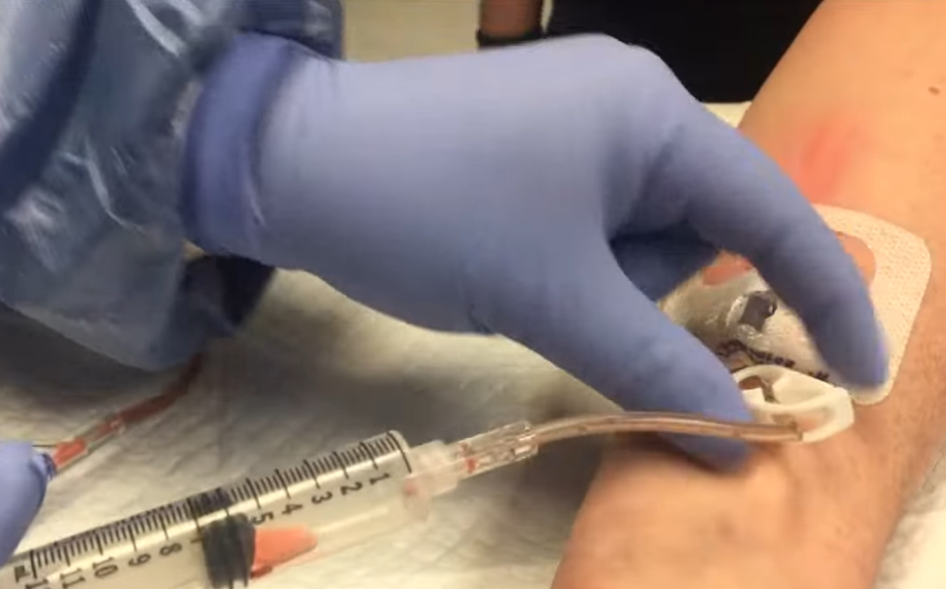
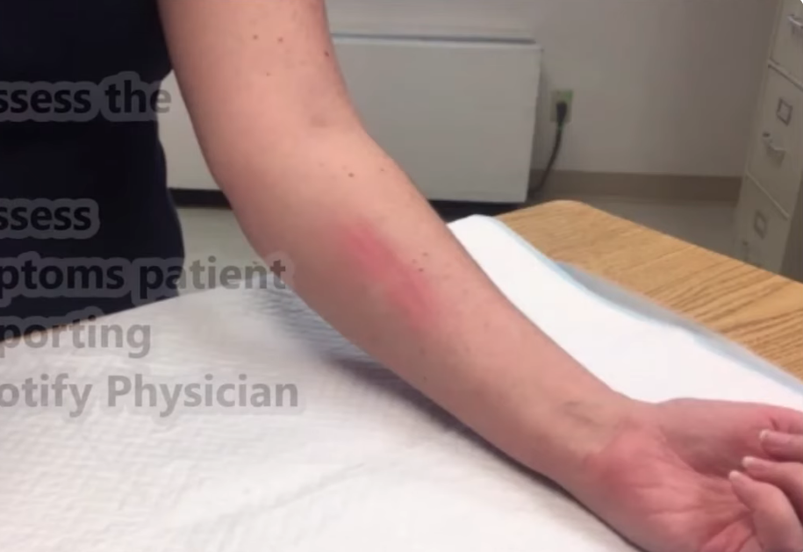
7
3
1
4

Slide 11
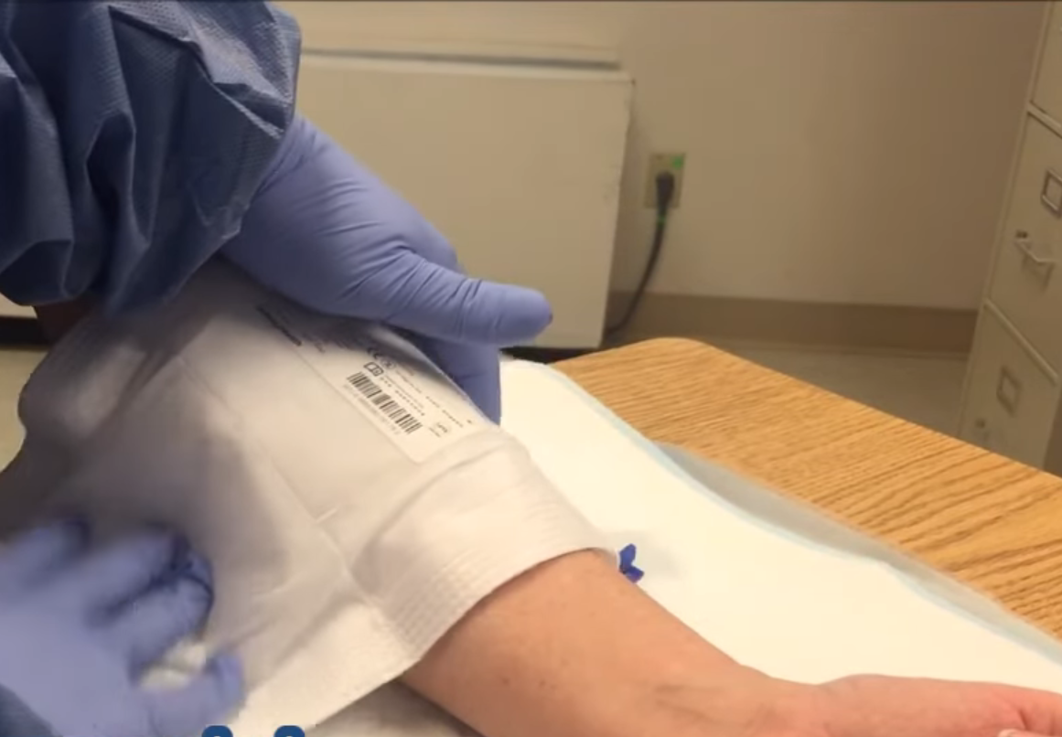
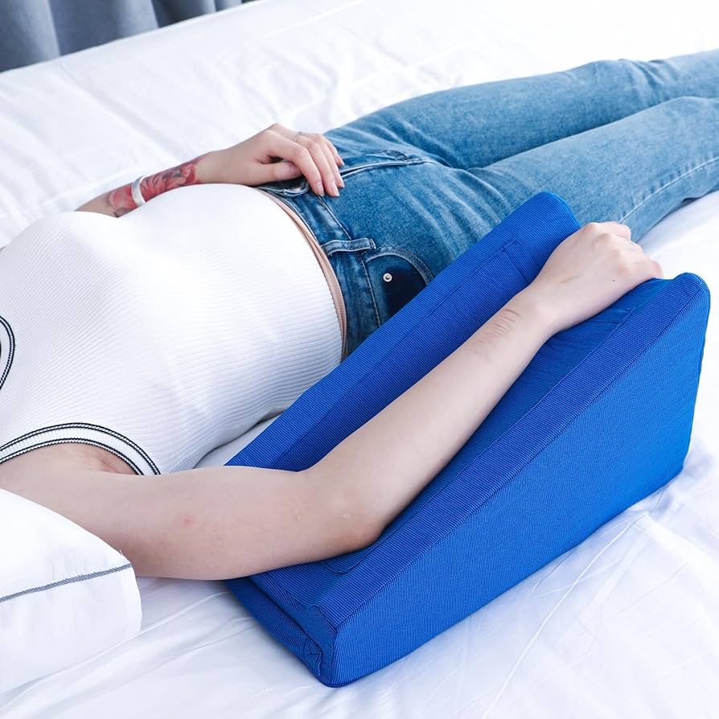

2
6
5

Slide 12
Guidelines for Extravasation Intervention
Stop the chemotherapy.
Aspirate the extravasated drug with another 10 ml-20 ml syringe and record its amount.
Remove the cannula carefully without pressure.
Mark the extravasation area with a pen.
Inform the doctor and administer the drug if it has an antidote.
Apply cold compresses (except for vinca alkaloids).
Elevate the extravasation area.

Slide 13
Having received her last chemotherapy three days ago, Ms. Nesrin presents to the emergency room with intense nausea and weakness.
History/Physical Examination
Nausea and vomiting for five days; severe for the last three days. Complaint of weakness. Pulse arrhythmia.
Vital Signs
Blood pressure: 80/55 mm/Hg Pulse: 58/min Respiration: 20/min Fever: 36.9⁰ C
Lab Results
Hb=11 gr/dL Platelets = 178bin/µL Neutrophil = 500 Leukocyte = 10.3 bin/µL
K= 6 mEq/L Ca= 7 mg/dL P= 4.5 mg/dL Uric Acid =8 mg/dL

Slide 14
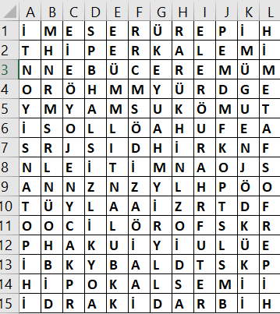
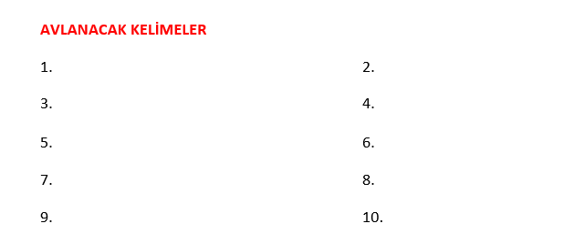
A HUNT FOR SYMPTOMS
The puzzle contains ten terms related to the patient's complaints and abnormal vital and lab results. First, identify and write down the terms, then find them in the puzzle.

Slide 15
From the remaining empty letters in the symptom hunt puzzle you have to make a phrase according to the following encryption. When you get the word right, the letter of the word you have found is your last clue to escape.
Line 2; Letter 1
Line 3; Letter 10
Line 4; Letter 4
Line 5; Letter 3
Line 7; Letter 1
Line 9; Letter 5
Line 10; Letter 3
Line 10; Letter 4
Line 12; Letter 3
Line 13; Letter 7

Slide 16
After chemotherapy, Mrs. Nesrin developed oral mucositis and had difficulty eating.
Examine the oral mucositis visual on the patient model. Determine Mrs. Nesrin's degree of oral mucositis (grade classification scale) and identify the relevant oral care approaches. Hang the five correct approaches on the corkboard.

