Slide 1
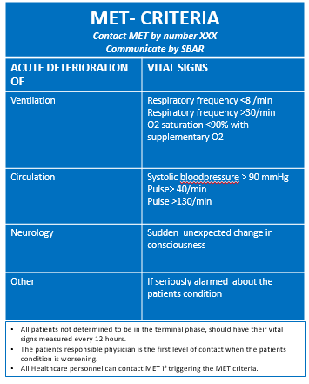
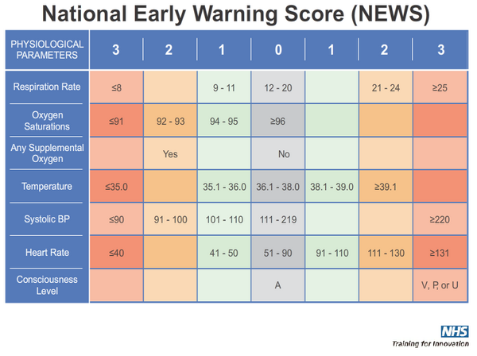
Overview of the MET criteria and NEWS with the accompanying response protocol
Limitations of medical treatment should be evaluated within the first 24 hours
NEW- score | Vital sign frequency | Response/ Escalation
0 | Minimum of 2 x /24 hours
1-4 | Minimum of 3 x /24 hours (1 per shift) | Nurses can evaluate the need for more frequent vital sign measurements
5-6 or score of 3 or more in a single parameter | Hourly, or as instructed by physician. Document assessment and measures in ‘NEWS response’ in the OM- chart | Alert the responsible physician. Nurse and physician consider calling MET
≥ 7 | Continuous monitoring until physician assessment. Document assessment and measures in ‘NEWS response’ in the OM-chart | Immediately alert responsible physician. Call MET if patient is not stabilised and the condition under control within 20 minutes
When seriously concerned about the patient, alert the responsible physician and/ or MET, regardless of NEW- score.
© Royal College of Physicians 2012
Supl. File 2: The MET criteria was introduces in 2012, and is in use P2. The NEWS and response protocol was introduced in 2016, and is in use P3.

