Slide 1
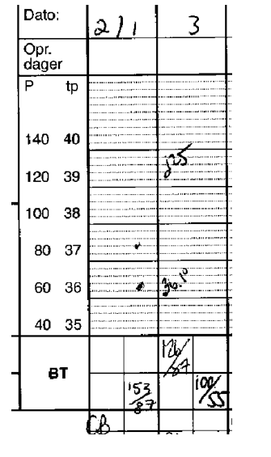
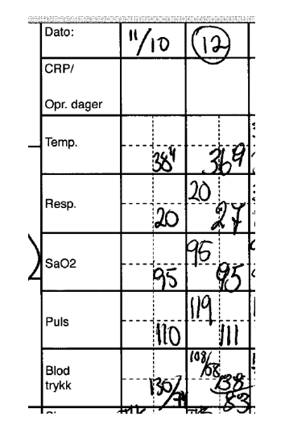
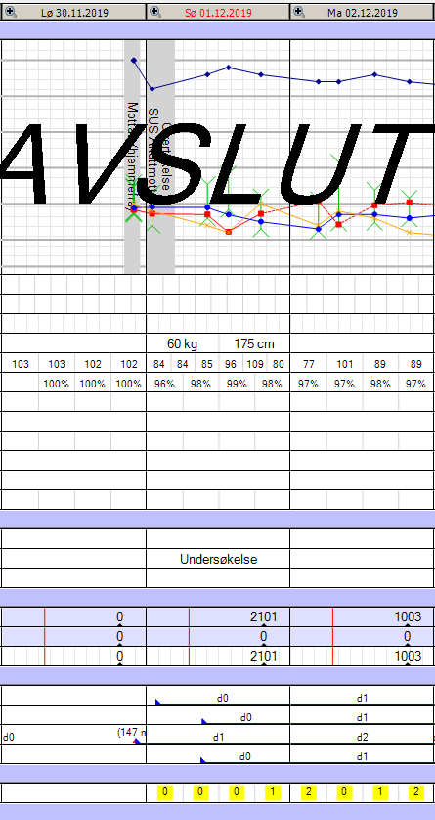
Examples of the charts with documented vital signs used in the three time periods
P1
P2
P3
Supl. File 3: Development of patient OM-chart. In P1, no room for respiratory frequency documentation. In P2, new charts developed when the MET- c criteria was implemented. In P3, NEWS is incorporated in the chart. All vital signs are documented both in the top of the chart, and in the bottom as NEW -score. By clicking on the numbers, detailed information about time for registration and all vital sign values are available.

