Slide 1
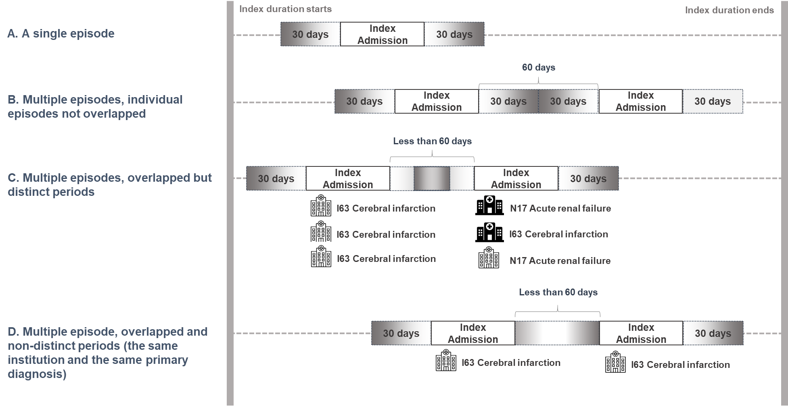
Additional file 1. Adjustment rules for overlapped episode windows
Modified from the classification of overlapped episode windows [17].
Notes:
Additional file 1. Adjustment rules for overlapped episode windows

