Slide 1
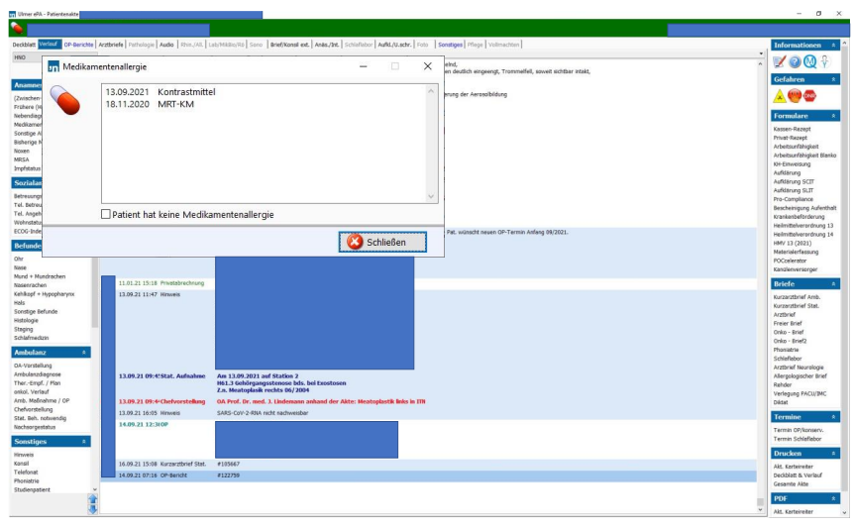
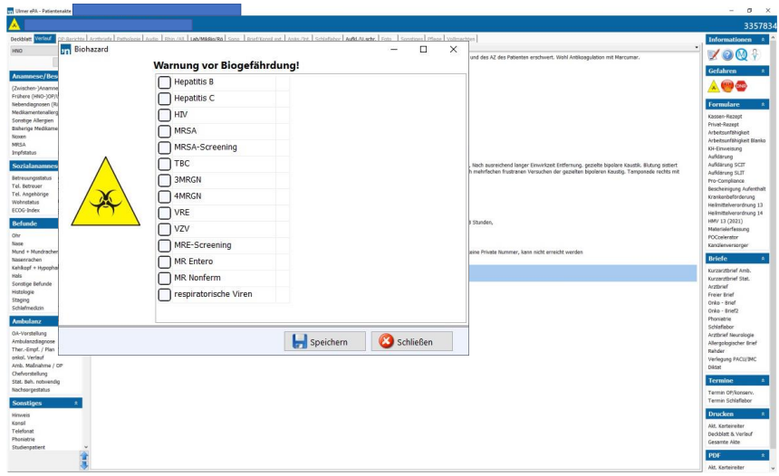
Supplementary Figure 1
A
B
Supplementary Figure 1: A: Drug allergies marked in the ePA at Site A. If a medication allergy is indicated on admission, the electronic file is marked with a red exclamation mark (red pill), which is always visible when the file is opened. The allergy is noted by hand in the Kardex and color-coded. B: Biohazard warning hazard sign in the ePA at Site A. If an infectious pathogen is detected and marked in a patient, the ePF is color-coded.

