Slide 1
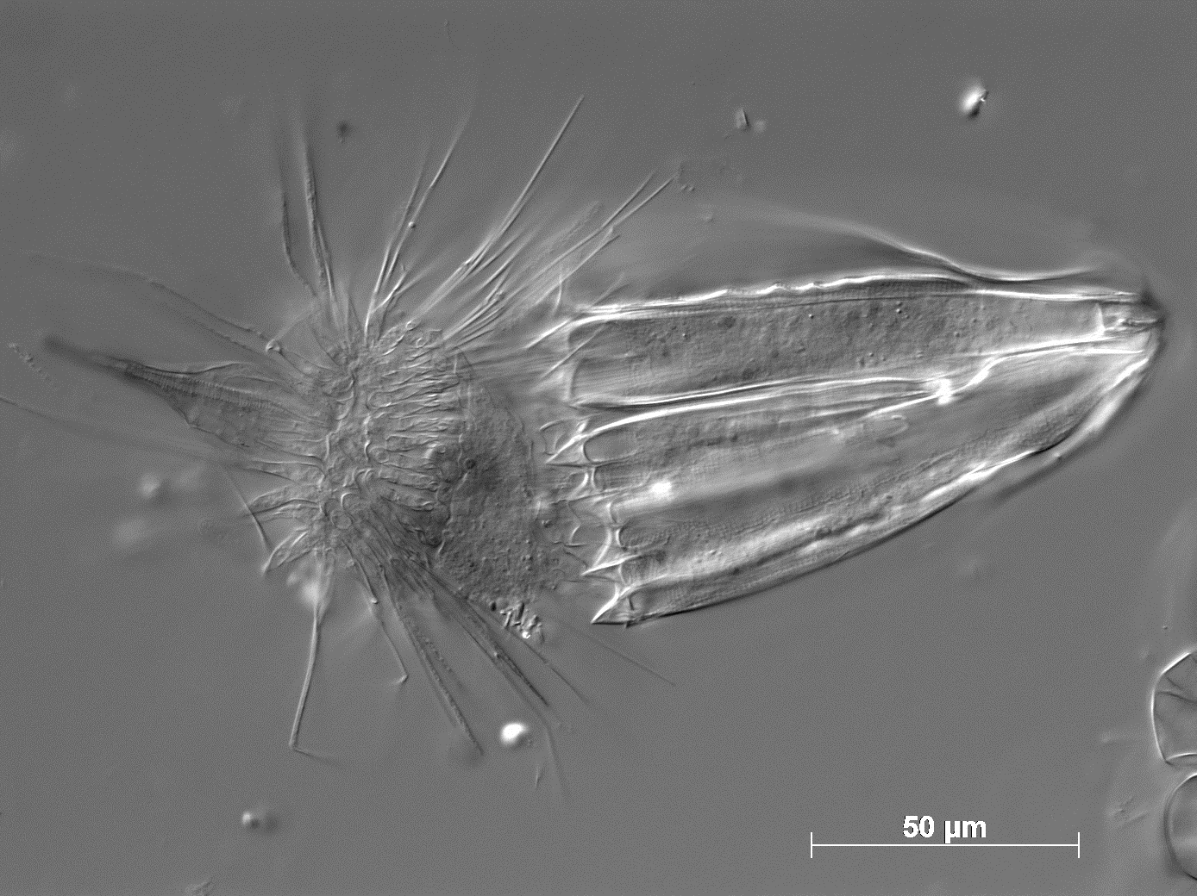
Notes:
DIC image.

Slide 2
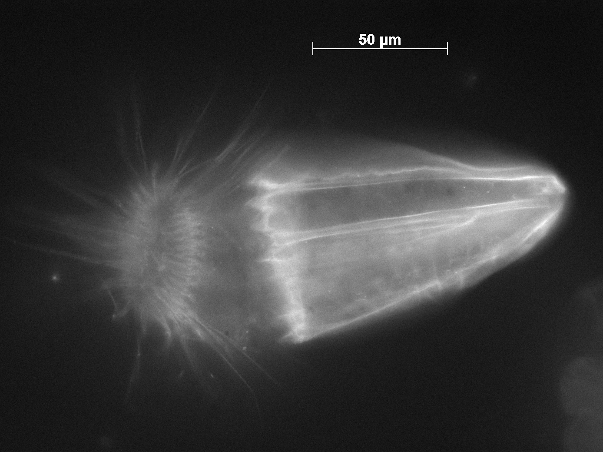
Notes:
DAPI image. Note diffuse label of exoskeleton (almost no internal tissue).

Slide 3
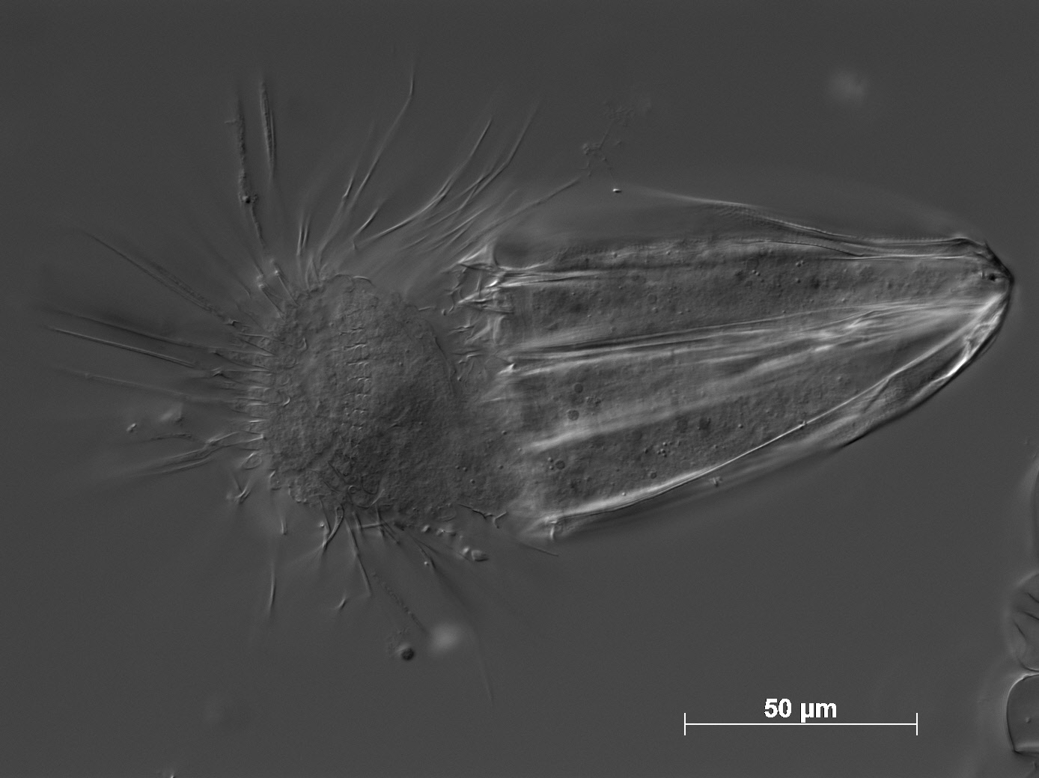
Notes:
DIC image.

Slide 4
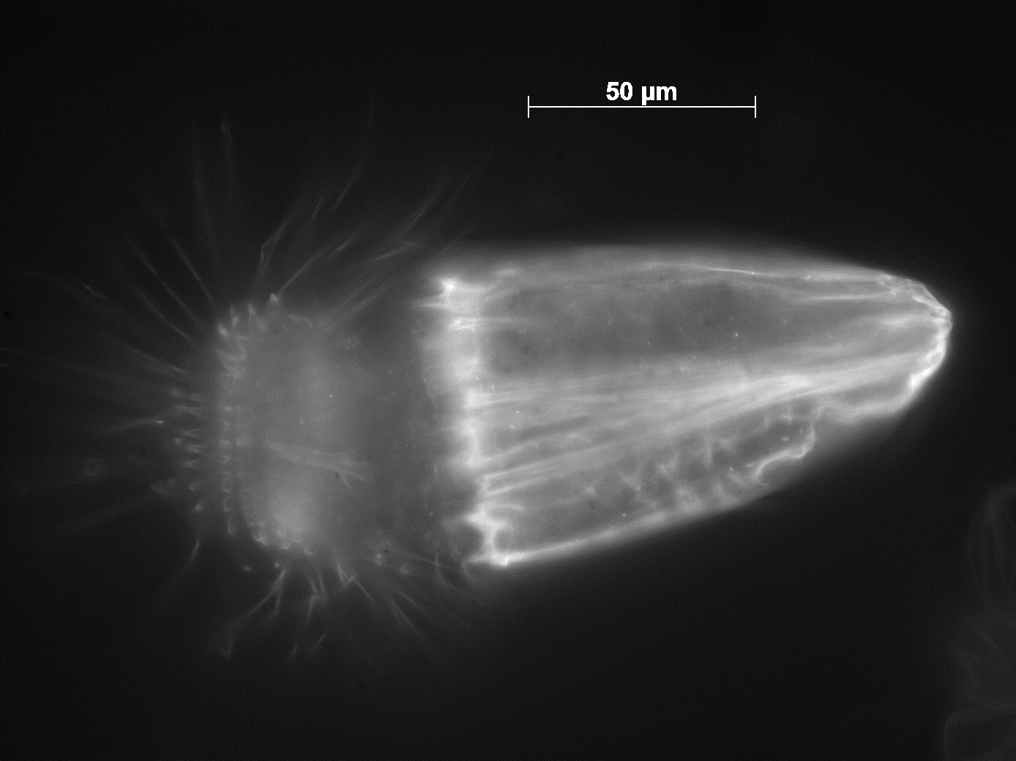
Notes:
DAPI image. Note diffuse label of exoskeleton and very few small internal signals (point sources).

Slide 5
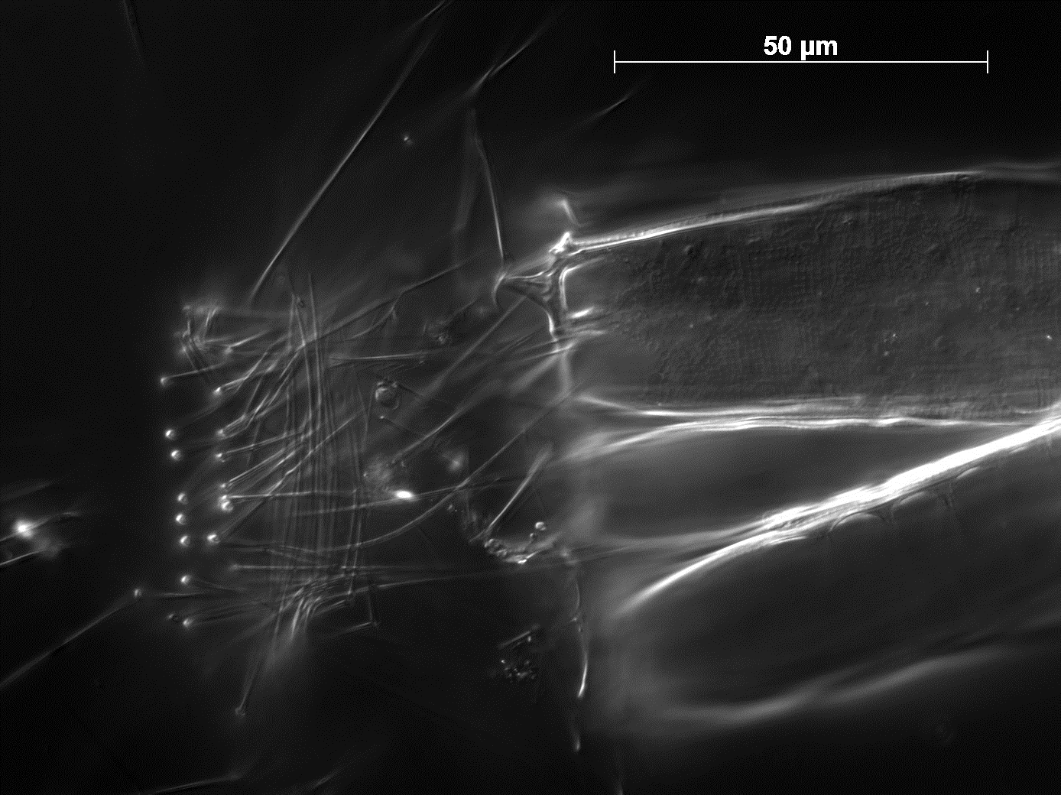
Notes:
DIC image

Slide 6
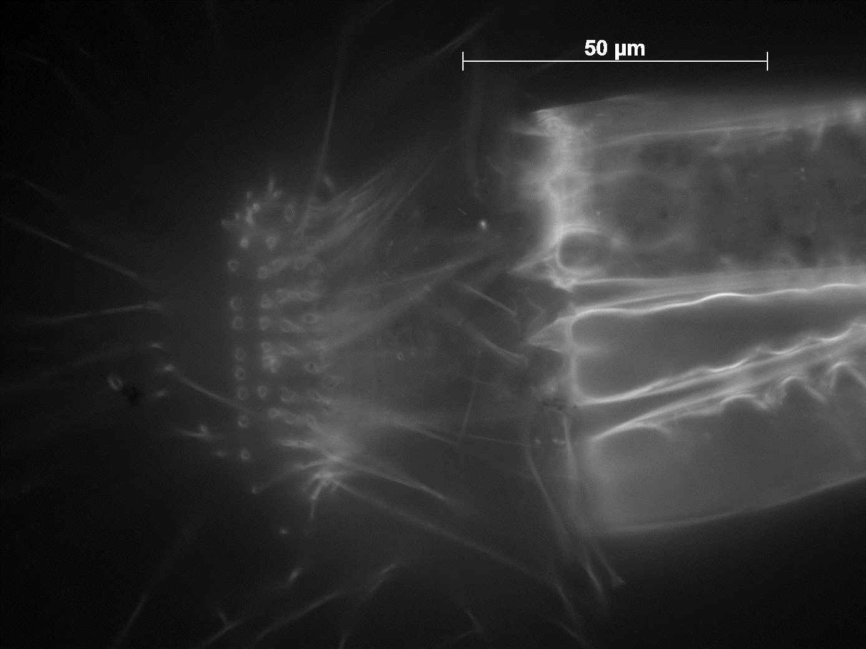
Notes:
DAPI image. Note diffuse label of exoskeleton (not internal tissue).

Slide 7
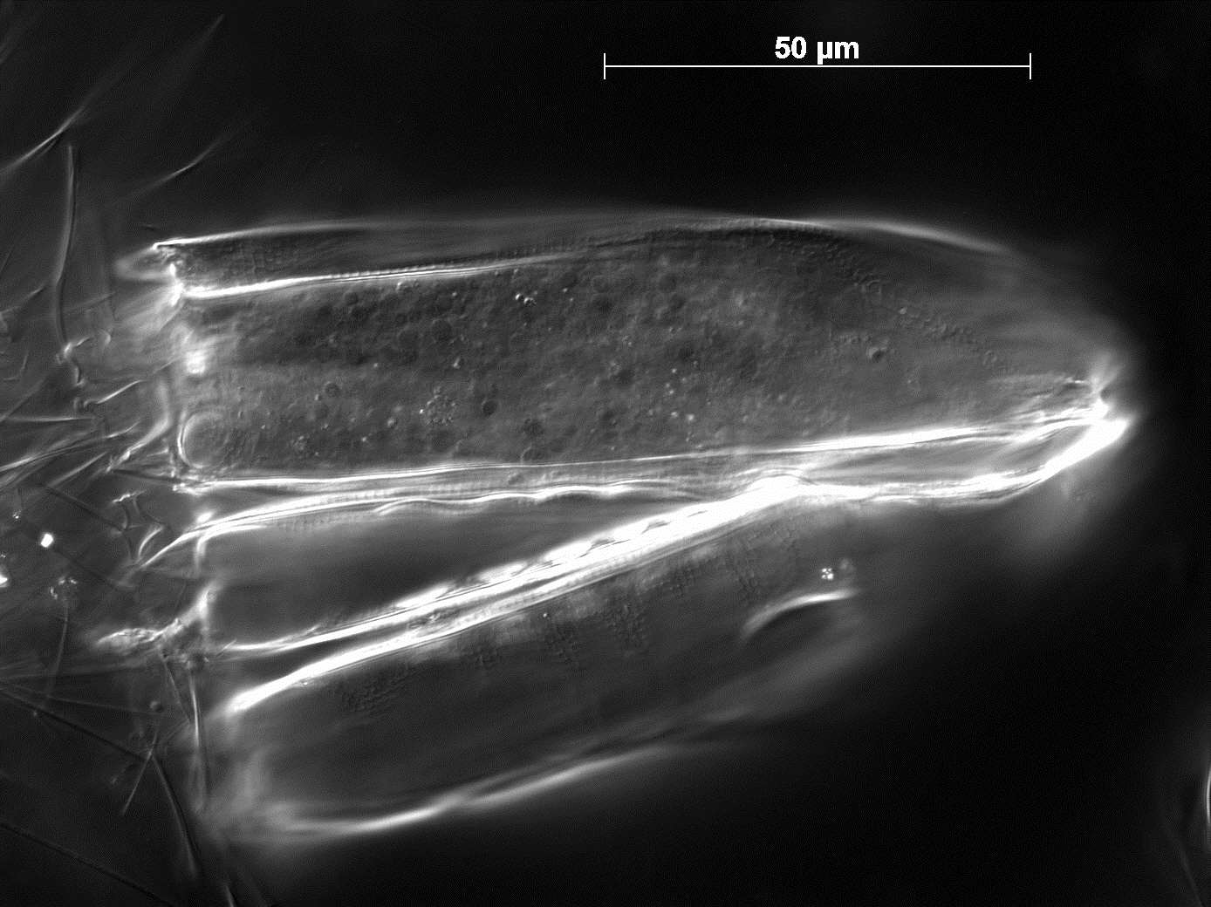
Notes:
DIC image.

Slide 8
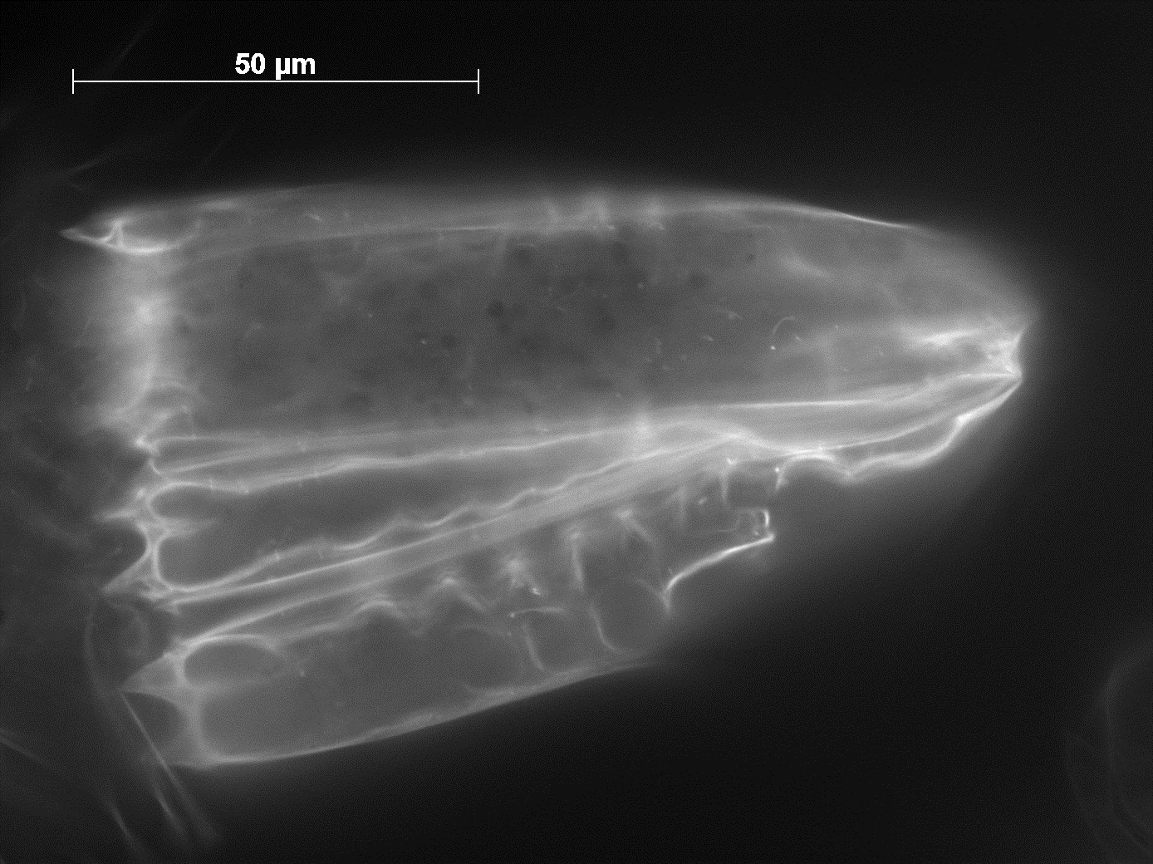
Notes:
DAPI image. Note label of exoskeleton (not internal tissue).

