Slide 1
Notes:
DIC image.

Slide 2
Notes:
DAPI image. Note diffuse label of exoskeleton (no internal tissue labeling).

Slide 3
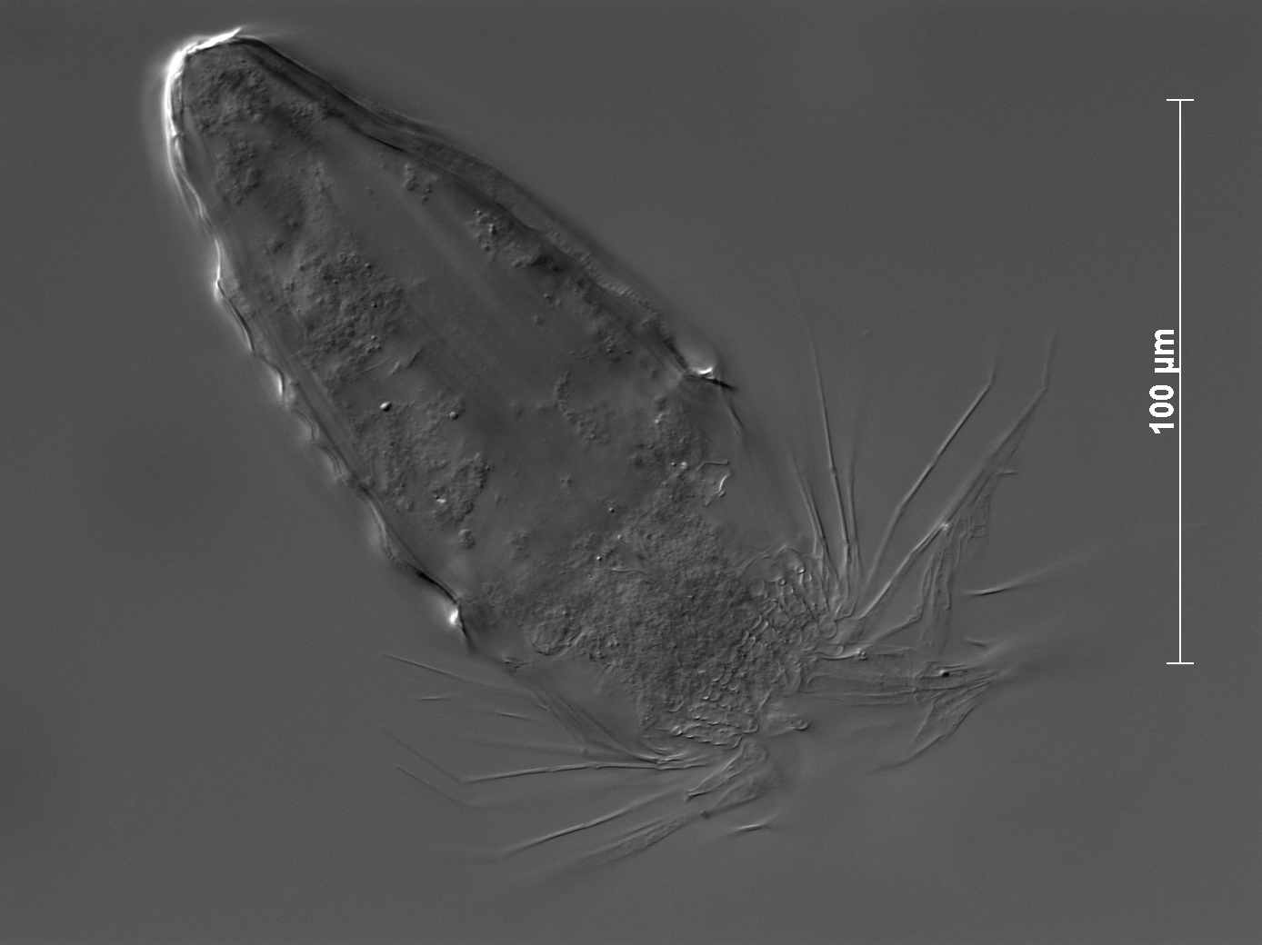
Notes:
DIC image.

Slide 4
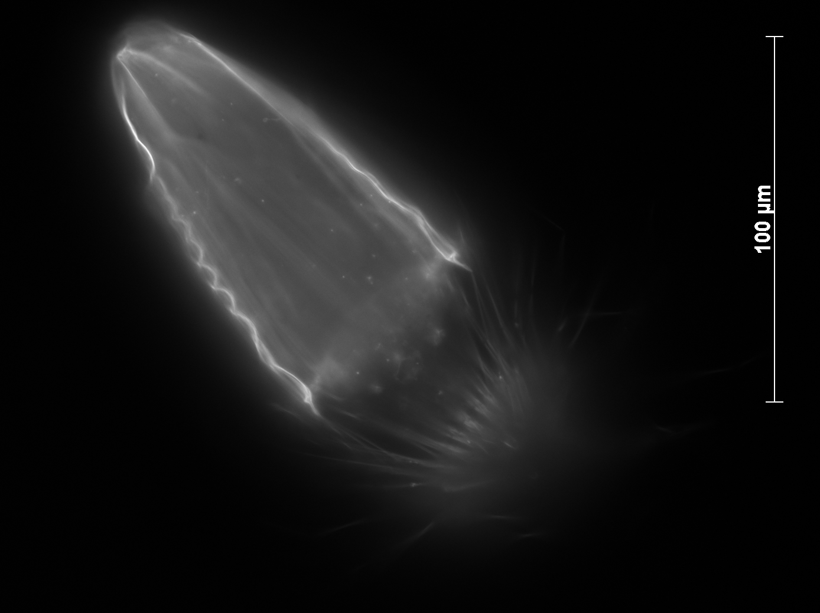
Notes:
DAPI image. Note diffuse label of exoskeleton (very little internal tissue labeling).

Slide 5
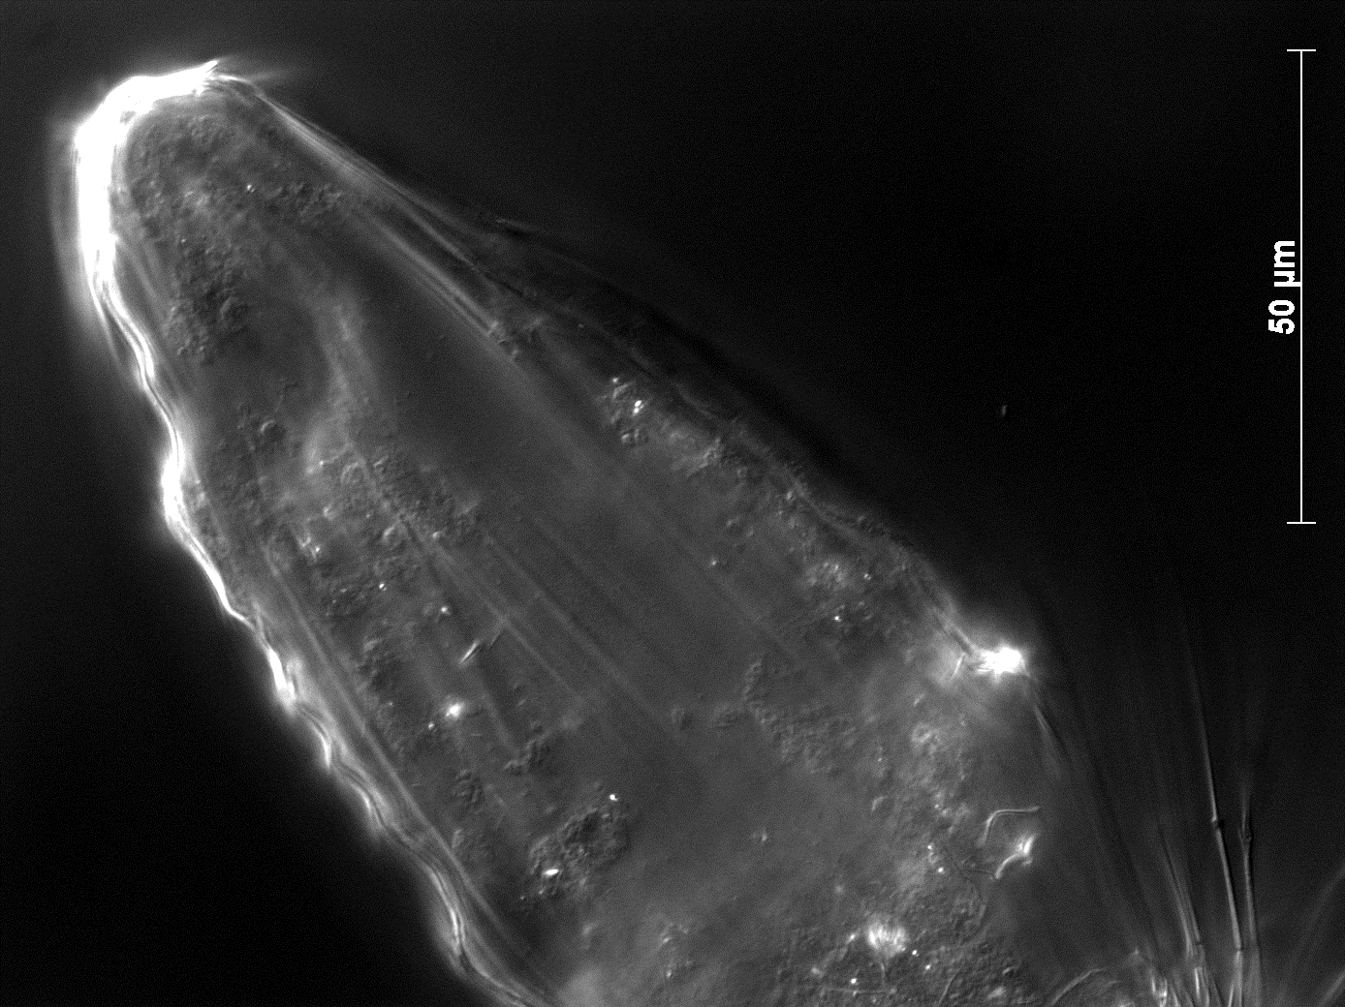
Notes:
DIC image.

Slide 6
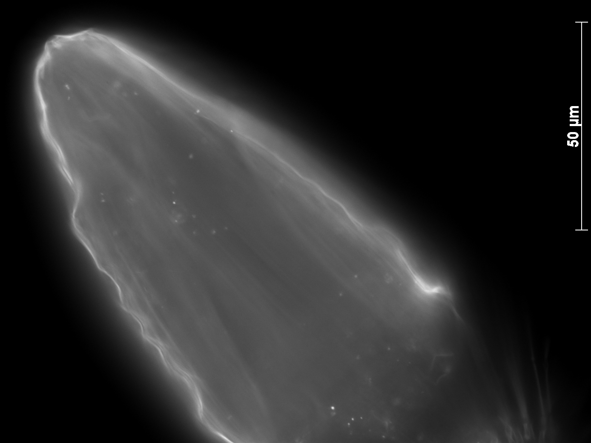
Notes:
DAPI image. Note diffuse label of exoskeleton and very little label of internal tissue (only point sources).

Slide 7
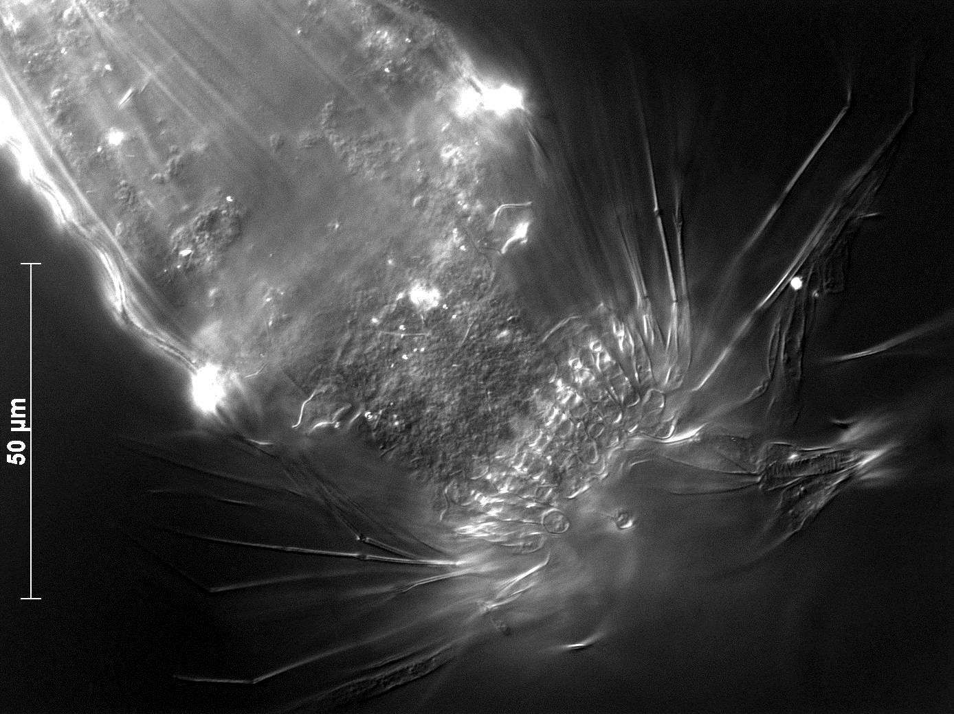
Notes:
DIC image.

Slide 8
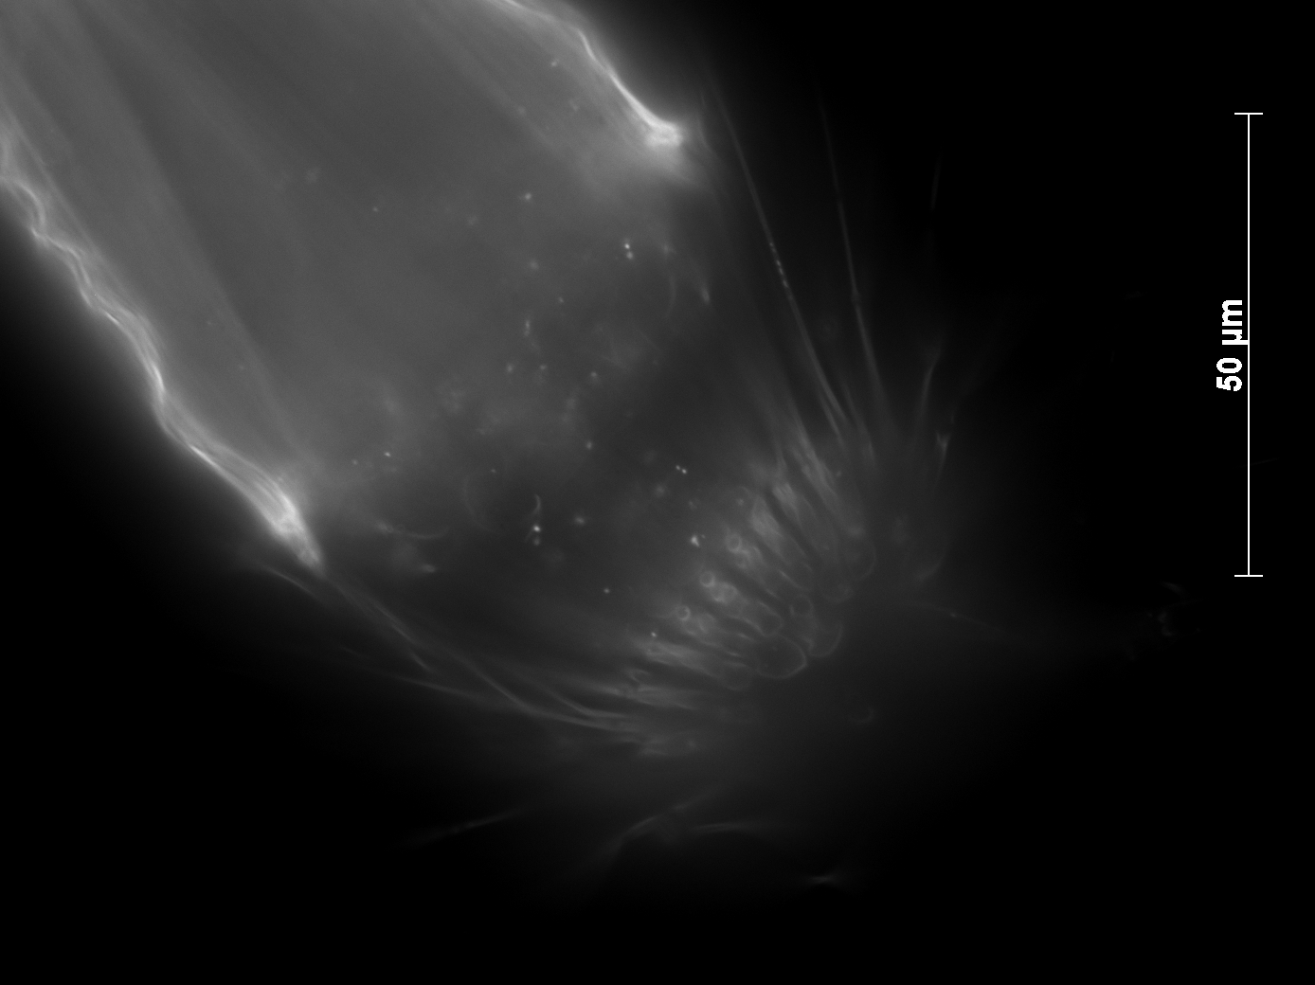
Notes:
DAPI image. Note diffuse label of exoskeleton and very little label of internal tissue (only point sources).

