Slide 1
Supplementary Information
Analysis of urinary exosomal metabolites identifies cardiovascular risk signatures with added value to urine analysis
Marta Agudiez¹, Paula J Martinez¹, Marta Martin-Lorenzo^{1#}, Angeles Heredero², Aranzazu Santiago- Hernandez¹, Dolores Molero³, Juan Manuel Garcia-Segura^{3,4}, Gonzalo Aldamiz-Echevarria², Gloria Alvarez-Llamas^{1,5*}
Immunology Department, IIS-Fundacion Jimenez Diaz-UAM, Madrid, Spain.
Cardiac Surgery Department, Fundacion Jimenez Diaz-UAM, Madrid, Spain.
CAI-RMN, Universidad Complutense, Madrid, Spain.
Department of Biochemistry and Molecular Biology, Faculty of Biology, Universidad Complutense, Madrid, Spain.
REDINREN, Madrid, Spain.
*Corresponding author: Gloria Alvarez-Llamas. Immunology Department. IIS-Fundacion Jimenez Diaz.
Avda. Reyes Catolicos 2. 28040 Madrid, Spain. Phone N. (+34) 915504800 2203. email: galvarez@fjd.es
#Corresponding author: Marta Martin-Lorenzo. Immunology Department. IIS-Fundacion Jimenez Diaz. Avda. Reyes Catolicos 2. 28040 Madrid, Spain. Phone N. (+34) 915504800 2202. Email: marta.martin@fjd.es

Slide 2
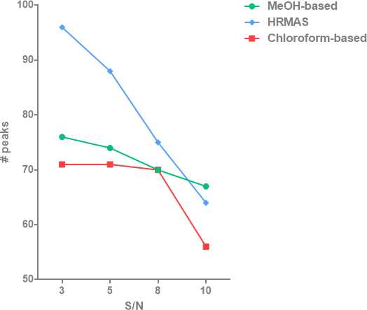
Additional file 2: Fig. S2. Number of detected peaks at different sensitivity cut-off values, estimated as 3, 5, 8 or 10 times signal to noise ratio (S/N).

