Slide 1


Nucleus-cytoskeleton communication in embryonic stem cells
and its impact on OCT4-chromatin interactions
Romero JJ et al.
Additional file 13 – Supplementary Fig. S5
Nuclei segmentation

Slide 2
YPet-OCT4 ES cell line
Control condition

Slide 3
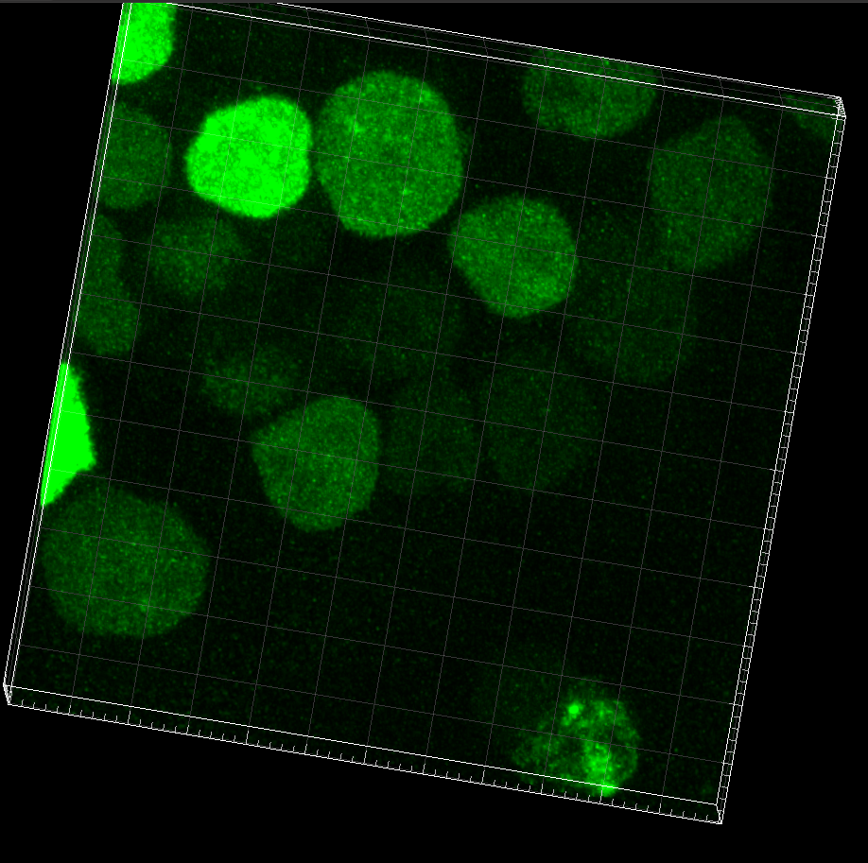
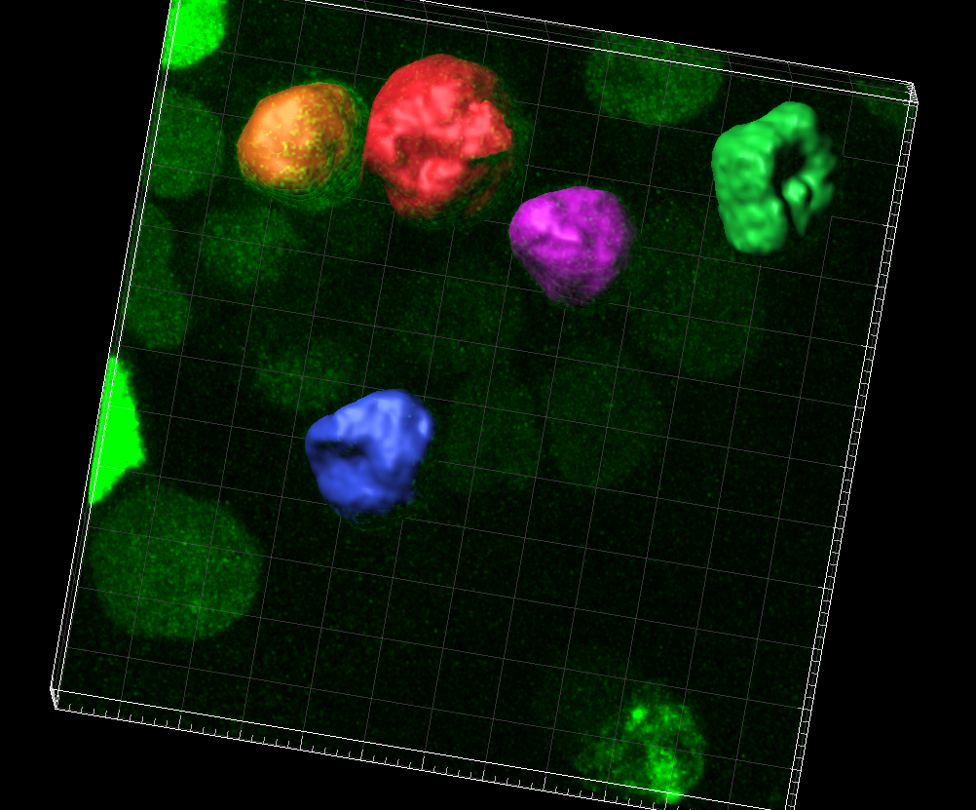
YPet-OCT4 + mem-mCherry
Control condition
Image0001stack.imx

Slide 4
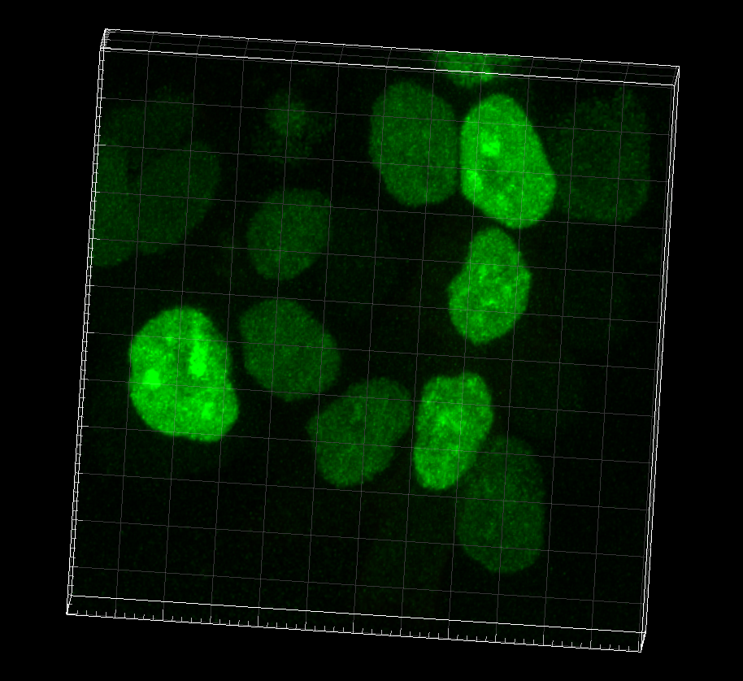
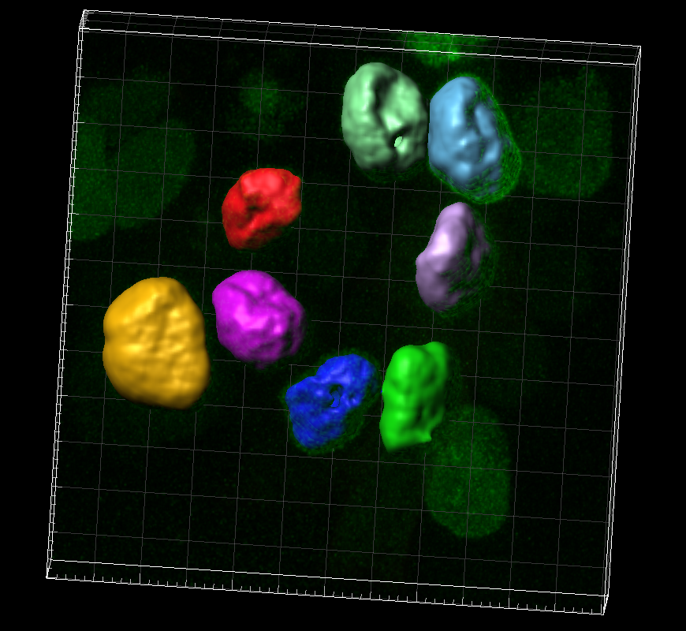
YPet-OCT4 + mem-mCherry
Control condition
Image0002stack.imx

Slide 5
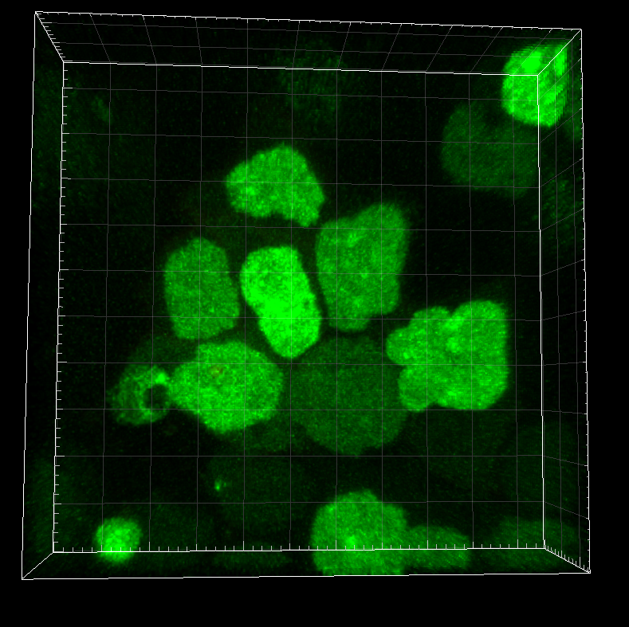
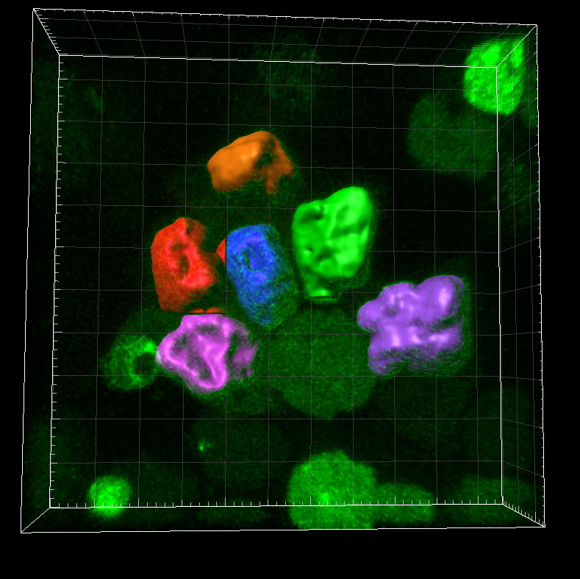
YPet-OCT4 + mem-mCherry
Control condition
Image0006stack.imx

Slide 6
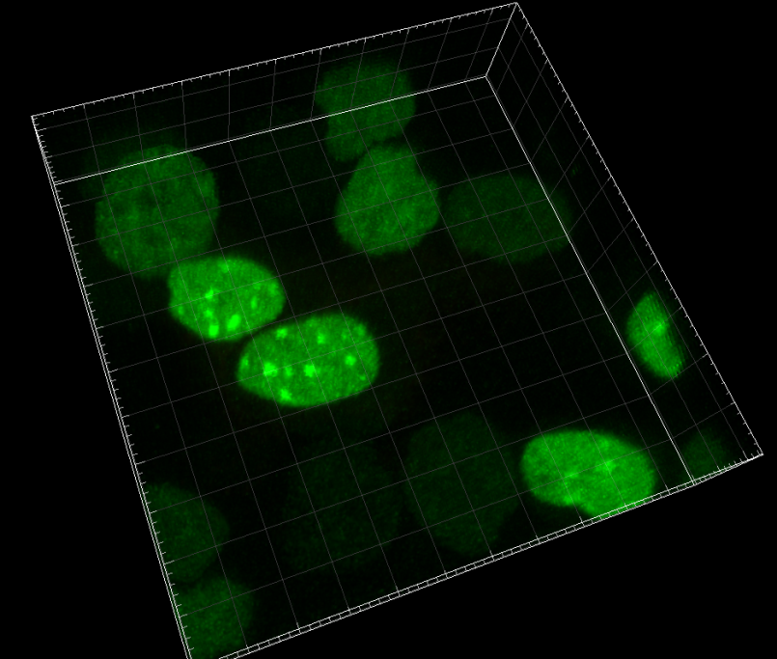
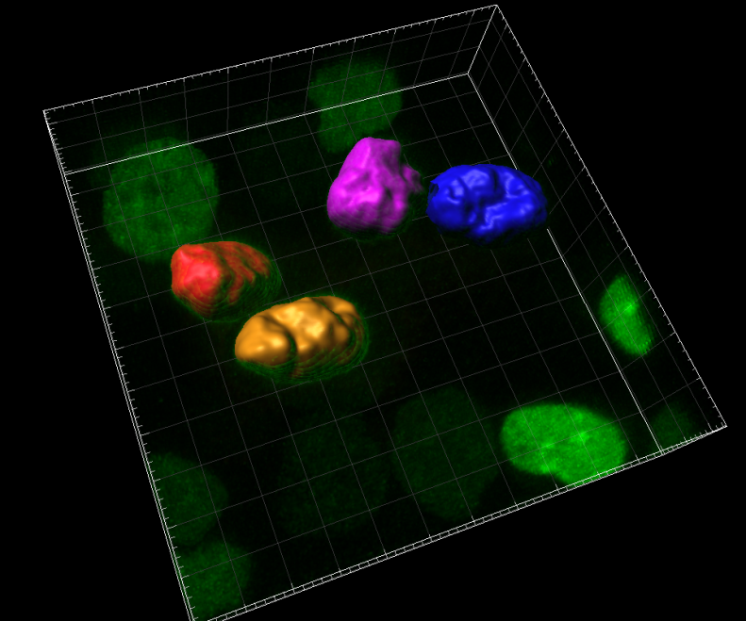
YPet-OCT4 + mem-mCherry
Control condition
Image0007stack.imx

Slide 7
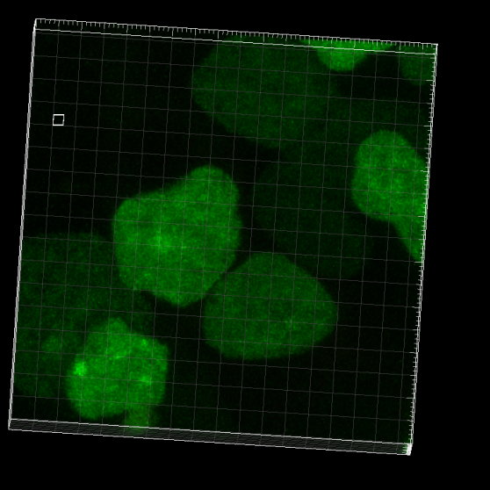
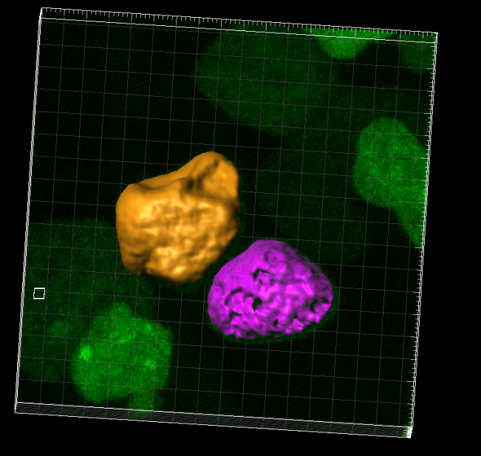
YPet-OCT4 + mem-mCherry
Control condition
Image0008stack.imx

Slide 8
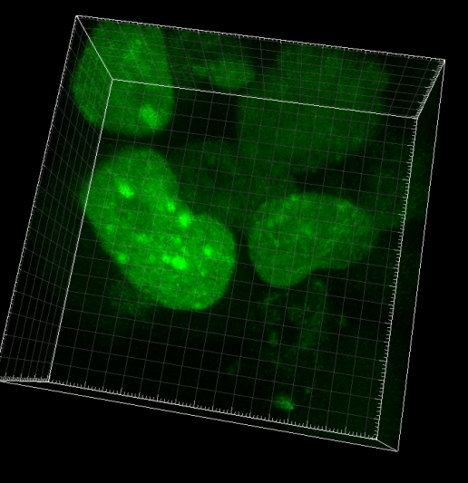
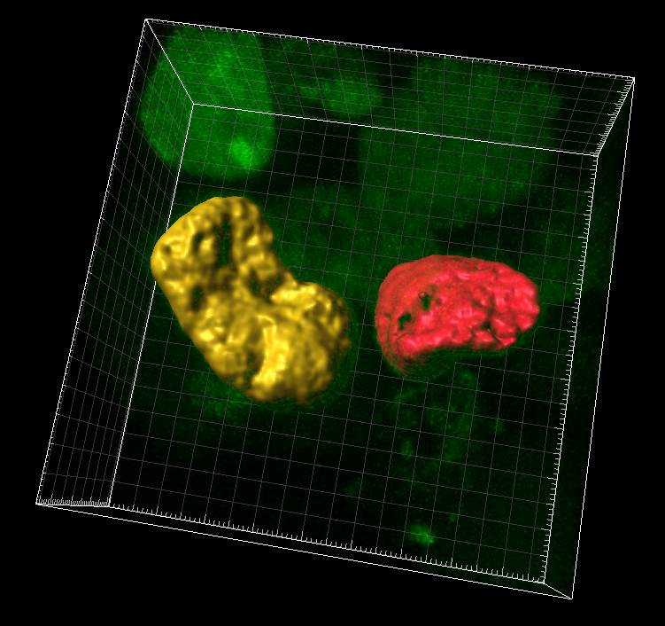
YPet-OCT4 + mem-mCherry
Control condition
Image0012stack.imx

Slide 9
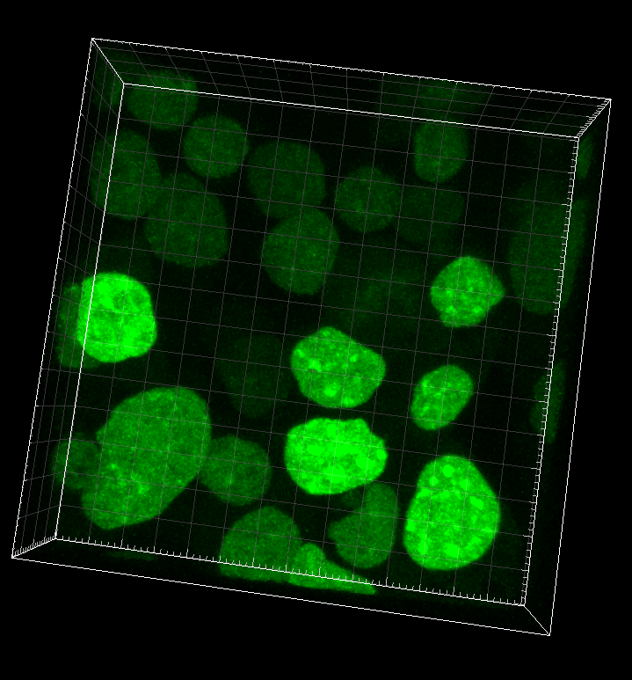
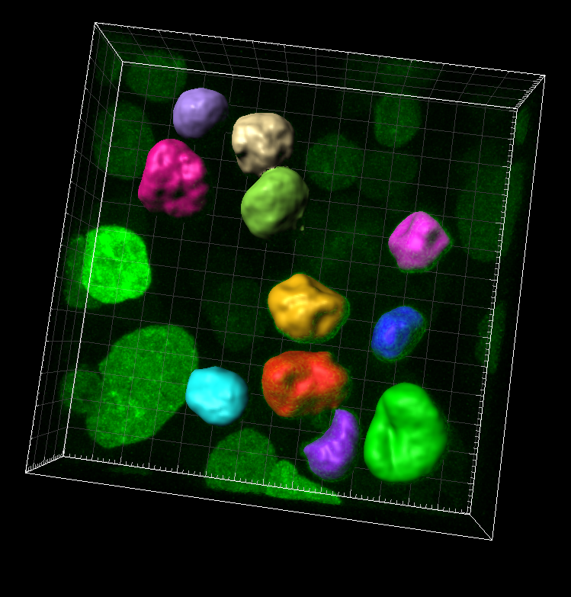
YPet-OCT4 + mem-mCherry
Control condition
Image0001stack.imx

Slide 10
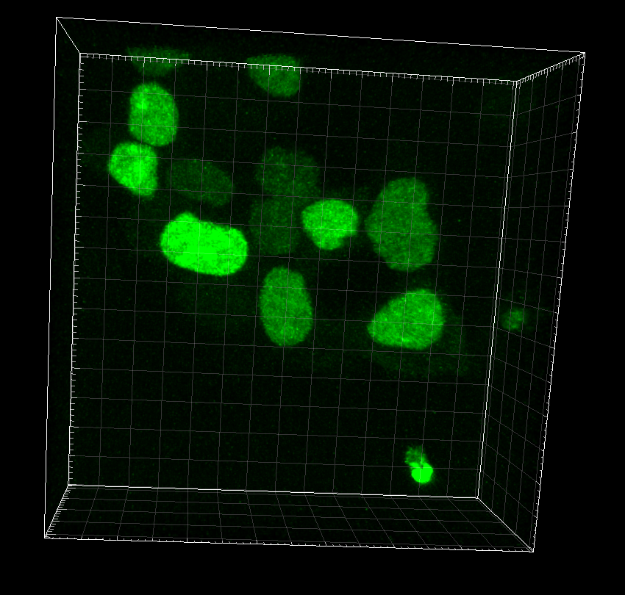
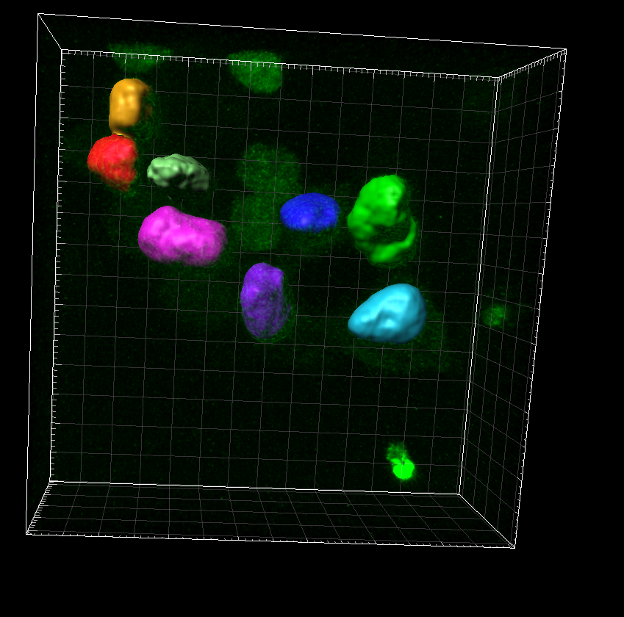
YPet-OCT4 + mem-mCherry
Control condition
Image0004stack2.imx

Slide 11
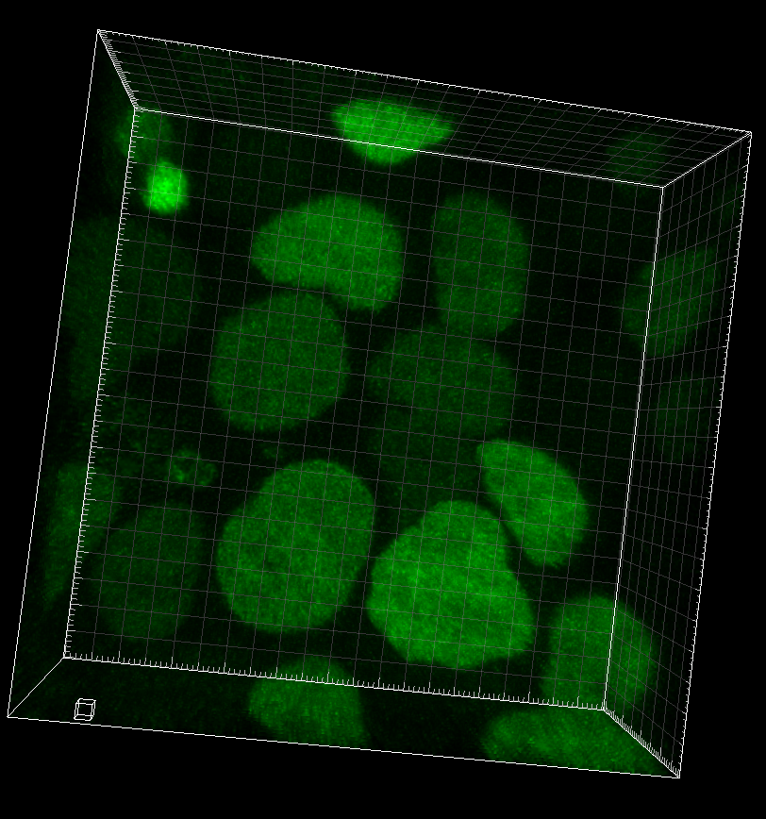
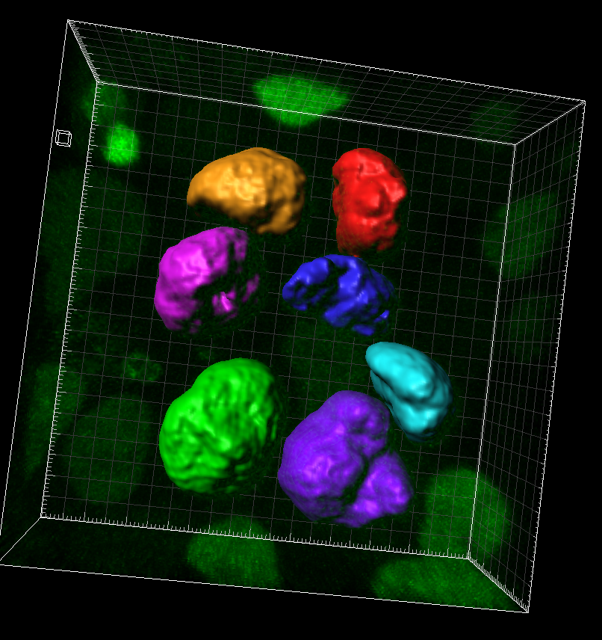
YPet-OCT4 + mem-mCherry
Control condition
Image0005stack1.imx

Slide 12
YPet-OCT4 ES cell line
Latrunculin-B treatment

Slide 13
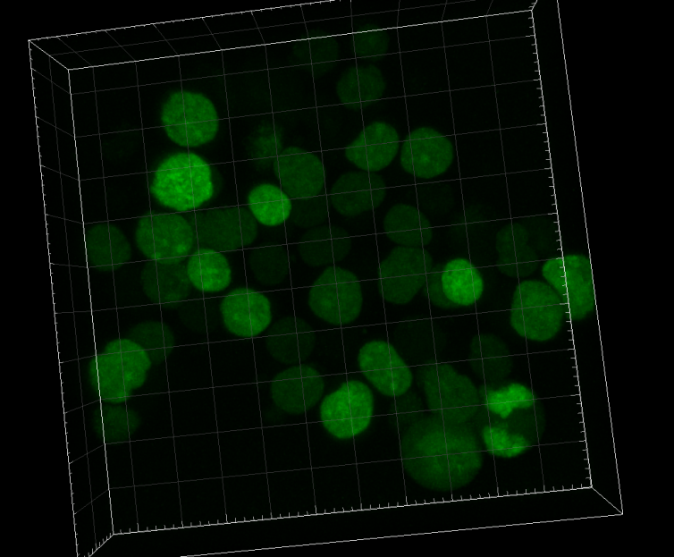
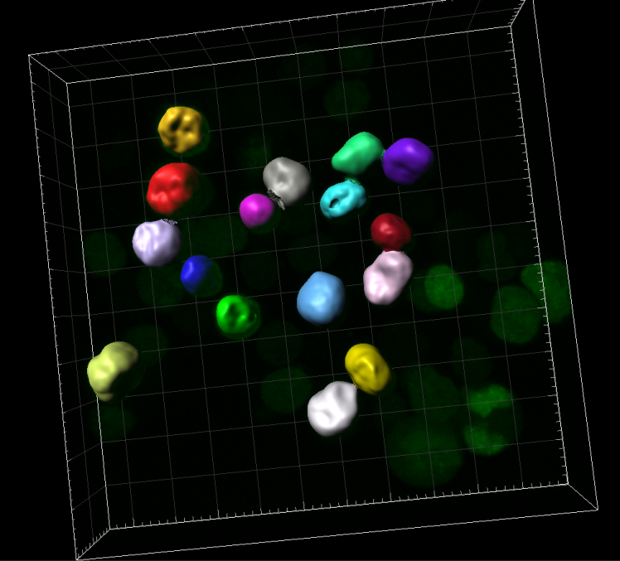
YPet-OCT4
Latrunculin-B treatment
ImageFV10002.00013.imx

Slide 14
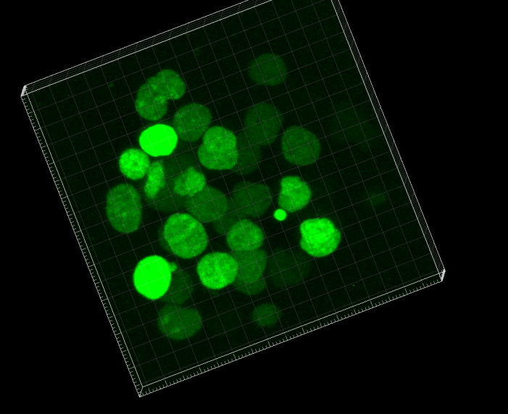
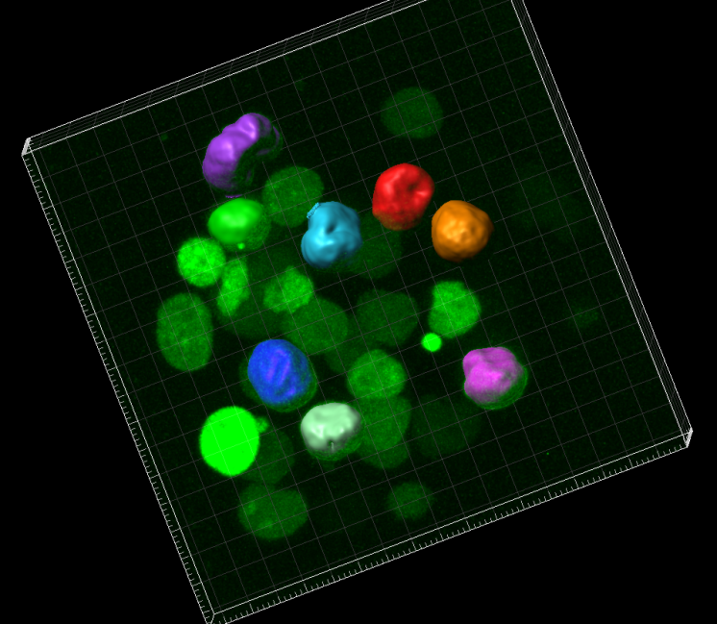
YPet-OCT4
Latrunculin-B treatment
ImageFV10002.40010.imx

Slide 15
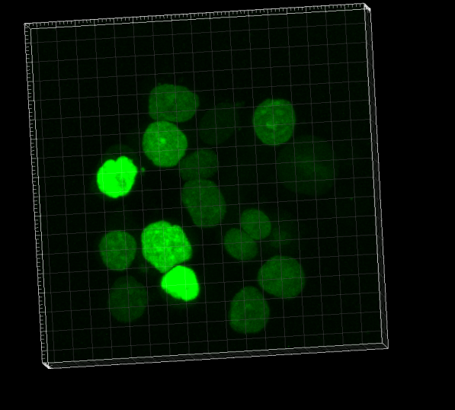
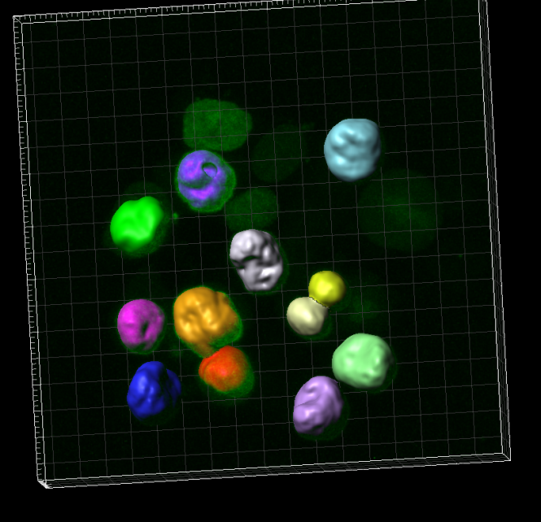
YPet-OCT4
Latrunculin-B treatment
ImageFV10002.40011.imx

Slide 16
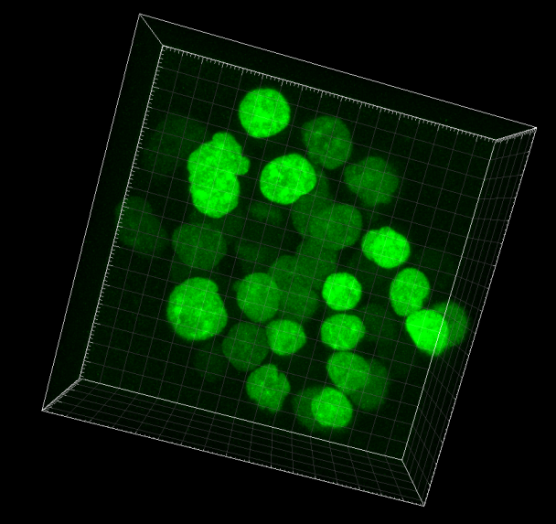
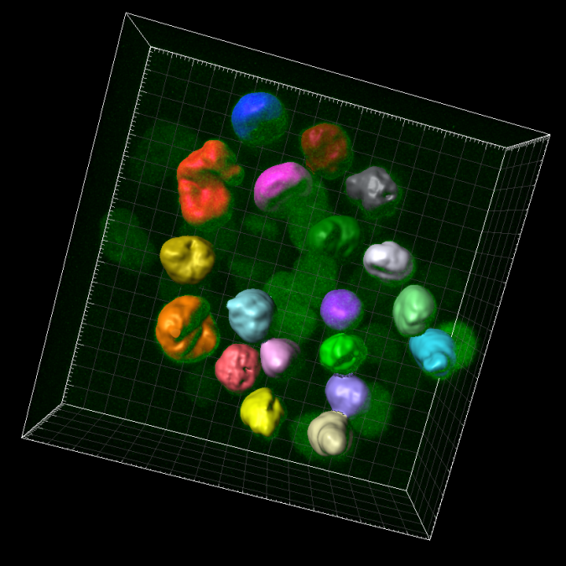
YPet-OCT4
Latrunculin-B treatment
ImageFV10002.50008.imx

Slide 17
YPet-OCT4 ES cell line
Taxol treatment

Slide 18
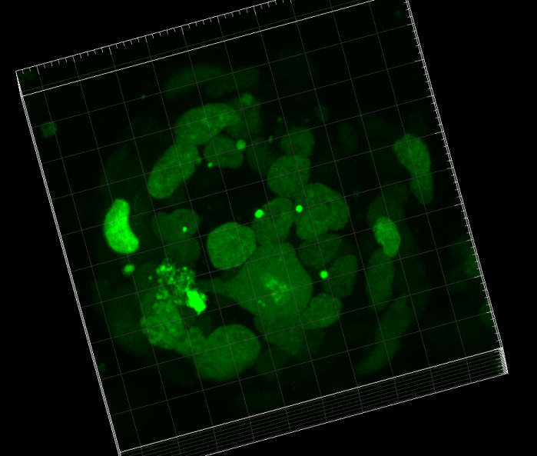
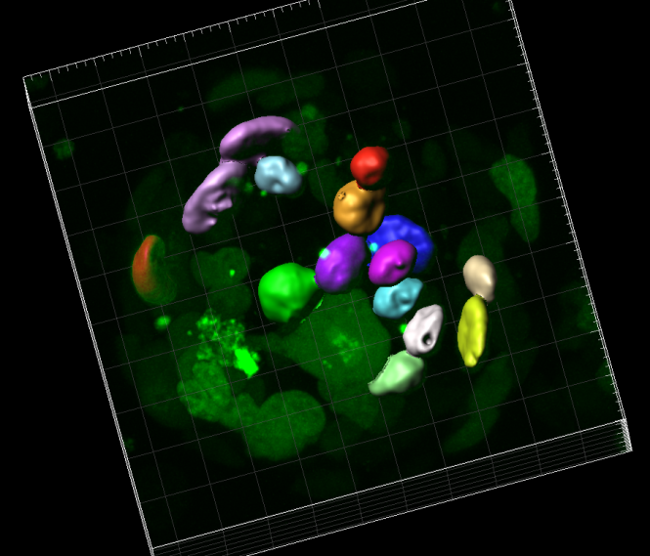
YPet-OCT4
Taxol treatment
ImageFV10002.00030.imx

Slide 19
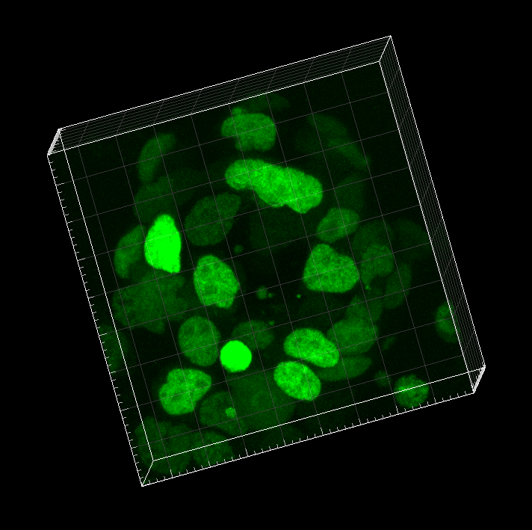
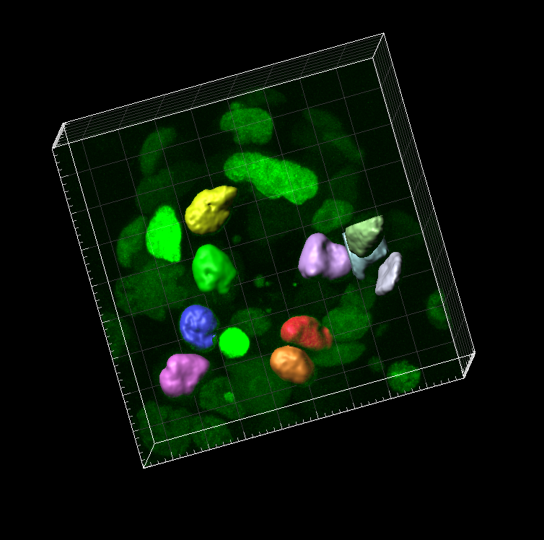
YPet-OCT4
Taxol treatment
ImageFV10002.40036.imx

Slide 20
YPet-OCT4 ES cell line
Vinblastine treatment

Slide 21
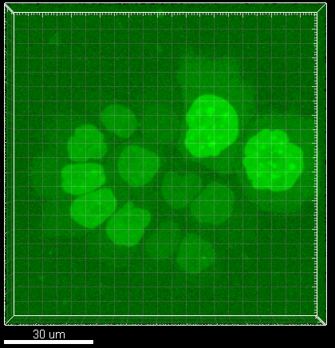
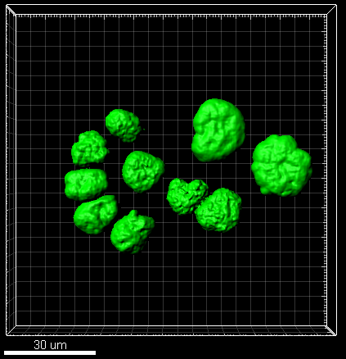
YPet-OCT4
Vinblastine treatment
Stack 1.imx

Slide 22
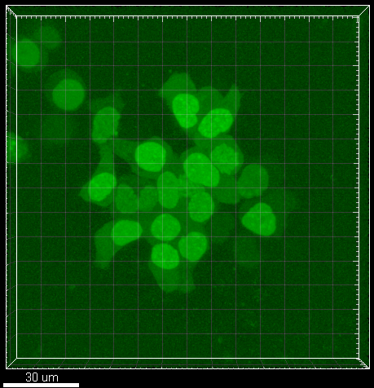
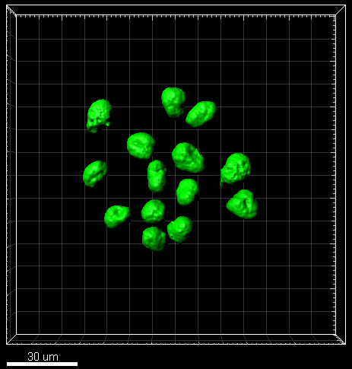
YPet-OCT4
Vinblastine treatment
Stack 2.imx

Slide 23
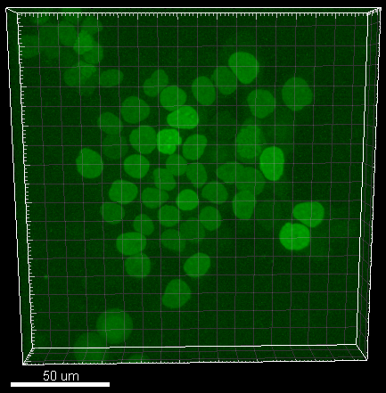
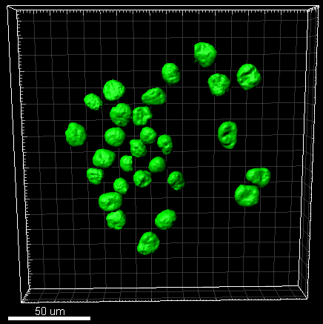
YPet-OCT4
Vinblastine treatment
Stack 3.imx

Slide 24
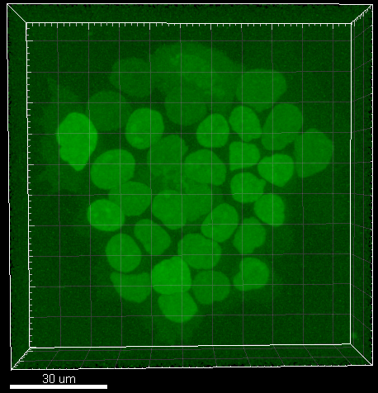
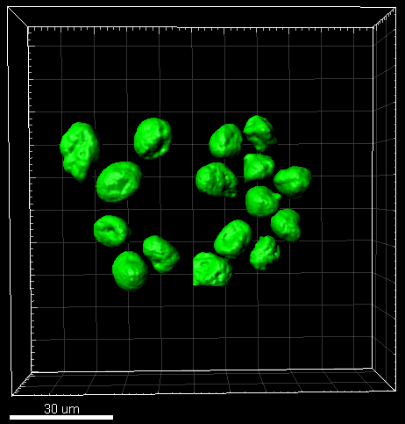
YPet-OCT4
Vinblastine treatment
Stack 4.imx

Slide 25
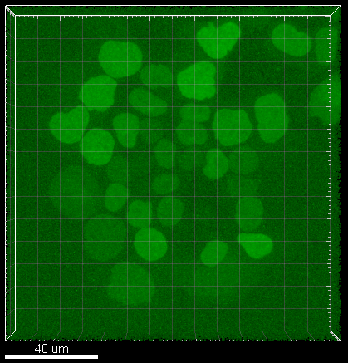
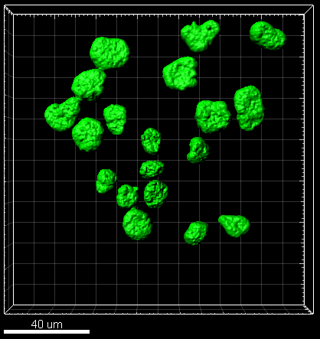
YPet-OCT4
Vinblastine treatment
Stack 5.imx

Slide 26
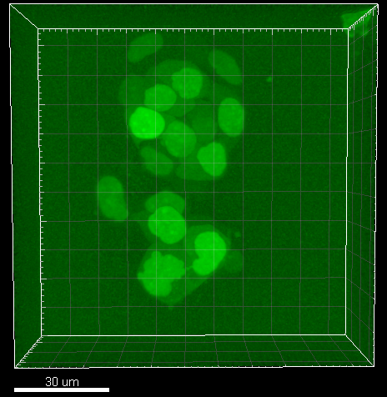
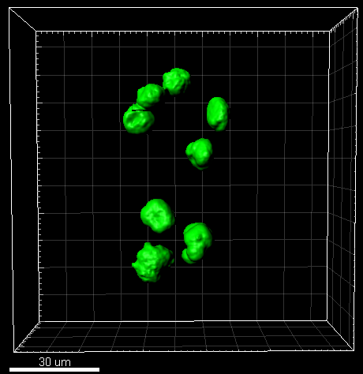
YPet-OCT4
Vinblastine treatment
Stack 6.imx

Slide 27
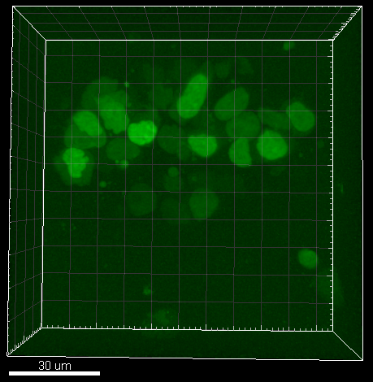
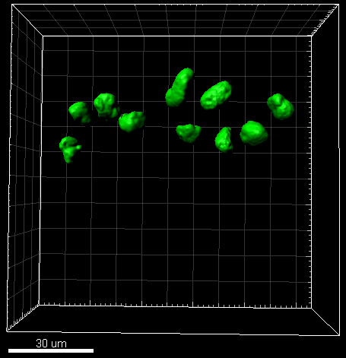
YPet-OCT4
Vinblastine treatment
Stack 8.imx

Slide 28
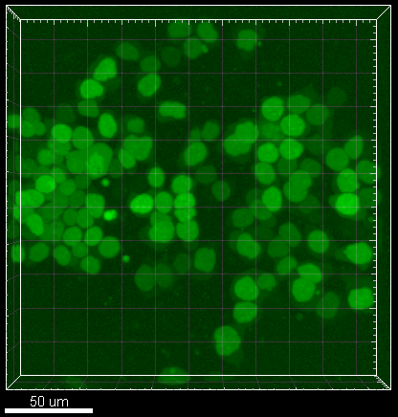
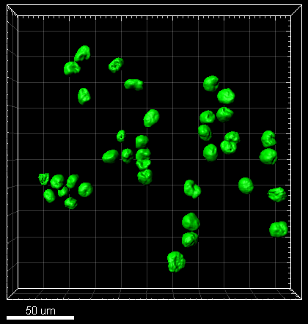
YPet-OCT4
Vinblastine treatment
Stack 9.imx

Slide 29
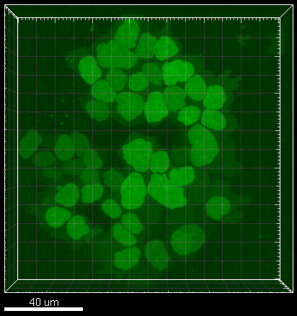
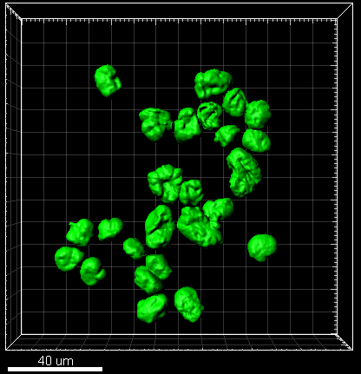
YPet-OCT4
Vinblastine treatment
Stack 10.imx

Slide 30
W4 ES cell line
Control condition (H2B-mCherry expression)

Slide 31
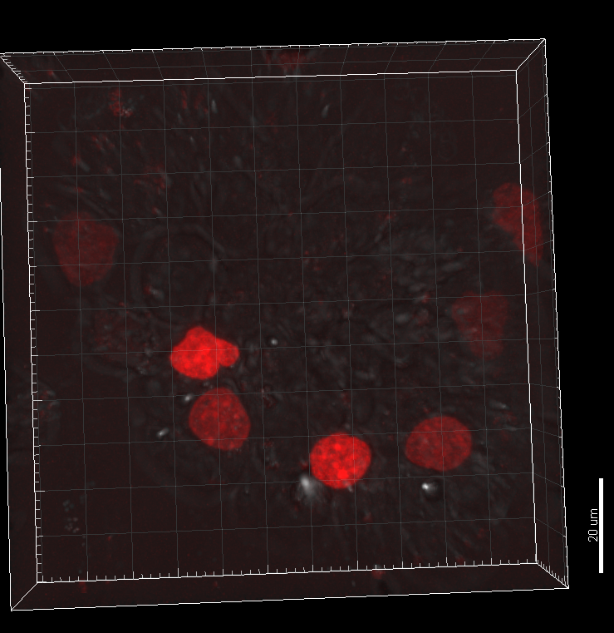
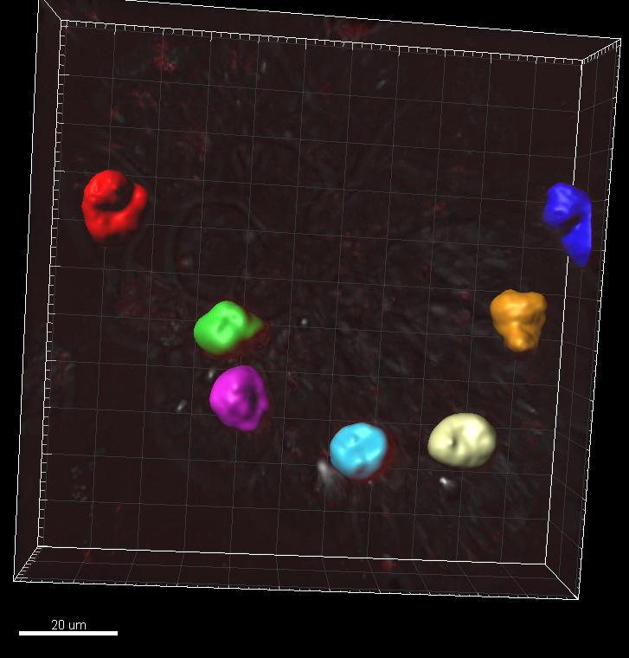
W4 H2B-mCherry
Control condition
Image Fv1001.90022.imx

Slide 32


W4 H2B-mCherry
Control condition
ImageFv1001.90018.imx

Slide 33


W4 H2B-mCherry
Control condition
Image Fv1001.90012.imx

Slide 34


W4 H2B-mCherry
Control condition
Image Fv1003.5005.imx

Slide 35


W4 H2B-mCherry
Control condition
Image Fv1003.10024.imx

Slide 36


W4 H2B-mCherry
Control condition
Image Fv1003.60020.imx

Slide 37


W4 H2B-mCherry
Control condition
Image Fv1003.70016.imx

Slide 38


W4 H2B-mCherry
Control condition
Image Fv 1004.5007.imx

Slide 39
W4 ES cell line
GFP-Vim(1-138) and H2B-mCherry expression
Images were saturated digitally to facilitate the visualization and segmentation

Slide 40


W4 GFP-vim(1-138) + H2B-mCherry
Vim(1-138) expression
Image 15.imx

Slide 41


W4 GFP-vim(1-138) + H2B-mCherry
Vim(1-138) expression
Image 17.imx

Slide 42


W4 GFP-vim(1-138) + H2B-mCherry
Vim(1-138) expression
Image 19.imx

Slide 43


W4 GFP-vim(1-138) + H2B-mCherry
Vim(1-138) expression
Image 28.imx

Slide 44


W4 GFP-vim(1-138) + H2B-mCherry
Vim(1-138) expression
Image 31.imx

Slide 45


W4 GFP-vim(1-138) + H2B-mCherry
Vim(1-138) expression
image 34.imx

Slide 46


W4 GFP-vim(1-138) + H2B-mCherry
Vim(1-138) expression
Image39.imx

Slide 47


W4 GFP-vim(1-138) + H2B-mCherry
Vim(1-138) expression
Image41.imx

Slide 48


W4 GFP-vim(1-138) + H2B-mCherry
Vim(1-138) expression
Image42.imx

Slide 49


W4 GFP-vim(1-138) + H2B-mCherry
Vim(1-138) expression
Image3.imx

Slide 50


W4 GFP-vim(1-138) + H2B-mCherry
Vim(1-138) expression
Image6.imx

Slide 51


W4 GFP-vim(1-138) + H2B-mCherry
Vim(1-138) expression
Image12.imx

Slide 52


W4 GFP-vim(1-138) + H2B-mCherry
Vim(1-138) expression
Image13.imx

