Slide 1
Supplementary Figure 1: Phylogenetic tree of GH5 endoglucanases, including FL-GsCelA. SgEGV and BsCel5A. The three phylogenetically distant GH5 EGs, i.e. GsCelA, SgEGV and BsCel5A, exhibit the similar self-truncation process.

Slide 2
Supplementary Table 1. List of GH family 5 proteins mentioned in the phylogenetic tree.
protein code | Organism | Protein Name
2ZUM | Pyrococcus horikoshii OT3 | endo-β-1,4-glucanase
1VRX | Acidothermus cellulolyticus 11B | endo-β-1,4-glucanase
4V2X | Bacillus halodurans C-125 | β-glucanase
4YZP | Bacillus licheniformis DSM 13 = ATCC 14580 | endoglucanase
1LF1 | Bacillus sp. (in: Bacteria) CBS 670.93 | cellulase
5XRC | Bacillus sp. BG-CS10 | cellulase
1WKY | Bacillus sp. JAMB-602 | β-mannanase
1G01 | Bacillus sp. KSM-635 | endo-β-1,4-glucanase K
3JUG | Bacillus sp. N16-5 | β-mannanase
3PZT | Bacillus subtilis subsp. subtilis str. 168 | endo-β-1,4-glucanase
3ZMR | Bacteroides ovatus ATCC 8483 | endo-xyloglucanase
4YHE | Bacteroidetes bacterium AC2a | endo-cellulase
6MP2 | Bifidobacterium longum DJO10A | β-mannosidase active
4NF7 | Butyrivibrio proteoclasticus B316 | Cel5C
3W0K | Caldanaerobius polysaccharolyticus KMTHCJ | endoglucanase
5ECU | Caldicellulosiruptor saccharolyticus DSM 8903 | endoglucanase
4X0V | Caldicellulosiruptor sp. F32 | β-1,3-1,4-glucanase
5OYC | Cellvibrio japonicus Ueda107 | Cel5D
1UUQ | Cellvibrio mixtus NCIMB 8633 | β-mannosidase 5A
6PZ7 | Clostridium acetobutylicum ATCC 824 | CAC0826
3NDY | Clostridium cellulovorans ATCC 35269 | endo-β-1,4-glucanase
6Q1I | Clostridium longisporum | endo-β-1,4-glucanase
6GVB | Cutibacterium acnes 266 | exo-β-1,4-mannosidase
5IHS | Cytophaga hutchinsonii ATCC 33406 | periplasmic endoglucanase 5B
1EGZ | Dickeya dadantii 3937 | endo-β-1,4-glucanase
3NCO | Fervidobacterium nodosum Rt17-B1 | endo-β-1,4-glucanase
6KDD | Fervidobacterium pennivorans DSM 9078 | Ferpe_1841
6MQ4 | Hungateiclostridium cellulolyticum | AceceDRAFT_0142
4IM4 | Hungateiclostridium thermocellum | endo-β-1,4-glucanase E
4U3A | Hungateiclostridium thermocellum ATCC 27405 | endo-β-1,4-glucanase
2Y8K | Hungateiclostridium thermocellum ATCC 27405 | xylanase
1CEC | Hungateiclostridium thermocellum NCIB 10682EL | endo-β-1,4-glucanase
1TVN | Pseudoalteromonas haloplanktis A23 | endoglucanase (CelG)
1A3H | Salipaludibacillus agaradhaerens | endo-β-1,4-glucanase 5A
5FIP | Thermoanaerobacterium sp. A57Txylan | endo-β-1,4-glucanase / celulase (CelDZ1a)
2CKR | Thermobifida fusca YX | endo-β-1,4-glucanase 5A
4TUF | Xanthomonas campestris pv. campestris | endo-β-1,4-glucanase
AAU08303.1 | Bacillus sp. HB102 | endo-beta-1,4-glucanase
AAX54913.1 | Bacillus sp. WRD-2 | Endoglucanase
ABK63475.1 | Bacillus subtilis | Cellulase
ABV08875.1 | Paenibacillus polymyxa | Endoglucanase
ACI15227.1 | Bacillus subtilis | Endoglucanase
ACJ12789.1 | Bacillus subtilis | beta-1,4-endo-glucanase
ACO59154.1 | Pectobacterium carotovorum | endoglucanase CelV3
ACO59155.1 | Pectobacterium carotovorum | endoglucanase CelN2
ACY72384.1 | Bacillus pumilus | cellulose hydrolase
ADI39639.1 | Paenibacillus campinasensis | cellulase, partial
ADO21451.1 | Geobacillus stearothermophilus | endoglucanase
BAF62086.1 | Paenibacillus sp. KSM-N440 | endoglucanase
BAF62087.1 | Paenibacillus sp. KSM-N659 | endoglucanase
WP_011093543.1 | Pectobacterium atrosepticum | cellulase family glycosylhydrolase
WP_013311450 | Paenibacillus polymyxa | cellulase family glycosylhydrolase
WP_013372536 | Paenibacillus polymyxa | cellulase family glycosylhydrolase
WP_013487061.1 | Bacillus cellulosilyticus | cellulase family glycosylhydrolase
WP_014664145.1 | Bacillus sp. JS | cellulase family glycosylhydrolase
WP_014700240.1 | Pectobacterium parmentieri | cellulase family glycosylhydrolase
WP_015714018.1 | Bacillus | endo-beta-1,4-glucanase EglS
WP_015840552.1 | Pectobacteriu | cellulase family glycosylhydrolase
WP_019258536.1 | Bacillus subtilis | cellulase family glycosylhydrolase
WP_024085371.1 | Bacillus amyloliquefaciens group | cellulase family glycosylhydrolase

Slide 3
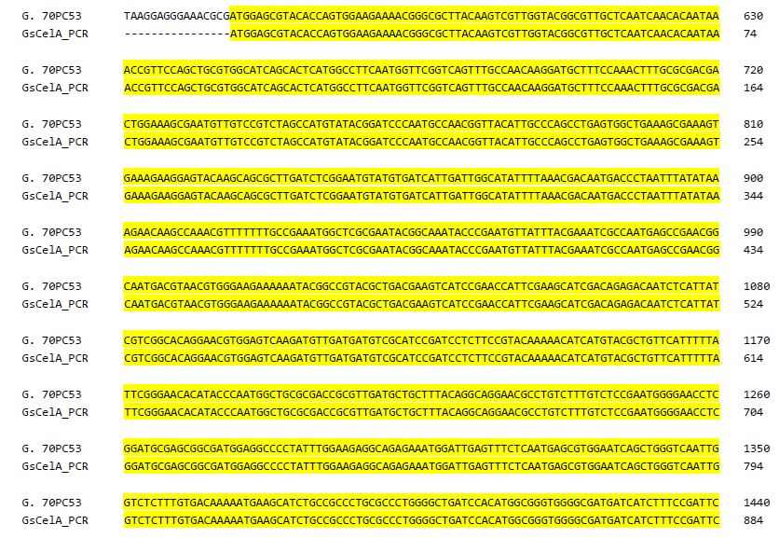
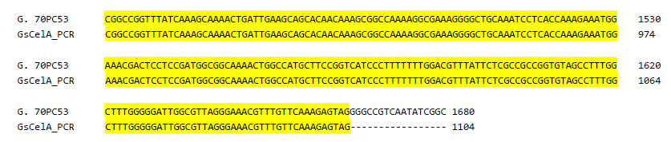
GsCelA-F
K315
GsCelA-R
Supplementary Figure 2. Verification of GsCelA sequence in the genomic DNA of Geobacillus sp.70PC53. Amplification of full length GsCelA gene from Geobacillus sp.70PC53 (GsCelA PCR) and alignment with celA open reading frame (G. 70PC53 genome) demonstrated C-terminal region existence in the genome of Geobacillus sp.70PC53. The amino acid K315 near by the cleavage site is indicated in red box. Primers used in PCR amplification are indicated by arrows.

Slide 4
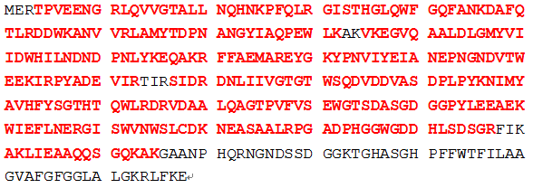
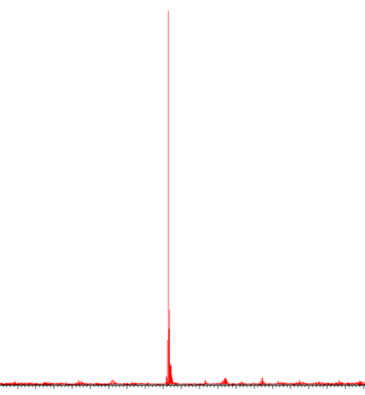
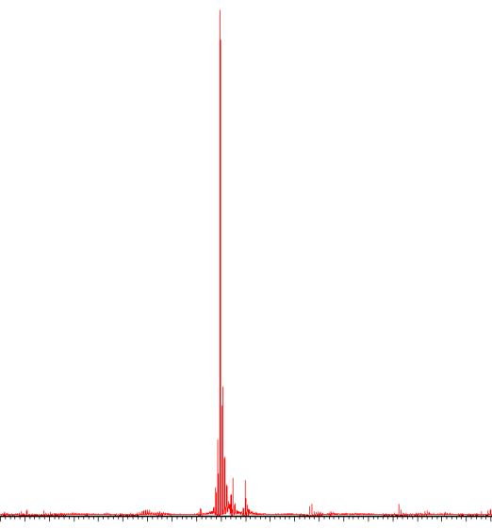
a
1
50
51
100
101
150
151
200
201
250
251
315
300
301
350
351
b
Full length GsCelA molecular weight
100
42140
Relative abundance (%)
0
36000
40000
42000
44000
46000
c
m/z
Truncated GsCelA molecular weight
100
35491
Relative abundance (%)
0
33500
34500
35500
36500
37500
m/z
Supplementary Figure 3: Mass spectrometry identification of FL-GsCelA and truncated GsCelA. (a) Result of N-terminal sequencing (in black box) and LC-MS-MS analysis (in red). (b) The molecular weight of FL-GsCelA is 42140 Da. (c) The molecular weight of truncated GsCelA is 35491 Da, which suggests that the self-truncation point is between K315 and G316.

Slide 5
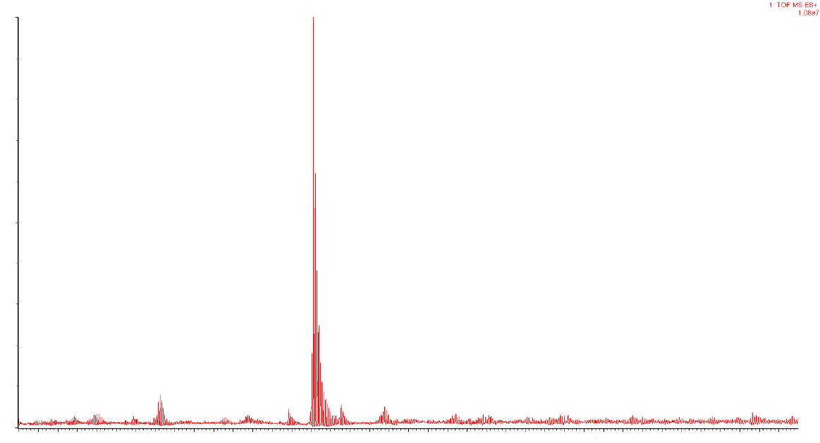
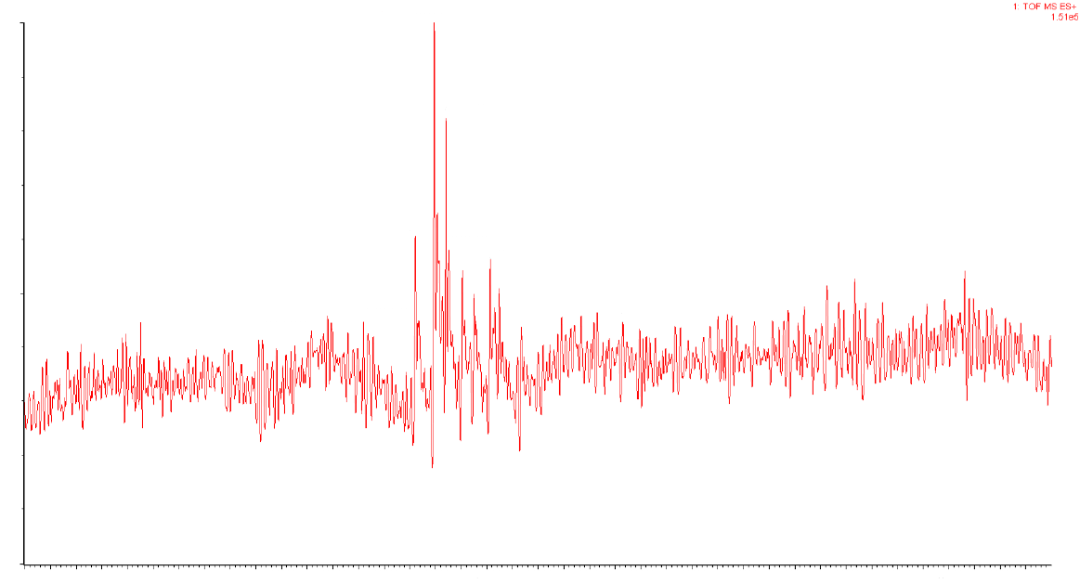
a
Truncated BsCel5A molecular weight
100
33781
Relative abundance (%)
33802
0
33000
36000
mass
30000
31000
32000
34000
35000
37000
38000
39000
m/z
b
Truncated SgEGV molecular weight
100
41990
42103
Relative abundance (%)
0
41000
46000
mass
38000
39000
40000
42000
43000
44000
45000
47000
m/z
Supplementary Figure 4: BsCel5A and SgEGV truncated form MW as detected by LC-MS-MS. (a) BsCel5A truncated form MW is 33781 Daltons. (b) SgEGV truncated form is about 42000 Daltons.

Slide 6
a
b
Supplementary Figure 5: Comparison of T₅₀ (a) and TA₅₀ (b) between FL-GsCelA and ∆309-368. T₅₀ is similar between FL-GsCelA and ∆309-368, but TA₅₀ is higher for ∆309-368 than FL-GsCelA.

Slide 7
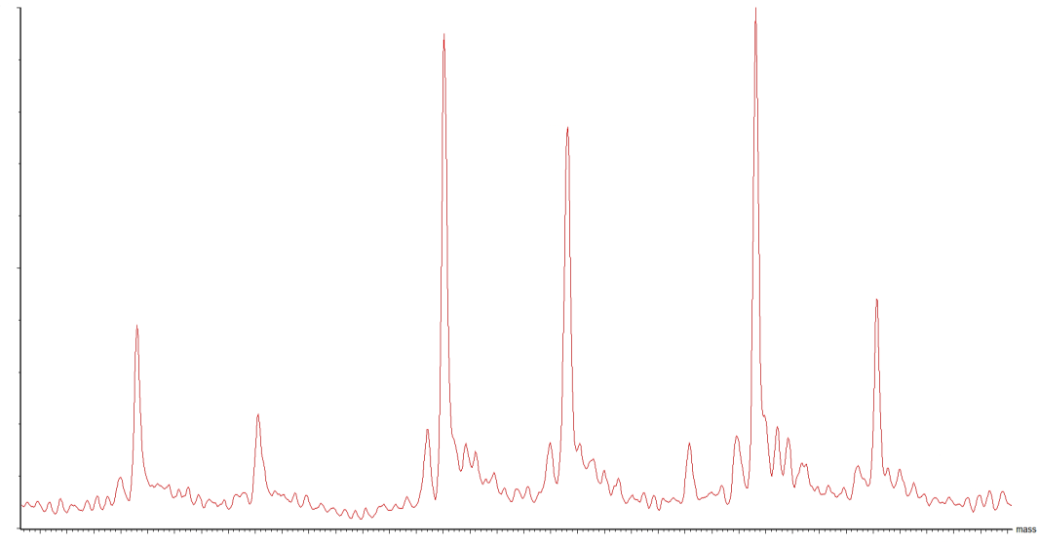
Molecular weight of truncated ∆310-320-GsCelA
100
315 a.a.
318 a.a.
316 a.a.
Relative abundance (%)
319 a.a.
312 a.a.
313 a.a.
0
35400
35500
35600
35700
35800
35900
36000
36100
36200
m/z
Supplementary Figure 6. Mass spectrometry of truncated GsCelA mutant Δ310-320.

Slide 8
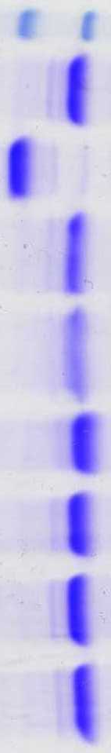
Full length
2% CMC
Truncated
1% CMC
2% cellobiose
4% cellobiose
kDa
43
34
Supplementary Figure 7. GsCelA self-truncation was suppressed by CMC and cellobiose. FL-GsCelA was incubated with CMC or cellobiose at 25 ℃ for 120 hr and analysis with 10 % SDS-PAGE gel.

Slide 9
Protein name | Protease activity
Thermolysin | 407±73 U/mg
GsCelA | 0 U/mg
Supplementary Figure 8. Metalloprotease activity assay of purified GsCelA. Protease activity was detected by using 0.6 % casein as substrate and thermolysin as positive control. One protease unit is defined as 1 μM of tyrosine released per minute.

Slide 10
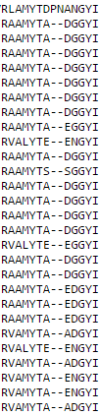
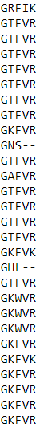
Endoglucanase [Geobacillus 70PC53]
cellulase [Bacillus subtilis]
endoglucanase [Bacillus amyloliquefaciens LFB112]
protein BglC [Bacillus sp. JS]
endoglucanase [Bacillus subtilis subsp. subtilis str. RO-NN-1]
endoglucanase [Bacillus subtilis]
beta-1,4-endo-glucanase precursor [Bacillus subtilis]
beta-1,4-endo-glucanase mutant M44-11, partial [Bacillus subtilis]
BglC [Bacillus licheniformis DSM 13 = ATCC 14580]
Cel5A [Paenibacillus polymyxa]
cellulase [Bacillus amyloliquefaciens]
cellulase [Bacillus cellulosilyticus DSM 2522]
cellulase [Bacillus sp. WRD-2]
cellulase, partial [Paenibacillus campinasensis]
cellulose hydrolase [Bacillus pumilus]
endo-1,4-beta-glucanase [Bacillus subtilis BSn5]
endo-1,4-beta-glucanase [Paenibacillus polymyxa E681]
endo-beta-1,4-glucanase [Bacillus sp. HB102]
endoglucanase [Geobacillus stearothermophilus]
endoglucanase [Paenibacillus sp. KSM-N115]
endoglucanase [Paenibacillus sp. KSM-N440]
endoglucanase [Paenibacillus sp. KSM-N659]
endoglucanase CelN2 [Pectobacterium carotovorum]
endoglucanase celv3 [Paenibacillus polymyxa SC2]
endoglucanase CelV3 [Pectobacterium carotovorum]
endoglucanase V [Pectobacterium atrosepticum SCRI1043]
glycoside hydrolase family protein [Pectobacterium wasabiae WPP163]
glycoside hydrolase family protein [Pectobacterium carotovorum subsp. carotovorum PC1]
P69 N70
R297 K300
Supplementary Figure 9. Sequence alignment analysis between GsCelA with other GH5 EGs with a CBM domain. Based on protein sequence alignment, two amino acids, P69 and N70, are unique in GsCelA. R297 and K300 are two positive charge amino acids near to the truncated point A315.

Slide 11
Supplementary Table 2. List of primers used for construction of point mutations and truncation from mutants.
Primers name | Sequence (5'-3')
GsCelA-F | CATATGGAGCGTACACCAGTGGAAGAAAA
GsCelA-R | CGCCCCTCGAGCTACTCTTTGAACAAACG
E142A-F | AAATCGCCAATGCGCCGAACGGCAAT
E142A-R | TCATTGCCGTTCGGCGCATTGGCGATTTC
E231A-F | TGTCTTTGTCTCCGCATGGGGAACCTCGGAT
E231A-R | ATCCGAGGTTCCCCATGCGGAGACAAAGA
K315A-F | AAAAGGCGCGAGGGGCTGCAAAT
K315A-R | ATTTGCAGCCCCTCGCGCCTTTT
TC30aa-R | CGCCCCTCGAGCTACTCTTTGAACAAACG
TC60aa-R | CGCCCCTCGAGACCGGAAGCATGGCCAG
TC71aa-R | CGCCCCTCGAGAAACCGGCCGGAATCGG
GsCelA-Δ310-320-1 | TGATTGAAGCAGCACAACAACACCAAAGAAATGGAAACGA
GsCelA-Δ310-320-2 | TCGTTTCCATTTCTTTGGTGTTGTTGTGCTGCTTCAATCA
BsCel5A-F | CCATGGCAGCAGGGACAAAAACG
BsCel5A-R | CTCGAGATTTGGTTCTGTTCCC

