Slide 1
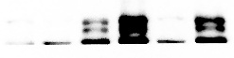


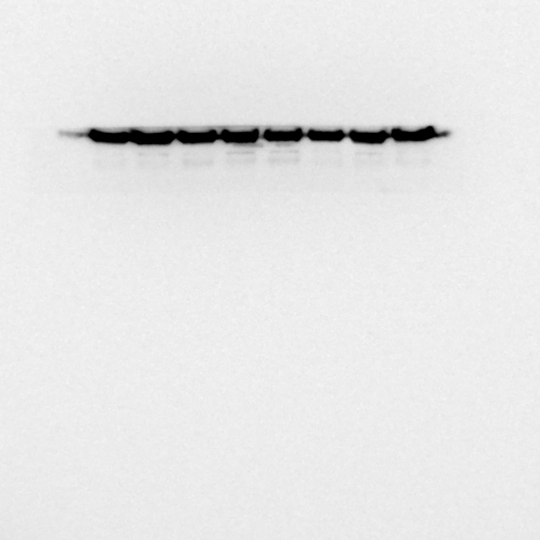
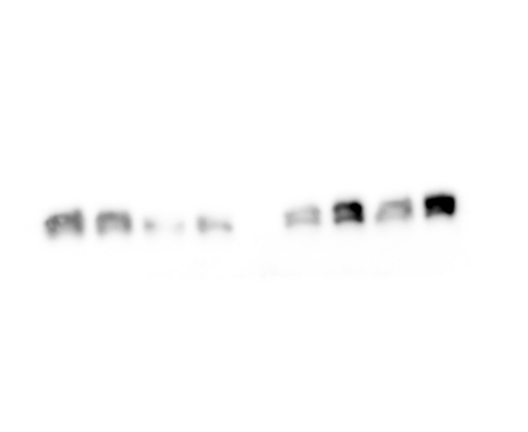
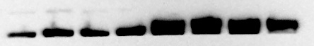
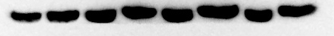

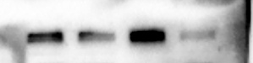
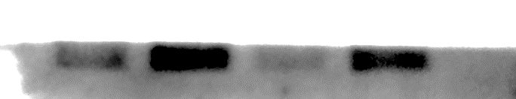
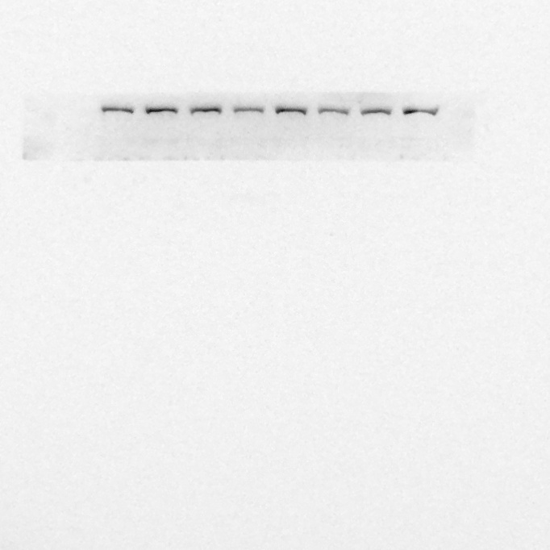
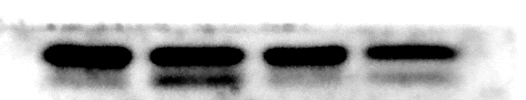
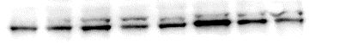
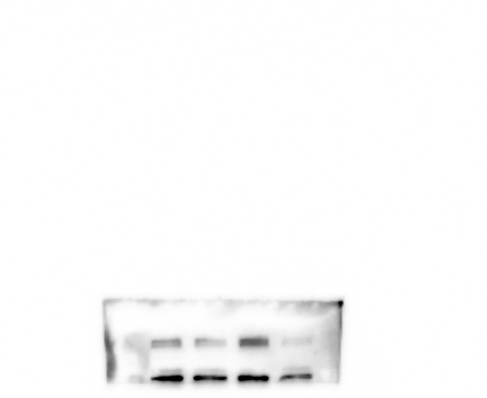
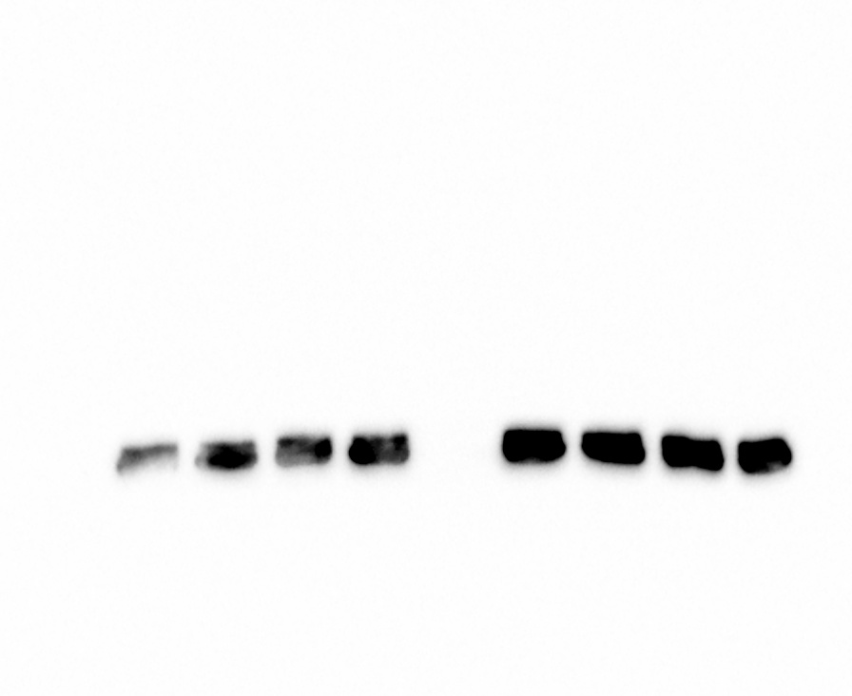
Fig. 1J
Fig. 6G
RT
COLD
RT
COLD
RT
COLD
RT
COLD
FABP4
HIF1α
GAPDH
GAPDH
Fig. 5C
Fig. 6G
RT
COLD
RT
COLD
CON COCL2 CON COCL2
LC3B-Ⅰ
FABP4
LC3B-Ⅱ
GAPDH
VDAC
Fig. 6I
CON COCL2 CON COCL2
Fig. 5G
CPT1β
RT
COLD
RT
COLD
BNIP3
CPT1α
LC3B-Ⅰ
LC3B-Ⅱ
UCP2
GAPDH
RT
COLD
RT
COLD
CPT1β
GAPDH

Slide 2
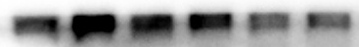

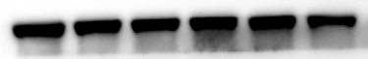
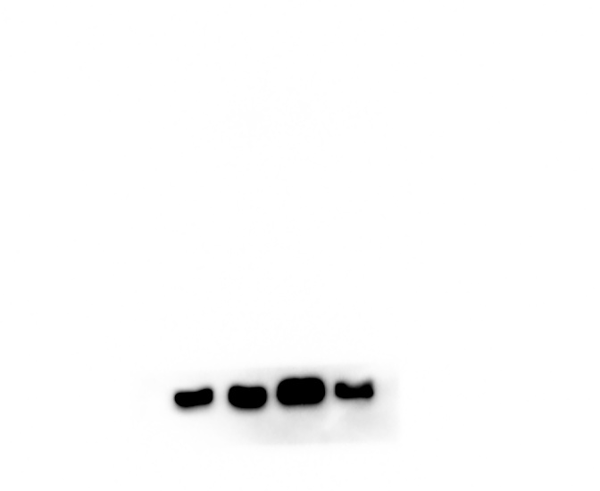
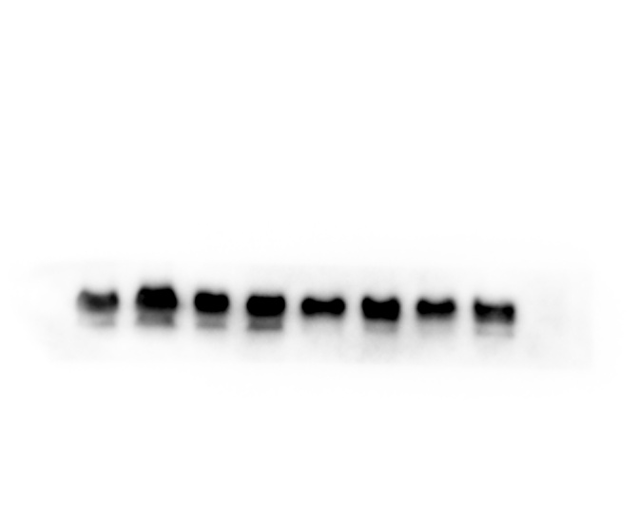


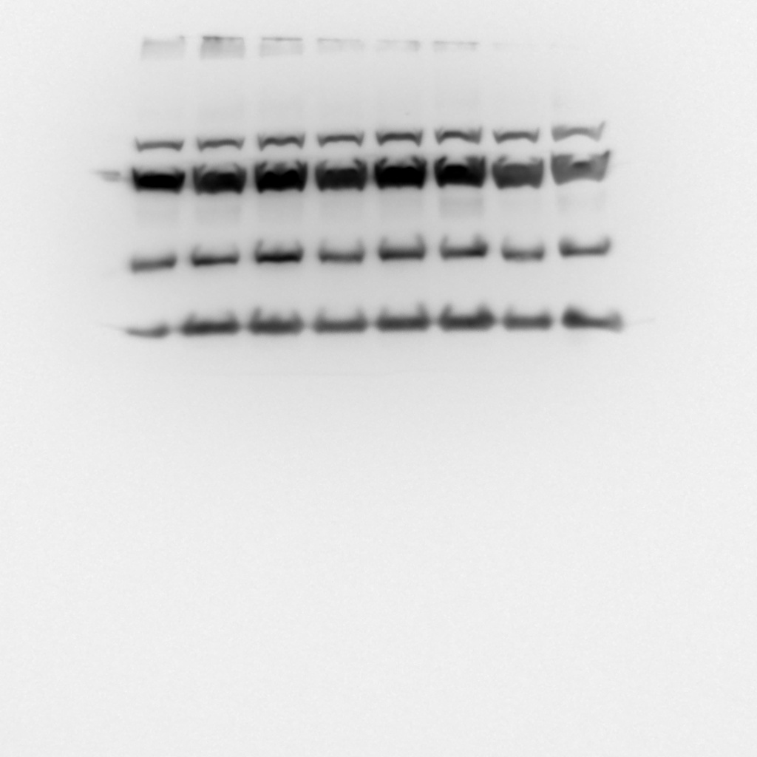
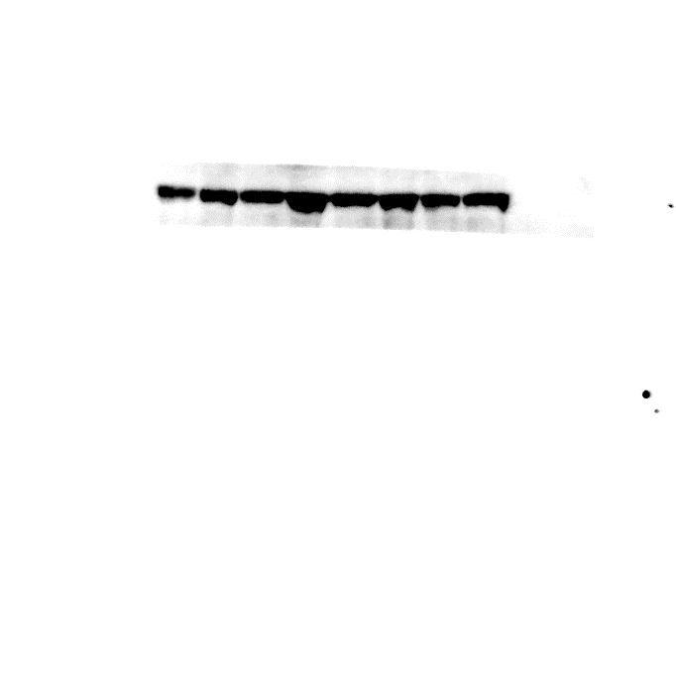
Fig. S4E
Fig. S1D
RT
COLD
RT
COLD
RT
COLD
RT
COLD
BNIP3
UCP1
GAPDH
GAPDH
RT
COLD
RT
COLD
iWAT
LC3B-Ⅰ
LC3B-Ⅱ
Fig. S1E
RT
COLD
RT
COLD
Fig. S4G
UCP1
GAPDH
RT
COLD
RT
COLD
BAT
CⅤ-ATP5A
CⅢ-UQCRC2
CⅣ-MTCO1
CⅡ-SDHB
CⅠ-NDUFB8
GAPDH

