Slide 1
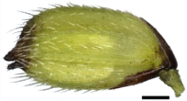
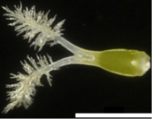
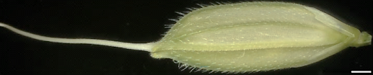
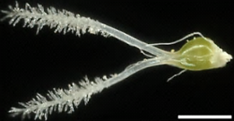
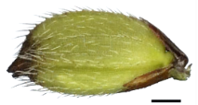

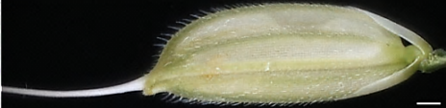

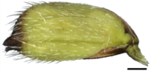



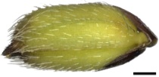

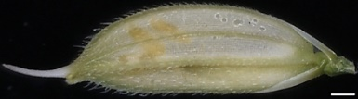

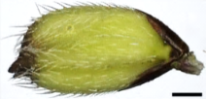

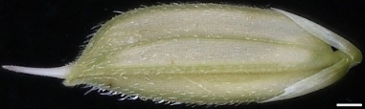

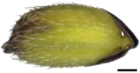
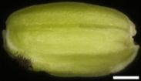
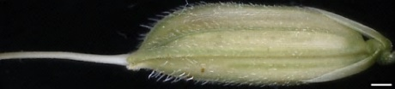


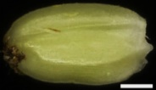
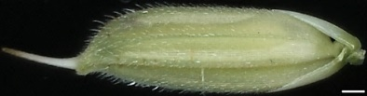


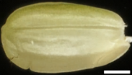
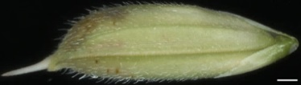

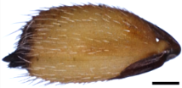
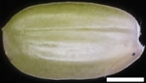
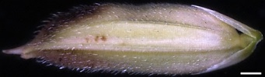

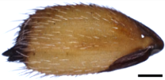
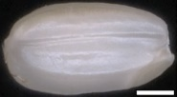

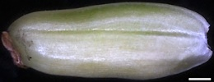
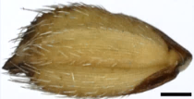
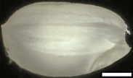
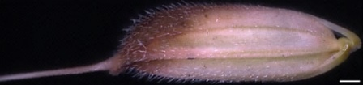

A
SN
LGR
B
SN
LGR
DAP
Husked
Dehusked
Husked
Dehusked
0
S1
1
2
S2
3
4
S3
7
10
S4
13
18
S5
21
29
b.
Figure S1

Slide 2
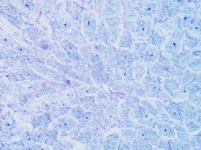
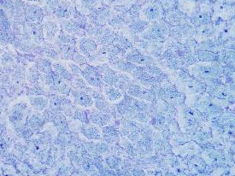
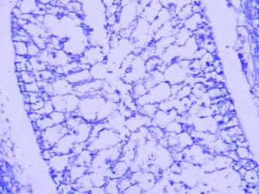
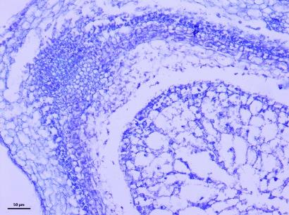
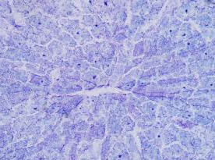
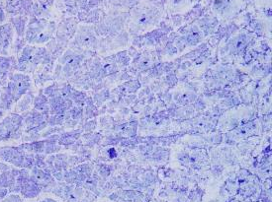
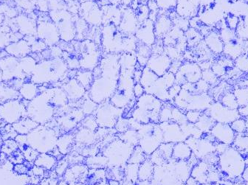
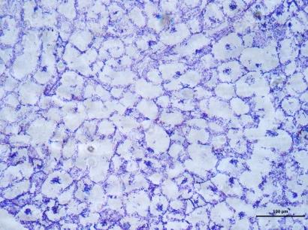
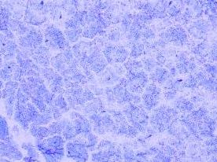
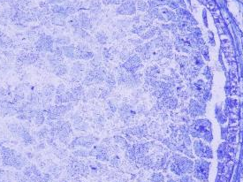
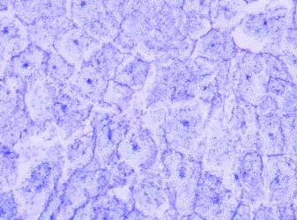
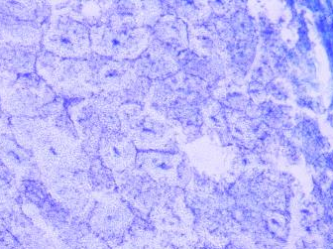
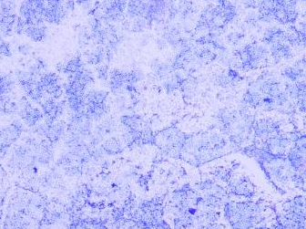
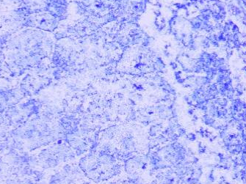
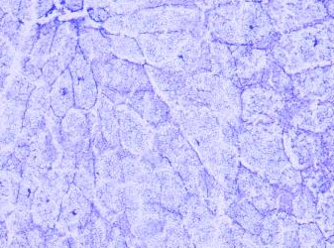
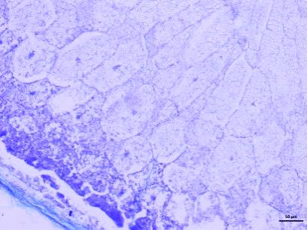
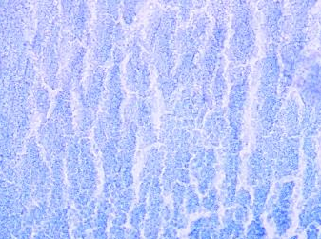
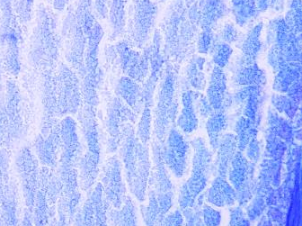
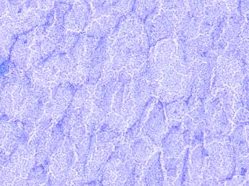
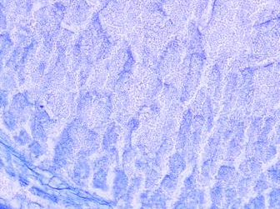
C
SN
LGR
i
ii
iii
iv
4 DAP
(S2)
v
vi
vii
viii
5 DAP
(S3)
ix
x
xi
xii
7 DAP
(S3)
xiii
xiv
xv
xvi
9 DAP
(S3)
xvii
xviii
xix
xx
11 DAP
(S4)
Figure S1

Slide 3
A
Figure S2

Slide 4
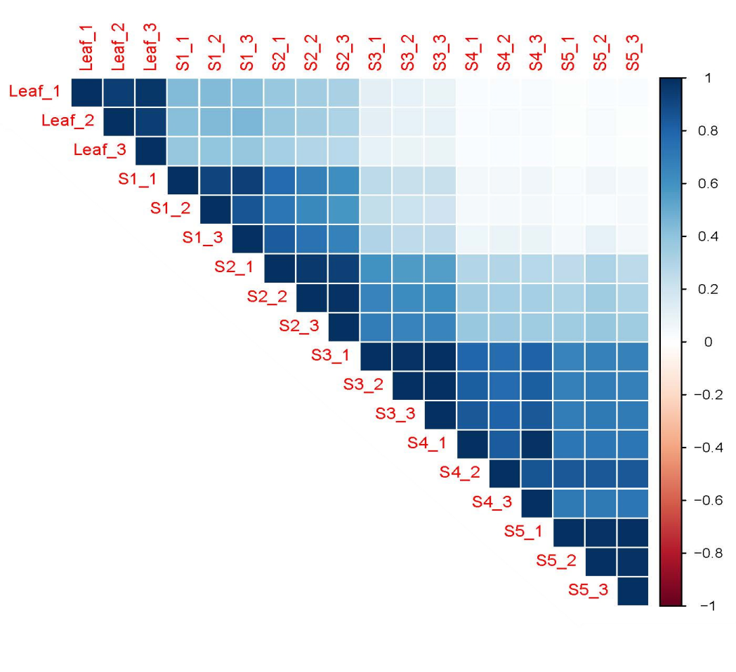
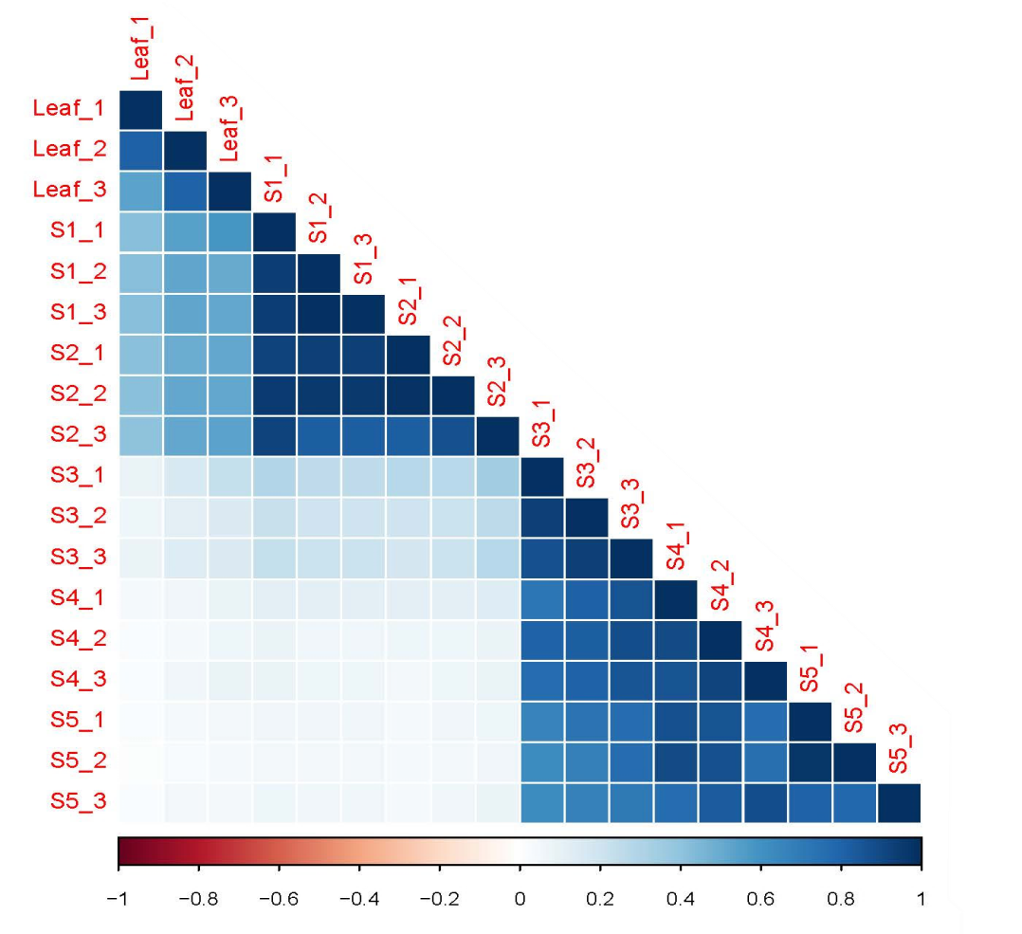
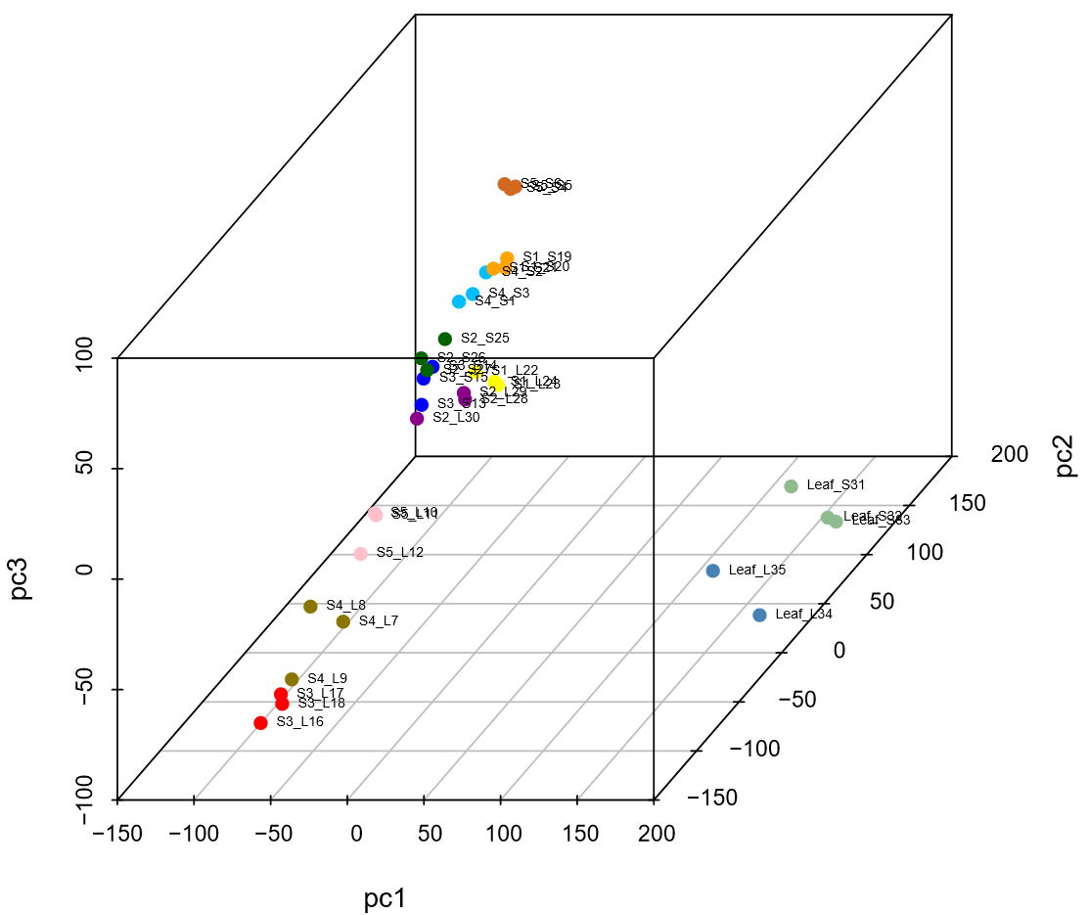
B
SN
SN
LGR
LGR
C
SN–S5
SN S1
SN S2
SN S3
SN S4
SN S5
SN Leaf
LGR S1
LGR S2
LGR S3
LGR S4
LGR S5
LGR Leaf
SN–S1
SN–S4
SN–S3
SN–S2
LGR-S1
LGR-S2
LGR-S5
SN–L
LGR-S4
LGR-L
LGR-S3
Figure S2

Slide 5

SN
LGR
2002
1267
3563
Figure S3

Slide 6
a
A
C
B
Figure S4

Slide 7
a
c
d
Figure S5

Slide 8



A
SN
LGR
Figure S6

Slide 9

B
C
Figure S6

Slide 10


A
B
Figure S7

Slide 11



A
Log₂FPKM
B
C
Figure S8

Slide 12
Figure S9

Slide 13
A
Auxin
cv
cv
cv
C
cv
cv
cv
cv
cv
cv
cv
cv
cv
cv
cv
cv
cv
cv
Figure S10

Slide 14
B
ABA
C
GA
Figure S10

Slide 15

D
Ethylene
cv
cv
cv
cv
Figure S10

Slide 16


E
BR
G
JA
cv
F
CK
H
SA
Figure S10

Slide 17
C
A
B
Figure S11

Slide 18
D
SN
a
b
LGR
c
d
e
f
g
h
Figure S11

Slide 19
D
i
j
k
l
m
SN
LGR
Figure S11

Slide 20
A
B
C
Figure S12

Slide 21

A
B
Figure S13

Slide 22




A
miRNAs up; Targets down
SN S1
SN S2
SN S3
SN S4
SN S5
LGR S1
LGR S2
LGR S3
LGR S4
LGR S5
B
miRNAs down; Targets up
SN S1
SN S2
SN S3
SN S4
SN S5
LGR S1
LGR S2
LGR S3
LGR S4
LGR S5
Figure S14

Slide 23
Figure S15

Slide 24


A
B
Figure S16

