Slide 1
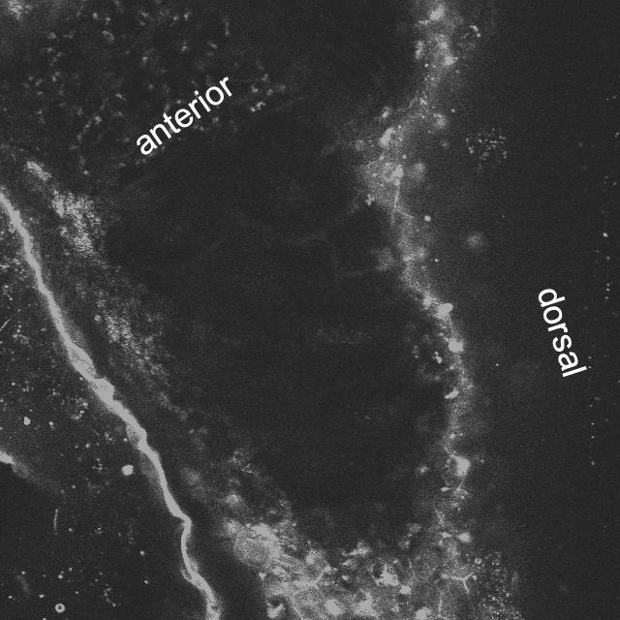
Movie S1. Geometry of the anterior intestinal lumen of zebrafish larvae in different sections of the z-axis.

Slide 2
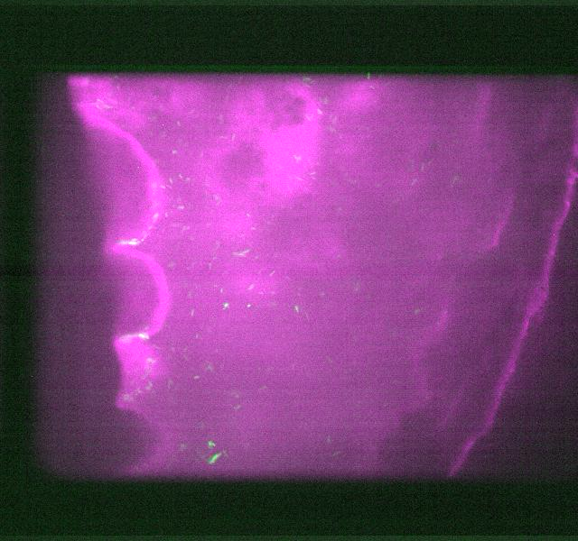

Dorsal
Anterior
z
$$\text{20}\text{μm}$$
Movie S2. Bacterial swimming behavior in the larval zebrafish anterior intestine from the fold to the center. 50 fps

Slide 3
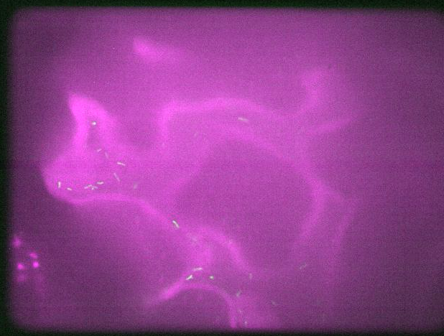

$$\text{20}\text{μm}$$
Movie S3. Bacterial swimming behavior in the larval zebrafish anterior intestinal fold.

