Slide 1
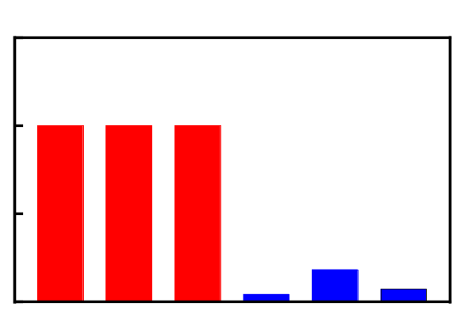
Supplementary Fig.S1
A
Coding potential score
1.5
B
1.0
Chromosome 3q13.2
0.5
0
GAPDH
ACTB
ACTA1
Hotair
Malat1
AC092894.1
mRNA
lncRNA

Slide 2
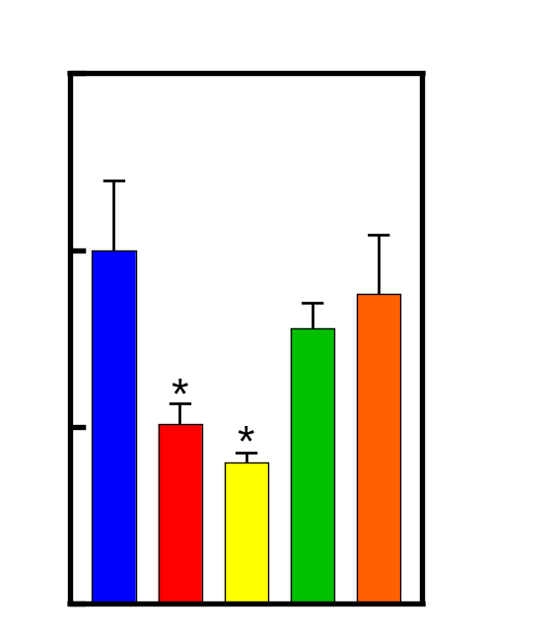
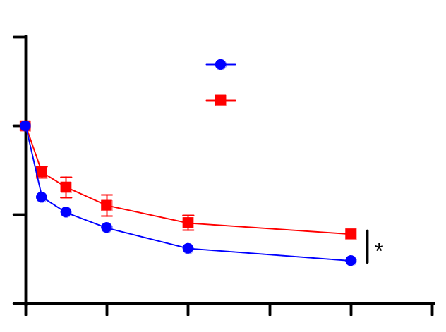
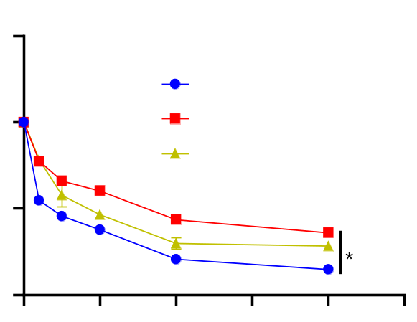
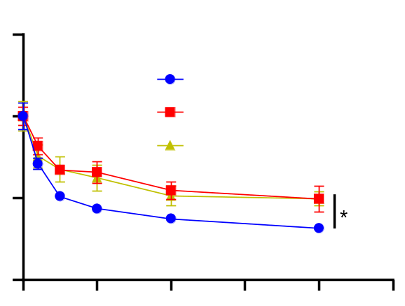
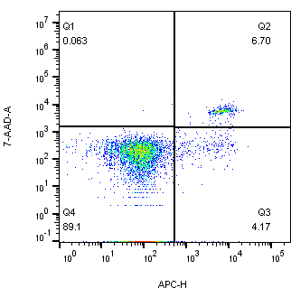
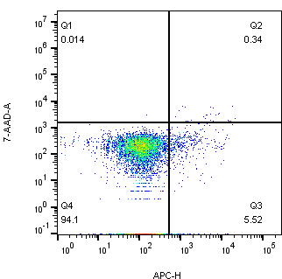

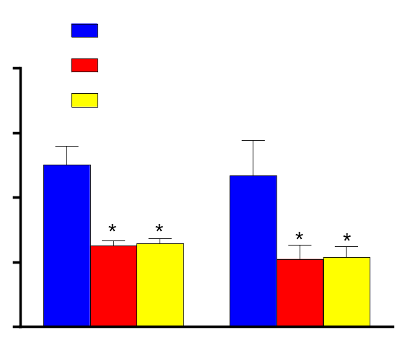
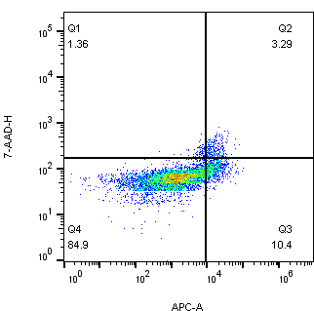
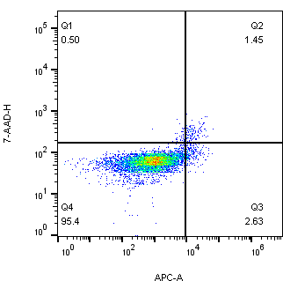
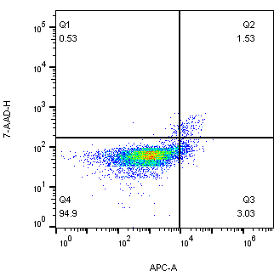
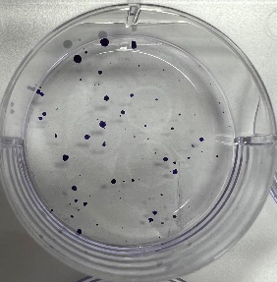
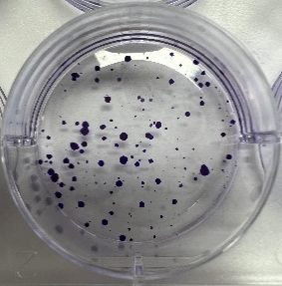
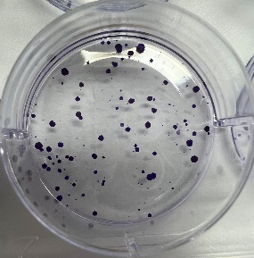
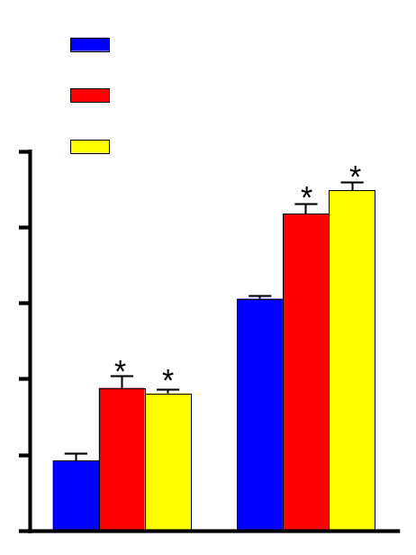
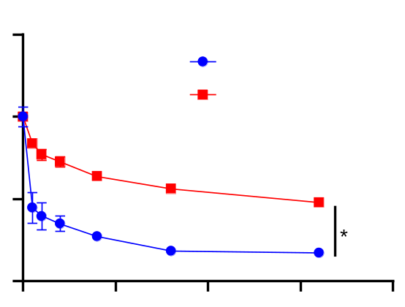
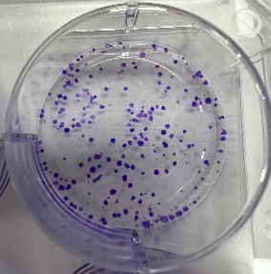
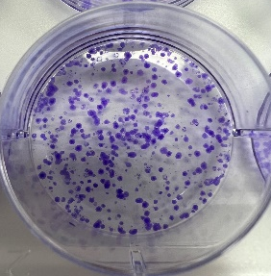
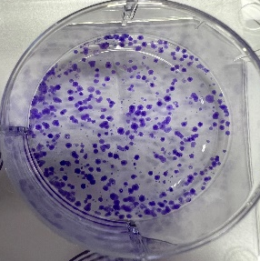
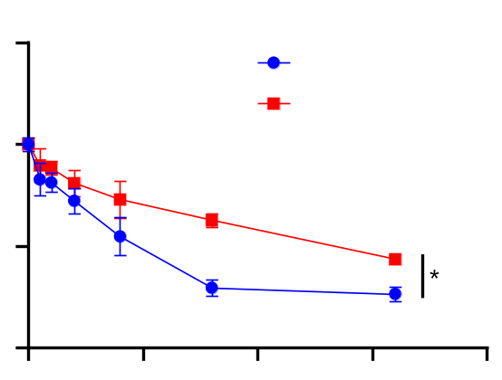
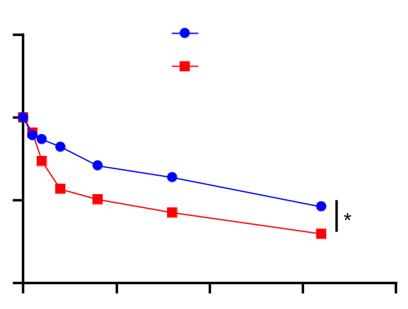
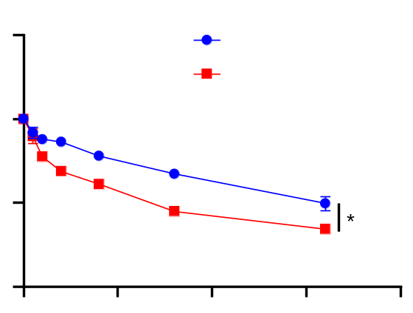
Supplementary Fig.S2
A
B
1.5
C
LoVo
150
HCT116
150
shNC
HCT116-OxR
1.0
100
shAC092894.1-1
100
Relative expression of
AC092894.1
Cell viability
(% of control)
shAC092894.1-2
Cell viability
(% of control)
0.5
50
50
0
0
0
5
10
15
20
25
0
0
5
10
15
20
25
Oxaliplatin(μg/ml)
shNC
μg/ml
shAC092894.1-2
shAC092894.1-3
shAC092894.1-1
shAC092894.1-4
D
E
shNC
shAC092894.1-1
shAC092894.1-2
F
150
HCT116
shNC
shNC
LoVo
20
shAC092894.1-1
100
shAC092894.1-1
15
shAC092894.1-2
Cell viability
(% of control)
shAC092894.1-2
Apoptosis(%)
50
7-AAD
10
0
HCT116
5
0
5
10
15
20
25
0
LoVo
HCT116
μg/ml
Annexin-V APC
G
shNC
shAC092894.1-1
shAC092894.1-2
H
shNC
I
5-Fu
shAC092894.1-1
150
HCT116
LoVo
250
shAC092894.1-2
100
HCT116-OxR
200
Cell viability
(% of control)
150
50
Number of clones
HCT116
100
0
0
50
100
150
200
50
μg/ml
0
LoVo
HCT116
J
Irinotecan
K
5-Fu
L
Irinotecan
150
HCT116
150
Vector
150
Vector
100
HCT116-OxR
100
AC092894.1
100
AC092894.1
Cell viability
(% of control)
Cell viability
(% of control)
Cell viability
(% of control)
50
50
50
0
0
50
100
150
200
0
0
50
100
150
200
0
0
50
100
150
200
μg/ml
μg/ml
μg/ml

Slide 3
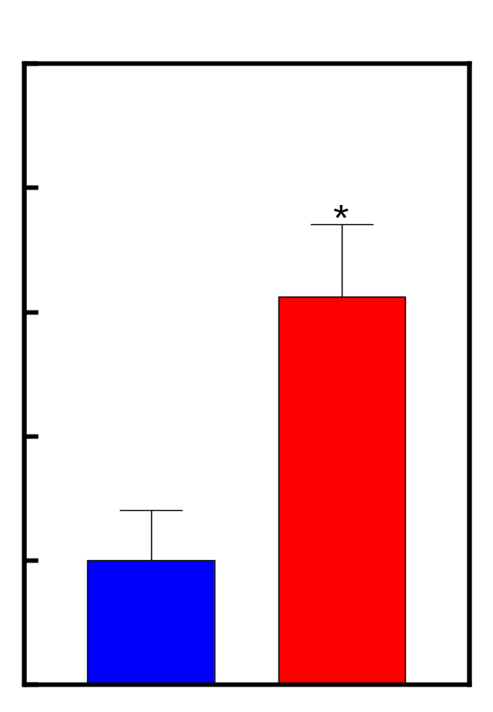
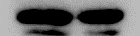
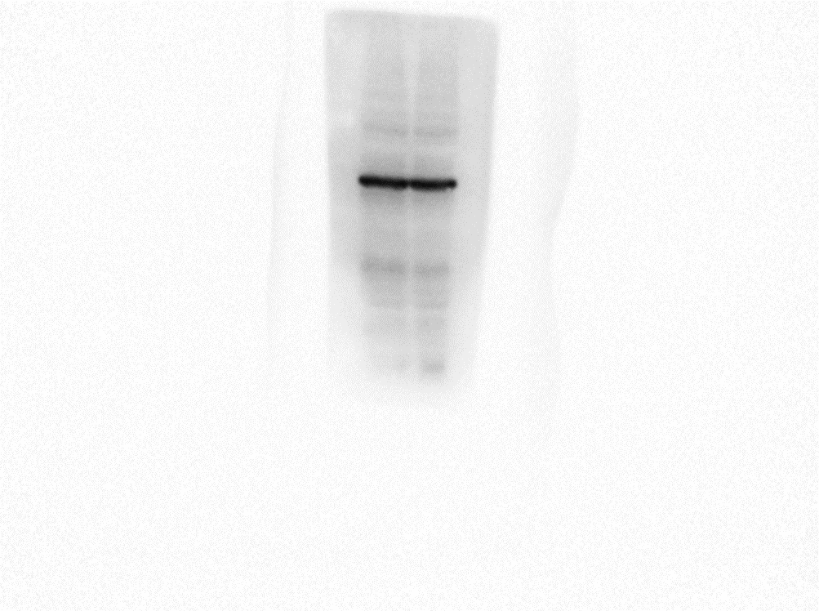
Supplementary Fig.S3
B
5
A
LoVo-OxR
HCT116-OxR
4
Vector
AC092894.1
Vector
AC092894.1
3
Relative RASGRP3 mRNA expression
TNF-α
22KD
2
α-Tubulin
55KD
1
0
Vector
AC092894.1

Slide 4
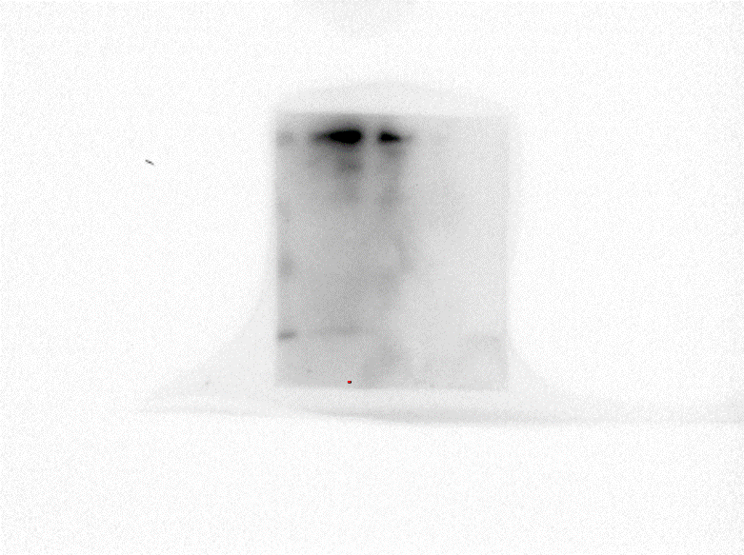
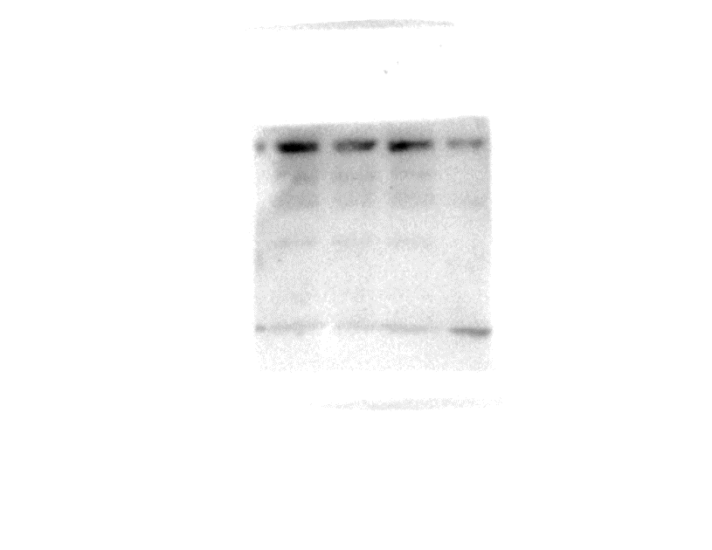
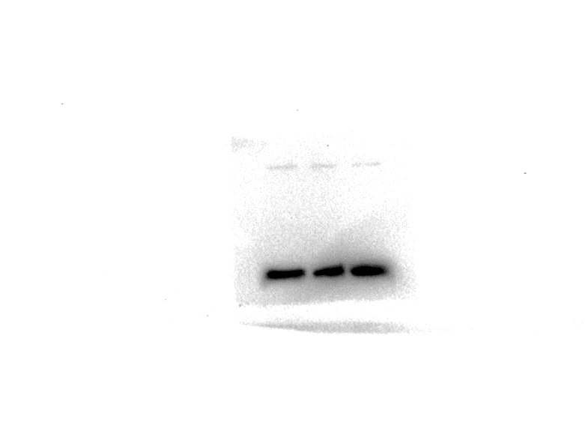
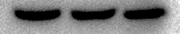
Supplementary Fig.S4
LoVo-OxR
HCT116-OxR
siRASGRP3-3
siRASGRP3-2
siRASGRP3-2
scramble
siRASGRP3-3
scramble
p-p38
41KD
α-Tubulin
55KD

Slide 5
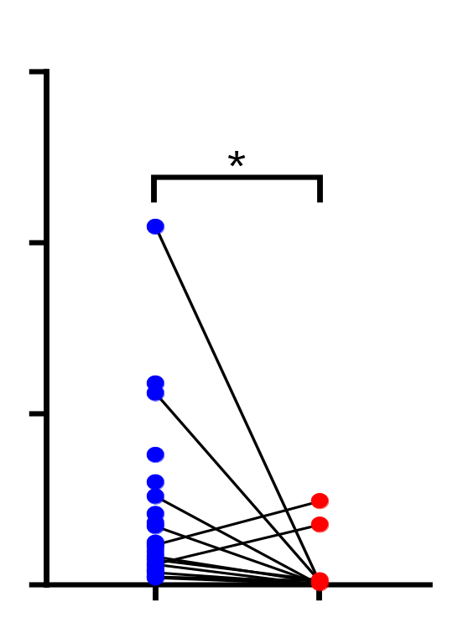
Supplementary Fig.S5
A
15
B
LoVo-OxR(AC092894.1)
10
scramble
siUSP3-1
siUSP3-2
siUSP3-3
Relative USP3 mRNA expression
5
USP3
59KD
0
GAPDH
36KD
Oxa-Sensitive
(n=28)
Oxa-Resistant
(n=12)

Slide 6
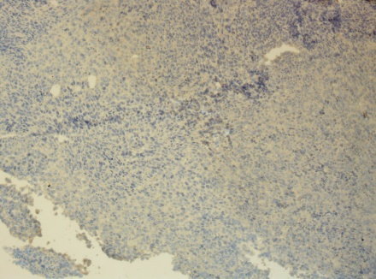
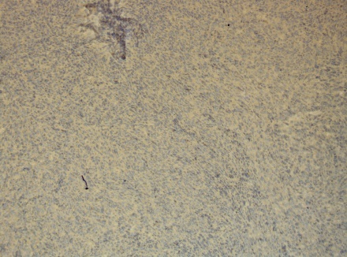
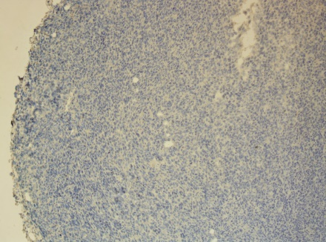
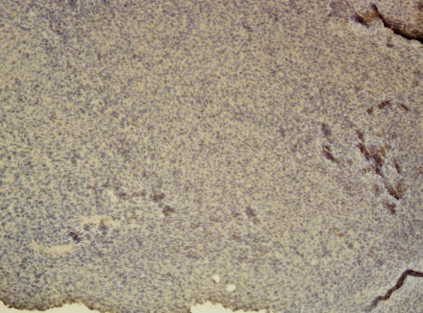
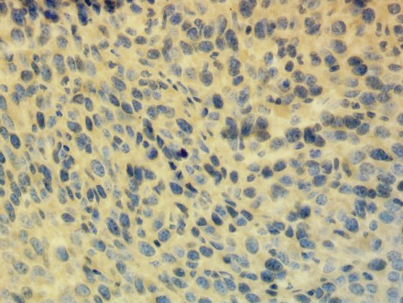
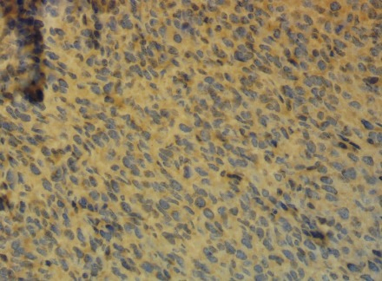
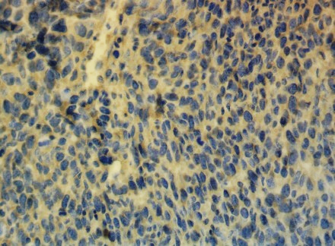
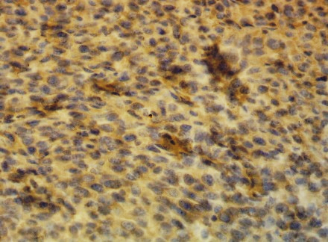
Supplementary Fig.S6
DMSO
Oxa
Vector
AC092894.1
Vector
AC092894.1
100X
400μm
RASGRP3
400X
100μm

Slide 7
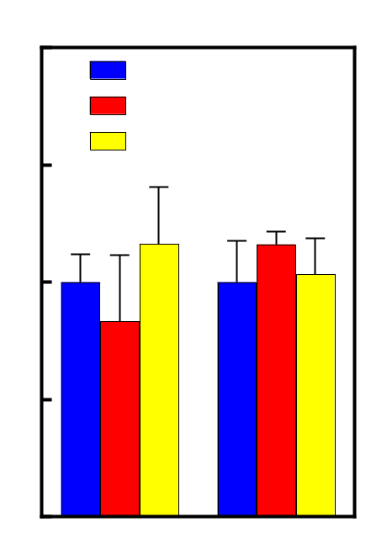
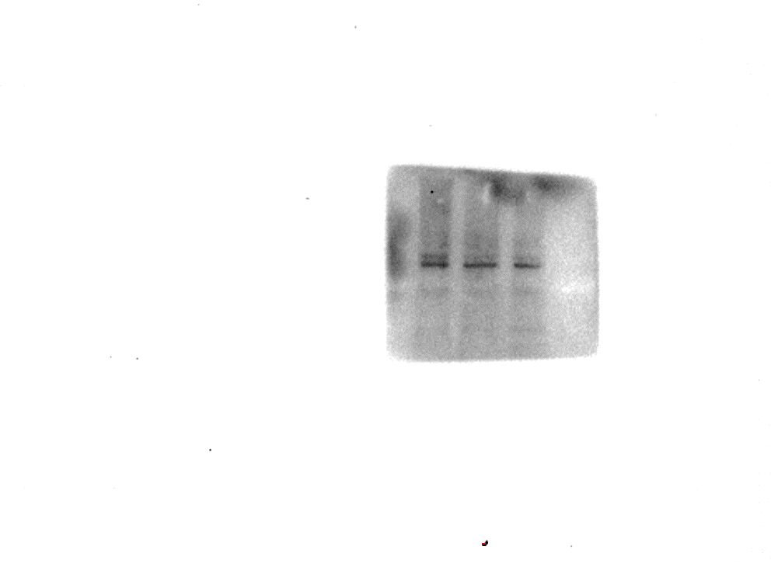
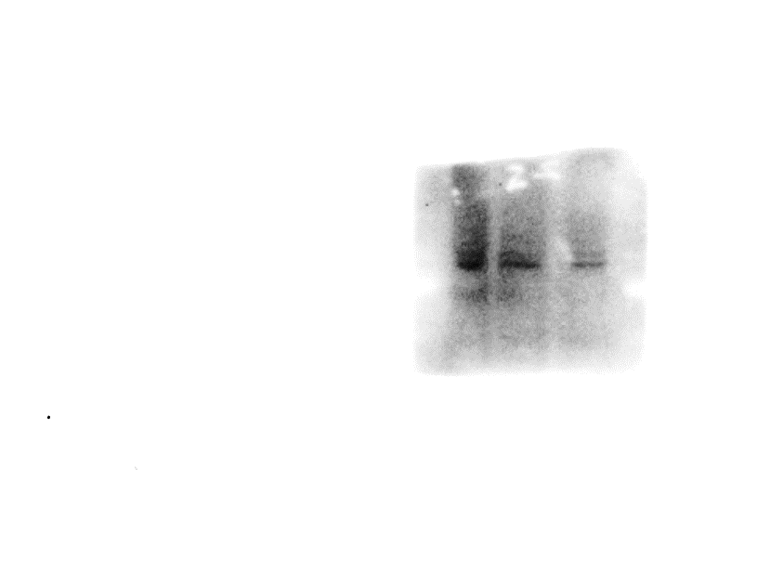
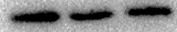
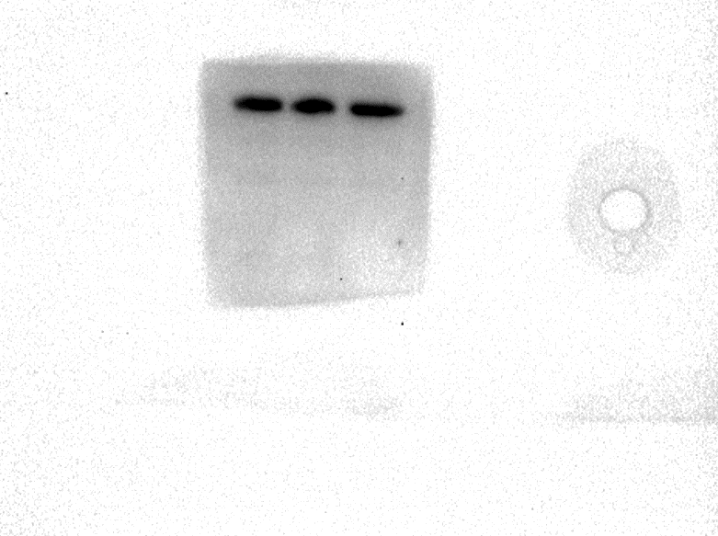
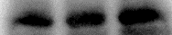
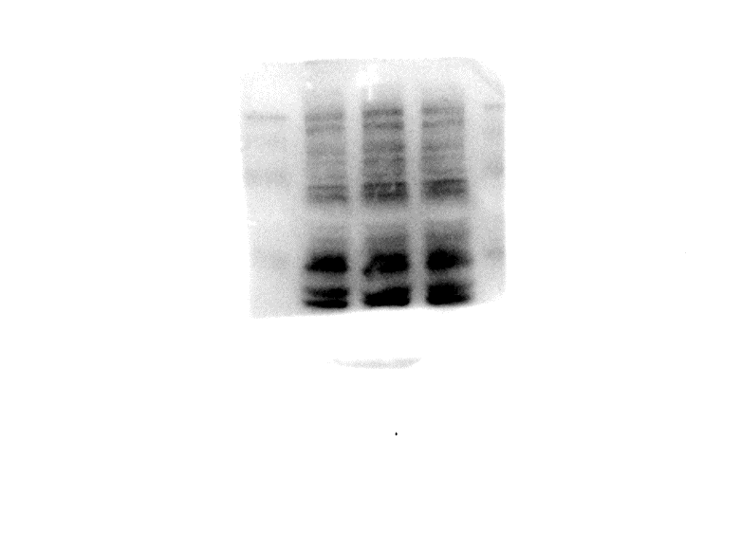
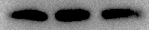
Supplementary Fig.S7
A
2.0
scramble
siRASGRP3-2
B
1.5
siRASGRP3-3
LoVo-OxR
HCT116-OxR
siRASGRP3-3
siRASGRP3-2
siRASGRP3-2
Relative expression of
AC092894.1
scramble
siRASGRP3-3
scramble
1.0
AR
98KD
0.5
GAPDH
37KD
0
LoVo-OxR
HCT116-OxR
C
LoVo-OxR
HCT116-OxR
siRASGRP3-2
siRASGRP3-3
scramble
siRASGRP3-3
scramble
siRASGRP3-2
USP3
59KD
GAPDH
37KD

