Slide 1
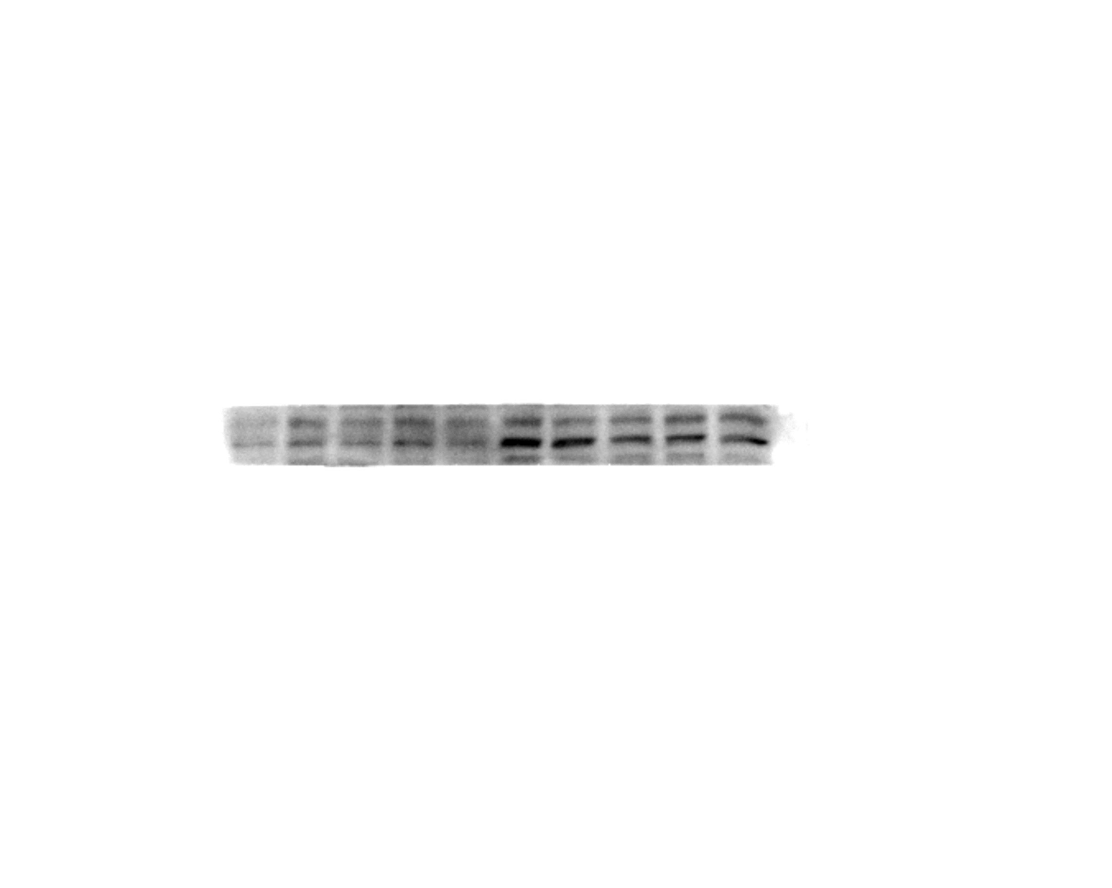
Fig. 2C
NC
CD
TMIGD1
29KD
β-Actin
45KD

Slide 2
Fig. 2I
TMIGD1
29KD
β-Actin
45KD
water
DSS
Alcohol
TNBS
TMIGD1
29KD
β-Actin
45KD

Slide 3
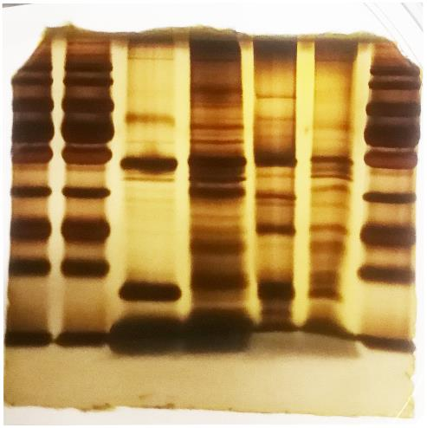
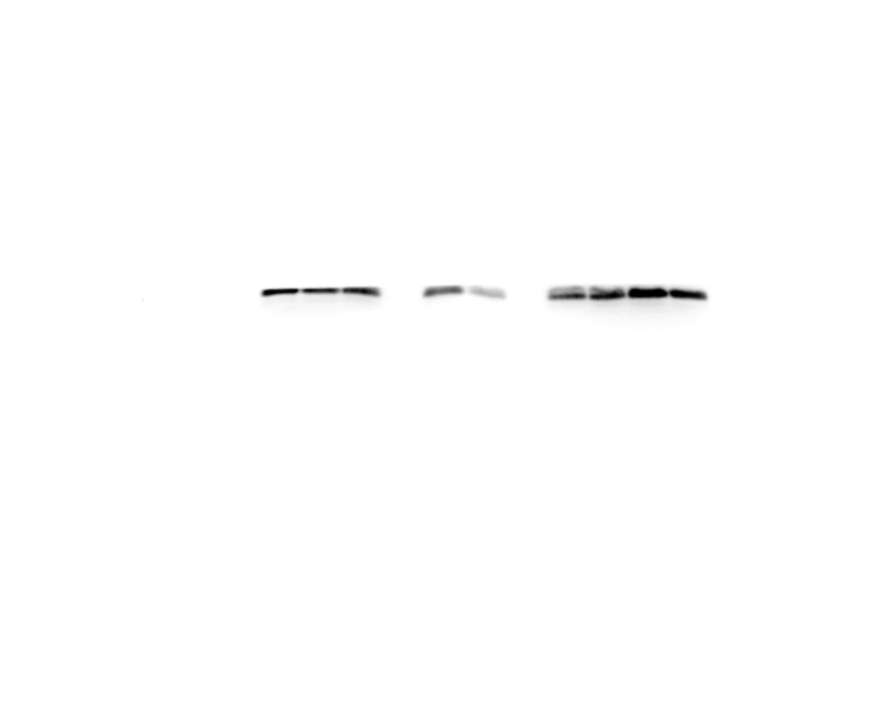
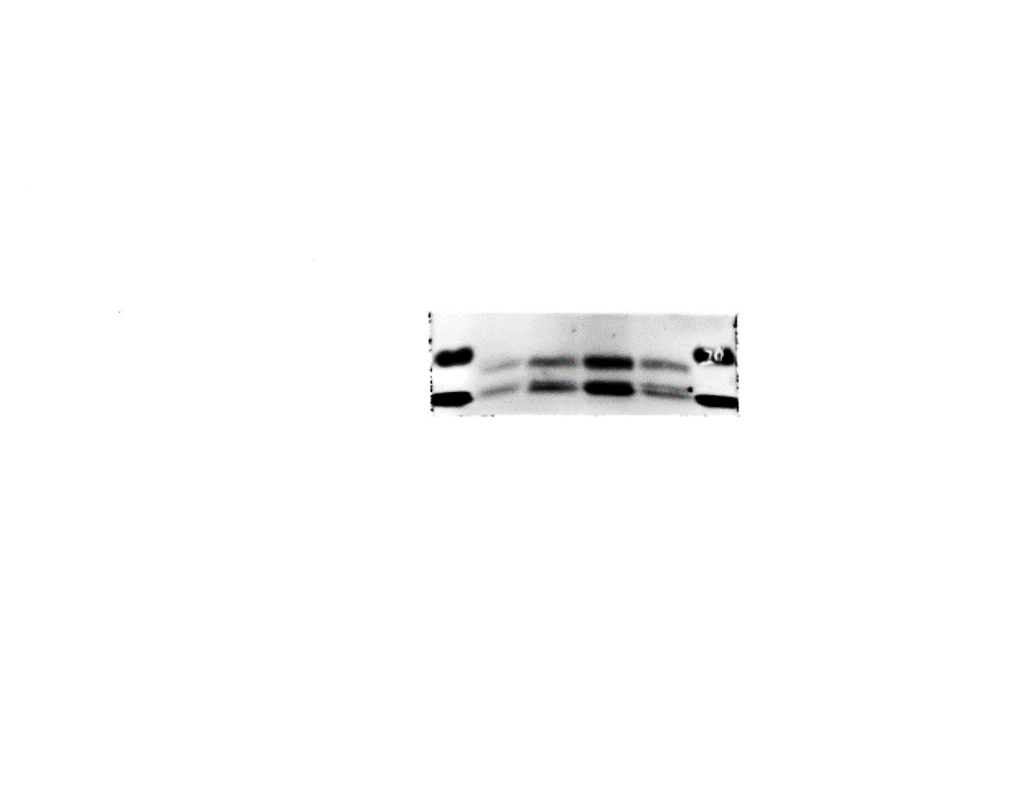
Fig. 4J
Fig. 5A
TMIGD1 OE
sh-TMIGD1
Control
sh-Control
CLDN3
20KD
180kD
130kD
100kD
70kD
CLDN4
18KD
55kD
40kD
35kD
25kD
ZO-1
220KD
15kD
E-cadherin
135KD
40KD
Marker
IgG
Flag
TMIGD1
29KD
β-Actin
45KD

Slide 4
Fig. 5C
IP
Fig. 5D
IP
Input
Flag
WB
IgG
BANF1
WB
Input
IgG
Flag
(TMIGD1)
40KD
BANF1
19KD
BANF1
19KD
Flag
(TMIGD1)
40KD
Fig. 5E
TMIGD1-GST
Input
-
-
+
+
BANF1-Flag
-
Input
+
-
+
GST
56KD
Flag
19KD

Slide 5
Fig. 5H
Fig. 5I
WT +
water
WT +
DSS
Tmigd1^{INT-KO}
+ water
Tmigd1^{INT-KO}
+ DSS
TMIGD1 OE
sh-TMIGD1
Control
sh-Control
ph-p65
65KD
ph-p65
65KD
p65
65KD
p65
65KD
BANF1
19KD
BANF1
19KD
β-Actin
45KD
β-Actin
45KD

Slide 6
Fig. 5L
NCM460
Cytoplasm
Nucleus
p65
65KD
Lamin B1
68KD
β-Actin
45KD
Control
sh-Control
Control
sh-Control
TMIGD1 OE
sh-TMIGD1
TMIGD1 OE
sh-TMIGD1

Slide 7
Fig. 6A
NC
CD
BANF1
19KD
β-Actin
45KD
Fig. 6B
Control
TMIGD1 OE
sh-Control
sh-TMIGD1
CHX (hours)
0
3
6
0
3
6
0
3
6
0
3
6
BANF1
19KD
β-Actin
45KD

Slide 8
Fig. 6E
Fig. 6F
ph-p65
65KD
ph-p65
65KD
p65
p65
65KD
65KD
ZO-1
220KD
ZO-1
220KD
E-cadherin
135KD
E-cadherin
135KD
BANF1
19KD
19KD
BANF1
40KD
TMIGD1
TMIGD1
29KD
29KD
β-Actin
45KD
β-Actin
45KD
sh-Control
Control
sh-TMIGD1
BANF1 OE
+
-
-
Control
sh-Control
TMIGD1 OE
sh-BANF1
+
-
-
+
+
-
+
+
-
-
+
+
-
+
+
-
-
+
-
-
+

Slide 9
Fig. 6I
Fig. 6J
IP
IP
WB
Input
p65
IgG
WB
Input
BANF1
IgG
BANF1
19KD
p65
65KD
p65
65KD
BANF1
19KD

Slide 10
Fig. 6L
Cytoplasm
Nucleus
Fig. 6M
Cytoplasm
Nucleus
p65
65KD
p65
65KD
This is the same blot, just different exposure times.
19KD
19KD
BANF1
BANF1
19KD
19KD
Lamin B1
68KD
Lamin B1
68KD
β-Actin
45KD
β-Actin
45KD
sh-Control
Control
sh-TMIGD1
BANF1 OE
+
-
-
+
-
-
-
-
-
-
+
+
-
+
+
-
Control
sh-Control
TMIGD1 OE
sh-BANF1
+
+
-
+
+
-
+
+
+
+
-
+
+
-
-
-
+
-
-
+
-
+
+
-
+
+
-
-
+
-
-
+

Slide 11
Fig. 8F
TMIGD1
29KD
β-Actin
45KD
Responders
Non-responders

Slide 12
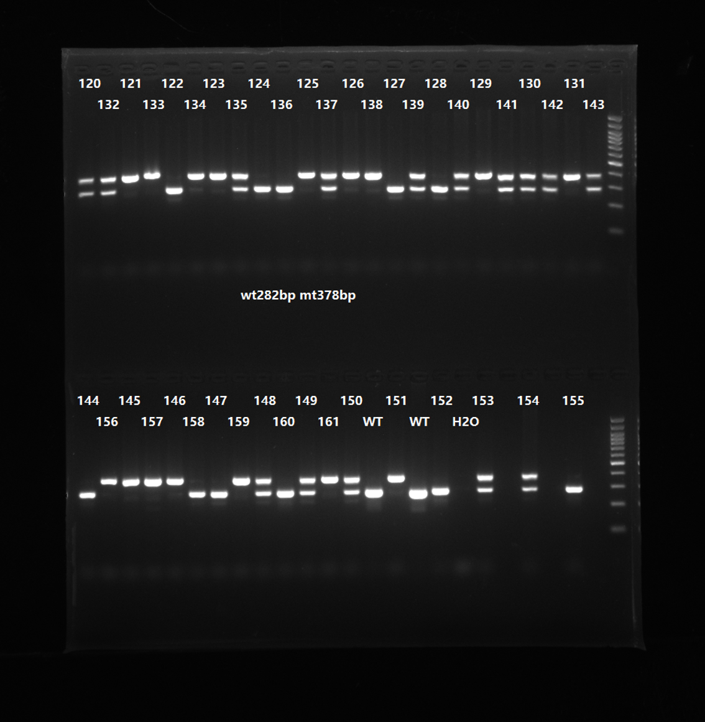
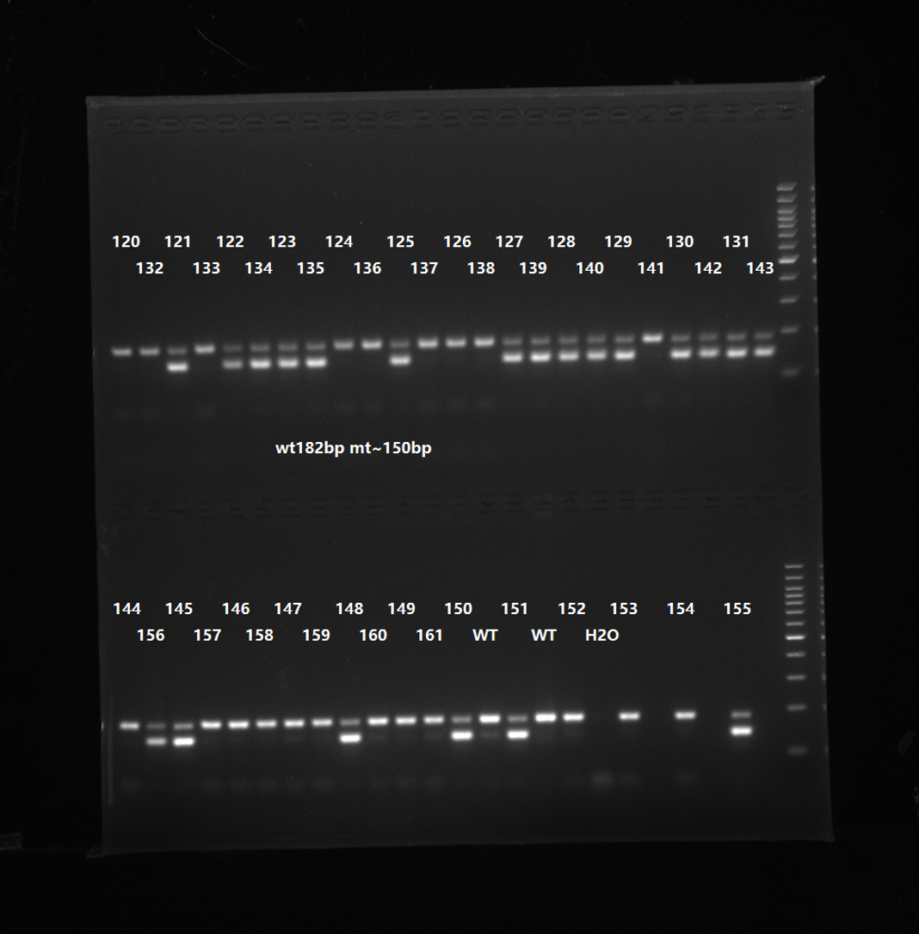
Fig. S1C

Slide 13
Fig. S3F
ZO-1
220KD
E-cadherin
135KD
β-Actin
45KD
WT +
water
WT +
DSS
Tmigd1^{INT-KO}
+ water
Tmigd1^{INT-KO}
+ DSS
Fig. S3G
ZO-1
220KD
E-cadherin
135KD
β-Actin
45KD
WT +
Alcohol
WT +
TNBS
Tmigd1^{INT-KO}
+ Alcohol
Tmigd1^{INT-KO}
+ TNBS

Slide 14
Fig. S4B
The right 6 panels are samples of NCM460 treated with IL-6.
TMIGD1
29KD
TMIGD1
29KD
β-Actin
45KD
β-Actin
45KD
Control
20 ng/ml
50 ng/ml
10 ng/ml
100 ng/ml
200 ng/ml
Control
50 ng/ml
10 ng/ml
100 ng/ml
20 ng/ml
200 ng/ml
Caco2 TNF-α
NCM460 TNF-α

Slide 15
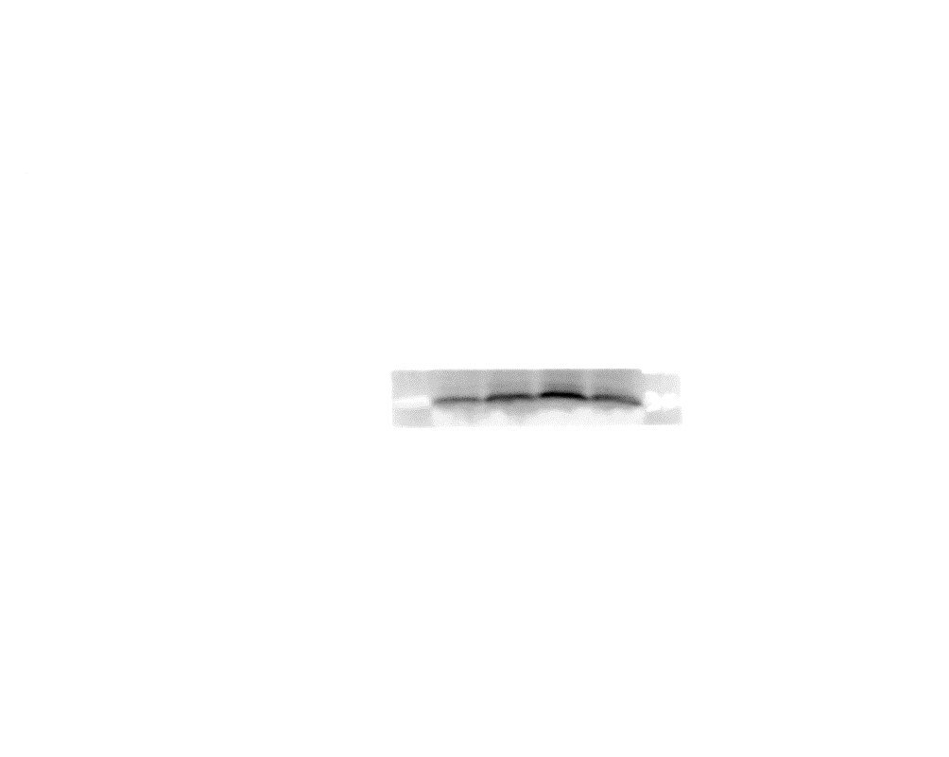
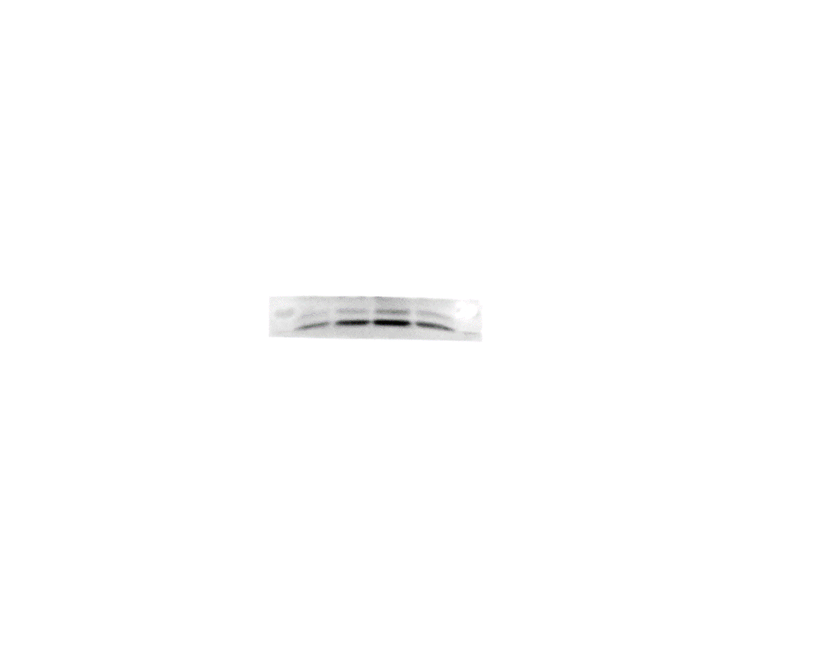
Fig. S5A
CLDN3
20KD
CLDN4
18KD
ZO-1
220KD
E-cadherin
135KD
40KD
TMIGD1
29KD
β-Actin
45KD
Control
sh-Control
TMIGD1 OE
sh-TMIGD1

Slide 16
Fig. S6A
NCM460
Caco2
TMIGD1
40KD
29KD
β-Actin
45KD
Control
Control
TMIGD1-Flag
TMIGD1-Flag
The other panels are samples unsuccessfully overexpressing TMIGD1.

Slide 17
Fig. S6B
IP
Input
Flag
IgG
IP
Input
Flag
IgG
TMIGD1
40KD
29KD
TMIGD1
40KD
NCM460
29KD
Caco2

Slide 18
Fig. S7A
ph-p65
65KD
p65
65KD
BANF1
19KD
β-Actin
45KD
WT +
Alcohol
WT +
TNBS
Tmigd1^{INT-KO}
+ Alcohol
Tmigd1^{INT-KO}
+ TNBS

Slide 19
Fig. S7B
Fig. S7C
Cytoplasm
Nucleus
Cytoplasm
Nucleus
p65
65KD
ph-p65
65KD
Lamin B1
68KD
p65
65KD
β-Actin
45KD
BANF1
19KD
Control
Control
sh-Control
sh-Control
TMIGD1 OE
sh-TMIGD1
TMIGD1 OE
sh-TMIGD1
β-Actin
45KD
Control
sh-Control
TMIGD1 OE
sh-TMIGD1

Slide 20
Fig. S7D
IκBα
39KD
ph-IκBα
40KD
IKKα
85KD
IKKβ
87KD
ph-IKKα/β
85/87KD
β-Actin
45KD
The left 4 panels are other cell lines.
Control
sh-Control
The right 4 panels are other cell lines.
TMIGD1 OE
sh-TMIGD1

Slide 21
Fig. S8A
Fig. S8B
ph-p65
65KD
ph-p65
65KD
p65
65KD
p65
65KD
ZO-1
220KD
ZO-1
220KD
E-cadherin
135KD
E-cadherin
135KD
BANF1
19KD
19KD
BANF1
TMIGD1
40KD
29KD
TMIGD1
29KD
β-Actin
45KD
β-Actin
45KD
sh-Control
Control
sh-TMIGD1
BANF1 OE
+
-
-
Control
sh-Control
TMIGD1 OE
sh-BANF1
+
-
-
+
+
-
+
+
-
-
+
+
-
+
+
-
-
+
-
-
+

Slide 22
Fig. S8E
Cytoplasm
Nucleus
Fig. S8F
Cytoplasm
Nucleus
p65
65KD
p65
65KD
19KD
This is the same blot, just different exposure times.
19KD
BANF1
BANF1
19KD
19KD
Lamin B1
68KD
Lamin B1
68KD
β-Actin
45KD
β-Actin
45KD
sh-Control
Control
sh-TMIGD1
BANF1 OE
+
-
-
+
-
-
Control
sh-Control
TMIGD1 OE
sh-BANF1
+
-
-
+
-
-
+
+
-
+
+
-
+
+
-
+
+
-
-
+
+
-
+
+
-
+
+
-
+
+
-
-
+
-
-
+
-
-
+
-
-
+

Slide 23
Fig. S9D
ph-p65
65KD
p65
65KD
CLDN4
18KD
ZO1
220KD
E-cadherin
135KD
BANF1
19KD
TMIGD1
29KD
β-Actin
45KD
WT
+
DSS
+
Control
ADV
WT
+
DSS
+
Tmigd1
ADV
WT
+
DSS
+
Banf1
ADV
Tmigd1^{INT-KO}
+
DSS
+
Control
ADV
Tmigd1^{INT-KO}
+
DSS
+
Tmigd1
ADV
Tmigd1^{INT-KO}
+
DSS
+
Banf1
ADV

