Slide 1










Fig6E
Lrrk2
Vector
Si-Lrrk2
NC
Lrrk2
Lrrk2
Ser637-Drp1
Ser637-Drp1
Ser616-Drp1
Ser616-Drp1
Total-Drp1
Total-Drp1
β-actin
β-actin

Slide 2
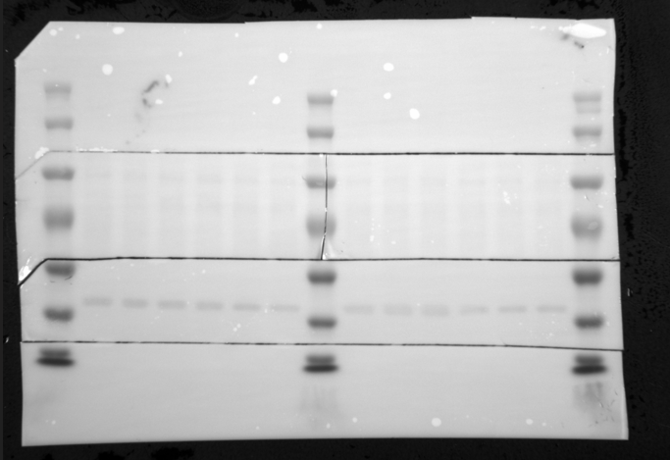
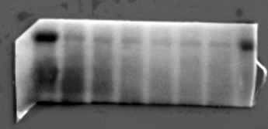
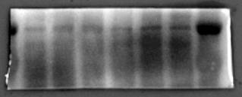
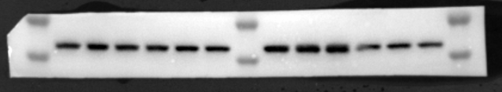
Lrrk2
Vector
Si-Lrrk2
NC
Lrrk2
Vector
Si-Lrrk2
NC
Ser637-Drp1
100 KD
Ser637-Drp1
Ser637-Drp1
75KD
β-actin
50 KD
40 KD
β-actin

Slide 3
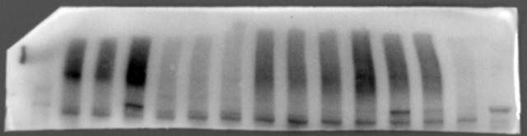
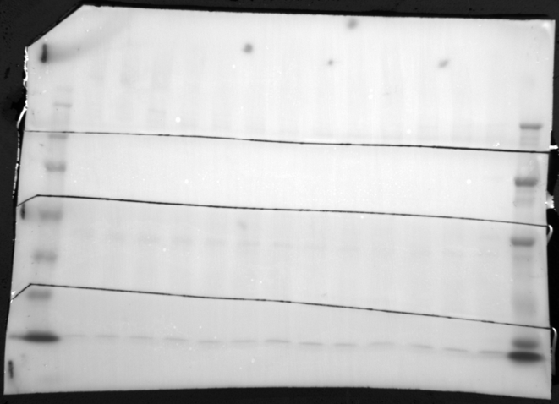
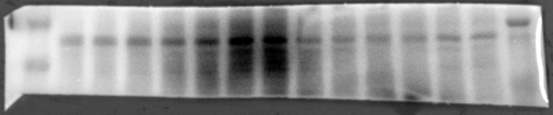
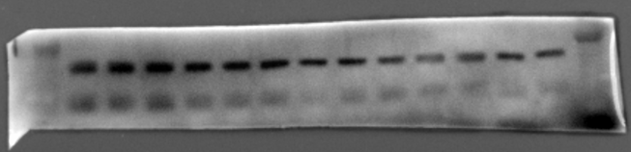
Lrrk2
Vector
310KD
Lrrk2
245KD
Lrrk2
Lrrk2
Vector
Si-Lrrk2
NC
100 KD
Ser616-Drp1
75 KD
Total-Drp1
Ser616-Drp1
100 KD
75 KD
Total-Drp1

Slide 4
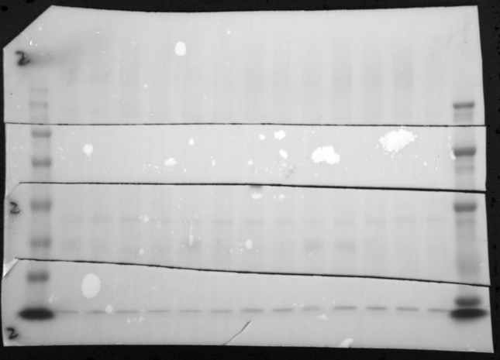
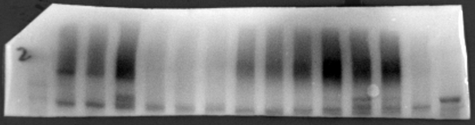
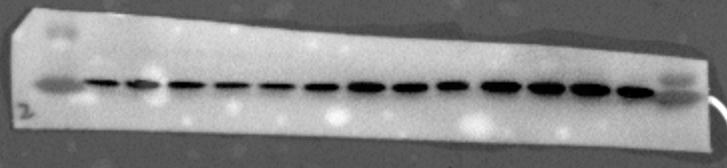
Si-Lrrk2
NC
Lrrk2
310KD
245KD
Si-Lrrk2
NC
50 KD
40 KD
β-actin

Slide 5




Fig6F
TEX
TPEX
Lrrk2
Ser637-Drp1
Ser616-Drp1
Total-Drp1
β-actin

Slide 6
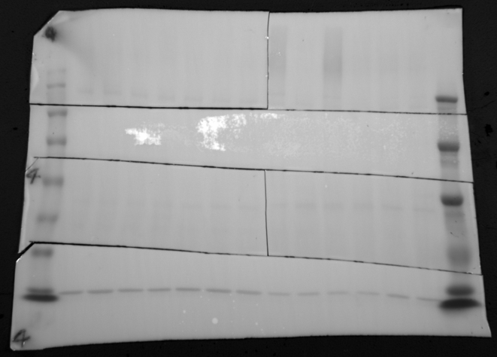
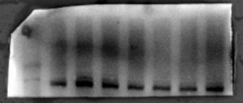
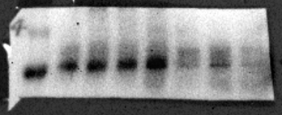
Lrrk2
TEX
TPEX
Lrrk2
310KD
245KD
TEX
TPEX
Ser637-Drp1
Ser637-Drp1
100 KD
75KD

Slide 7
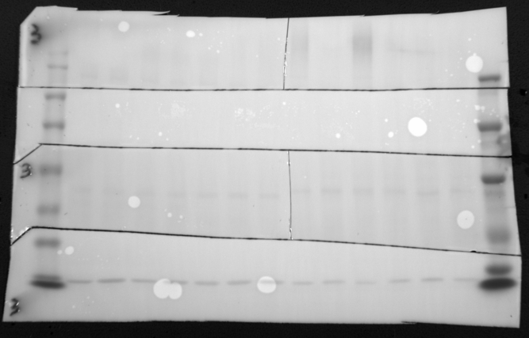
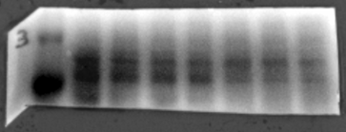
Ser616-Drp1
TPEX
TEX
Ser616-Drp1
100 KD
75KD

Slide 8
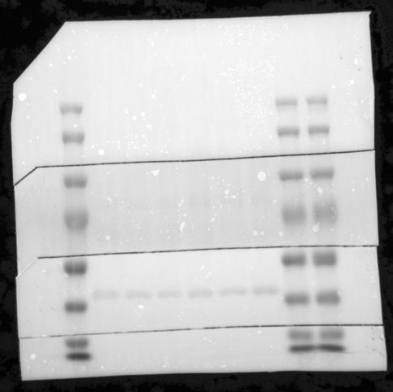
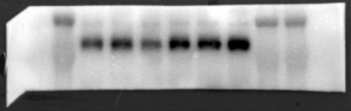
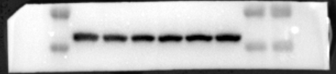
TEX
TPEX
100 KD
Total-Drp1
75KD
Total-Drp1
β-actin
50 KD
40 KD
β-actin

Slide 9

Fig6G
PD-1⁺CD8⁺T + + + +
CD3/CD28 - - + +
IGRP + + - -
Midiv-1 - + - +
Ser637-Drp1
Ser616-Drp1
Total-Drp1
β-actin

Slide 10
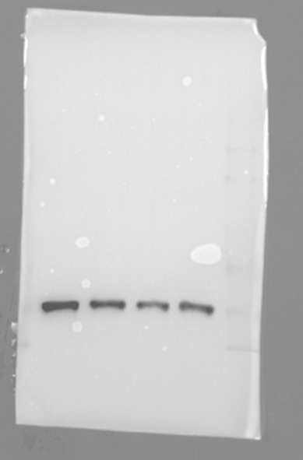
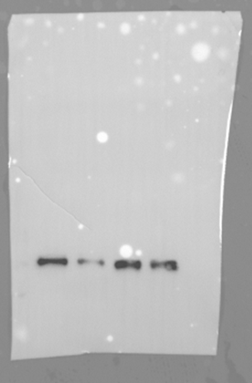
β-actin
55 KD
40KD
Ser637-Drp1
Ser616-Drp1
100 KD
100 KD
Total-Drp1
75KD
75KD
100 KD
75KD

